Slide 1













































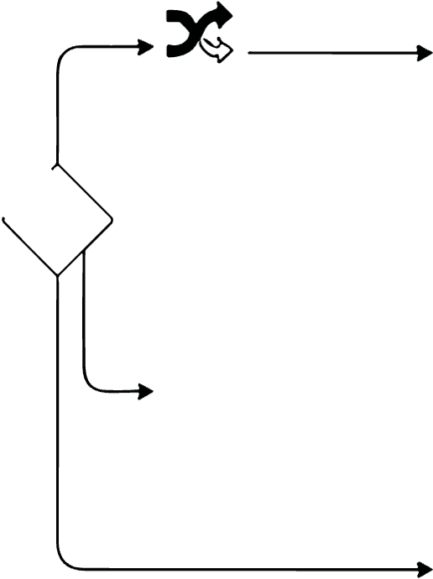






















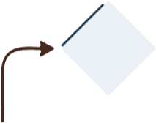































































































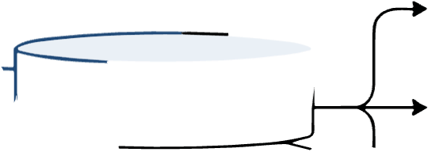





































Retrieval-Augmented Generation System (AstrBot Plugin) — Architecture Overview
User Query /
Grounded Response
LLM Tool Use
with Citations
PDF Ingestion
Stage 1 - Abstract Index (AbstractIndexManager)
GraphRAGRouter:
GraphRAGEngine:
& Indexing
Query Intent
Multimodal Knowledge Graph
arXiv
Abstract
Qwen3.5-98
Embedding
Milvus Abstract
Classification
MultimodalGraphBuilder
search,
Estraction
GGUF
Collection
add, addf,
Extract iabeled graph triples
/CORE
diet,
GRAPH_LOCAL
Entity1
[Reixtion]
Entity2
PDF
LocalGGUFClient
Qwen3.5-48
LLM
fields
paper_id
Entity-
LLM
山
bulld,
Relationn
-uses
Attention
graph_build,
title
arsit_add,
abstract_text
refstats
Rule-based
AstrBotEmbedding
vector
IFLOAT_VECTOR;
VECTOR
Multimodal
Dataset
−has
F1
Paper Ingestion
keyword
AbstractExtractor
Provider/Ollama
COSINE
(/paper add, addf, arxiv_add)
Definition/
Technical
Storage Backends
Traversal Modes
X
GRAPH_GLOBAL
Local
Stage 2 — Chunk Retrieval (HybridRAGEngine)
ContentReranker
Trends
entity-neighbors,
(BAAl/bge-reranker-
JSON
Global
HybridPDFParser
MultimodalPDFExtractor
Semantic Chunking
Milvus Hybrid Index
SimpleProperty
Neo4j
Louvain
G
HYBRID/AUTO
GraphStoreGraphSto
adaptive
(JSON)
PDF
rshold
Saloe
Node
text,
chunk_size=512,
metadata
VectorRetriever
Multimodal LLM & Generation
cosin)
Reciprocal
LlamaCppVLMProvider
Generation
CitationLinker
Storage Architecture
Rank Fusion
Layer
data/figures/(paper_id)/
k=60)
milvus_papers.db
data/tables/(paper_id)/
paper_embeddings
n_ctx=4096
(chunks/embeddings)
(hyDrid_index)
Figures/tables flowrs
Combine nodes,
AstrBot GLM
Links log to
BM25Retriever
for image/table QA
/ Local VLM
bibliographys in
milvus_abstracts.db
paper_doc_stats.json
(rank_bm25)
query, graph context
in response
(atracts)
file_name
- added_time
· chunk_count
-vector_ids
AstrBot SDK
PyMuPDF/Docling
Milvus Lite
Ollama
LLamalndex
BAAl/bge-reranker
CORE API

