Slide 1


OSwrite：Improving the lifetime of MLC STT-RAM with One-Step write
Wei Zhao¹, Wei Tong¹, Dan Feng¹, Jingning Liu¹, Jie Xu¹, Xueliang Wei¹, Bing Wu¹, Chengning Wang¹, Weilin Zhu¹, Bo Liu²
¹Huazhong University of Science and Technology,
²Hikstor Technology Co., LTD
36th International Conference on Massive Storage Systems and Technology (MSST 2020)

Slide 2
Outline
Background
Motivation
Design
Evaluation
Conclusion

Slide 3



Background
Big Data
Cloud Storage
Machine Learing
Huge demand of larger cache
Leading to large energy consumption
SRAM based cache: high leakage power, low density and scalability.
Notes:
目前SRAM面临的问题就是能耗和集成密度，而只有STT-RAM最有希望解决这一问题。

Slide 4
Background
Spin-Transfer Torque Random Access Memory (STT-RAM):
High density 
Low leakage power 
Compatibility with CMOS 
High write energy and latency  leading to low performance improvement compared with SRAM
Multi-Level Cell STT-RAM can be used:
Nearly 2X density of (Single-Level Cell) STT-RAM
Better performance
Two-Step write
Less lifetime, higher write energy and write latency

Slide 5




Background
Structure: Two Magneto resistive cells and one transistor.
Write hard bit need a larger current than soft bit.
soft
$$I_{hard}>I_{soft}$$
hard
Write hard damages the soft value, and one extra write is needed to restore soft. i.e. two-step write
00 → 10
00
10
$$I_{hard}$$
Data format:
$$I_{soft}$$
$$[hard,soft]$$
01
11

Slide 6
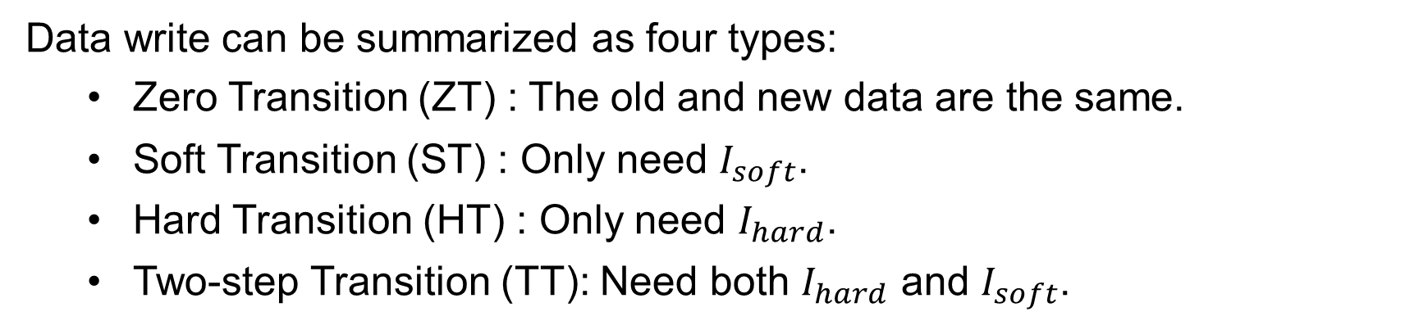


Background
00
10
$$I_{hard}$$
$$I_{soft}$$
01
11
Data write can be summarized as four types:
Zero Transition (ZT) : The old and new data are the same.
Soft Transition (ST) : Only need $I_{soft}$.
Hard Transition (HT) : Only need $I_{hard}$.
Two-step Transition (TT): Need both $I_{hard}$ and $I_{soft}$.

Slide 7
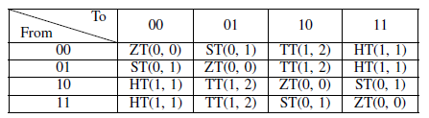
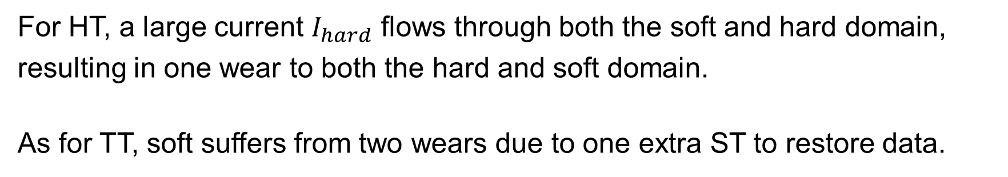
Motivation
For HT, a large current $I_{hard}$ flows through both the soft and hard domain, resulting in one wear to both the hard and soft domain.
As for TT, soft suffers from two wears due to one extra ST to restore data.
(Wear to hard, wear to soft)
Soft bit suffers more wears thus leading to less lifetime than hard.

Slide 8
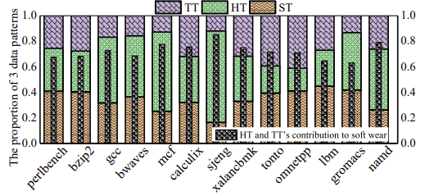

Motivation
The contributions to the lifetime degradation of three data transitions:
$${Contribution}_{HT,TT}=\frac{{wear}_{HT,TT}}{{wear}_{HT,TT,ST}}$$
The result indicates that nearly 70% lifetime degradation is caused hard bit flips. ST leads to 30% reduction.

Slide 9
Design
We mainly reduce HT and TT, and decreasing ST at the same time.
We propose One-Step write (OSwrite) to write data with only one step, the main contributions are as follows:
We propose Half-Sized Compression (HSC).
We propose Hard Transition Removal Encoding scheme (HTRE).
The implementation of OSwrite.
System level evaluation.

Slide 10
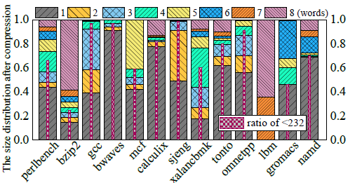
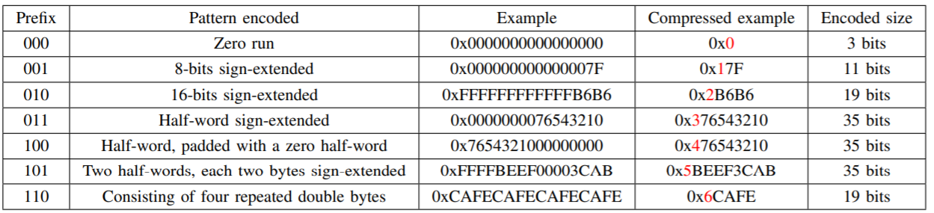
Design
1. Half-Sized Compression (HSC)
Frequent Pattern Compression
We observe that many LLC cache lines can be compressed (Frequent Pattern Compression) to half-size, and the saved space is varied.

Slide 11
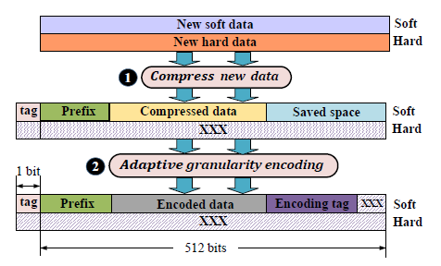
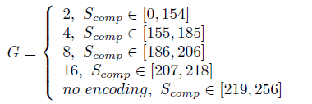
Design
1. Half-Sized Compression (HSC)
Compress data to half-size to reduce HT and TT, then organizing the new data layout.
Encoding the compressed data with adaptive granularity of Flip-N-Write (FNW) to reduce ST.
G is the compressed data size.
Writing data on soft line can be finished by one-step.

Slide 12
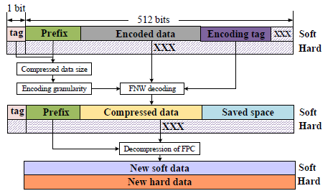
Design
1. Half-Sized Compression (HSC)
Decoding procedure:
The encoded data are decoded by FNW decoder.
The decoded data are then decompressed by FPC decompressor.

Slide 13
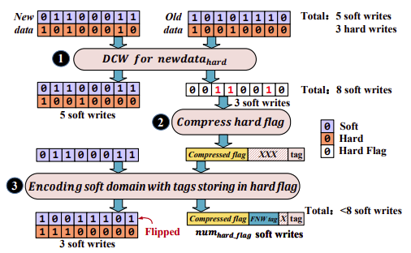
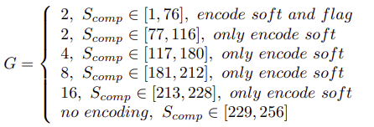
Design
2. Hard Transition Removal Encoding (HTRE) scheme
Not all cache lines can be compressed to less than half-size.
We use XOR logic to get the hard flag (SLC STT-RAM) data of the new and old data. (Remove HT and TT)
Due to the many existing ‘0’ data, hard flag can be easily compressed. (Reduce the writes to hard flag)
Encoding the soft line and hard flag to reduce ST and the write energy of hard flag. Then, they are write simultaneously to ensure one-step write.

Slide 14
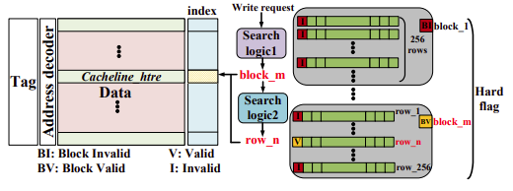
Design
2. Hard Transition Removal Encoding (HTRE) scheme
Not all cache lines equip hard flags. We dynamically allocate it for cache line.
When a cache line will be encoded by HTRE, we use the two-level search logic to find the empty hard flag.
While the empty one is found, the state of this flag is set to ‘Invalid’.
When a block encoded by HTRE is evicted, the flag state is set to ‘Valid’.

Slide 15
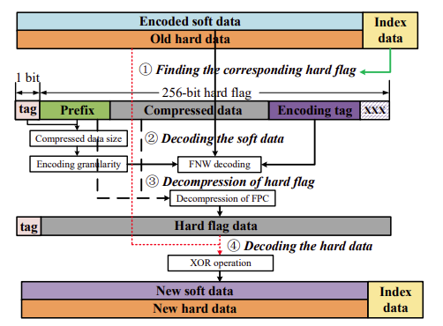
Design
2. Hard Transition Removal Encoding (HTRE) scheme
Decoding procedure:
Finding the corresponding hard flag via the index data.
Decoding the data in soft line by FNW decoding.
Decompressing the hard flag by FPC decompressor.
Decoding hard data through simple XOR operation.

Slide 16
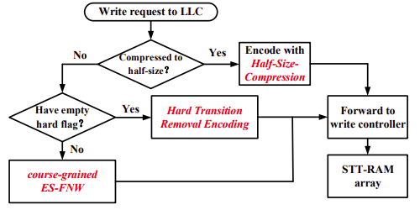
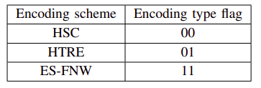
Design
3. Implementation of OSwrite
Write operation
If cache line cannot be encoded by HSC and HTRE, then it is encoded by ES-FNW by storing the encoding tags in index data.
Encoding type flag
Writing the encoding type tag of ‘00’ and ‘01’ is a one-step write operation.

Slide 17
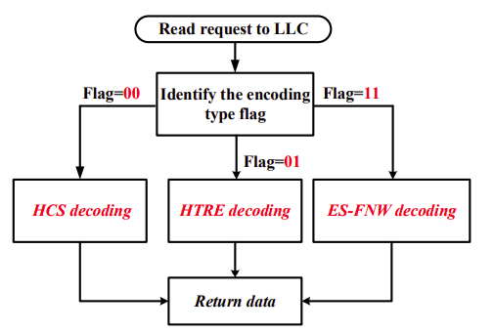
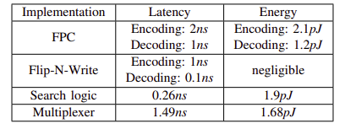
Design
3. Implementation of OSwrite
Read operation
Overhead analysis
Capacity overhead:
index data + hard flag array 12.55%
Hardware overhead:
The decoding procedure is on the critical path, and encoding latency can be hidden by the long write latency.

Slide 18
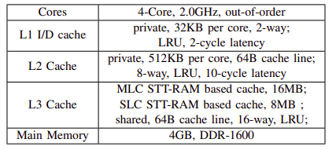
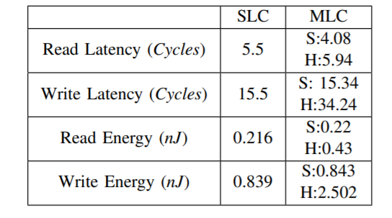
Evaluation
We use gem5 to implement Oswrite, and the benchmarks are from CPU SPEC 2006.
System configuration
STT-RAM parameters
Compared with several schemes:
8MB SLC STT-RAM cache.
DCW [B.-D. Yang et al’ISCS 07]: Data Comparison Write.
TSTM [H.Luo et al’DAC 16]: Using 3MLCs to indicate the value of 2 MLCs.
ES-FNW [J. Xu et al’ICCD 17]: Encoding soft and hard with FNW seperately.
HSC+ES-FNW: Encoding half-sized cache lines with HSC, and others are encoded by ES-FNW.
Oswrite: This is our scheme with all optimizations.

Slide 19
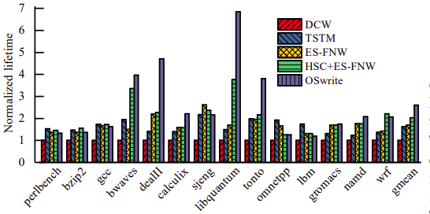
Evaluation
1. Lifetime
OSwrite can improve lifetime to 2.6 compared with baseline.

Slide 20
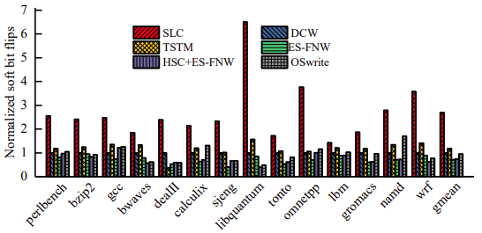
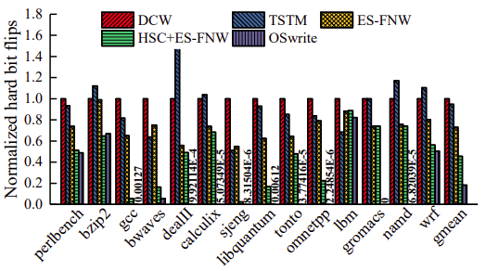
Evaluation
2. Bit flips
Soft bit flips
Hard bit flips
Compared with baseline, OSwrite can reduce soft and hard bit flips by 5.3% and 82.8%, respectively.

Slide 21
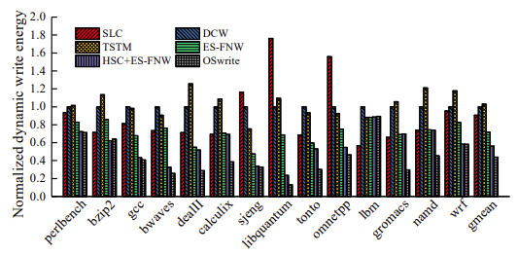
Evaluation
3. Write energy
OSwrite can reduce write energy by 56.2% compared with baseline.

Slide 22
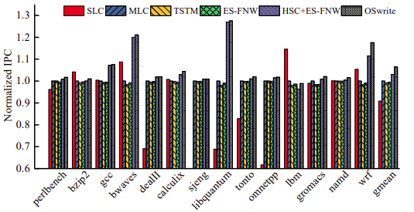
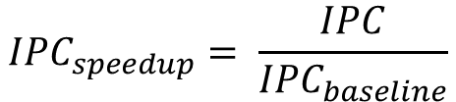
Evaluation
4. Performance
$${IPC}_{speedup}= \frac{IPC}{{IPC}_{baseline}}$$
OSwrite can improve performance by 6.4% compared with baseline.

Slide 23
Conclusion
Challenges:
Two-step write of MLC STT-RAM.
Limited lifetime.
OSwrite:
We propose Half-Sized Compression (HSC).
We propose Hard Transition Removal Encoding scheme (HTRE).
The implementation of OSwrite.
OSwrite can improve the lifetime of MLC STT-RAM to 2.6×, and reduce write energy and improve system performance by 56.2% and 6.4%, respectively.

Slide 24
Thanks for your listening! Q&A

