Slide 1


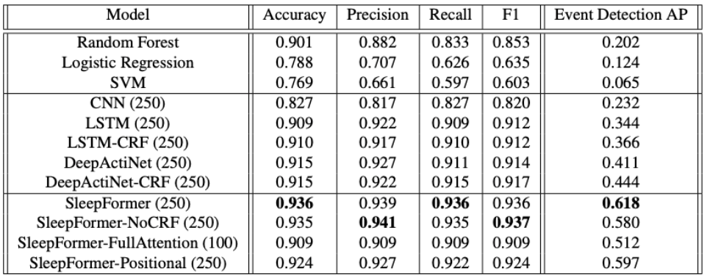
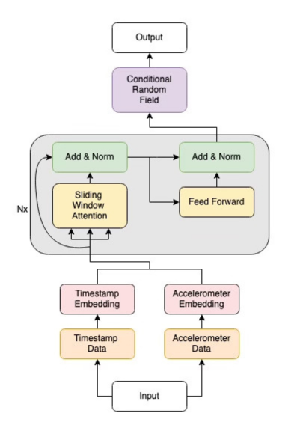


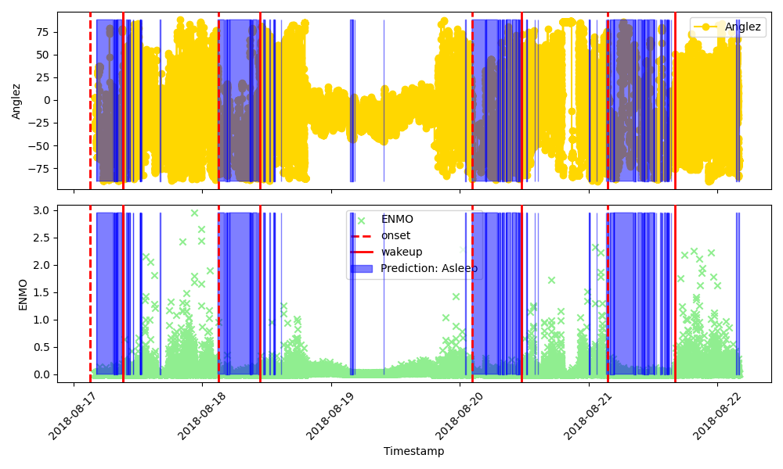
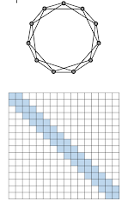
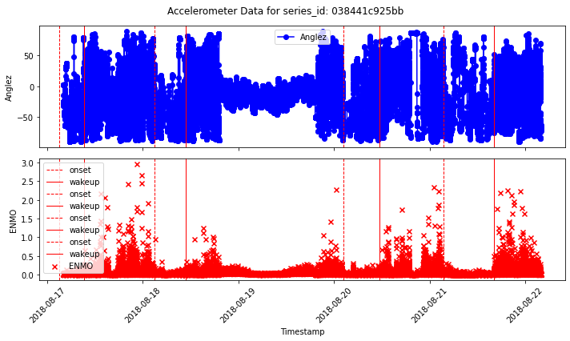
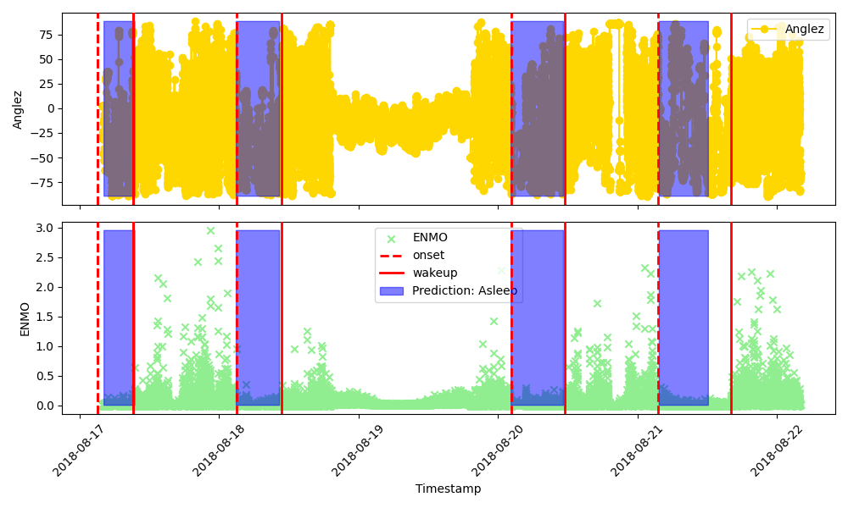
SleepFormer: A Transformer-based Sleep Classifier
Harshil Vagadia, Xintong Qu, Jake Michiels, Azeez Ishaqui {harshil, xqu46, aishaqui3, jmichiels3}@gatech.edu
Problem Statement
Technical Approach
Quantitative Results
What:
Classify the sleep state at each timestamp from wrist-worn accelerometer data. Sleep States = {Asleep, Awake}
Why:
Monitoring sleep is important. Disrupted sleep leads to increased stress and emotional distress.
PSG can monitor sleep, but they are intrusive and bulky.
Timestamp Embedding:
Converts time signal to higher-dimension; Replaces positional Embeddings.
Sparse Attention:
Vanilla transformers cannot deal with long sequences due to quadratic computation.
Sparse Attention attends only to few selective items. Conditional Random Field: Maintains consistency among neighboring predictions. Discourages state change in short duration.
Qualitative Results
PSG Monitoring *
Smart Watch Monitoring **
Dataset
Released by Child Mind Institute.
Multi-Day accelerometer timeseries data of 500 subjects.
Features: Timestamp: Accurate to nearest second.
Angle-Z: Orientation of accelerometer to z-axis
ENMO: Euclidean norm minus one.
Before Postprocessing
Dealing with Long Sequences
Chunking:
Divides a long timeseries in chunks of fixed lengths. No attention or gradients between chunks.
Sliding Window Attention:
Attends to a neighbors in a fixed window around the current element. Window moves with item.
After Postprocessing
Sliding Window Attention ***
Codes available at
https://github.com/HV007/SleepFormer
* https://www.concorde.edu/blog/what-does-polysomnographic-technologist-do ** https://kuhndentist.com/blog/new-smartwatch-identifies-sleep-apnea/
*** https://blog.research.google/2021/03/constructing-transformers-for-longer.html

