Slide 1
Construct 3
Unsupervised Anomaly Detection and Denoising with Autoencoders
Hardageri Vikranth Reddy — 24WU0102008
Hasini Mukkumala — 24WU0102042
1

Slide 2
Agenda
1. Motivation — why detect defects without labels
2. Methodology — autoencoders, our three models, one-class protocol
3. Results — reconstructions, metrics, ROC/PR, latent space
4. Ablations — what each component really buys us
5. Limitations & Q&A — honest gaps and what is next
2

Slide 3
Motivation
Factory visual inspection: thousands of items per hour, too fast for manual checks
Defects are rare and diverse — collecting labeled defects is slow and expensive
Goal: learn what “normal” looks like, then flag anything that does not fit
No defect labels needed — train only on good examples (one-class learning)
Our testbed: Fashion-MNIST — 28×28 images of clothing, 10 classes
Bonus task: denoise corrupted images with the same architecture
3

Slide 4
What Is an Autoencoder?
Input
784
512
256
32
bottleneck
256
512
Output
784
Encoder
Latent code z
Decoder
Compressor (encoder) squeezes the image into a tiny code, then rebuilds it (decoder)
Trained to copy its input — the bottleneck forces it to keep only essentials
Large rebuild error on a new image → likely an anomaly (never seen this before)
4

Slide 5
Three Models We Built
Model | Architecture | Params | Test MSE | ROC-AUC
FC-AE | 784 → 512 → 256 → 32 bottleneck | 1,086,768 | 0.01979 | 0.843
Conv-AE | conv 1 → 32 → 64, latent 32 | 256,257 | 0.01459 | 0.857
Denoising-AE | conv backbone + Gaussian noise σ=0.3 | 256,257 | 0.01668 | 0.843
FC-AE = fully connected baseline; Conv-AE = convolutional (best); Denoising-AE = learns to remove input noise.
5

Slide 6
One-Class Anomaly Protocol
Training: 9 classes only — class 5 (Sandal) is held out, never seen by the model
Scoring: anomaly score = reconstruction error (MSE) on each test image
Threshold: 95th percentile of reconstruction error on normal data
Test set: 9,000 normal images + 1,000 held-out Sandal images
Result (Conv-AE): precision 0.416, recall 0.321, F1 0.363
Sandals reconstruct badly because the model never learned their shape → high error
6

Slide 7
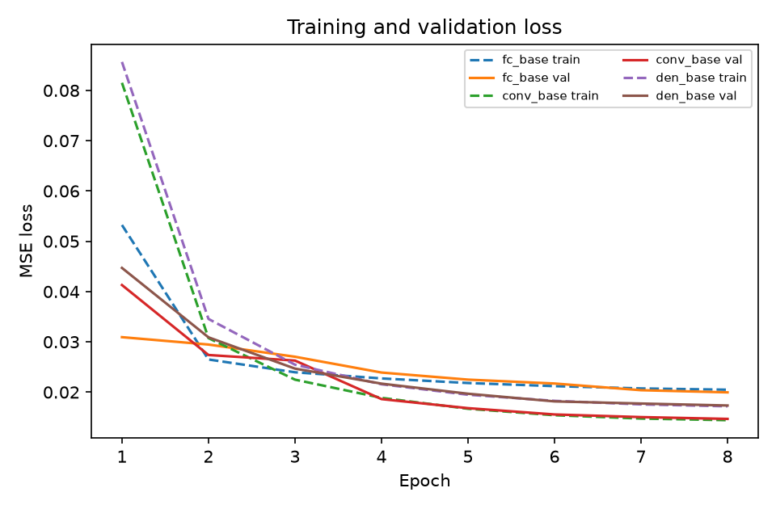
Training Curves
Train/validation loss over 8 epochs for FC, Conv, and Denoising autoencoders (Adam 1e-3, cosine schedule, batch 256, seed 42).
7

Slide 8
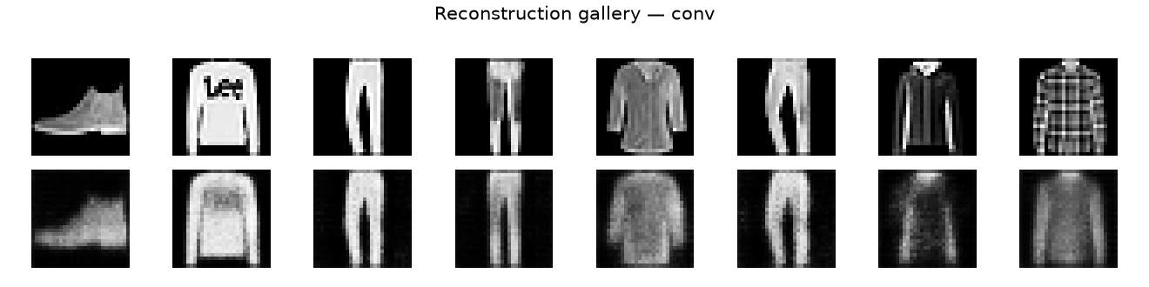
Reconstruction Gallery — Conv-AE
Original vs reconstructed images: sharp details show the 32-dim bottleneck captures real structure.
8

Slide 9
Results: All Three Models
Model | Test MSE ↓ | ROC-AUC ↑ | Precision | Recall | F1
FC-AE | 0.01979 | 0.843 | 0.401 | 0.301 | 0.344
Conv-AE (best) | 0.01459 | 0.857 | 0.416 | 0.321 | 0.363
Denoising-AE | 0.01668 | 0.843 | 0.404 | 0.305 | 0.348
Conv-AE wins on every metric — 4× fewer parameters than FC-AE, better everywhere
Precision/recall/F1 reported for Conv-AE at the 95th-percentile error threshold
9

Slide 10
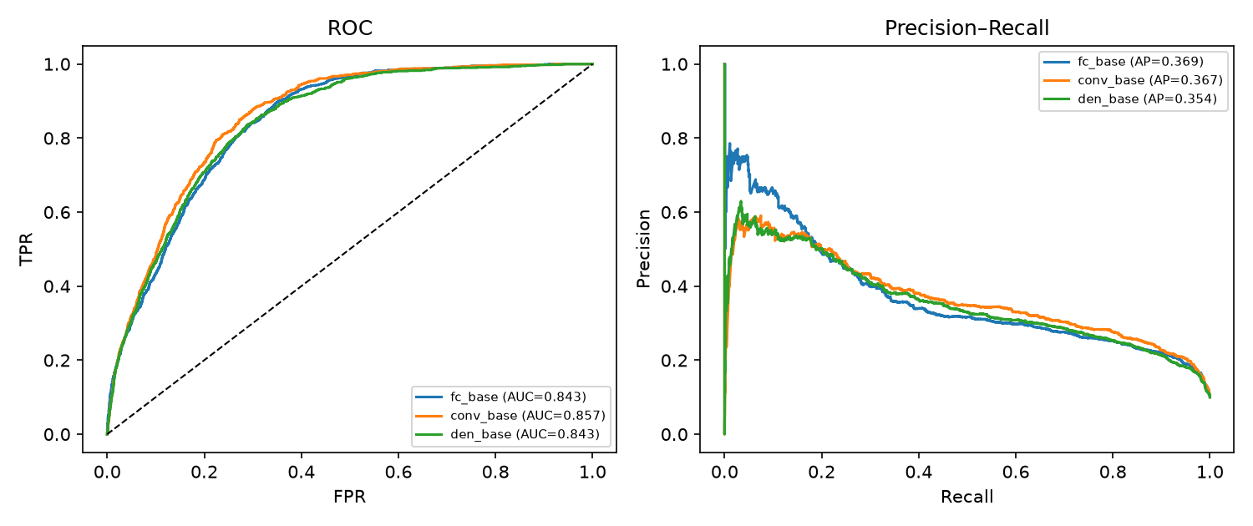
ROC and Precision-Recall Curves
ROC-AUC 0.857 (Conv-AE) — reconstruction error separates unseen Sandals from normal items.
10

Slide 11
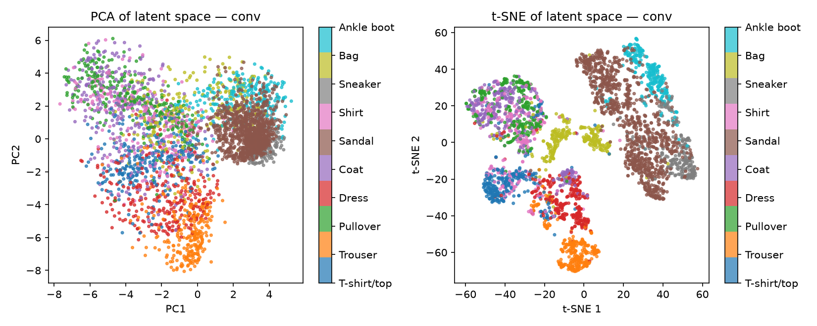
Latent Space — Conv-AE
PCA + t-SNE of the 32-dim bottleneck: similar garments cluster together without any labels.
11

Slide 12
Ablations (FC-AE): Batch-Norm Is Critical
Variant | Test MSE ↓ | ROC-AUC ↑
Baseline | 0.01979 | 0.843
No batch-norm | 0.03767 | 0.773
No dropout | 0.02144 | 0.817
Removing batch-norm nearly doubles MSE and drops AUC by 0.070 — the biggest single factor
Dropout removal hurts less (AUC 0.843 → 0.817); regularizes without degrading much
12

Slide 13
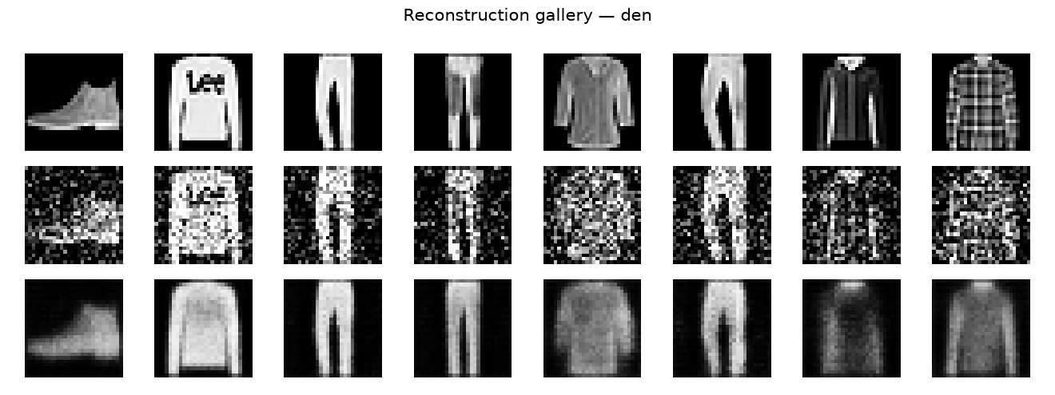
Denoising Demo
Noisy input → clean reconstruction. Trained with Gaussian noise σ=0.3; test MSE 0.01668.
13

Slide 14
Limitations
Single seed (42) — no repeated runs, so no variance estimates
Only 8 epochs of training — models may be undertrained
One fixed anomaly class (Sandal) — results may not generalize to other classes
MSE-only scoring — perceptual or feature-space losses unexplored
No real factory images — Fashion-MNIST is a clean proxy, not production data
14

Slide 15
Q&A
Thank you!
Backup: live demo script in docs/DEMO_SCRIPT.md
15

