Slide 1
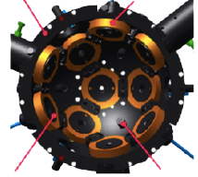

Reaction Sphere control
Bushra Kiyani
Nick Poelstra
Huib Versteeg
Laurens Van der heijden

Slide 2
Contents
Introduction
Assumptions
Dynamics & Kinematics
Control Schemes
Result Analysis
Conclusion

Slide 3
Introduction
Why reaction spheres (RS)?
Compared to reaction wheels (RW), RS have the following advantages:
4π Rotation: RS is suspended by magnets
3 axis control : Savings of size, weight and power
Eliminates friction of rotating parts
Solve ball bearing problems: Lubrication is a challenge in the space environment
Why not?
Still need to achieve technological readiness level (TRL)

Slide 4
Approach
Design 4 RS control schemes with the following in mind:
Stable and quick movement to desired attitude
Micro-satellite power and computing capabilities
Probable torque limits for RS
Disturbance torque

Slide 5
Assumptions
Main assumptions
No initial power limit
No computing power limit
No noise, lag or errors in attitude determination sensors or Reaction sphere actuator
Constant Perturbation torques of 0.1 mNm in every direction (s/c frame).
Circular orbit around Earth at 700 km altitude.
Symmetric satellite (I = 2.5 kg\m^2)
Test inputs are a series of consecutive attitude step responses.

Slide 6


Satellite Equations of Motion
Attitude Dynamics
Converts input moments into angular velocity and angular momentum in s/c body fixed reference frame.
Rate of change of angular velocity in s/c body frame:
Integrate angular accelerations to obtain angular velocity and multiply with moment of inertia (J) to obtain angular momentum:

Slide 7




Satellite Equations of Motion
Quaternion Kinematics
1. Convert body fixed rotation to quaternion derivative with the following kinematics:
2. Integrate dq/dt and then calculate rotation matrix and Euler angles from q as follows:

Slide 8

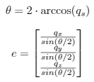
Satellite Equations of Motion
Relative attitude from absolute attitude
The relative quaternion is calculated from the attitude of the s/c and attitude of orbital, nadir pointing frame as follows:
Conversion from quaternion to axis angle rotation where e is the rotation eigen axis and theta the rotation angle

Slide 9

Satellite Equations of Motion
Relative attitude from absolute attitude
Quaternion representing orbit orientation. Orbital frame is nadir pointing frame with Z-axis pointing to the Earth’s center, x axis pointing in the direction of flight and y –axis completing the right handed frame. Results is a continuous rotation of orbital frame about the negative y axis.

Slide 10

Satellite Equations of Motion
Reaction sphere reference frame
V_{SC} and V_{RS} are vectors in s/c and RS reference frame respectively. C is the rotation matrix describing the orientation of s/c or Rs in the inertial reference frame.
Dynamics and kinematics are the same as for the s/c, but with torque input flipped and transformed to RS frame.

Slide 11
Control Schemes
Multi-Axis PID controller (MA PID)
Model Predictive Controller (MPC)
Angle-Axis PID Controller (AA PID)
Non-linear Dynamic Inversion control (NDI)

Slide 12
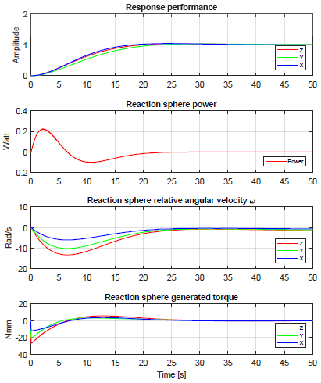
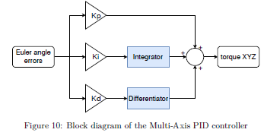

Result Analysis
Multi-axis PID controller (MA PID)

Slide 13
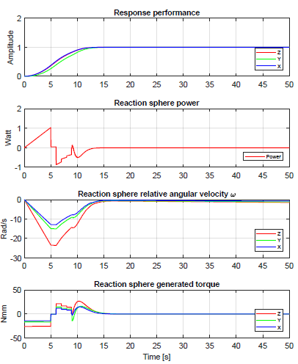
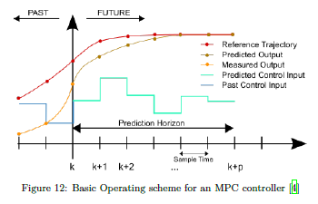

Result Analysis
Model Predictive control system (MPC)

Slide 14
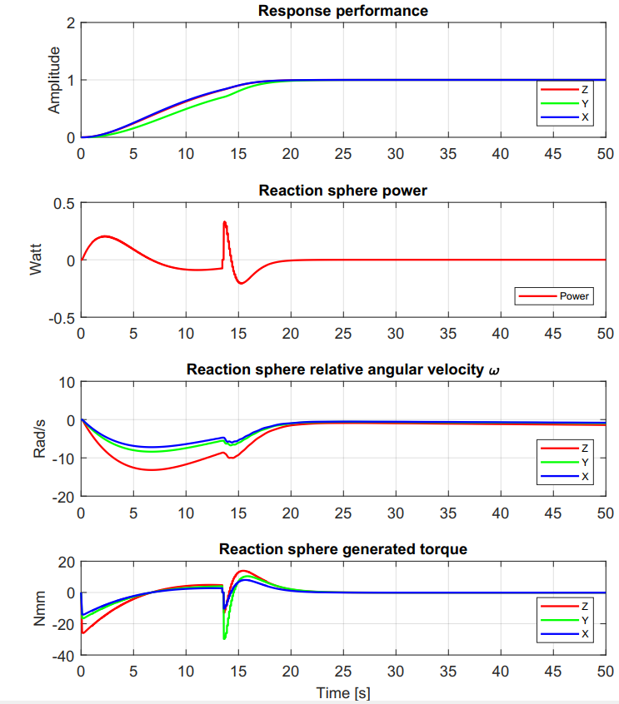
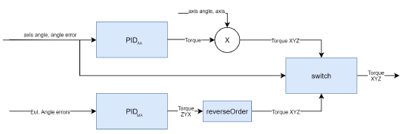
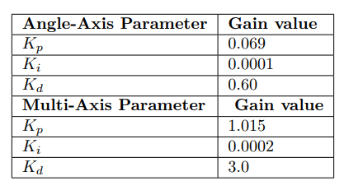
Result Analysis
Angle-Axis PID Controller (AA PID)

Slide 15
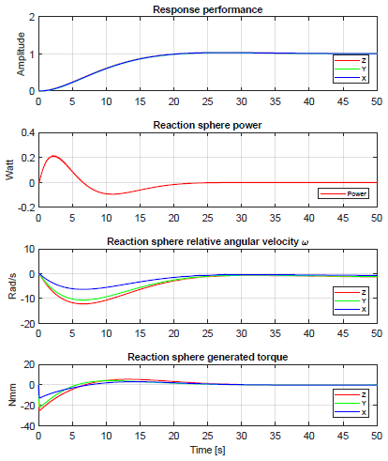
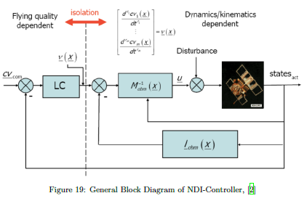

Result Analysis
Non-linear Dynamic Inversion control (NDI)

Slide 16
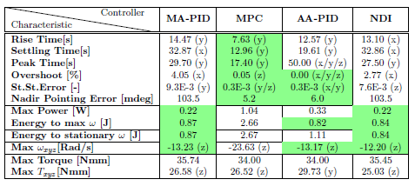
Controller Comparison

Slide 17
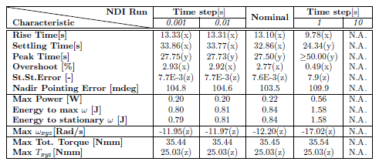
Effect of Alterations
Time step Alteration

Slide 18
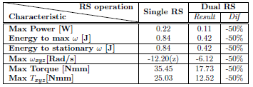
Effect of Alterations
Redundancy

Slide 19
Conclusion
MPC is preferable controller for a Reaction sphere in a Microsat
Ability to stay within a certain torque range
Arrives at desired setpoint fastest with smallest pointing error
Angle Axis PID a good alternative when computing resources are limited
Gains should be changed per maneuver to stay within torque range

Slide 20
THANK YOU!

