Slide 1
H4.4 - Summary of chapters 7.1 and 7.2
Of the thesis “Ansatz für ein prozessintegriertes
Qualitätsregelungssystem für nicht stabile Prozesse“
Hans Dörmann Osuna
by Kevin Kretschmar
and Krister Wolfhard

Slide 2
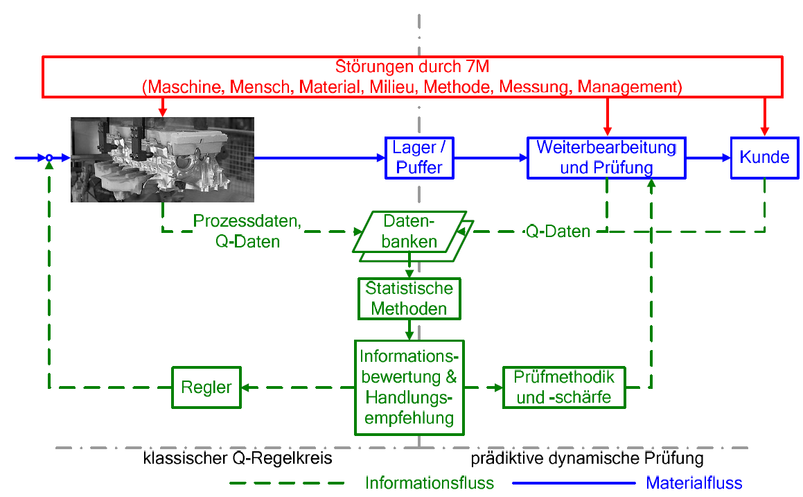

Slide 3
Classic quality control loop (reactive)
Serves the timely detection and control of deviations
Backwards chained
Measures do not affect the currently produced part
Process parameters are statistically evaluated
Recommended action is derived
Control variables of the parameters must be measurable and processable
z.B. temperature, pressure, ...

Slide 4
Data evaluation
Takes place on the basis of decision-support systems
based on machine learning methods
E.g. decision trees
Data is prepared using data mining methods
Data Understanding
Data set with required variables is created
Data Preparation
Data record is prepared as required
Table with input and target values
Data may be summarized in sections

Slide 5
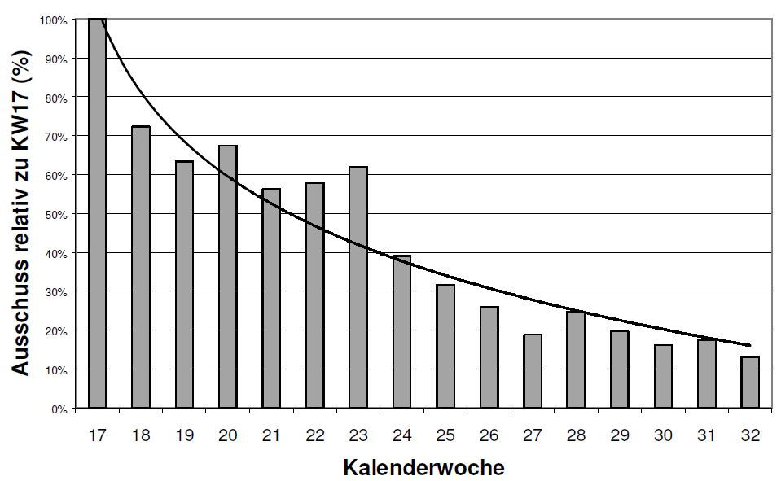
Data evaluation II
Modeling and data analysis
Modeling through decision trees based on the data set
CART/CHAID decision trees
Implementation
New target specifications are generated by models
Existing specifications are adjusted
Rules derived from the model are confirmed/refuted

Slide 6
Predictive dynamic testing
Same target parameterization of the systems as at the time of model creation
No changes in the general conditions (i.e. change of tools), as these influences would not be included in the models
Same environmental conditions as at the time of modeling
Change of general conditions → Anpassung des Modells
Based on existing process and quality data
Classification into three quality categories:
Components that are highly likely to be good
Components that are highly likely to be defective
Parts that cannot be clearly classified

Slide 7
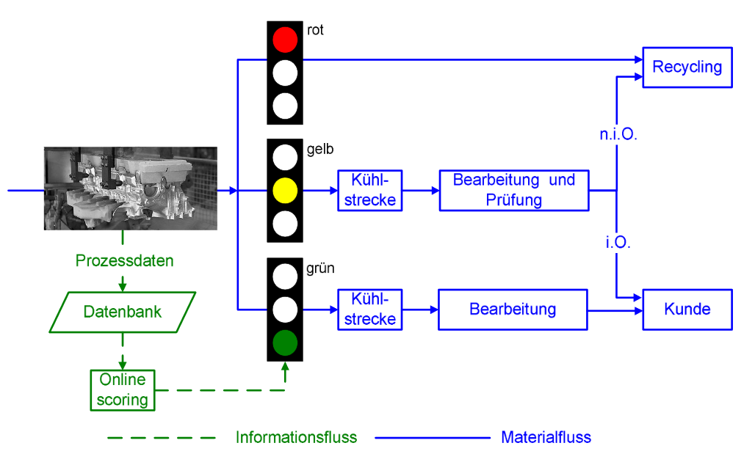

Slide 8
Forward quality control loop
Base data for predictive testing:
Historic data for model creation
Current production data for prediction
Current data for testing models
Historic Data → Classification of parts

Slide 9
Methods of predictive dynamic testing
Interactive procedures
Non-interactive procedures cannot be changed accordingly
All methods split data sets into training data and test data
CART decision tree
CART decision tree with defined Misclassification costs
CHAID decision tree
C 4.5 decision tree
C 4.5 decision tree with different Pruning-settings
Binary logistic regression
neural networks

Slide 10
Methods of predictive dynamic testing
Results of the methods can be "if-then-rules" or mathematical equations
Future components receive calculation fields that are used to determine the probability
Threshold values to determine the category

