Slide 1
CS542200 Parallel Programming Basic ViM Tutorial
Chin-Feng Lee
2015/9/30

Slide 2
Outline
Basic Concepts
Common Operations
Open / Close / Suspend / Resume
Normal-Mode / Insert-Mode / Visual-Mode
Cursor movements
Screen Scrolling
Copy / Paste / Delete
Undo / Redo / Search

Slide 3
Basic Concepts
ViM is a modal editor
VIM has 11 modes
Users should always aware of current mode
ViM uses keyboard only
this can be pretty difficult to learn
“Google is your best firend”

Slide 4
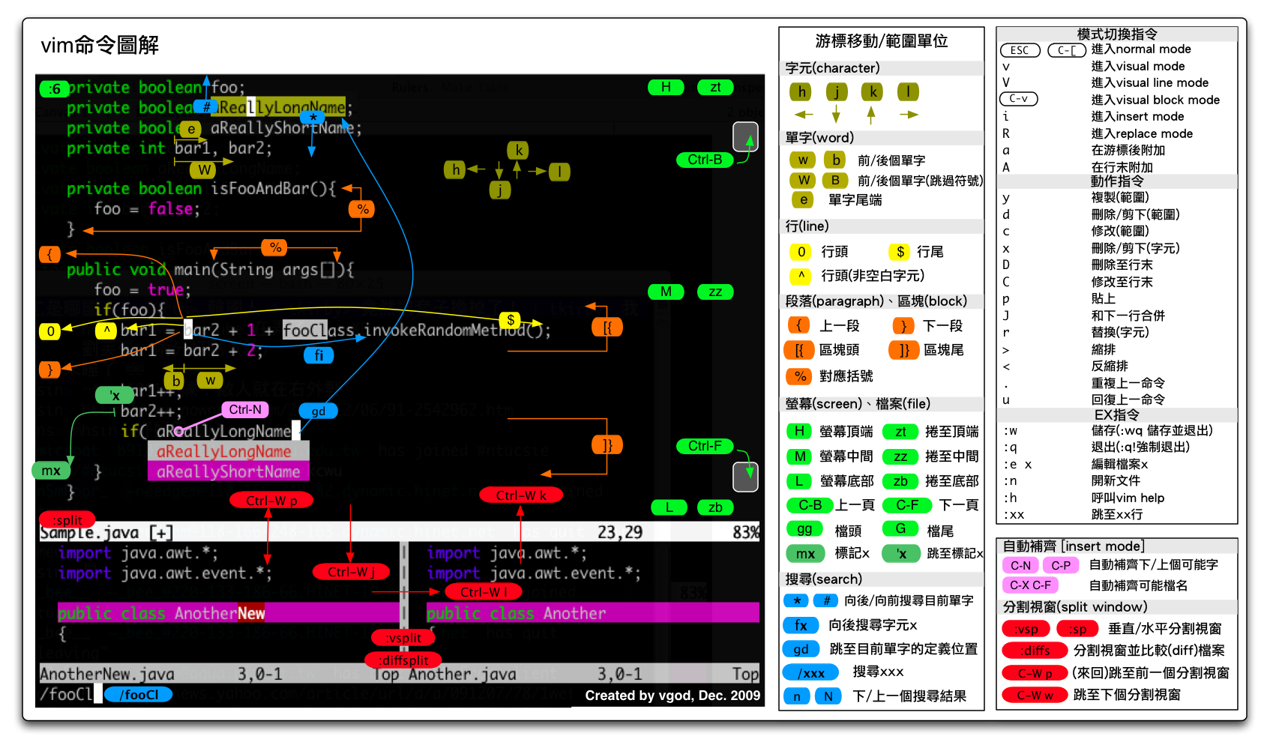
Common Operations
http://blog.vgod.tw.s3.amazonaws.com/wp-content/uploads/2009/12/vim-cheat-sheet-full.png

Slide 5
Common Operations 1 Open / Close / Suspend / Resume
Open / Close File: [:help write-quit]
vim file.txt
:q
Suspend / Resume
<Ctrl> + <Z>
jobs
fg [number]

Slide 6
Common Operations 2 Normal-Mode / Insert-Mode / Visual-Mode
Normal Mode <Esc>
Every entered are interpreted as commands
One can always switch to this mode by double tapping <Esc>
Insert Mode <i> <I> <a> <A> <o> <O>
Most keys are inserted as text
i | switch to insert-mode before cursor
I | switch to insert-mode and jump to first non-blank character of this line
a | switch to insert-mode after cursor
A | switch to insert-mode and jump to the end of the line
o | Add a new line after current line and get into insert-mode
O | Add a new line before current line and get into insert-mode

Slide 7
Common Operations 2 (cont’d) Normal-Mode / Insert-Mode / Visual-Mode
Visual Mode <v> <V> <Ctrl + v>
Visually select some texts (with most normal-mode commands)
To Sum up:
v | Switch to the visual mode (character oriented)
V | Switch to the visual mode (line oriented)
Ctrl + v | Switch to the visual mode (block oriented)
Insert Mode
Command Mode
Visual Mode
<i> <I> <a> <A> <o> <O>
<v> <V> <Ctrl + v>
<Esc>
<Esc>

Slide 8
Common Operations 3 Cursor movements
k
Move in character unit
in vi (normal mode) <h> <j> <k> <l>
in vim (any mode) <←> <↓> < ↑ > <→>
Move in word unit
h
l
j
w | Jump to the beginning of next world
W | Jump to the beginning of next world, ignore punctuation
e | Jump to the end of next world
E | Jump to the end of next world, ignore punctuation
b | Jump to the beginning of last world
B | Jump to the beginning of last world, ignore punctuation
ge | Jump to the end of last world
gE | Jump to the end of last world, ignore punctuation

Slide 9
Common Operations 3 (cont’d) Cursor movements
Move to the beginning / end of one line
\
Move to somewhere relative to screen
Home / 0 | Move to the first column of the line
^ | Move to the first non-blank column of the line
End / $ | Move to the last column of the line
g_ | Move to the last non-blank column of the line
H | Move to the top of current screen
M | Move to the middle of current screen
L | Move to the bottom of current screen

Slide 10
Common Operations 3 cont’d Cursor movements
Move to any line in a file
[num]G / :[num] | Move to the line with line number [num]
gg | Move to the first line of the file
G | Move to the last line of the file
[num]% | Move to the line at [num]% relative to the file

Slide 11
Common Operations 3 cont’d Screen Scrolling
Ctrl + F / PgDn | Scroll the screen one page forward
Ctrl + B / PgUp | Scroll the screen one page backward
Ctrl + E | Scroll the screen one line forward
Ctrl + Y | Scroll the screen one line backward
zt | Scroll the screen to place the cursor at the 1st non-blank line
zb | Scroll the screen to place the cursor at the last non-blank line
zz | Scroll the screen to place the cursor at the 1st non-blank line

Slide 12
Common Operations 4 Copy / Paste / Delete
Yank (copy) <y>
Paste <p>
y[num]l | Yank [num] chars before cursor
y[num]h | Yank [num] chars after cursor
yy | Yank this line
[num]yy | Yank [num] lines from cursor
p | Paste after cursor
P | Paste before cursor
“[num]p | Paste the [num]-th most recent contents after cursor

Slide 13
Common Operations 4 (cont’d) Copy / Paste / Delete
Delete <d><x>
the deleted contents are yanked and can be pasted later
x / Del | Delete chars after cursor
X / BackSpace | Delete chars before cursor
d[num]l / [num]X | Delete [num] chars before cursor
d[num]h / [num]x | Delete [num] chars after cursor
dd | Delete this line
[num]dd | Delete [num] lines from cursor

Slide 14
Common Operations 5 Undo / Redo / Search
Undo / Redo
Search
u | Undo
Ctrl + r | Redo
/[RegExp] | Search for pattern in a file
n | Next occurrence of the searched pattern
N | Last occurrence of the searched pattern

Slide 15
References
Vim Introduction and Tutorial
https://blog.interlinked.org/tutorials/vim_tutorial.html
OpenViM Interactive Tutorial
http://www.openvim.com/

