Slide 1
2021 MLP Progress Robotic Mobile Fulfillment System
Yonsei University
Machine Learning Project Team 09
2021.04.08

Slide 2
Outline
Background
Proposal 1 – DeepRL
Robot Path Planning
Proposal 2 – Item Classification
Item Pod Assignment
PSA decision rules by ML
Association Analysis of item for PSA
Proposal 3 – Queuing Network Model
Robot Storage Assignment

Slide 3
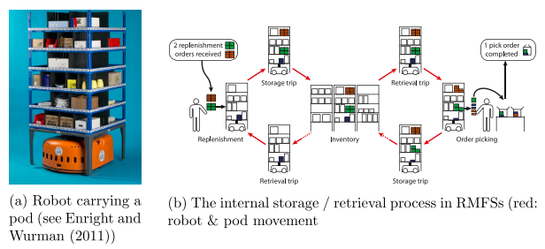
Background
RMFS(The Robotic Mobile Fulfillment System)
Automated parts-to-picker system
As the world leans toward untact technology, more warehouses utilize robots for their logistics
Mobile robots transport movable shelves, called “pods”, that contain the inventory, back and forth between the storage area and the workstations

Slide 4
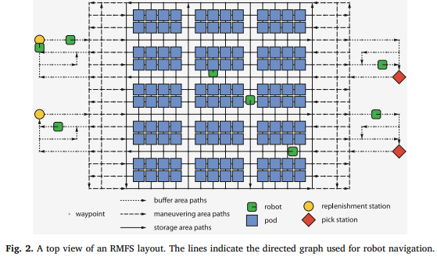
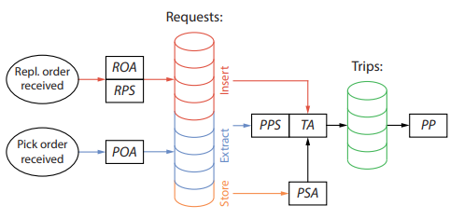
Background
RMFS(The Robotic Mobile Fulfillment System)
RAWSIM-O : Agent-based discrete-event simulation framework
Has a few decision rules for each problem
Objective : Increase efficiency of the practical warehouse
Replenishment
Pick
ROA : Replenishment Order Assignment
RPS : Replenishment Pod Selection
POA : Pick Order Assignment
PPS : Pick Pod Selection
PSA : Pod Storage Selection
TA : Task Allocation
PP : Path Planning

Slide 5
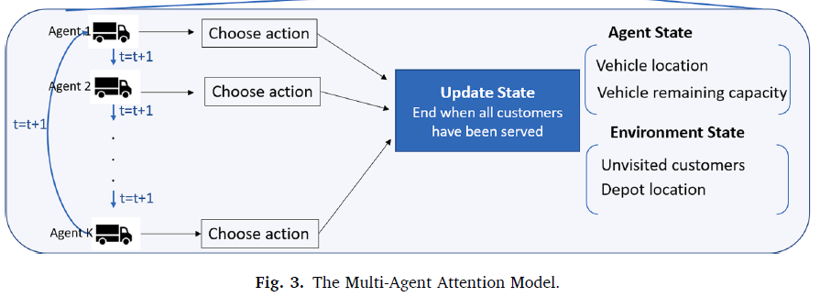
Proposal 1 – DeepRL
Suggestion
Multi-agent Deep Reinforcement Learning with Adversarial agent
Multi-agent Deep RL

Slide 6
Proposal 1 – DeepRL
RL
Problem
Overall logistics → Vehicle Routing Problem only
Fix other setting (ex. Task allocation, Order assignment)
State, Action, Reward
Replenishment, pick station status and action (Embedded, Empty)
Mobile robot location(for every point) and action(←↑↓→)
Reward: -Cost
Agent
Normal: minimize total cost
Adversarial agent : maximize total cost
Intercept other pods due to urgent situation
Simply move around w/o pick & order
Training Algorithm (Next)

Slide 7

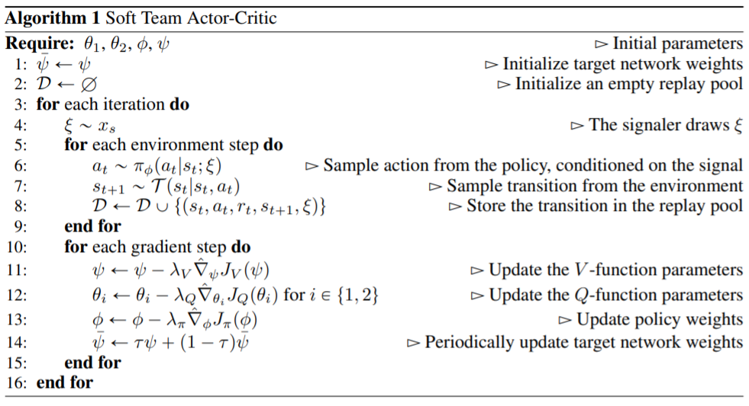
Proposal 1 – DeepRL
RL – Training Algorithm
Soft Actor-Critc (SAC) → Only single agent
Off-policy deep RL based on maxent
Multi-Agent SAC (STAC)¹
Centralized training with decentralized execution
Exploit extra information during training
Multi-agent planning
Multi-agent deep RL (cooperative behavior)

Slide 8
Proposal 1 – DeepRL
Limitation
Little RL background
Source code & Environment Setup
No RAWSim-O
Adversarial policy algorithm ¹
Unity ²
MLCS RL …
Other

Slide 9

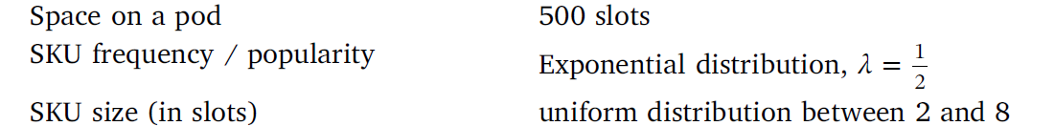
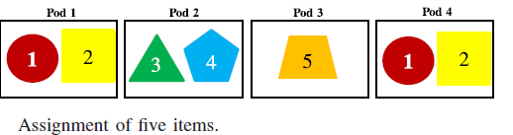
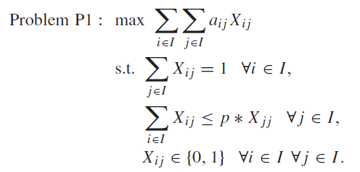
Proposal 2 – Item classification
Existing Research
“Decision rules for robotic mobile fulfillment systems” , M.Merschformann,…
Set in the Orders tap in RAWSIM-O
Set SKU size, item distribution, Order distribution
Uniform distribution, SKU size is 2~8 items in this paper
Item Classification is distributed in pods according the set distribution, but not applicated in a pod
“Item Assignment Problem in a Robotic Mobile Fulfillment System”, Hyun-Jung Kim..
Calculate Similarity value of Items from Frequency (Clustering)
Maximize the Sum of similarity values
Optimization Algorithm : Heuristic Algorithm ( to revise the varied similarity)
Re-optimization Algorithm (to representation item)

Slide 10
Proposal 2 – Item classification
Existing Research
There is no existing research about PSA(Pod Storage Assignment)
In RAWSIM-O, There are 5 decision rules for PSA
Random, Fixed, Nearest, Station-Based, Class
There is no decision rules for PSA considered on remaining items in a Pod

Slide 11
Proposal 2 – Item classification
Suggestion
Develop Initial State
Classification Based on Frequency, Similarity, Importance etc.
Find optimal Classification model
Using Classification algorithm with proper weight
Learning classification model from other Input as well as Frequency
Apply similarity value of three Items rather than just two
Use not A Pod, but several Pods
Store on a Pod based on Classification
Change classification when changing Similarity
Algorithm
Constructive Heuristic : Select High Demand Item
Heuristic Initialization Extensions : Select Representation Item based on matrix
Re-optimization Heuristic
Notes:
이 논문에서 초기 constructive heuristic을 기초로 확장한알고리즘 하나, reoptimization heuristic 하나 이렇게 두가지 변형 알고리즘이 있습니다.
Const H : 한 아이템의 주문 수(임의지정) 기준->대표 아이템(high demend되는 경우O)을 기준으로 다른 아이템들과의 각각의 similarity value 계산(그룹당 아이템갯수 정해져있음)
Heuristic Ini Exten: 1에서 초기rule 적용: 두가지 아이템을 한꺼번에 주문하는 주문 수의 평균 기준, 한 아이템에 대해 similarity value를 최댓값 사용
Reoptim H : 기존 solutio을 이용해서 다른 solution 찾기, similarity가 커지고 작아지는거에 따라서 다른 해를 찾는 것임.
Use Not a pod, 이 논문 내용이 한 포드 안에 여러 아이템을 분류해서 넣는 것 까지입니다. 그래서 우리는 여러 개의 포드 안에 여러 아이템을 분류해서 넣고자 하는 것.

Slide 12
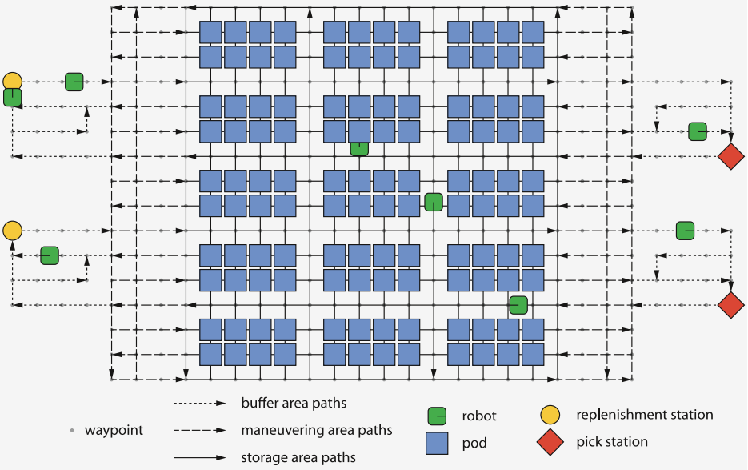
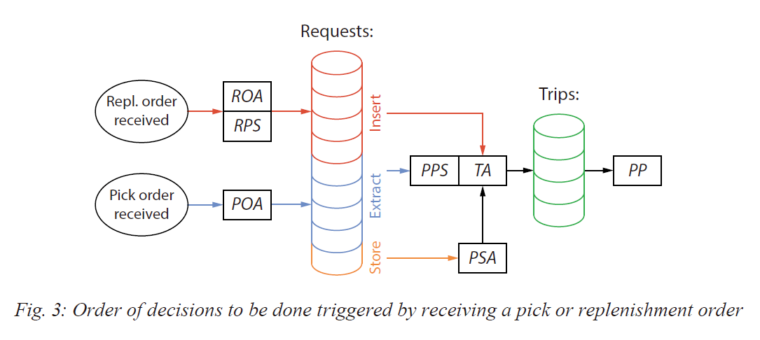
Proposal 2 – Item classification
Suggestion
Develop Decision Rule Modeling by Machine Learning
Add Pod Storage Assignment Decision Rules¹
In RAWSIM-O, There are 5 mode for PSA
Random, Fixed, Nearest, Station-Based, Class
Which part of the Storage is more efficient when Pods go back to Storage area
Frequency(the number of Pick order, Replenishment order), Remaining items in a Pod as features
3 part of the storage area as outputs

Slide 13
Proposal 2 – Item classification
Limitation
Hard to get reliable Dataset
Implementation to RAWSIM-O code(C#)

Slide 14
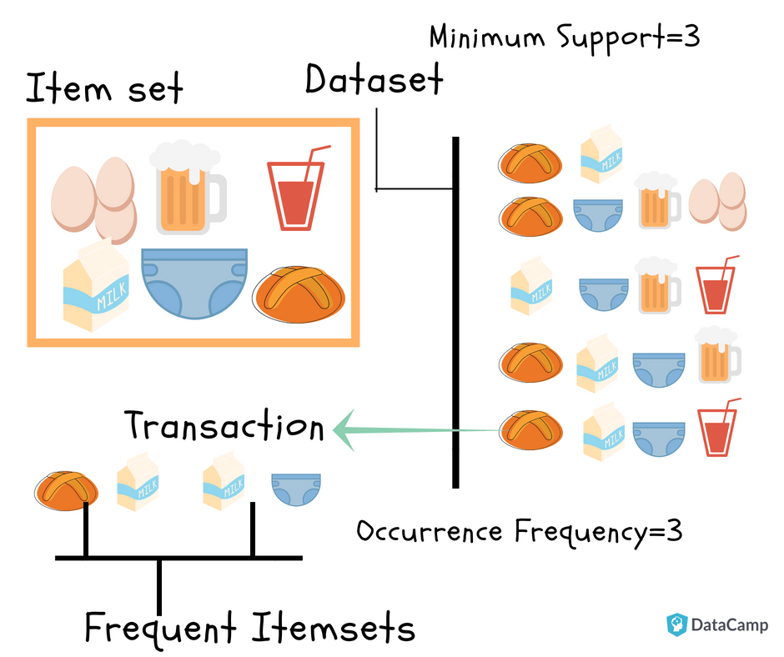
Proposal 2 – Item classification
Suggestion
Find association of products through the Market basket analysis
Add Pod Storage Assignment Decision Rules¹
2 Constraints
Place the related product nearby
Place the unrelated products faraway

Slide 15
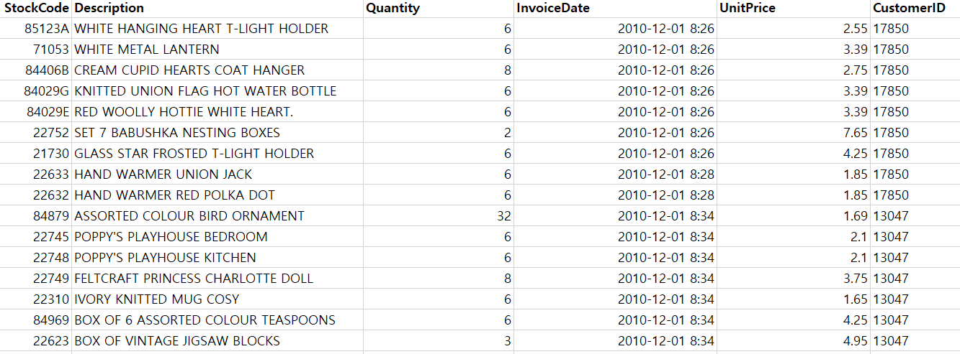
Proposal 2 – Item classification
Dataset (from Kaggle)
Online Retail (https://www.kaggle.com/puneetbhaya/online-retail)
Product ID
Product Name
Customer ID
Σ (# of Product ID with the same customer ID) = Shopping cart of one person

Slide 16
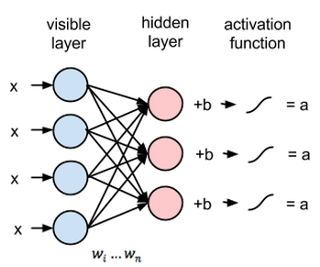
Proposal 2 – Item classification
Market Basket Analysis
Apriori Algorithm
finding frequent item sets in a dataset using prior knowledge of frequent itemset properties.
Limitiation : Slow for large item sets
Hruschka, H. (2014). Analyzing market baskets by restricted Boltzmann machines. OR spectrum, 36(1), 209-228.
Using Neural Network
Benefit
Reduce unnecessary movement of the robot
Raise Efficiency of the Path Planning
Limitation
Dataset is about online retail NOT about Customer
Need to find algorithm to optimize the hyperparameter
Notes:
Frequent Item set :
자주 등장하는 아이템 셋 (예를 들어서 11p의 사진을 보시면 [빵, 우유] 같은 것이 frequent item set이 됩니다.) 이걸 통해서 아이템끼리의 연관성을 찾아가려고 하는 것입니다.
RBM:
pattern recognition problems에서 주로 사용되는 학습 방법으로 joint probability ([빵, 우유]가 나타날 확률 등)을 구할 수 있습니다.
이 RBM의 장점은 한글로 번역하면 의미 전달이 잘 안될거 같아서 논문에서 설명한 대로 밑에 적어드리겠습니다.
“RBM allows us to analyze a higher number of product categories by simultaneous estimation for all categories investigated.”
Categories를 item set으로 이해하시면 될거 같고, 동시에 이 카테고리가 등장할 확률을 계산할 수 있다는 점이 장점입니다.
Limitation
1 : 이 데이터셋이 일반 고객 (개인)들이 온라인으로 구매한 데이터가 아니라 소매상들이 개인에게 팔기 위해서 구매한 데이터셋이라서 제가 생각했던 쿠팡이나 마켓컬리 같은 사이트의 데이터셋이 아니라는 이야기였습니다.
2 : 그 market basket analysis에서 아이템 셋 ( 예를 들어 [빵, 우유],[빵, 계란] 등등)들이 등장할 확률을 계산한 후에 이 확률들 중에서 최소 확률을 저희가 정해서 그 밑에 확률을 등장하지 않을 것이다 라는 식으로 버려야합니다. 이 부분에서 최소 확률을 구할 수 있는 알고리즘을 아직 제가 찾지 못한 점에서 적어놓은 것 입니다.

Slide 17
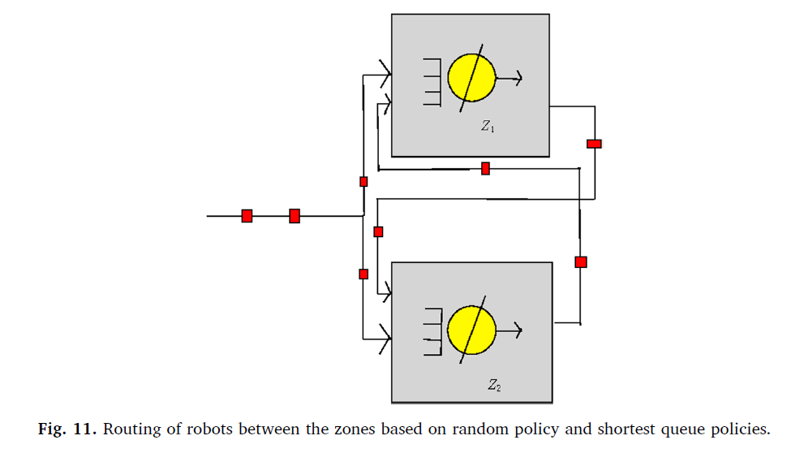
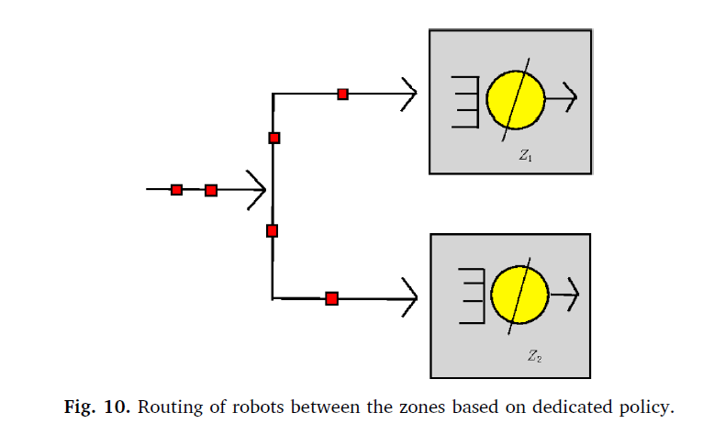
Proposal 3 – Queuing Network Model
Existing Papers
“Decision rules for robotic mobile fulfillment systems” , M.Merschformann,…
Not using Queuing Model, detailed simulation
Robot-storage zone assignment strategies, Debjit Roy
Most of research are on strategic level
Set up Layout warehouse
Using Multi-class closed queueing network model
Compare our model with Pooled Robot and Dedicated Robot
How to return to storage zone from order and replenishment station,
Robots active according to stochastic model
Queueing Network - pooled robot theory
Notes:
ARENA software: 로봇 교통에 관한 소프트웨어로 전에 말씀드렸다시피 매트랩 시뮬링크와 같은 형상
보통 queuing 모델을 이용한 전략적 모델이 제시되었는데 rowsim에서는 사용하지 않음
기존 대기열의 경우 이전 회의에서 논의한 dedicated robot 행동인데, closed queue는 닫힌 형태의 대기열 모양
Multi-class는 2가지 클래스(pick, replenishment order station에서 storage로 가는 경우를 다룬 것임

Slide 18
Proposal 3 – Queuing Network Model
Suggestion
Access Pooled Robot vs. Dedicated Robot in RAWSim-O
Add Decision Rule
PSA
ROA and POA
Decide the optical size of priority zones in PSA
Notes:
ROA: 하나의 replenishment order가 완료되면 그 다음 replenishment order를 위한 station을 선택하는 것
POA: 하나의 pick order가 완료되면 그 다음 pick order를 station 하나에 넣어놓는 것.

Slide 19
Summery
Proposal | RAWSim-O | Env | Method | Expected Effect | Limitation
1. Deep RL | X | Python, Unity | Reward/ Max cost (Action) | High Efficiency | Little RL background, Source Code
2-1) Item Pod Assignment | O | C# | Item Initial Station | Complexity of Model | How to adapt
2-2) PSA decision rules by ML | O | C#, Python | PSA | Reduce unnecessary robot path | How to adapt
2-3) Association of items | O | C#, python | PSA | Reduce unnecessary robot path | Hard to fit Model using Dataset
3. Queuing Network Model | O | C# | PSA, ROA, and POA | Improve Efficiency | How to adapt

