Slide 1
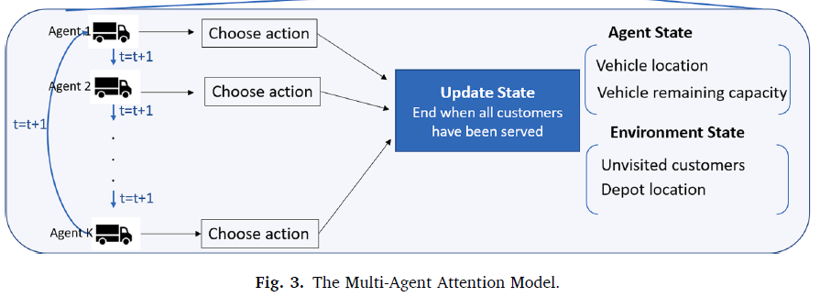
Proposal – DeepRL
Suggestion
Multi-agent Deep Reinforment Learning with Adversarial agent
Multi-agent Deep RL

Slide 2
Proposal – DeepRL
RL
Problem
Overall logistics → Vehicle Routing Problem only
Fix other setting (ex. Task allocation, Order assignment)
State, Action, Reward
Replenishment, pick station status and action (Embedded, Empty)
Mobile robot location(for every point) and action(←↑↓→)
Reward: -Cost
Agent
Normal: minimize total cost
Adversarial agent : maximize total cost
Intercept other pod due to urgent situation
Simply move around w/o pick & order
Training Algorithm (Next)

Slide 3

Proposal – DeepRL
RL – Training Algorithm
Soft Actor-Critc (SAC) → Only single agent
Off-policy deep RL based on maxent
Actor: learning the policy (maximize expected reward)
Critic: maximize its entropy in each visited state

Slide 4
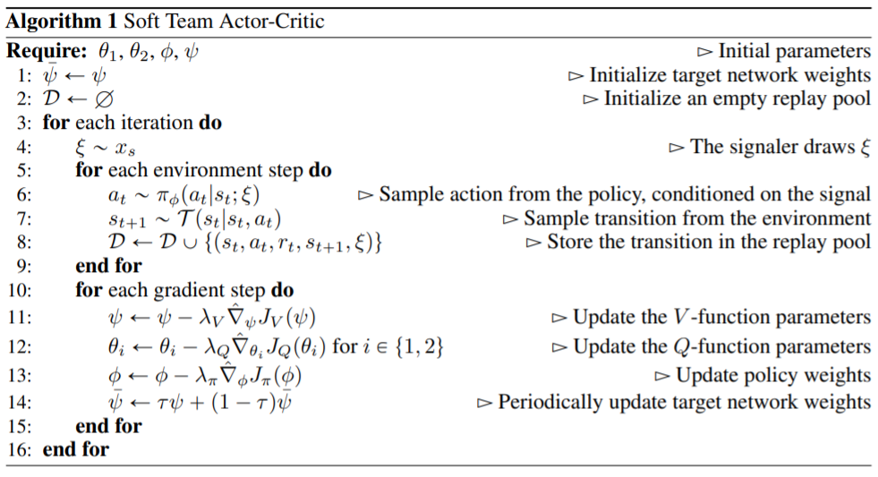
Proposal – DeepRL
RL – Training Algorithm
Soft Actor-Critc (SAC) → Only single agent
Off-policy deep RL based on maxent
Multi-Agent SAC (STAC)¹
Centralized training with decentralized execution
Exploit extra information during training
Multi-agent planning
Multi-agent deep RL (cooperative behavior)

Slide 5
Proposal – Adverserial agent
Limitation
Little RL background
Source code & Environment Setup
No RAWSim-O
Adversarial policy algorithm ¹
Unity ²
MLCS RL …
Other

