Slide 1
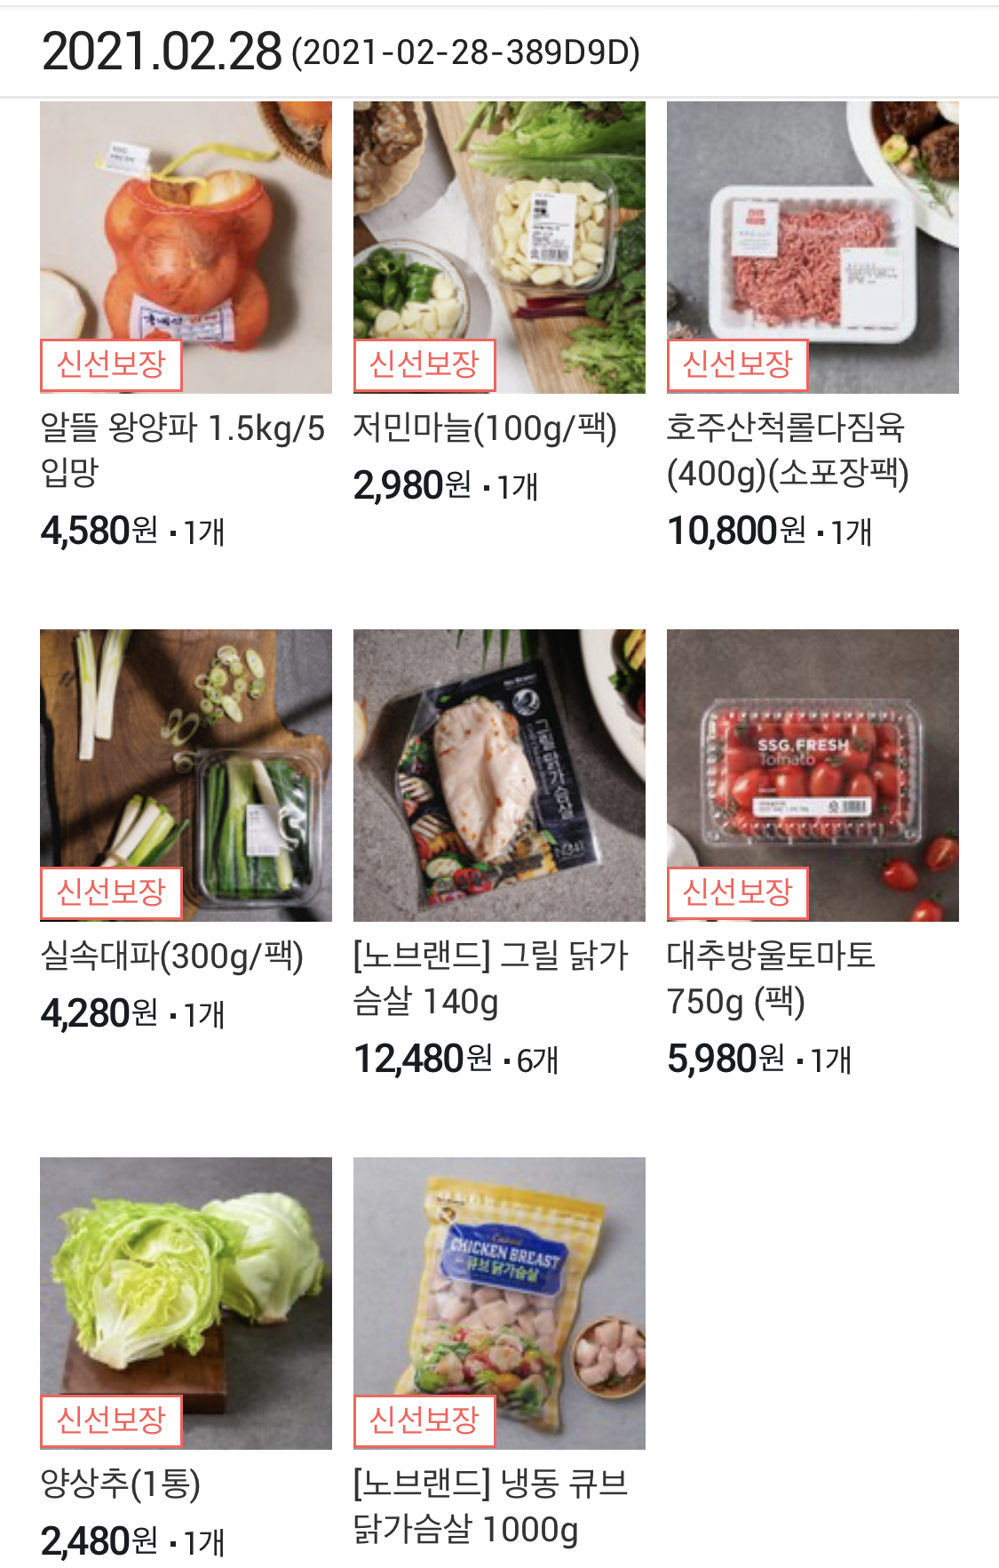
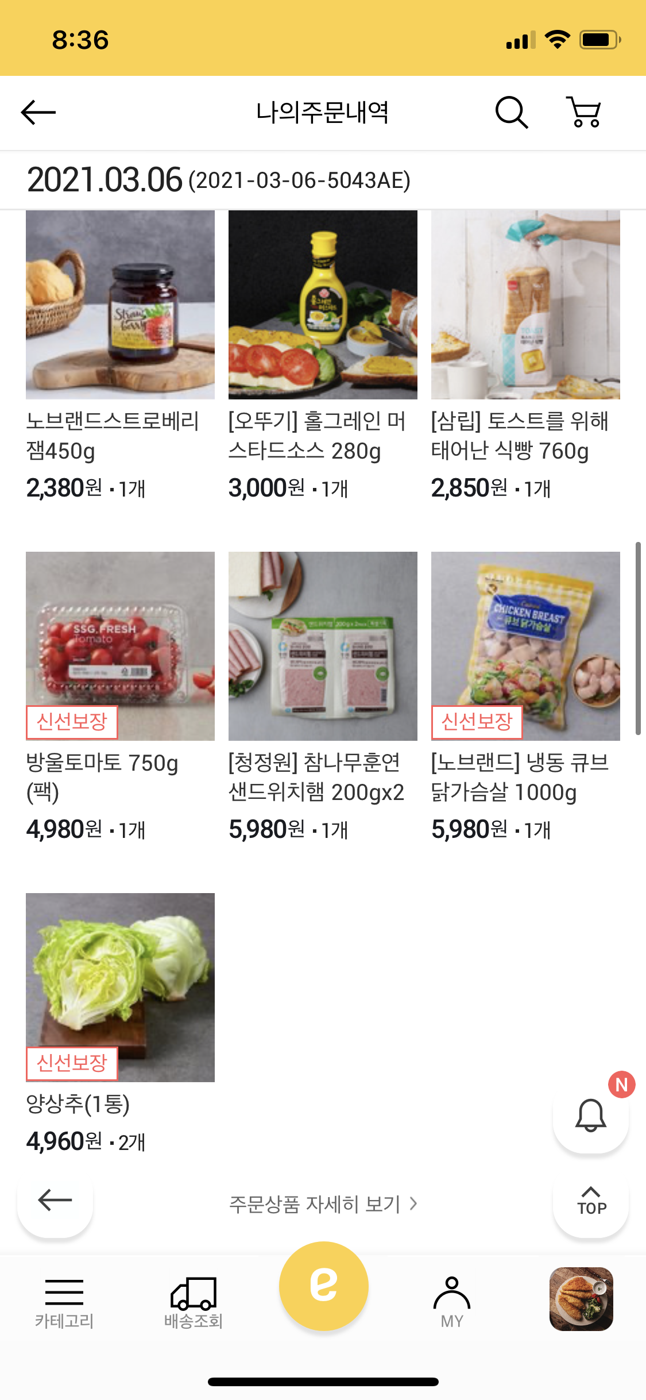
2. Data
Desired Dataset
Market basket Data

Slide 2
2. Data
Instacart Market Basket Dataset
Instacart: A grocery delivery and pick-up service in the United States
A sample of over 3 million grocery orders
Contains:
User id
Order id
Product name & id
Aisle name & id
Department name & id
Reordered
etc

Slide 3
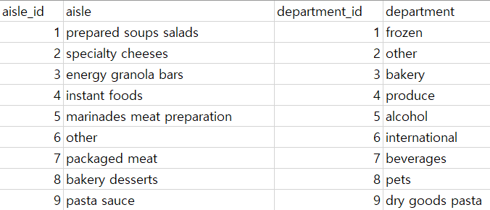
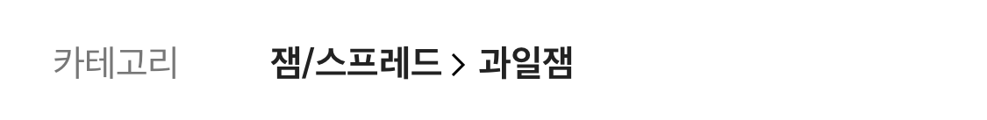
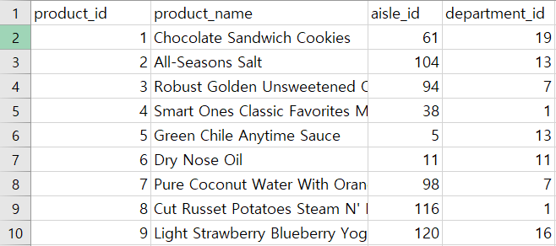
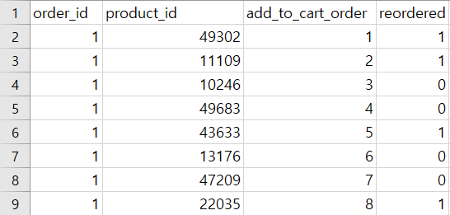
2. Data
Instacart Market Basket Dataset
Order_ID
Product
name
Department
Aisle
< Aisle & Department ID >
< Product Name & ID >
< Orders >

Slide 4
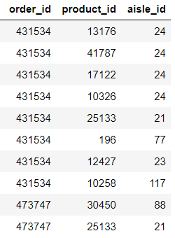
2. Data
Data Preprocessing
Since the # of the product is about 40,000, it is too much data to use for the RAWSim-O simulation
Data preprocessing by changing the product_id to aisle_id
Sum of same order_id = User’s market basket
Expected Problem
Small number of aisle_id were high in frequency
One
Market
Basket

Slide 5
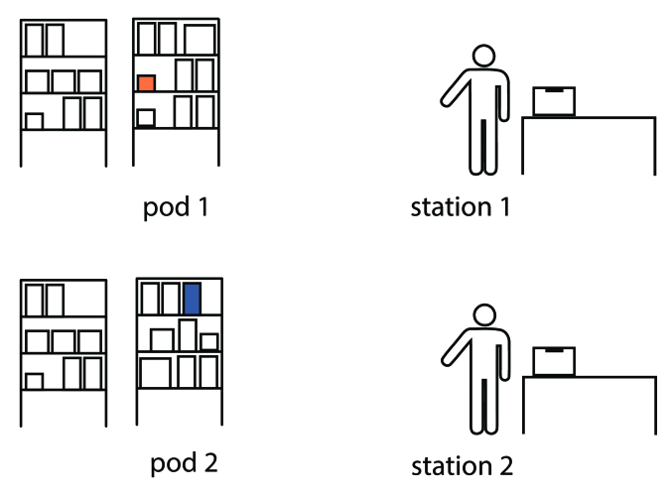
4. Expected Outcomes
Expected Outcomes
Expected to be more efficient than the conventional method of RAWSim-O
Maximize total throughput
Related three items will be contained in one pod
1 order, 1 movement of robot
Minimize total time
Reducing unnecessary movement of robots
eggs
milk
bread

