Slide 1


EPI – Propeller Brake Control Unit
EMI Filter Design
June 27th, 2017

Slide 2
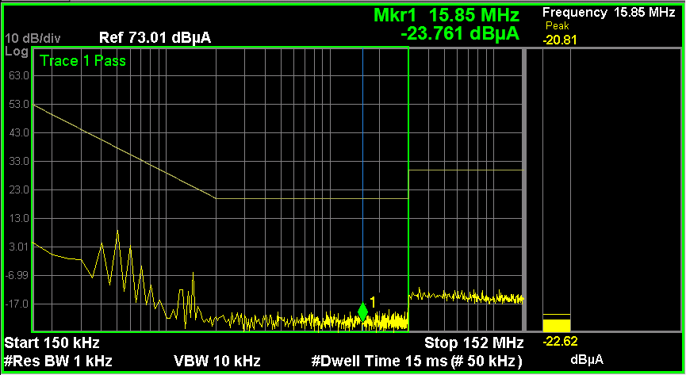
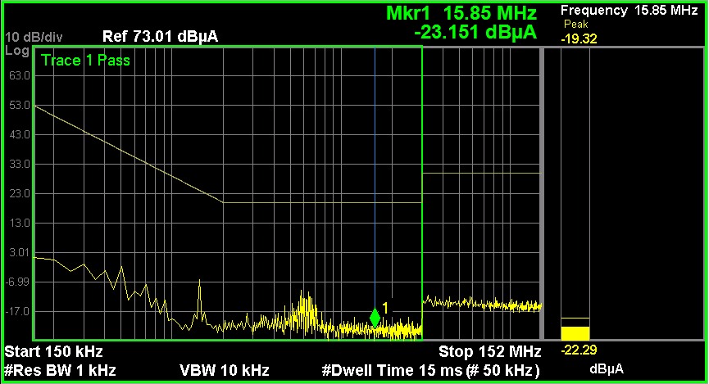

PBCU – Conducted emission
Measurements performed on PBCU-08, +28V power supply with no input filter (Schaffner was removed): no critical frequencies identified in the 150 kHz to 30 MHz
The measurement shows that the filter is not needed for the conducted emission but the filter is needed to guarantee the compliance to other EMI tests as : Power Input, Voltage spike, Audio Frequency conducted Susceptibility, Induced Signal Susceptibility, Radio Frequency Susceptibility (Radiated and conducted), Lightning Induced Transient Susceptibility
As risk mitigation, the Umbra-designed EMI filter will have filtering performance comparable to Schaffner EMI Filter
Common mode | Differential mode

Slide 3
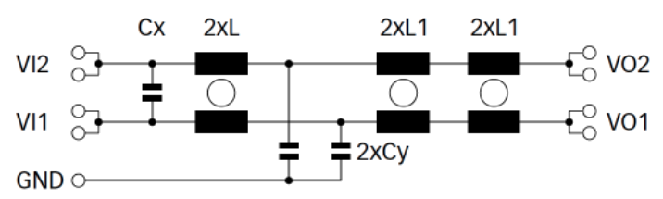
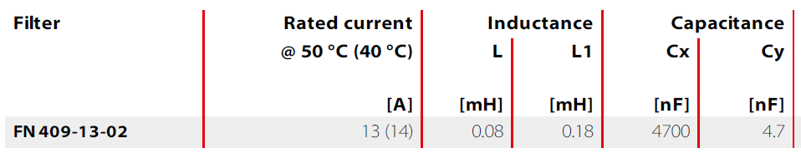
Schaffner FN409-13-02 - Characterization
Shaffner FN409-13-02 EMI Filter

Slide 4
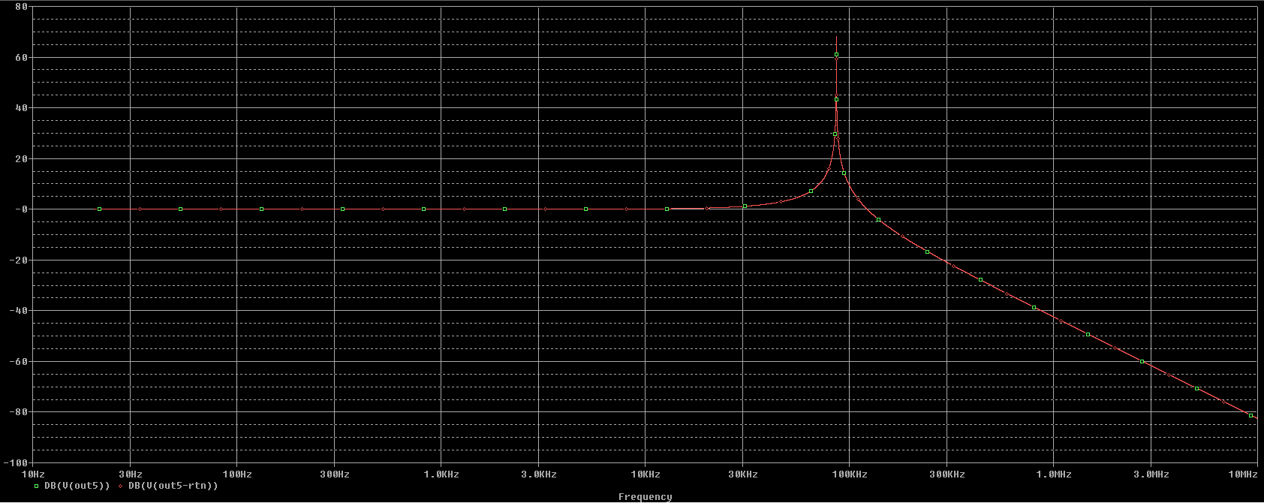
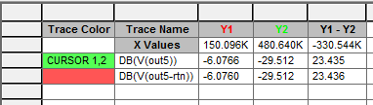
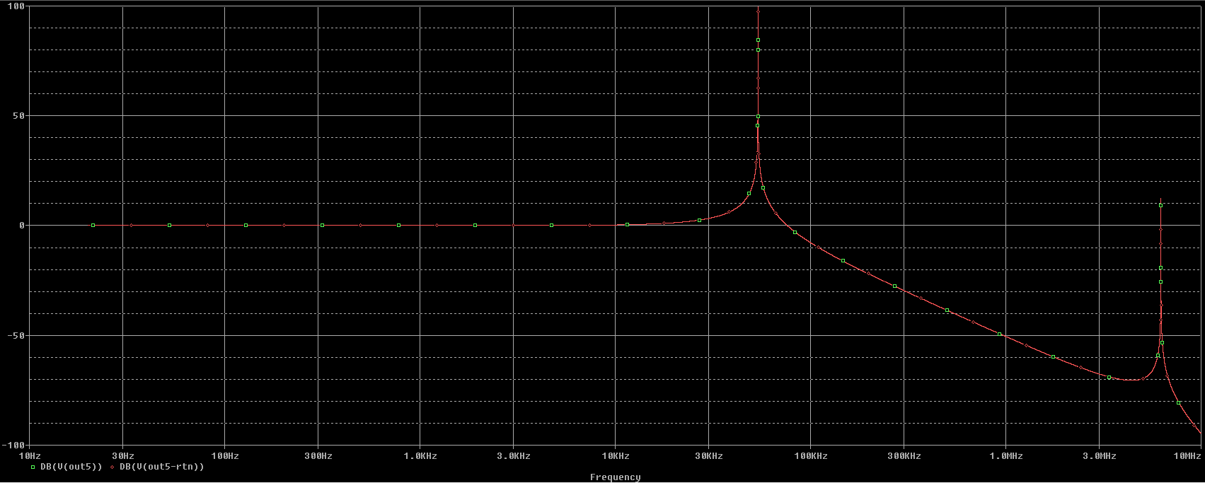
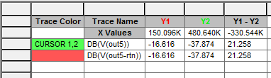
Schaffner FN409-13-02 – Spice Simulation
Common Mode – Bode Magnitude Diagram
6 dB attenuation at 150 KHz
Differential Mode – Bode Magnitude Diagram
16 dB attenuation at 150 KHz

Slide 5
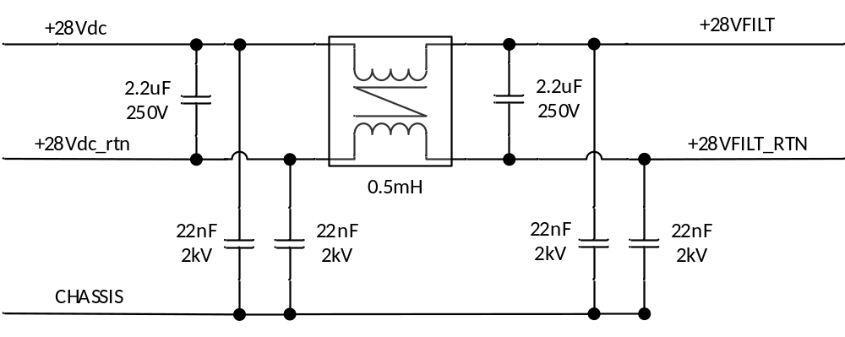
EMI Filter – Umbra Design
Custom EMI Filter
DM Capacitor
CM Inductor
CM Capacitor
Single stage second order EMI Filter (Umbra design)
CM and DM noise suppression for the 28Vdc line

Slide 6
EMI Filter – Umbra Design – Common Mode Inductor
Design Inputs:
  Nominal Inductance: 500 uH
  Steady State Current: 3 A
  Current Density: 5A/mm²
Design Outputs:
  Ferrite Toroidal Core: Magnetics ZW-41005-TC
  Inductance: 536 uH
  Leakage Inductance: 1.05 uH
  Cutoff Frequency: 50 Hz
  DC Resistance: 0.0078 Ohm
  Turns per Side: 9
  Wire Size: 19 AWG

Slide 7
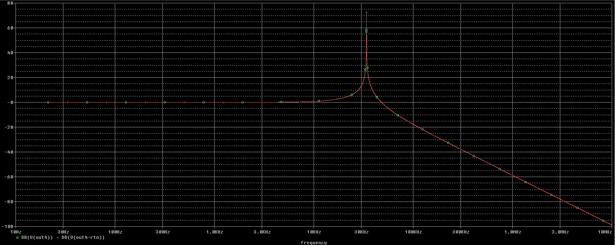

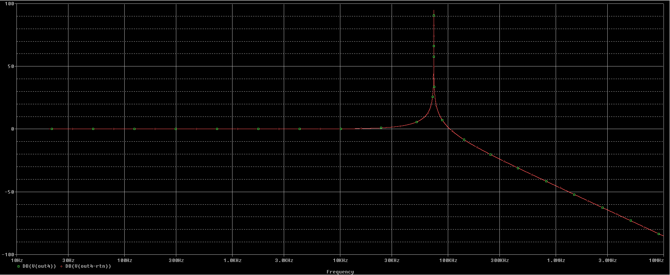

EMI Filter – Umbra Design – Spice Simulation
Common Mode – Bode Magnitude Diagram
25 dB attenuation at 150 KHz
Differential Mode – Bode Magnitude Diagram
10 dB attenuation at 150 KHz

Slide 8
EMI Filter Design - Comparison
Umbra Custom Filter | Shaffner Filter FN409-13-02
1 CM Inductor: 0.5 mH 2 Cx Capacitor: 2.2uF 4 Cy Capacitor: 22 nF CM attenuation: 25dB @ 150KHz DM attenuation: 10dB @ 150KHz | 1 CM Inductor L: 0.08 mH 2 CM Inductor L1: 0.18 mH 1 Cx Capacitor: 4.7uF 2 Cy Capacitor: 4.7 nF CM attenuation: 6dB @ 150KHz DM attenuation: 16dB @ 150KHz
Equivalent Inductor:
0.44 mH

