Slide 1
OBSOLESCENCE MANAGEMENT

Slide 2
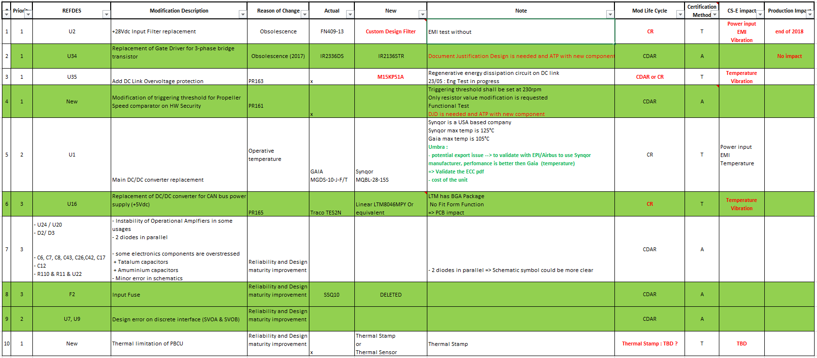
PBCU Hardware redesign

Slide 3
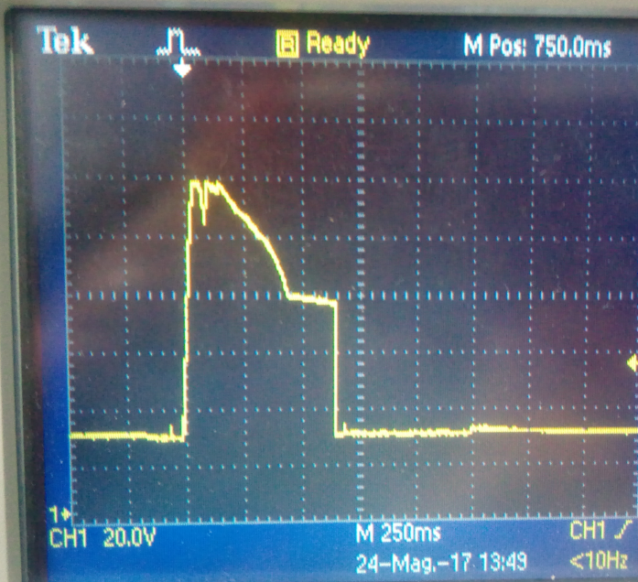
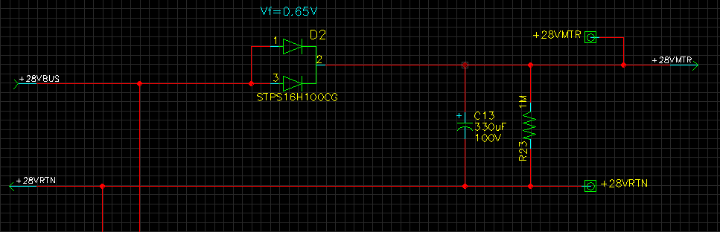

DC Bus Regeneration
Regenerative BEFM
The max voltage value measured drop the DC bus in the release phase is greater than 100Vdc for 300ms
The point of the measure is across the C13

Slide 4
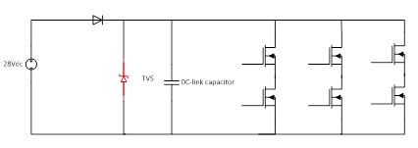
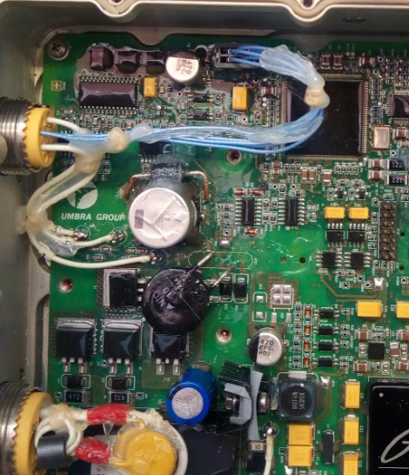
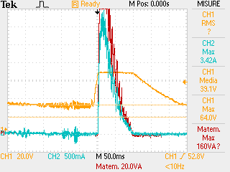
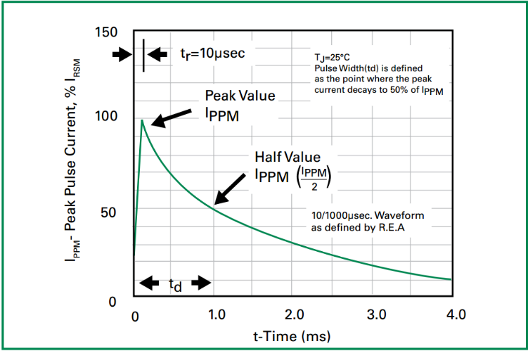
DC Bus Regeneration
Limiting the max voltage in the regenerative phase
Using a TVS (Transient Voltage Suppressor), model “15KPA51A” in parallel with C13 (DC link capacitor)
The measure of the TVS current shown a waveform similar to test pulse waveform reported on the TVS datasheet
Voltage drop

Slide 5
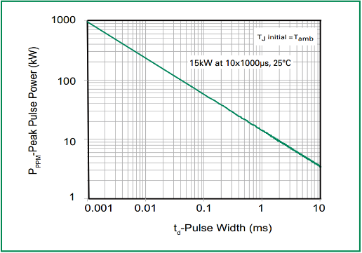
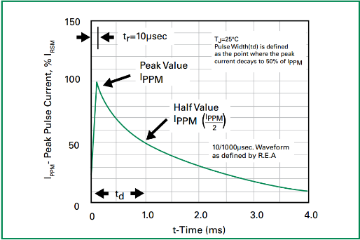
TVS Selection
The max peak current measured is 4A
The maximum voltage measured across the DC bus is 64V
The time of the duration of regenerative phase is 100ms
In the worst case the maximum power to dissipate is 4A*64V=256W
the Pppm Rating Curve reported on the datasheet has a maximum Pulse Width (td) of 10ms
td is the time between the current peak and the 50% of the same value.
For PBCU, Td = 50ms

Slide 6
TVS Selection
To extend the range of the curve the manufacturer suggests: ”interpolation to extend the curve can be applied to get an idea on the possible power capability”
The TVS Power capability at 50ms is about 1,185kW
The peak power required is 256W.
The TVS works about at 25% of its power capability
In the past months more than 5000 engage/release cycle was performed with no failure. Additional endurance test at different temperature are forecast to validate the solutuon
interpolation

Slide 7
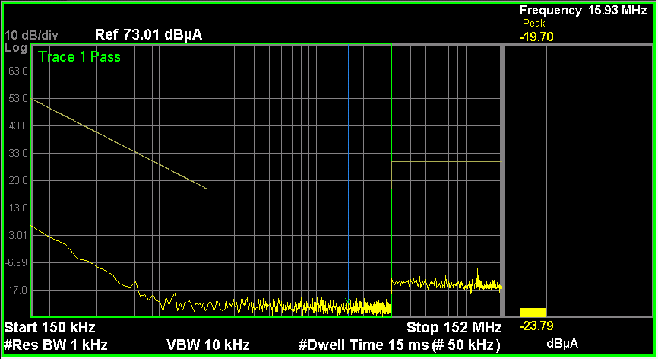
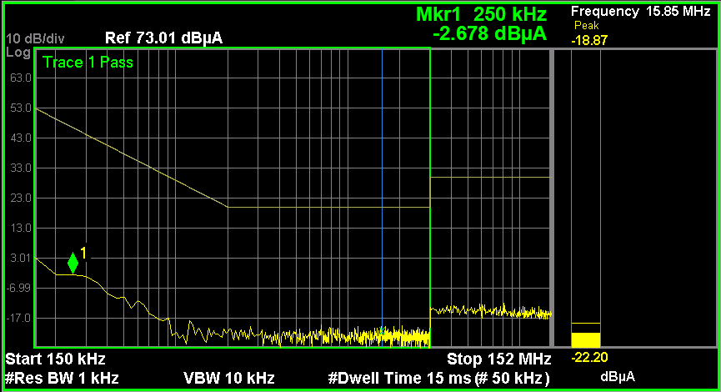
Filter replacement
PBCU -08
Shaffner filter FN408-13-02
Common mode | Differential mode

Slide 8
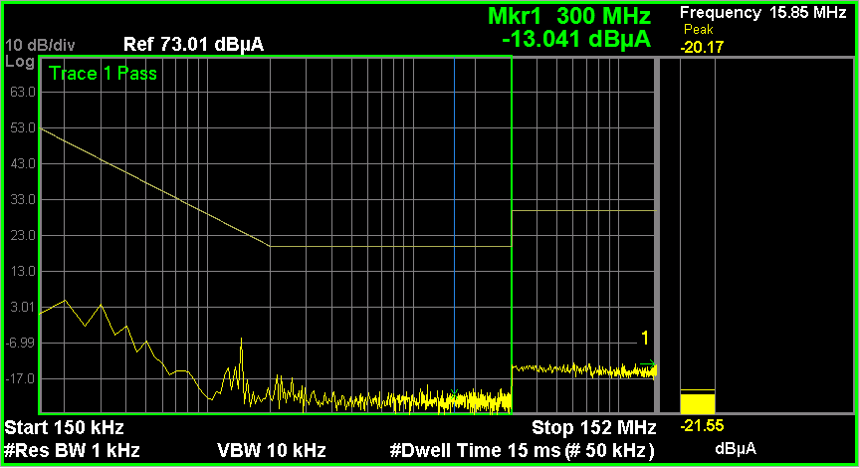
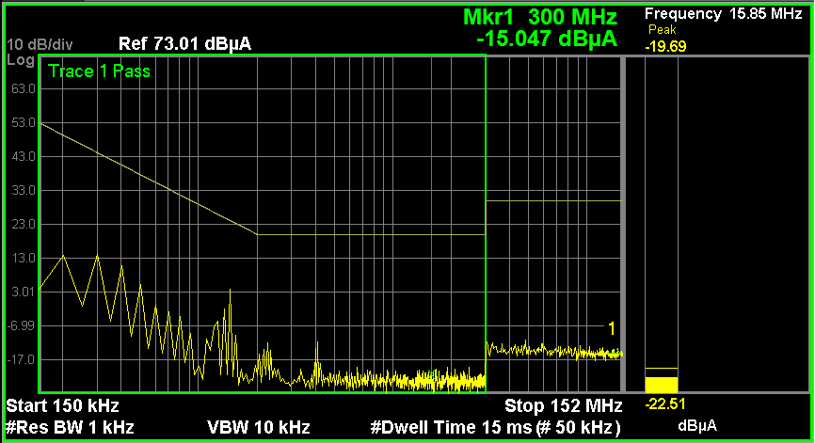
Filters replacement
Substitution the filter Shaffner with the filter Vicor
Vicor filter QPI-5LZ
Common mode | Differential mode

Slide 9
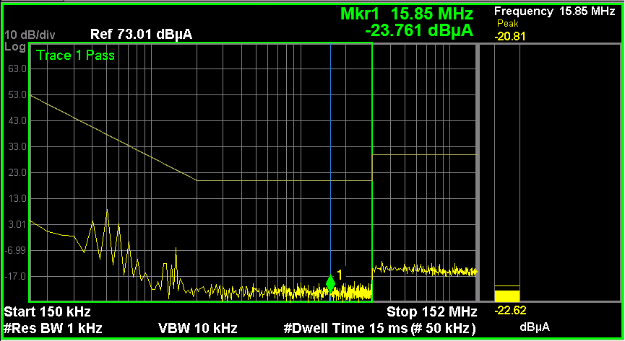
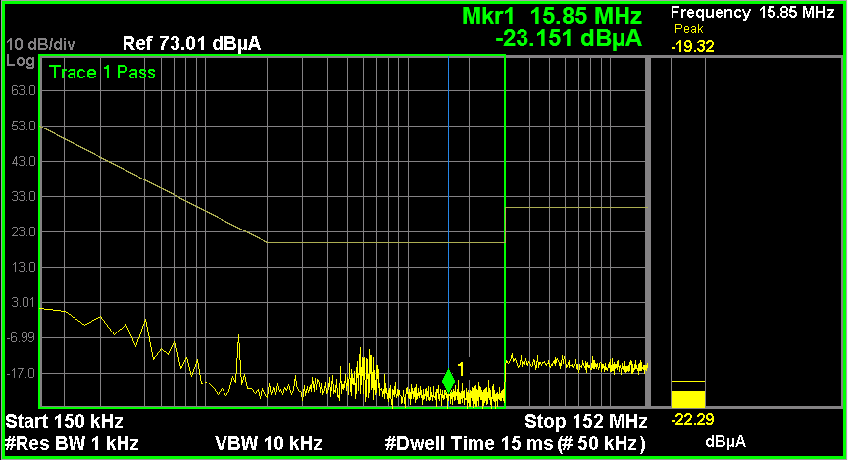
Filters replacement
No filter
Common mode | Differential mode

Slide 10
Filter Replacement
The measurement shown that the filter is not need for the conducted emission but the filter is needed to guarantee the compliance to:
Power Input
Voltage spike
Audio Frequency conducted Susceptibility
Induced Signal Susceptibility
Radio Frequency Susceptibility (Radiated and conducted)
Lightning Induced Transient Susceptibility
New filter based on discrete elements (inductance and capacitor) will be designed by Umbra

