Slide 1

Dynamically Controlled Particle Systems Jakob Progsch Simon Laube Benjamin Flück
TexPoint fonts used in EMF.
Read the TexPoint manual before you delete this box.: AAAAA

Slide 2
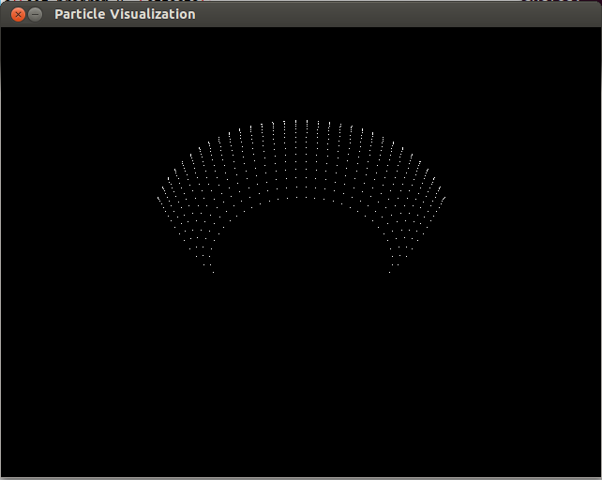
Particle Systems
Simulate a number of particles according to some given rules
Particles are represented by
Position[3]
Mass
Velocity[3]
Charge
Rules define forces and effects
Gravity
Collisions
Time step in the simulation
…

Slide 3
Dynamic Control
Algorithm:
Iterate over all particles and apply the desired rules
Problem:
Changing rules in a dynamic/random environment does not allow for many optimizations during compilation (e.g. games) between the selected rules
Our Solution:
Create a JIT-compiler to optimize these rules on the fly when they change

Slide 4
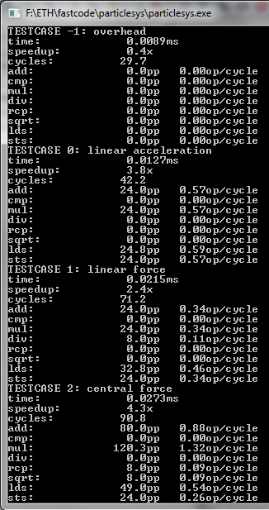
Performance Measurements
Performance in flops/particle
Number of particles has no influence; linear iteration through particles -> prefetcher hides all ram accesses
No flops/cycle (available, but unused)
Not useful for evaluating break-even point for JIT compiler
JIT compiler changes number of ops, stores, and loads
Branching/masking further skews results

Slide 5
Baseline Implementation
List of function pointers, sequentially applied to all particles
Example rule: gravitation
gravitational_force_apply(particle p, centre c, float dt) {
diff = p.position – c
r = distance(p.position, c)
r3 = 1.0f/(r*r*r)
p.velocity += dt*mu*diff*r3
}

Slide 6
Optimizations
Standard optimizations from class
Scalar replacement
Loop unrolling
Compiler optimizations
SIMD optimizations on a per-rule basis
SSE intrinsics
JIT compilation for global optimizations across rules including:
SSE and AVX Code generator
Load/Store combining
Constant folding
Common sub-expression elimination
Scheduling

Slide 7
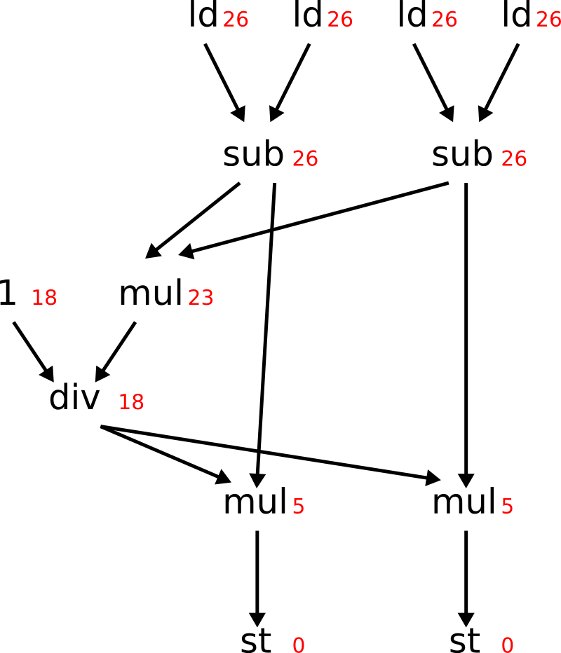
Optimizations – JIT Scheduling
Build a dependency DAG
Sum up latencies

Slide 8
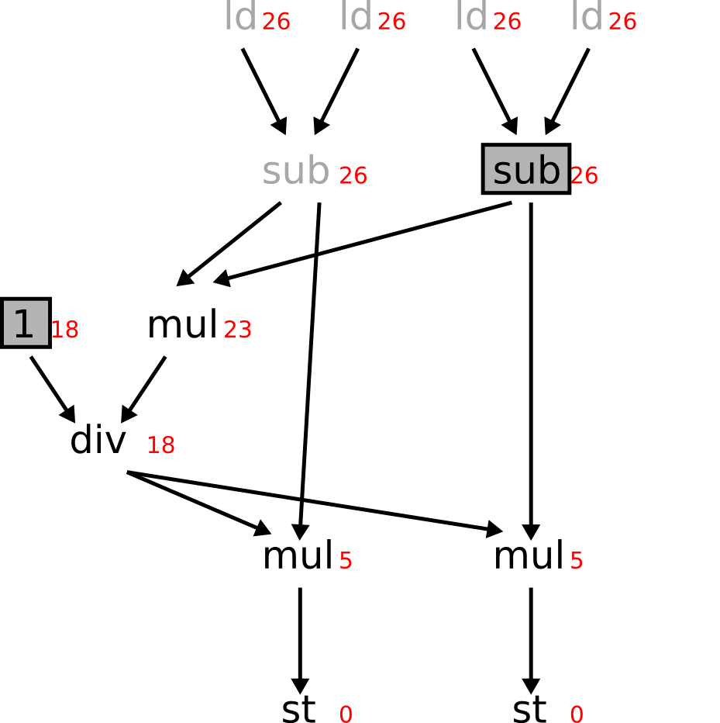
Optimizations – JIT Scheduling
Build a dependency DAG
Sum up latencies
Schedule instruction with highest latency

Slide 9
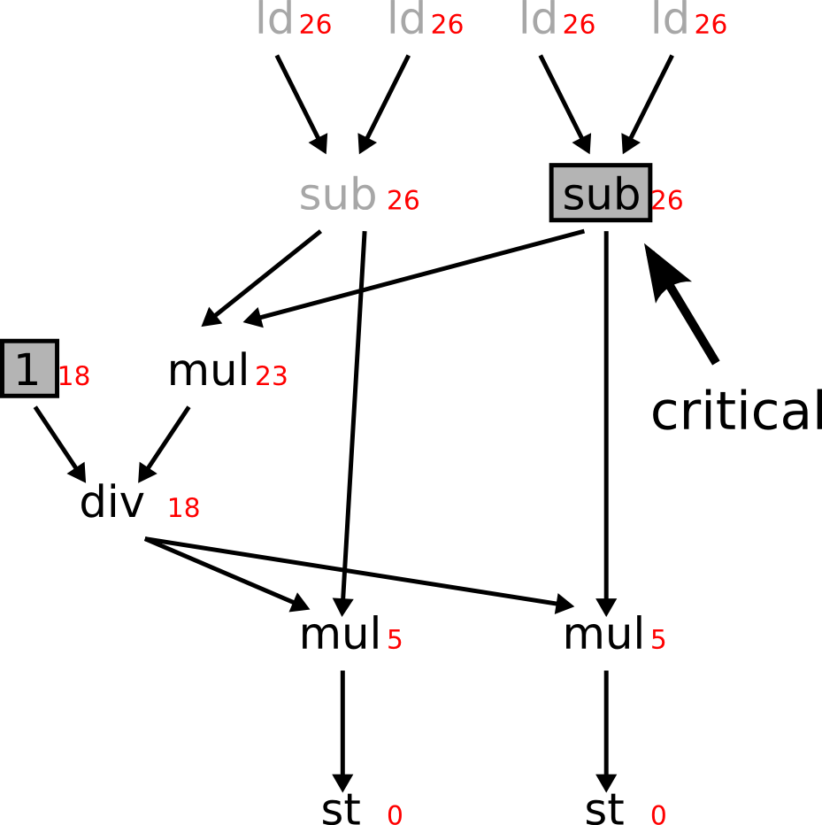
Optimizations – JIT Scheduling
Build a dependency DAG
Sum up latencies
Schedule instruction with highest latency
-> Ops on critical path get preferential treatment
Worst case runtime is O(op^2) In practice close to linear performance

Slide 10
Results – JIT compiler in Detail
Compile time in sub millisecond range
Code generation constant
Scheduling heavily depends on rule composition and number of instructions
Fast enough for real time usage

Slide 11
Results - Performance
SSE/AVX vectorization loses a lot of its potential gains due to data shuffling
Speed-up of ~2x instead of theoretical 4x/8x

Slide 12
Results - Performance
Given enough work SSE/AVX vectorization gains outweight data shuffling losses
Speed-up ~2.5/3.5x for SSE/AVX

Slide 13
Conclusions
Simple JIT compiler competitive/surpassing optimized code
Excluding loop unrolling, which the JIT compiler cannot yet do
“messiness” of optimizations hidden from programmer
JIT compiler can be improved using various known compiler techniques

Slide 14
The End & Questions

