Slide 1
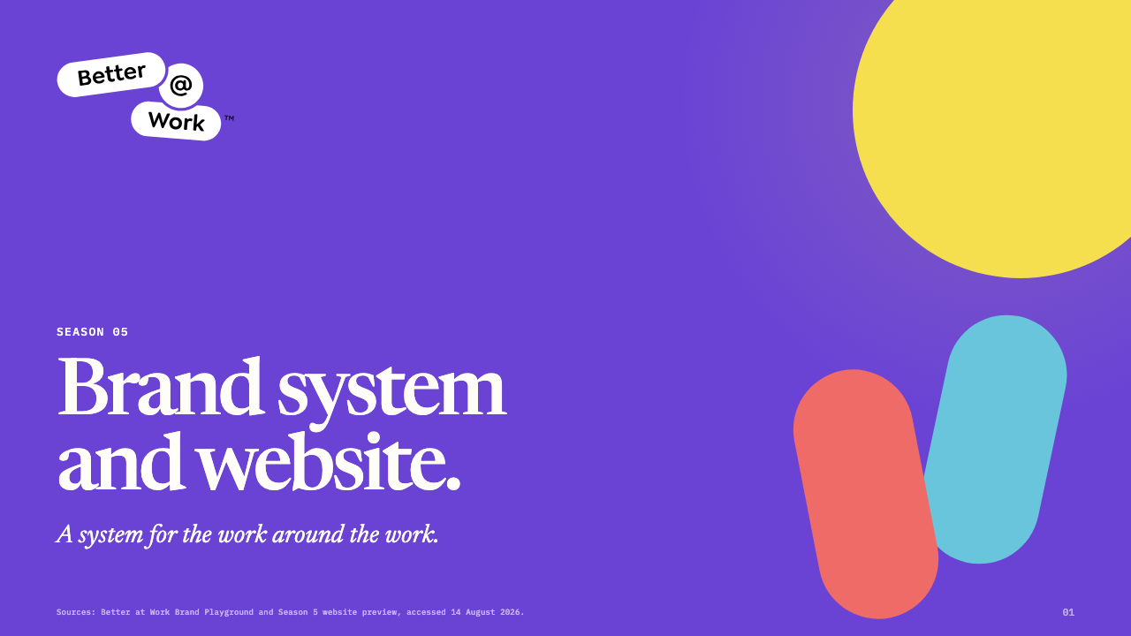
Notes:
[Sources] - https://www.figma.com/design/OMTB8YIiNcQ91Ljpzpmn2r - https://better-at-work-frontier.vercel.app/

Slide 2
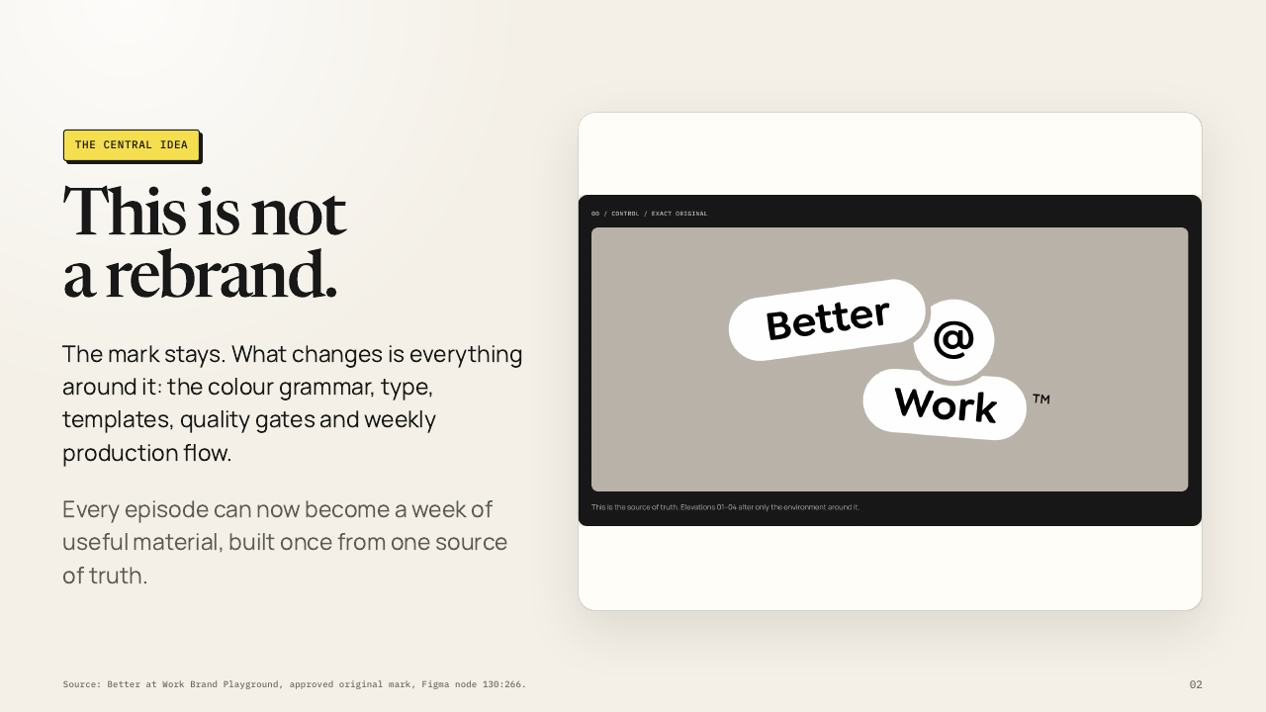
Notes:
[Sources] - https://www.figma.com/design/OMTB8YIiNcQ91Ljpzpmn2r

Slide 3
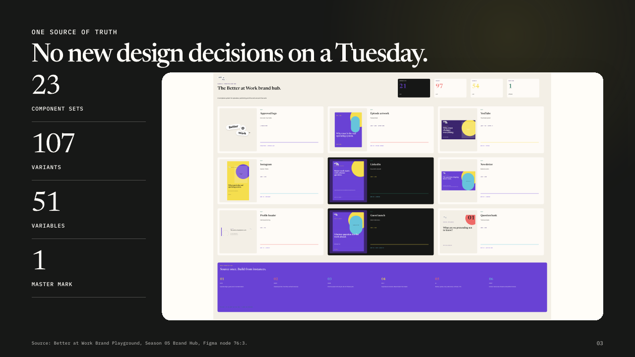
Notes:
[Sources] - https://www.figma.com/design/OMTB8YIiNcQ91Ljpzpmn2r

Slide 4
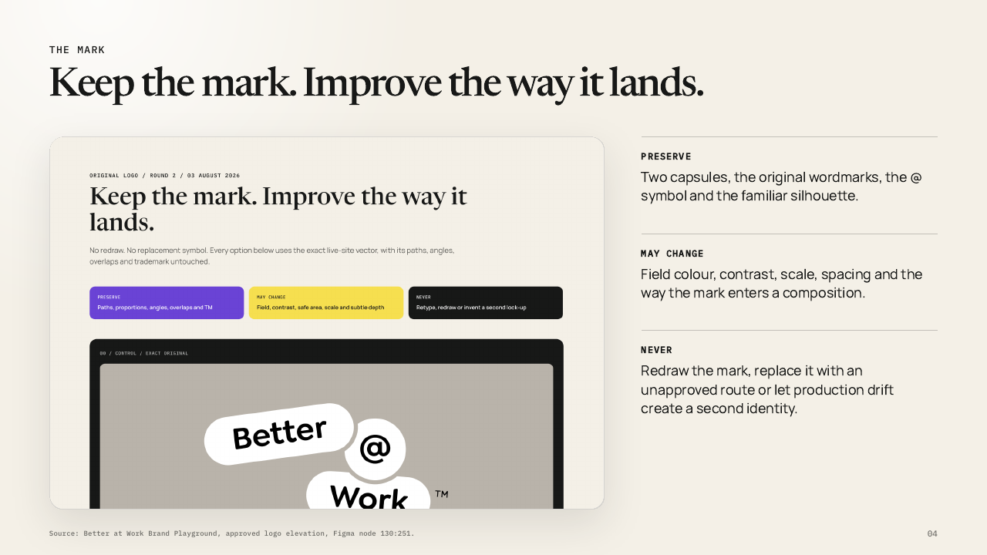
Notes:
[Sources] - https://www.figma.com/design/OMTB8YIiNcQ91Ljpzpmn2r

Slide 5
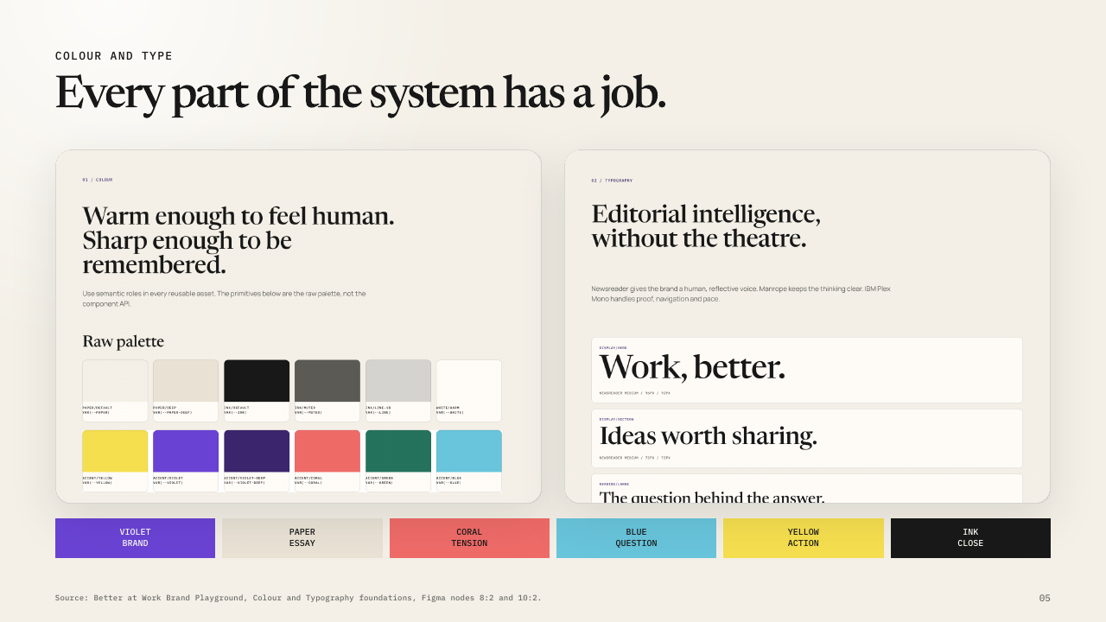
Notes:
[Sources] - https://www.figma.com/design/OMTB8YIiNcQ91Ljpzpmn2r

Slide 6
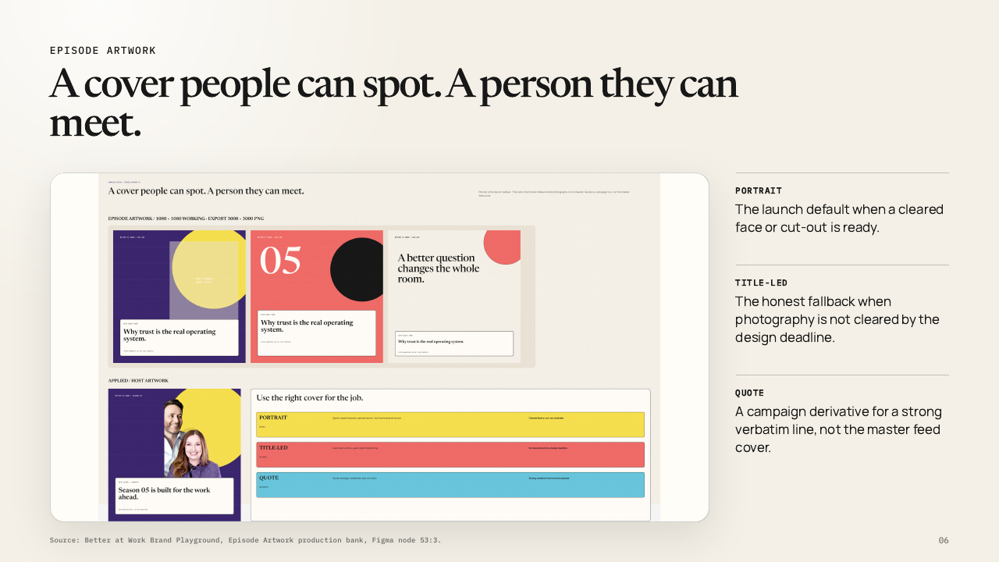
Notes:
[Sources] - https://www.figma.com/design/OMTB8YIiNcQ91Ljpzpmn2r

Slide 7
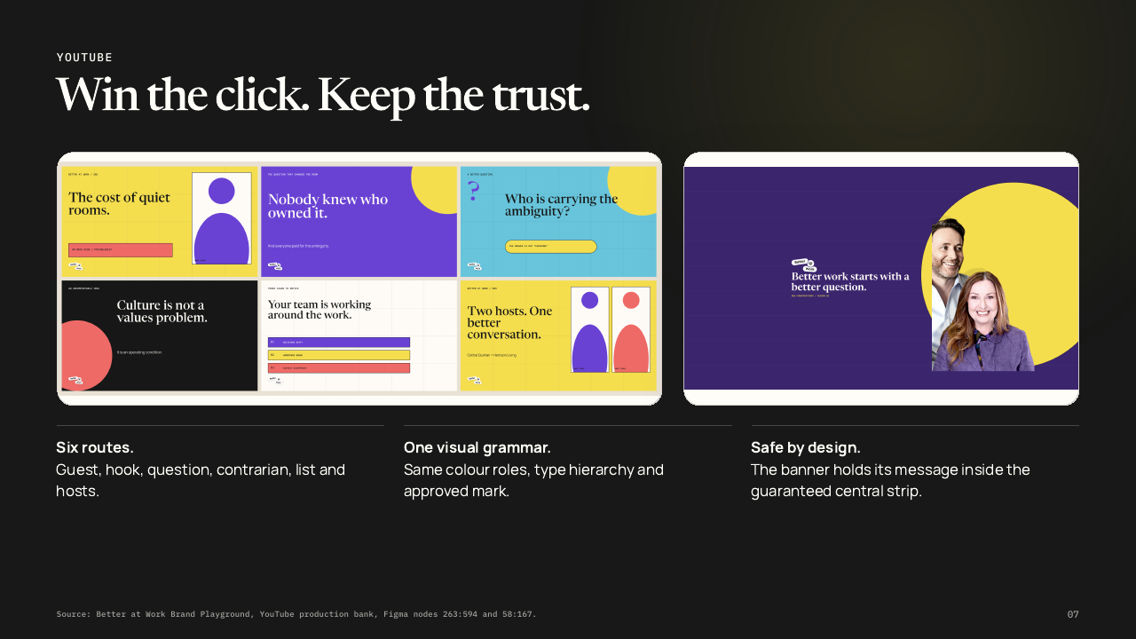
Notes:
[Sources] - https://www.figma.com/design/OMTB8YIiNcQ91Ljpzpmn2r

Slide 8
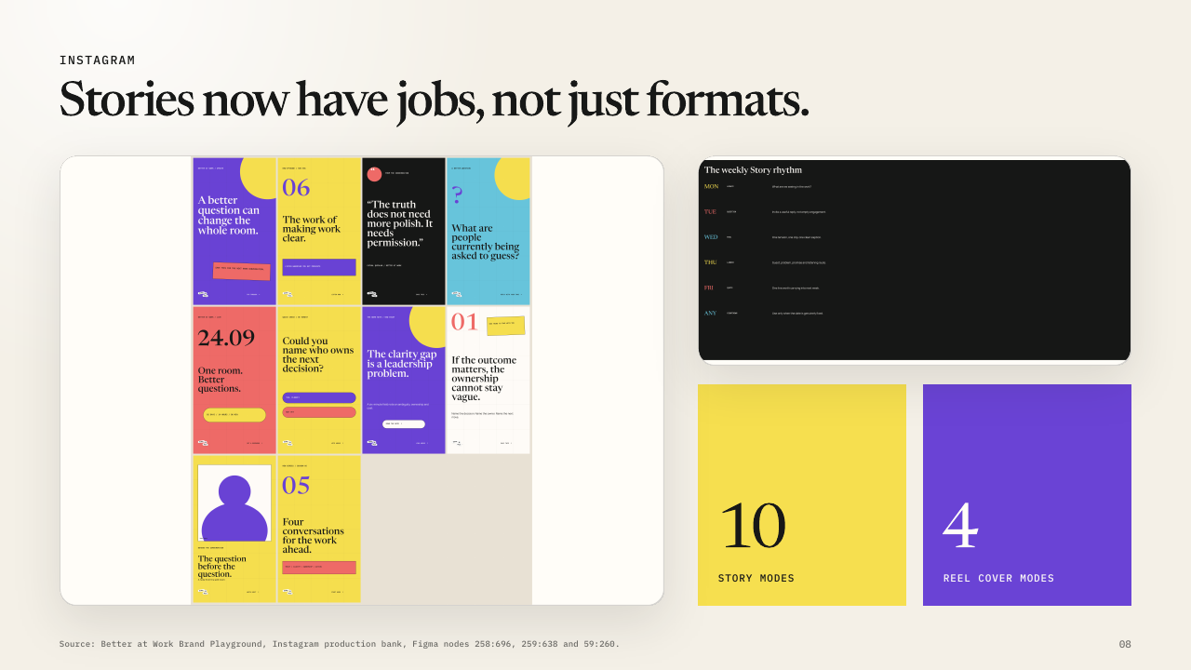
Notes:
[Sources] - https://www.figma.com/design/OMTB8YIiNcQ91Ljpzpmn2r

Slide 9
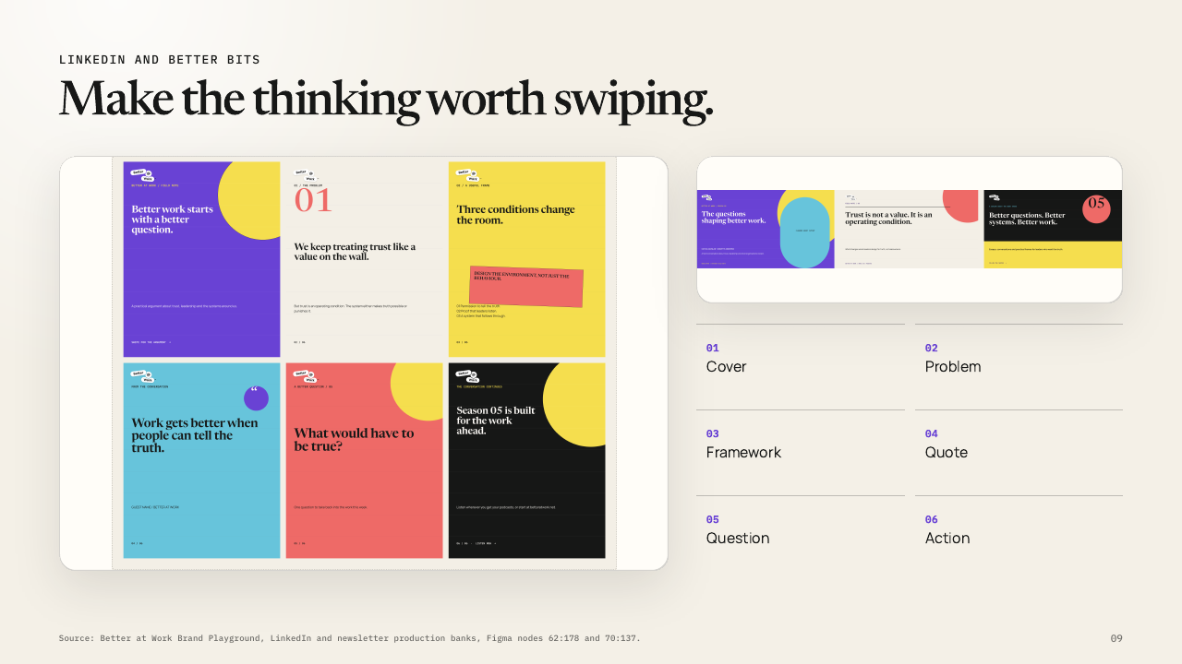
Notes:
[Sources] - https://www.figma.com/design/OMTB8YIiNcQ91Ljpzpmn2r

Slide 10
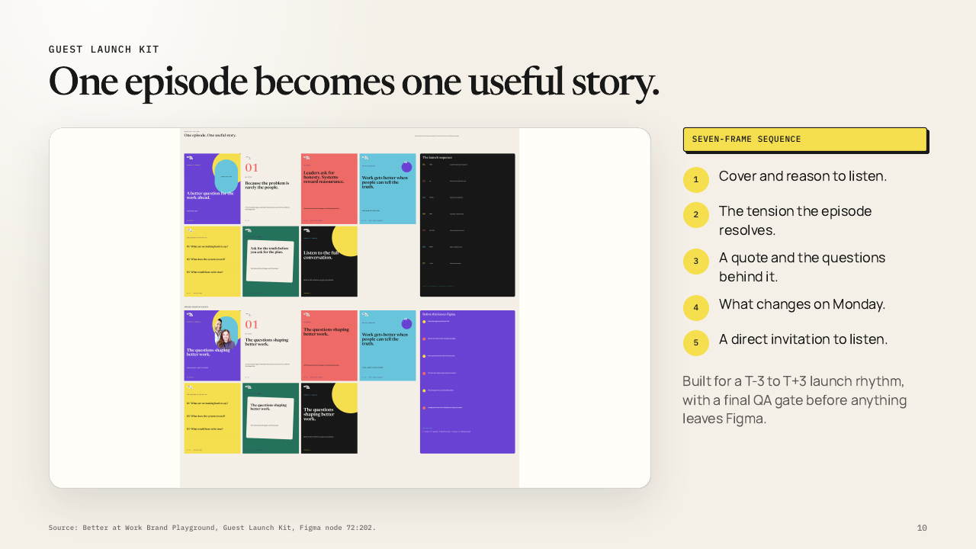
Notes:
[Sources] - https://www.figma.com/design/OMTB8YIiNcQ91Ljpzpmn2r

Slide 11
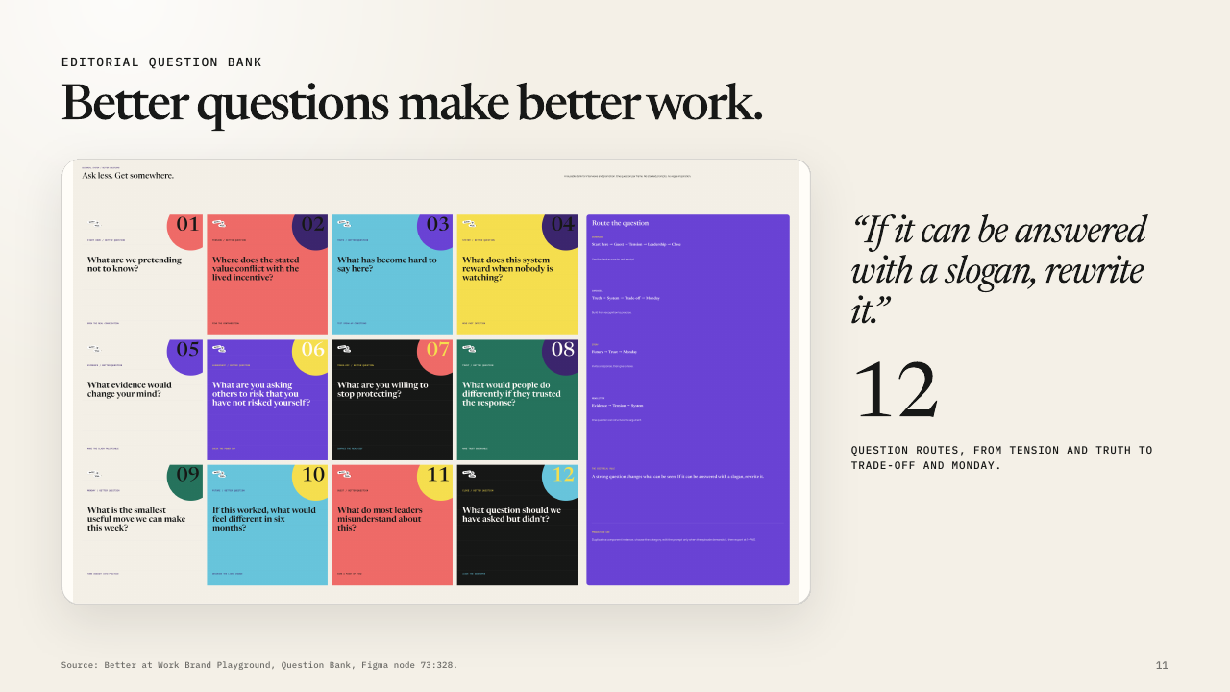
Notes:
[Sources] - https://www.figma.com/design/OMTB8YIiNcQ91Ljpzpmn2r

Slide 12
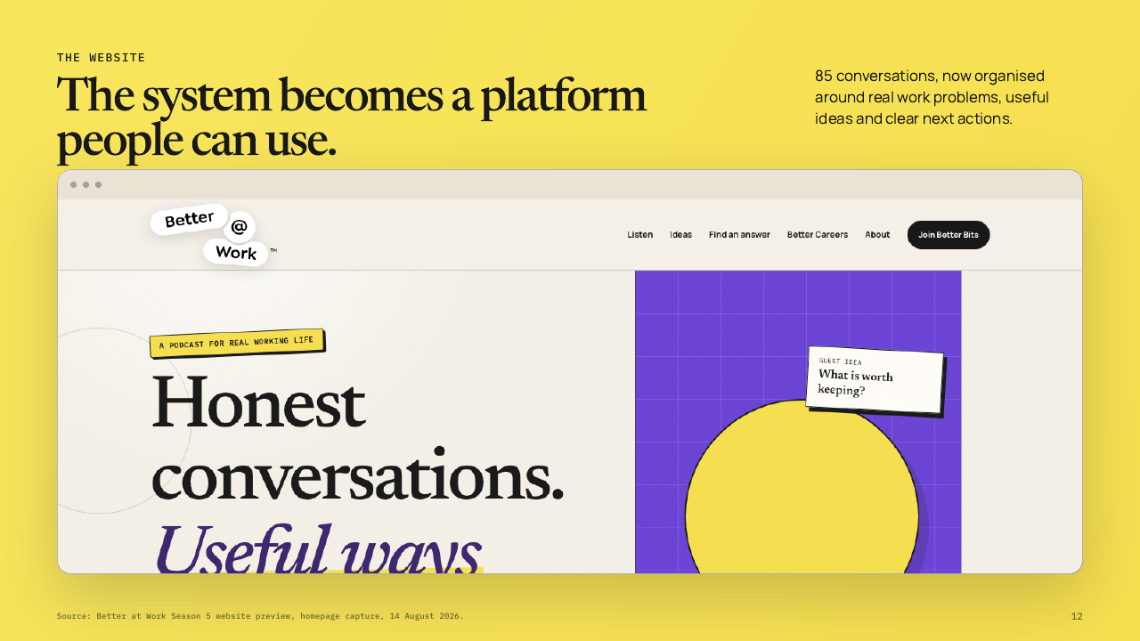
Notes:
[Sources] - https://better-at-work-frontier.vercel.app/

Slide 13
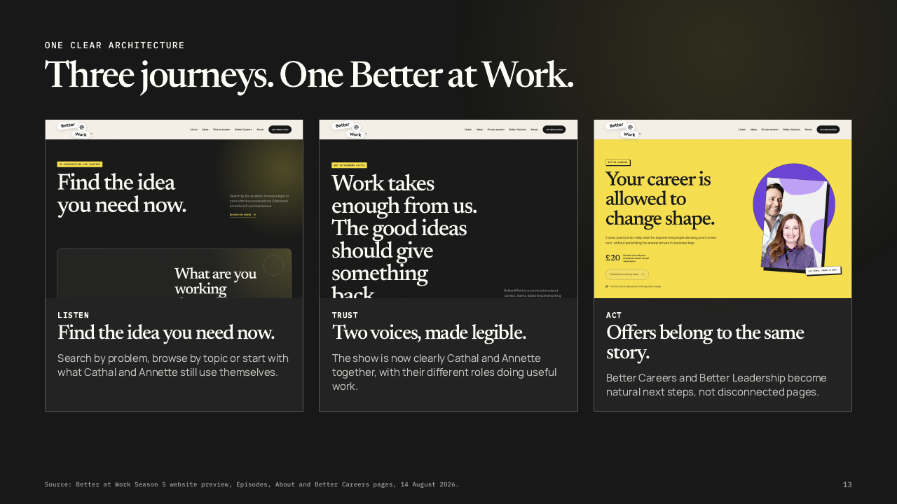
Notes:
[Sources] - https://better-at-work-frontier.vercel.app/

Slide 14
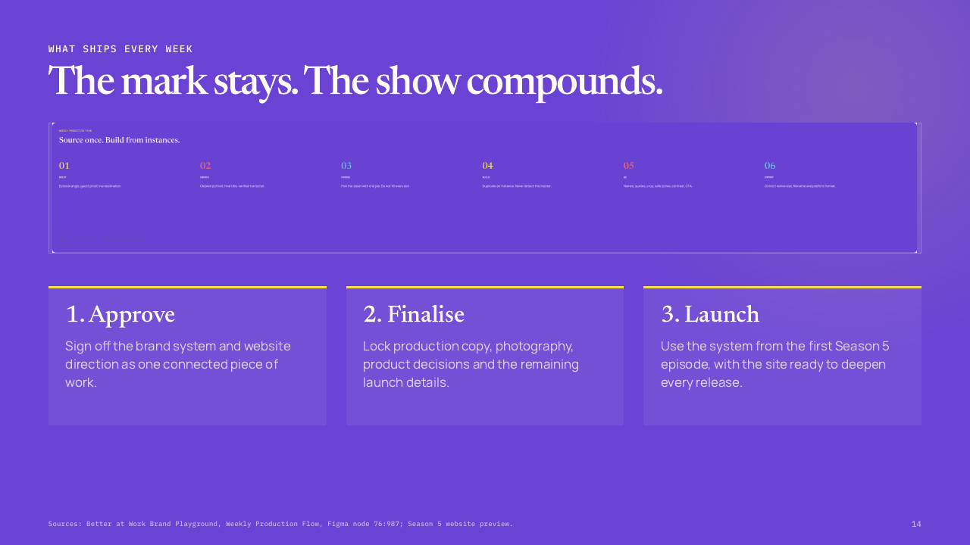
Notes:
[Sources] - https://www.figma.com/design/OMTB8YIiNcQ91Ljpzpmn2r - https://better-at-work-frontier.vercel.app/

