Slide 1
Exoplanet Science Yield sub-Working Group (ESYWG)
Advisory Committee Meeting 1: 3/21/2024

Slide 2
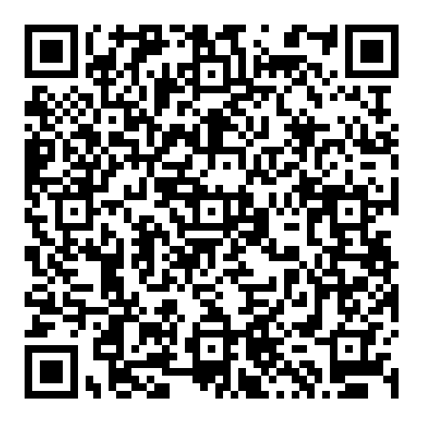
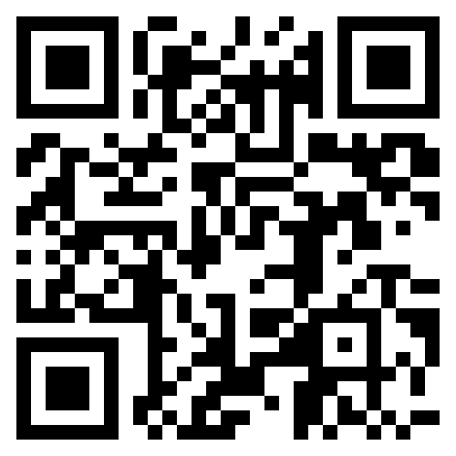
GOMAP-HWO Code of Conduct & Reporting Protocol
NASA Astrophysics Division Statement of Principles
All participants in GOMAP-HWO activities must adhere to the APD Statement of Principles
American Astronomical Society (AAS) Code of Ethics
The AAS Code of Ethics is required to be followed under the APD Statement of Principles
Reporting Protocol
Follow the procedures in the APD Statement of Principles and contact the HWO GIG
Use institutional reporting channels, as appropriate
NASA-funded individuals have access to NASA programs (Ombuds, Anti-Harassment, ODEO) and a facilitator to help navigate the various options
Code of Conduct: https://docs.google.com/document/d/1flXRhnN8aPi82BrGkPUwmidMqmk8ikFlGiMsQtkvaeo

Slide 3
Introductions
Co-Leads: Chris Stark (NASA GSFC), Dmitry Savransky (Cornell)
Yields: Rhonda Morgan (JPL), Peter Plavchan (GMU), Corey Spohn (NASA GSFC/NPP), Tiffany Glassman (Northrop)
Stars: Natalie Hinkel (LSU)
Occurrence rates: Jessie Christiansen (NExScI), Steve Bryson (NASA ARC)
Exozodi: Miles Currie (UW)
Exoplanet Models/Retrievals: Renyu Hu (JPL), Natasha Latouf (NASA GSFC NSF GRF), Avi Mandell (NASA GSFC)
Astrobiology: Niki Parenteau (NASA ARC)
Coronagraphs: Kevin Fogarty (NASA ARC), Roser Juanola-Parramon (NASA GSFC/UMBC), Lucie Leboulleux (Grenoble), Dan Sirbu (NASA ARC)
WFSC: Bruce Macintosh (UCSC), Susan Redmond (Caltech)
Telescope/systems: Stuart Shaklan (JPL)
Exposure times/Detector/Roman: Bijan Nemati (Tellus1 Scientific), Sarah Steiger (STScI)
Stray light: Charley Noecker (JPL)

Slide 4
Logistics and Resources
Google drive (WG subfolder under START/TAG shared drive: https://drive.google.com/drive/u/1/folders/1gGpR4VowDRHWzPeW_wgyKwtRreI8i43H) - Contact Chris for access
Email listserv (hwo-jwg-scs-esywg@lists.nasa.gov) - advisory committee has already been subscribed
Open question: do we kepe this for advisory committee only, or use for the full working group (perhaps with moderated sending for non-advisory committee members)?
Slack (both HWO_START_TAG and HWO_Community)
Dedicated channel on HWO_Community TBD

Slide 5
START/TAG Working Groups
START
Joint & Community
TAG
Galaxy Growth
Ravindranath & Postman
Living Worlds
Arney & Parenteau
DEIA & Mentorship
Scannapieco & TBD
Science Case Simulation
Batalha & Osten
Systems
Menzel & Shaklan
Evolution of the Elements
Lee & Scowen
Solar System in Context
Robinson & Shkolnik
GOMAP Synergies for Future Missions
Gaskin & Oschmann
Science Data Simulation
Greene & Tumlinson
Integrated Modeling
Levine & Liu
Ground-Based Astronomy in the 2030s/2040s
Lopez-Morales & Miyazaki
Communications
Schirner & Straughn
Science-Engineering Interface
Morrissey & Sitarski
Technology
Bolcar & Zhao
Space-Based Astronomy in the 2030s/2040s
Petre & Kataria
Artificial Intelligence & Machine Learning
Ansdell & Dean
Past Studies Comparison
Gaudi
Servicing
Van Campen & Grunsfeld

Slide 6
Science Case Simulation Working Groups
Science Case Simulation |  | JWG | Natasha Batalha (Ames) | Rachel Osten (STScI) | Aki Roberge | Develop codes to simulate returns from potential HWO science cases, starting with three needed to help design an integrated science modeling framework.
Science Case Simulation | Astrometry | JWG | Scott Gaudi (Ohio State) |  | Josh Pepper | Investigate performing high-precision astrometry with HWO and develop a tool to model astrometry surveys with a wide-field camera.
Science Case Simulation | Exoplanet Direct Imaging Yields | JWG | Dmitry Savransky (Cornell) | Chris Stark (GSFC) | Aki Roberge | Simulate numbers of different kinds of exoplanets found in various HWO coronagraphic imaging surveys, and work to increase the fidelity of yield modeling codes.
Science Case Simulation | Galaxy Evolution in the UV | JWG | Edmund Hodges-Kluck (GSFC) | Médéric Boquien (Université Côte d'Azur) | John O'Meara | Simulate returns from a challenging galaxy evolution science case that uses multi-object ultraviolet spectroscopy.
https://docs.google.com/spreadsheets/d/1iIKG7u2gLjxv8XdYZSA-HG84odmjvOqC_LH6Xl13Ivs

Slide 7
Liaisons to Other Working Groups/Subgroups
Science Case Simulation
Discovering Living
Worlds
Systems
Exoplanet Direct Imaging Yields
Stuart Shaklan
Natalie Hinkel
Target Stars and Systems
Niki Parenteau
Discovering Living Worlds
Bruce Macintosh
Jessie Christiansen
Dan Sirbu
Renyu Hu
Understanding the Solar System in its Galactic Context
Technology
Science Data Simulation
Characterizing Exoplanets
High-Contrast
Coronagraphs
Demographics & Architectures of Planetary Systems

Slide 8
Exoplanet Yield Modeling Working Group
Charter
Provide multiple independent estimates of scientific productivity of HWO’s exoplanet imaging instrumentation to guide START and TAG efforts.
Standardize astrophysical assumptions and calibrate exposure times/yields
Estimate the exoplanet yields obtained via high contrast imaging to:
Aid TAG efforts by benchmarking architectures, guiding and identifying key trade studies, and mapping sensitivities to bulk mission parameters
Aid START efforts by evaluating yields for different science goals/metrics, informing target selection and survey design

Slide 9
ESYWG Products
Key First Year Products
[02/2024] Establish communications w/ Sci-Eng Interface WG to define required inputs for bounding architectures
[04/2024] Exposure time benchmarking report (coordinated w/ Data Simulation WG)
[06/2024] Document summarizing all assumptions w/ links to publicly available inputs; identify necessary updates
[06/2024] List of observation/survey strategies to investigate
[07/2024] Status update at START/TAG F2F meeting
[08/2024] Assessment of ExoEarth candidate yields and sensitivities for several architecture bounding cases
[10/2024] Preliminary assessment of alternative survey strategies
[10/2024] Multi-dimensional grid of yields covering phase space of high-level mission parameters
Giver-Receivers
Inputs: stellar catalog, exoplanet occurrence rates, exozodi occurrence rates, exoplanet albedos, observational requirements, possible observational strategies/ConOps, coronagraph simulations, observatory performance parameters, overhead estimates, PSF subtraction guidance
Outputs: yield estimates for a variety of planet types, exposure time estimates, list of high priority targets, list of observations

Slide 10
Purpose of the Advisory Committee and ESYWG
Provide your expertise on relevant topics
Help set working group priorities and guide direction of work
Not to compute yields yourself (unless you really want to)
Note that we are not starting from scratch: we wish to build upon past efforts
Parallel effort: The HabWorlds Modeling and Analysis Tools Databse https://docs.google.com/spreadsheets/d/1qFcnbvsDgYE5rdY-fQ9Tsw7VcP3SEC8k/
We have two, fairly mature yield modeling codes
More are welcome, but must be provided by the community
Our goal is not to create a single definitive yield code: rather is is to standardize and record all inputs and assumptions, and to verify that we understand the sources of discrepancies in yield predictions

Slide 11
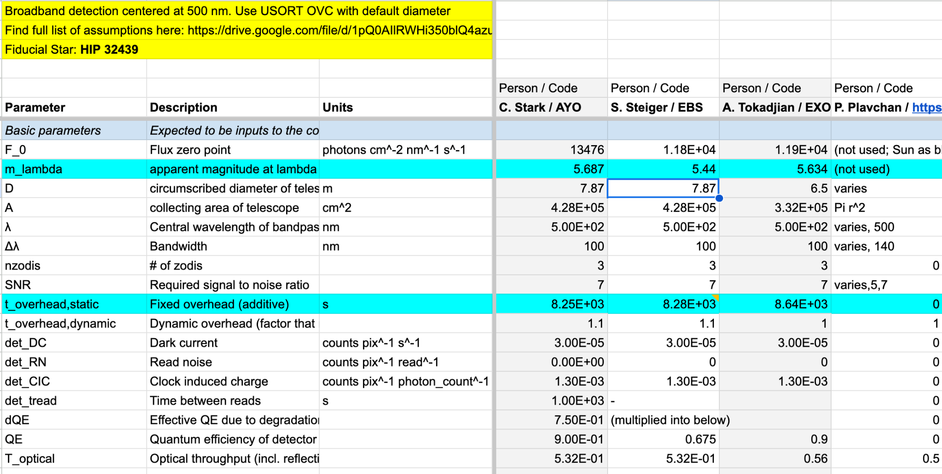
First Effort: ETC Calibration
Identify existing ETCs
Agree on common inputs
Compare outputs and intermediate calculations
https://drive.google.com/drive/u/1/folders/1iURjzKsqGG6_EXyJRNEAadZU0Rc93ZJa

Slide 12
Discussion
Additional verification/comparison efforts (e.g. exozodi, \eta_Earth, other \etas, etc.)
What else should we be doing?

