Slide 1
CDS/CTR/ESYWG Exposure Time Calibration Effort
Chris Stark
3/4/24

Slide 2
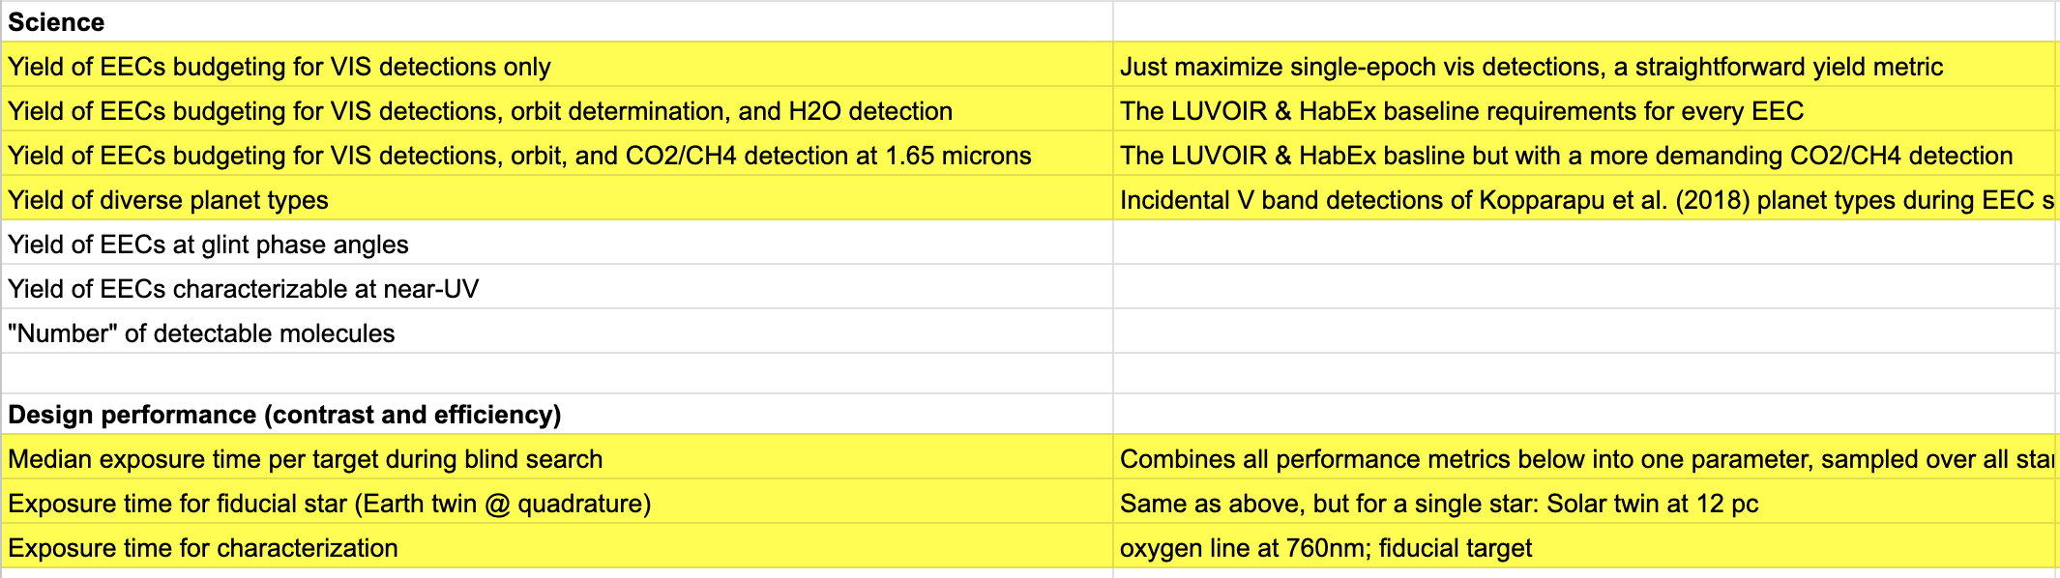
Coronagraph Design Survey
ExEP funded effort established prior to GOMAP/START/TAG
Co-chaired by Rus Belikov and Chris Stark
Data-finding survey of potential coronagraph designs for HWO
Three WGs: Robustness, Maturity, Science Performance
Report will be delivered in coming months; delivering KT matrix of metrics vs designs
Not a down-select!
Science Performance WG Tasks:

Slide 3
Coronagraph Technology Roadmap
Another coordinating ExEP study spun up prior to GOMAP/START/TAG
Co-chaired by Pin Chen and Laurent Pueyo
Developing roadmap for coronagraph tech development
Identifying possible areas of investment
Exposure time calculation for fiducial stars is part of this effort
Have generated a list of fiducial stars
START/TAG Exoplanet Science Yield WG
Co-chaired by Dmitry Savransky and Chris Stark
Just starting up now; inaugural e-mail sent last week; expect first meeting week of ~March 18
Big picture task: perform yield calculations to assist with trade studies for START/TAG efforts
First high priority task: validate exposure times between codes
CDS and CTR will wrap up soon, ESYWG will continue; exposure time calibration efforts being organized using ESYWG resources

Slide 4
CTR Fiducial Stars
ID | Dist [pc] | M_{V} | Spec Type | T_{eff} [K] | Met [dex] | Dia. [mas] | Earth-Equivalent-Insolation Ang Sep [mas] | Earth-Twin Flux Ratio | Earth-Twin RV Ampl [cm/s]
HIP 32439 HD 46588 | 18.2 | 5.4 | F8V | 6204 | -0.1 | .598 | 74.2 | 6.3E-11 | 7.1
HIP 77052 HD 140538 A (Psi Serpentis A | 14.8 | 5.9 | G5V | 5682 | 0.05 | .592 | 61.7 | 1.4E-10 | 9.7
HIP 79672 HD 146233 (18 Scorpii) | 14.1 | 5.5 | G2Va | 5785 | 0.03 | .685 | 74.0 | 1.1E-10 | 8.7
HIP 26779 HD 37394 (V538 Aurigae) | 12.3 | 6.2 | K1V | 5226 | 0.1 | .639 | 56.3 | 2.4E-10 | 11.5
HIP 113283 HD 216803 (Fomalhaut B) | 7.6 | 6.4 | K4Ve | 4601 | 0.04 | 0.853 | 58.3 | 5.9E-10 | 15.9

Slide 5
Exposure time comparison requires comparing more than exposure times
Adopt same astrophysical assumptions
Adopt same mission parameters
Adopt same observing strategy
Understand differences in exposure time calculation
Our approach:
Compare basic parameters, astrophysical fluxes, intermediate parameters, count rates, and exposure times
Have code directly print out these quantities as late as possible in the calculation
Will use this worksheet to coordinate efforts:
https://docs.google.com/spreadsheets/d/1lWHlKoCZ3ItY2lInM5CfmrySOGgzxhYx3iRpI1025Ao

Slide 6
Astrophysical Assumptions
Earth-twin at quadrature
1 Earth radius
Located at EEID
At quadrature/maximum elongation
Phase angle = 90 deg
Geometric albedo = 0.2
Lambertian phase function
3 “zodis” of dust
1 zodi = 22 mag arcsec^-2 at V band

Slide 7
Observing strategy
We will eventually compare characterization times, but we will start with detection only. We will use a different google sheet for characterization when the time comes.
Detection at 500 nm
SNR = 7
Aperture photometry (not matched filtering)
Assume noise floor term behaves a la Roman CGI calculations

Slide 8
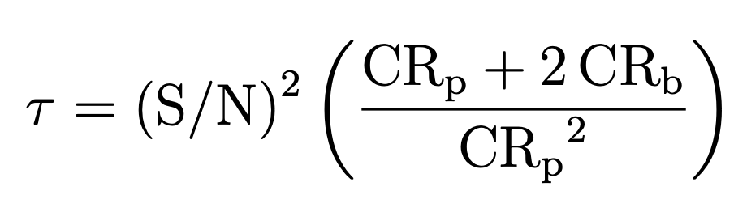
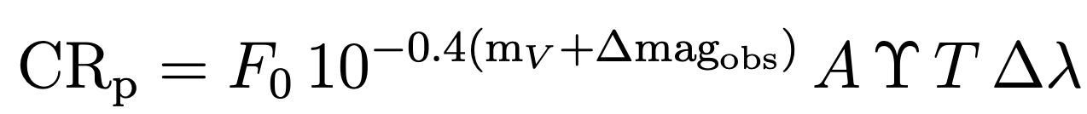
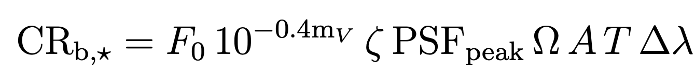
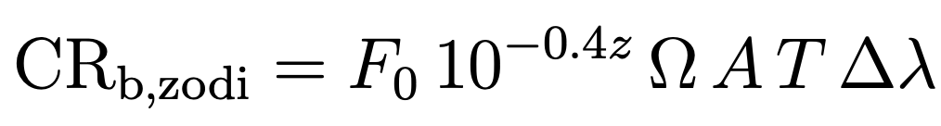
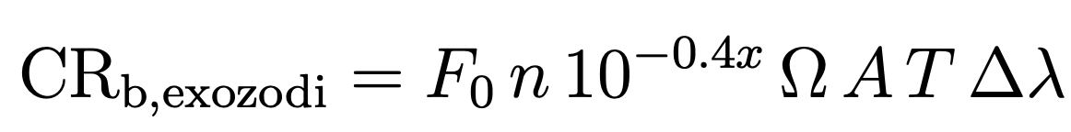
Exposure time calculations
Everyone uses slightly different forms of an exposure time equation.
We do not expect us all to adopt the same equation.
The goal is to understand how differences in exposure times relate to differences in assumptions/equation
The following are provided as an example
nf

Slide 9
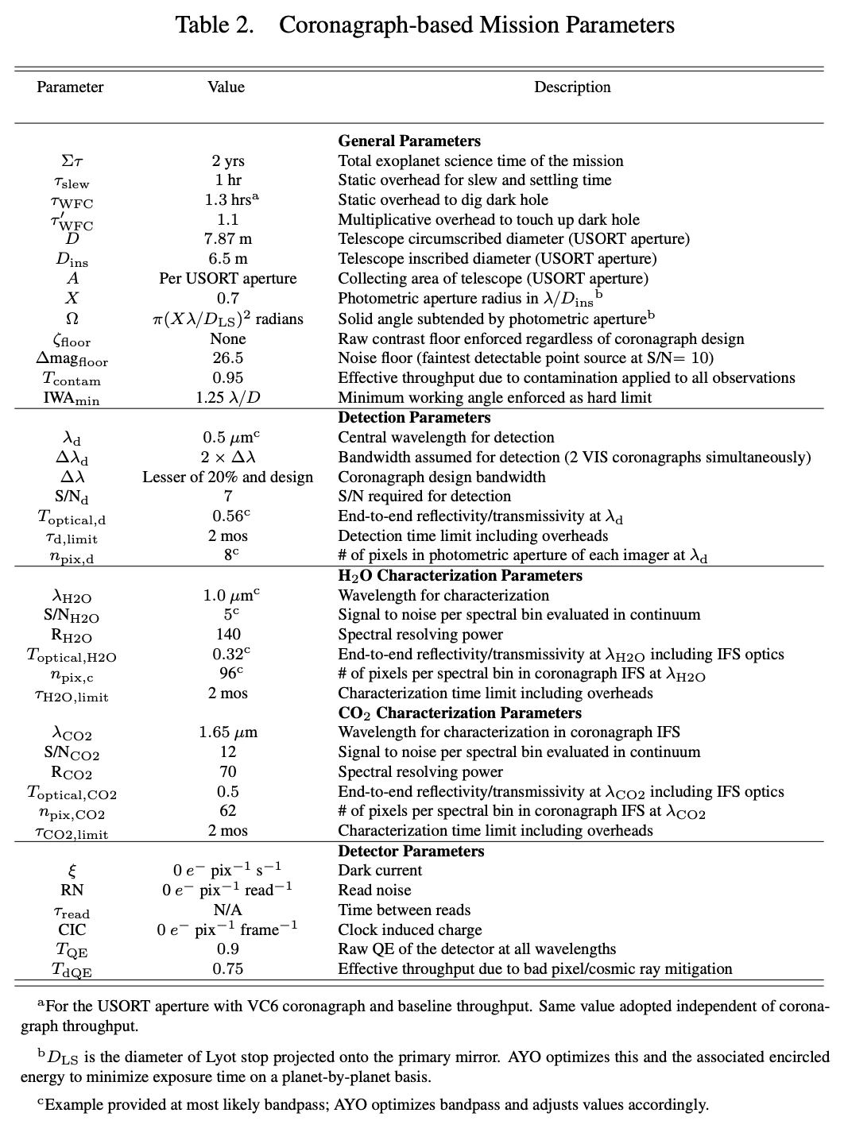
Mission Parameters
Summary document located in our google folder.
Need to update some of these parameters
Can (probably should) depart from CDS assumptions

Slide 10
Updated Noise Floor Treatment
AYO now has a systematic noise term in the exposure time equation à la Bijan Nemati
Contrast level
New
Old
Time
CR_{NF} set to the CR expected for a planet with Δmag=26.5 with X=0.3, linearly proportional to Ω
Old calculation: t = SNR² * (CR_{p} + 2*CR_{b}) / (CR_{p}²)
New calculation: t = SNR² * (CR_{p} + 2*CR_{b}) / (CR_{p}² – SNR² * CR_{NF}²)

Slide 11
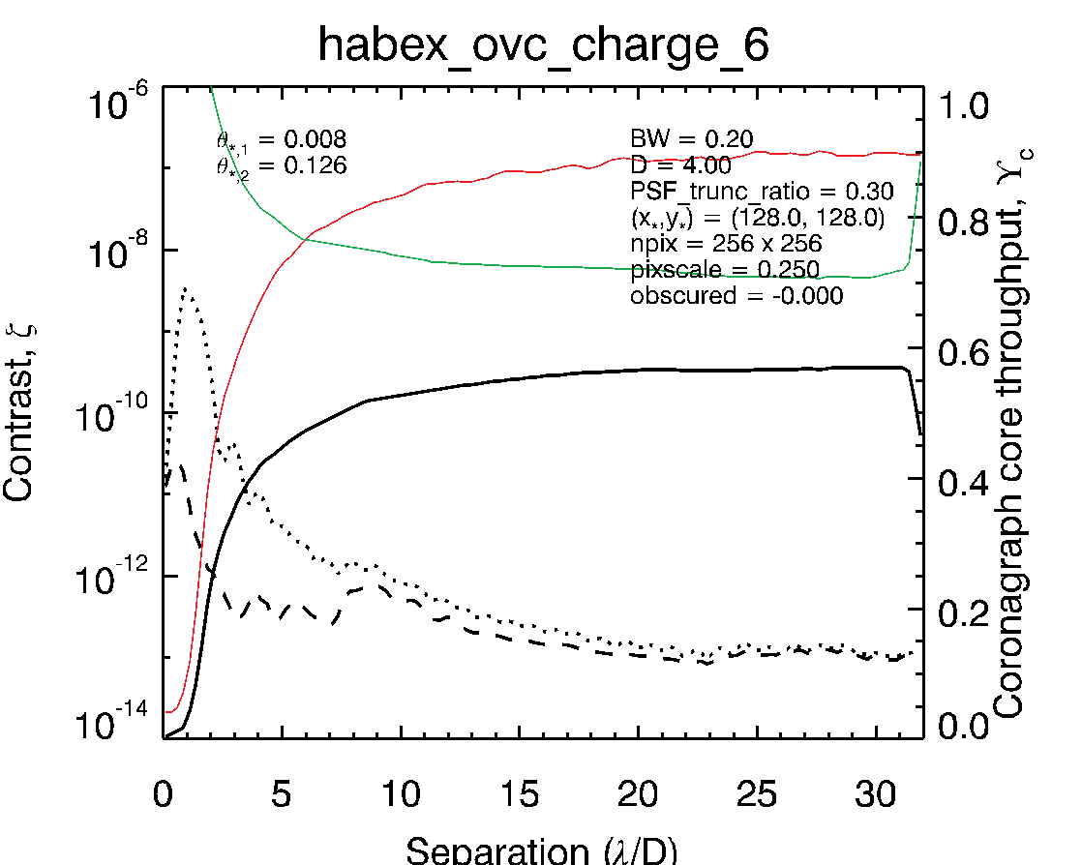
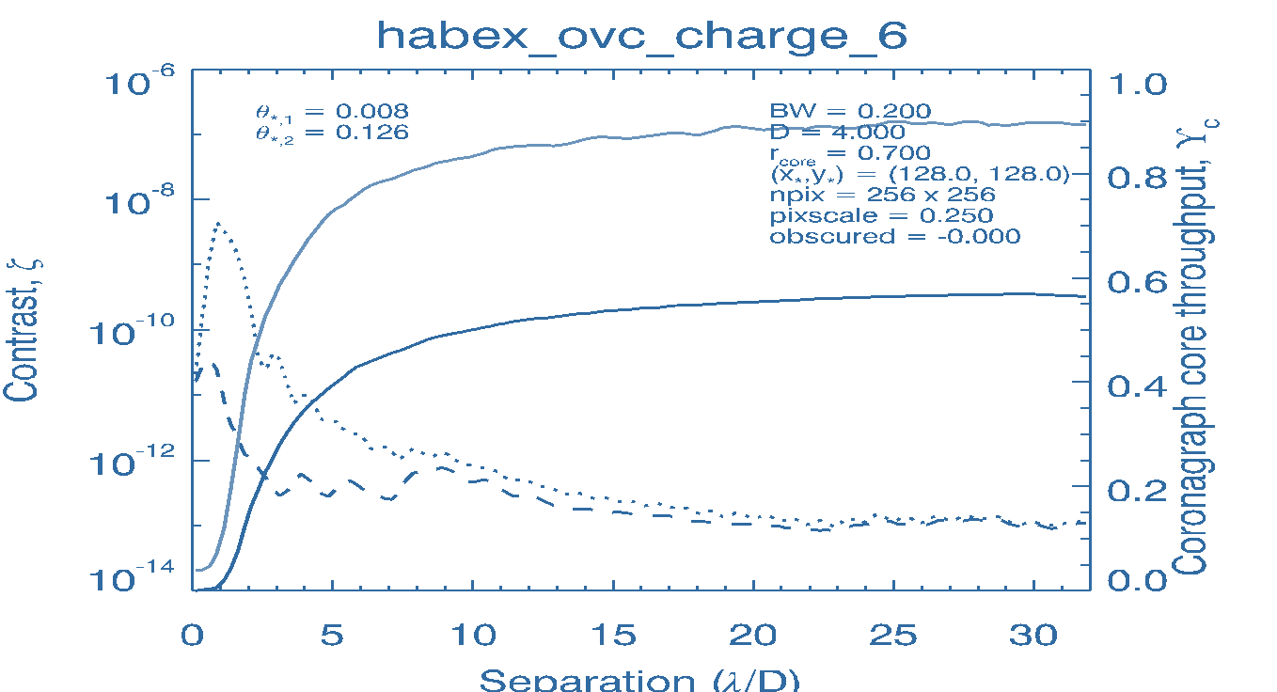
Updated Core Throughput Calculation
Blue solid line = core throughput using old method
Solid black line = core throughput using new method for X = 0.3
Green line = core Ω for X = 0.3
VC6 performance changes near the IWA. We were effectively undersizing the ideal photometric aperture near the IWA. However, this effect is minor and results in < 10% change in exposure times for background-limited objects near the IWA (b/c of the relatively broad minimum in exposure time curve on previous slide). The reason is b/c this isn’t “free throughput”—it comes at the cost of increased Ω and background. So this has a negligible affect on yield.

