Slide 1
ESYWG Full Membership Meeting
05/02/2024
Chris Stark
NASA GSFC
christopher.c.stark@nasa.gov
Dmitry Savransky
Cornell

Slide 2
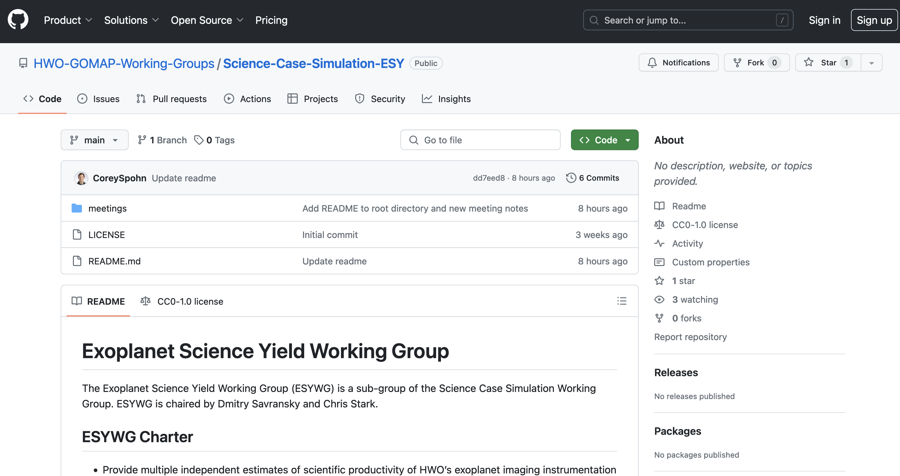
Logistics and Resources
Public Slack:
HWO_Community Slack, #esywg
Public GitHub repository:
https://github.com/HWO-GOMAP-Working-Groups/Science-Case-Simulation-ESY
Meeting notes, public documents, public code
Corey Spohn (NASA Goddard) is the POC

Slide 3
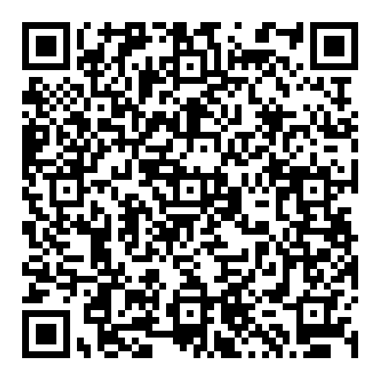
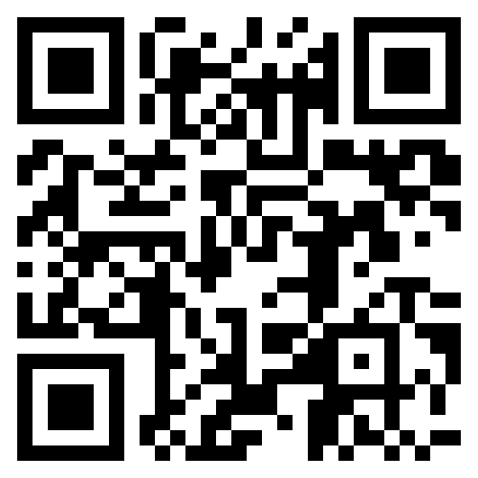
GOMAP-HWO Code of Conduct & Reporting Protocol
You must fill out the ESYWG follow-up survey to participate in this group. See e-mail.
NASA Astrophysics Division Statement of Principles
All participants in GOMAP-HWO activities must adhere to the APD Statement of Principles
American Astronomical Society (AAS) Code of Ethics
The AAS Code of Ethics is required to be followed under the APD Statement of Principles
Reporting Protocol
Follow the procedures in the APD Statement of Principles and contact the HWO GIG
Use institutional reporting channels, as appropriate
NASA-funded individuals have access to NASA programs (Ombuds, Anti-Harassment, ODEO) and a facilitator to help navigate the various options
Code of Conduct: https://docs.google.com/document/d/1flXRhnN8aPi82BrGkPUwmidMqmk8ikFlGiMsQtkvaeo

Slide 4
ESYWG Products & Timeline
Goal: CML3 by ~Jan 2025
Key First Year Products
[02/2024] Establish comms. w/ Sci-Eng Interface WG to define required inputs for bounding architectures
[04/2024] Exposure time benchmarking report (coordinated w/ Data Simulation WG)
[06/2024] Document all assumptions w/ links to publicly available inputs; identify necessary updates
[06/2024] List of observation/survey strategies to investigate
[06/2024] Status update at START/TAG F2F meeting
[08/2024] Assessment of ExoEarth candidate yields and sensitivities for several architecture bounding cases
[10/2024] Preliminary assessment of alternative survey strategies
[10/2024] Multi-dimensional grid of yields covering phase space of high-level mission parameters

Slide 5


ESYWG Products & Timeline
Goal: CML3 by ~Jan 2025
Key First Year Products
[02/2024] Establish comms. w/ Sci-Eng Interface WG to define required inputs for bounding architectures
[04/2024] Exposure time benchmarking report (coordinated w/ Data Simulation WG)
[06/2024] Document all assumptions w/ links to publicly available inputs; identify necessary updates
[06/2024] List of observation/survey strategies to investigate
[06/2024] Status update at START/TAG F2F meeting
[08/2024] Assessment of ExoEarth candidate yields and sensitivities for several architecture bounding cases
[10/2024] Preliminary assessment of alternative survey strategies
[10/2024] Multi-dimensional grid of yields covering phase space of high-level mission parameters

Slide 6

ESYWG Products & Timeline
Goal: CML3 by ~Jan 2025
Key First Year Products
[02/2024] Establish comms. w/ Sci-Eng Interface WG to define required inputs for bounding architectures
[04/2024] Exposure time benchmarking report (coordinated w/ Data Simulation WG)
[06/2024] Document all assumptions w/ links to publicly available inputs; identify necessary updates
[06/2024] List of observation/survey strategies to investigate
[06/2024] Status update at START/TAG F2F meeting
[08/2024] Assessment of ExoEarth candidate yields and sensitivities for several architecture bounding cases
[10/2024] Preliminary assessment of alternative survey strategies
[10/2024] Multi-dimensional grid of yields covering phase space of high-level mission parameters

Slide 7
Task Groups
Four Task Groups defined:
ETC Calibration TG
Lead: C. Stark (NASA Goddard)
Yield Inputs TG
Co-leads: T. Glassman (Northrop) / D. Savransky (Cornell)
Survey Strategy TG
Co-leads: N. Latouf (George Mason) / K. Fogarty (NASA Ames)
Visualizations TG
Co-leads: Sarah Steiger (STScI) / Corey Spohn (NASA Goddard)
How to participate: e-mail with sign-up sheet to come
Ideas for additional task groups? Contact Chris Stark or Dmitry Savransky

Slide 8
ETC Calibration Task Group Lead: Chris Stark (NASA Goddard)
Perform cross-model validation of existing exposure time calculators
Efforts will include:
Define standard stars, planets, and mission parameters
Generate exposure time calibration worksheet
Compare detection & characterization times as a function of spectral type
Identify differences and correct/understand them
Produce report of lessons learned
Already underway and coordinated with ExEP’s Coronagraph Design Survey and Coronagraph Technology Roadmap studies.

Slide 9
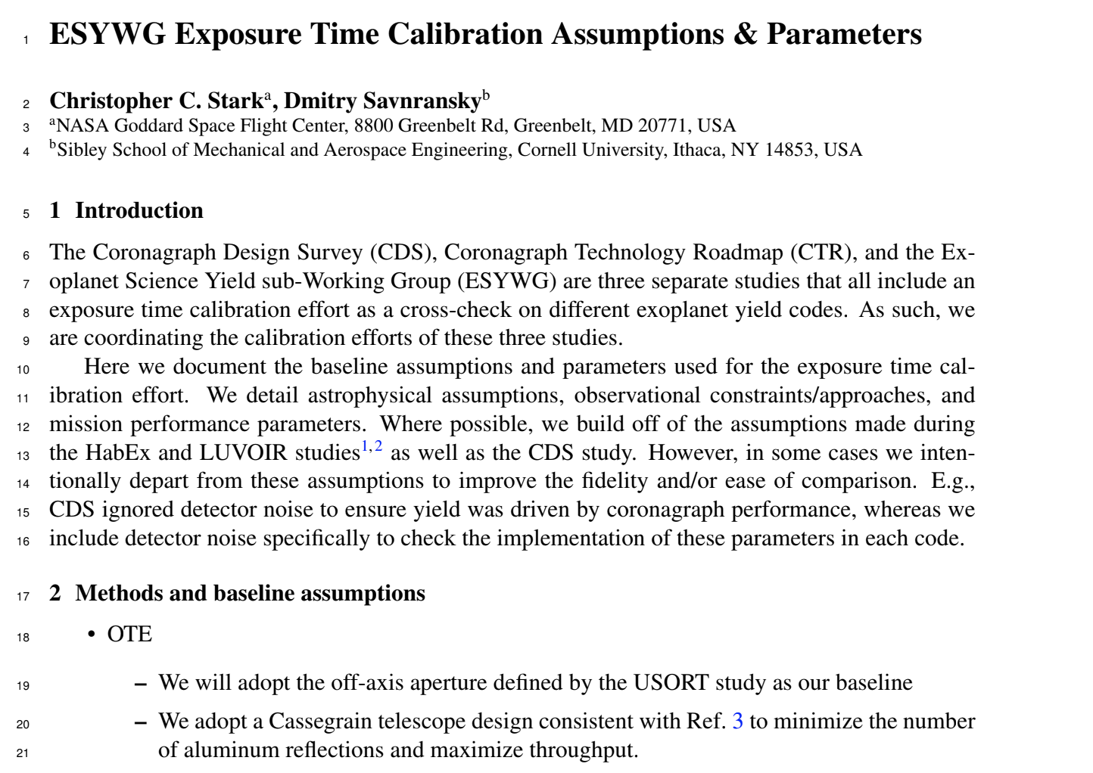
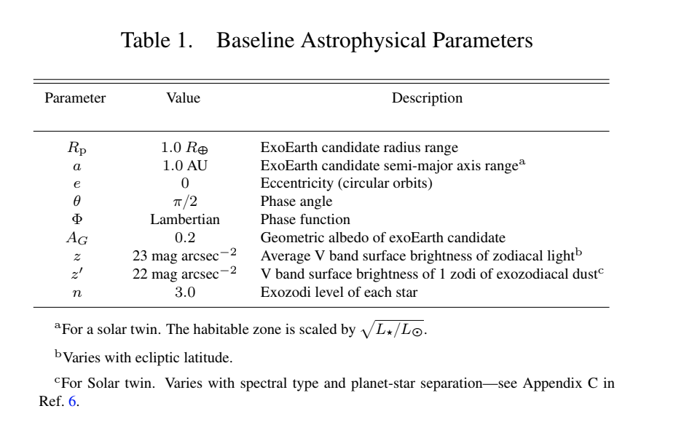
Yield Inputs Task Group Co-Leads: Tiffany Glassman (Northrop) and Dmitry Savransky (Cornell)
Update & document all yield input assumptions
Efforts will include:
Review inputs of yield codes
Review HabEx/LUVOIR assumptions
Identify those prescribed by EAC vs those that are defined by us/other WGs
Identify those that needed to be updated
Define nominal assumptions
Create clear documentation
Will be contacting WG/SG leads/liaisons for input on specific topics
Example of possible summary document

Slide 10
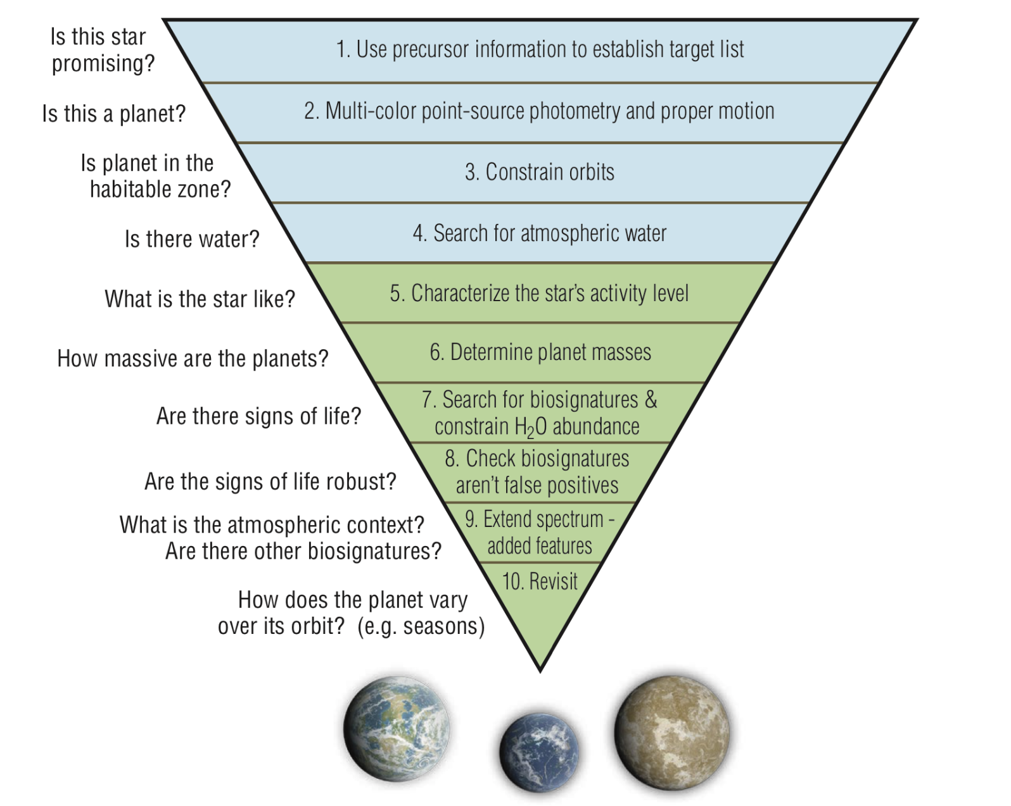
Survey Strategy Task Group Co-Leads: Kevin Fogarty (NASA Ames) and Natasha Latouf (George Mason)
Identify alternative exoplanet survey strategies for the ESYWG to simulate
Efforts will include:
Review HabEx/LUVOIR survey strategies
Identify scientific goals and observational limitations that motivated those strategies
Brainstorm alternative strategies
Define observational goals and ConOps
Identify those that are highest priority and can be easily simulated, as well as those than cannot be simulated
Document efforts
The LUVOIR order of observations

Slide 11
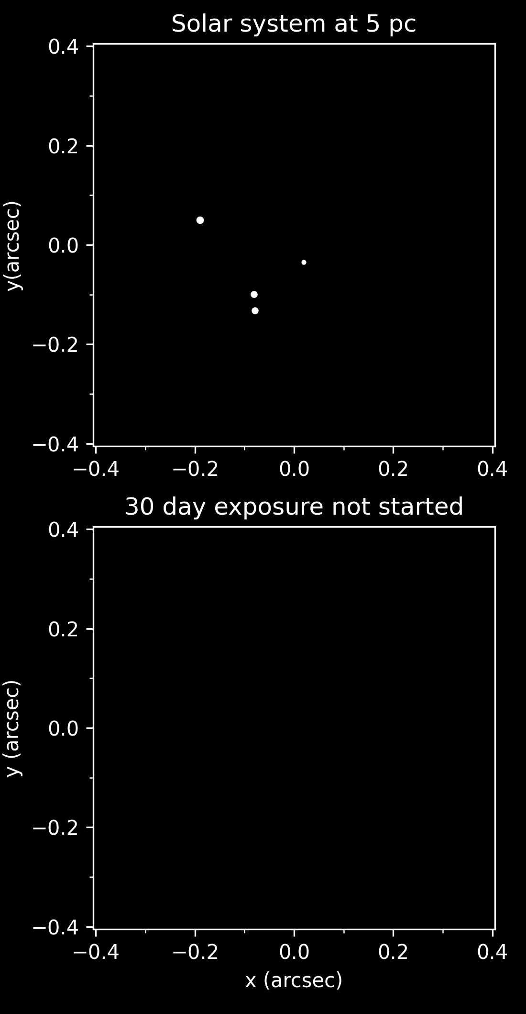
Visualizations Task Group Co-Leads: Corey Spohn (GSFC) and Sarah Steiger (STScI)
Create clear visualizations to communicate the results of the ESYWG (yields, ETC calibration efforts, mission simulations)
Efforts will include:
Review existing visualizations
Brainstorm new visualizations to aid scientists, yield calculators, and coronagraph designers
Identify high priority visualizations
Document work
Produce code that generates visualizations
Multiple avenues for participation:
Code development
Python proficiency strongly recommended
General membership
Help decide what visualizations are useful, provide suggestions on output, etc.

Slide 12
Task Group Updates

Slide 13
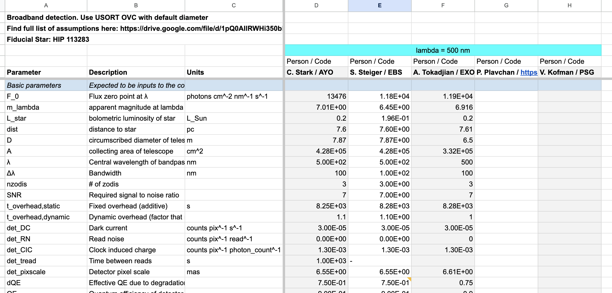
ETC Calibration Task Group Update
Members:
Sarah Steiger
Armen Tokadjian
Dmitry Savransky
Rhonda Morgan
Karl Stapelfeldt
Corey Spohn
Peter Plavchan
Pin Chen
Rus Belikov
Laurent Pueyo
Have developed calibration spreadsheet and list of standardized assumptions
https://drive.google.com/drive/u/1/folders/1iURjzKsqGG6_EXyJRNEAadZU0Rc93ZJa

Slide 14
ETC Calibration Task Group Update
Comparing exposure times and count rates for detection & characterization as a function of spectral type
Should wrap up by mid-May
Will keep all documentation for others to calibrate to later
Will produce draft report by end of May prior to June F2F
Lessons learned
Calibration document
Instructions & methods
Could host a future “hack” day?

Slide 15
Near-Term Plans

Slide 16
Near-Term Plans
[06/03/2024] Status update at START/TAG F2F meeting
Draft ETC Calibration TG Report
Rough draft of assumptions document from Yield Input TG
Brainstormed survey strategies from from Survey Strategy TG
Brainstormed visualization list from Visualizations TG

Slide 17
Featured Topic: Target Stars for HWO Direct Imaging Eric Mamajek (ExEP) Co-Chair of Target Stars and Systems sub-Working Group

