Slide 1
ESYWG Advisory Committee Meeting Please have the ESYWG google drive open on your machine
4/18/2024
Chris Stark
NASA GSFC
christopher.c.stark@nasa.gov
Dmitry Savransky
Cornell

Slide 2
Our charter
Provide multiple independent estimates of scientific productivity of HWO’s exoplanet imaging instrumentation to guide START and TAG efforts.
Standardize astrophysical assumptions and calibrate exposure times/yields
Estimate the exoplanet yields obtained via high contrast imaging to:
Aid TAG efforts by benchmarking architectures, guiding and identifying key trade studies, and mapping sensitivities to bulk mission parameters
Aid START efforts by evaluating yields for different science goals/metrics, informing target selection and survey design

Slide 3
Where is the ESYWG (in the “org chart”)?
START = Science, Technology, Architecture Review Team (the science-ish team)
TAG = Technical Assessment Group (the engineering-ish team)
START
Joint & Community
TAG
Galaxy Growth
Ravindranath & Postman
Living Worlds
Arney & Parenteau
DEIA & Mentorship
Scannapieco & TBD
Science Case Simulation
Batalha & Osten
Systems
Menzel & Shaklan
Evolution of the Elements
Lee & Scowen
Solar System in Context
Robinson & Shkolnik
GOMAP Synergies for Future Missions
Gaskin & Oschmann
Science Data Simulation
Greene & Tumlinson
Integrated Modeling
Levine & Liu
Ground-Based Astronomy in the 2030s/2040s
Lopez-Morales & Miyazaki
Communications
Schirner & Straughn
Science-Engineering Interface
Morrissey & Sitarski
Technology
Bolcar & Zhao
Space-Based Astronomy in the 2030s/2040s
Petre & Kataria
Artificial Intelligence & Machine Learning
Ansdell & Dean
Past Studies Comparison
Gaudi
Servicing
Van Campen & Grunsfeld

Slide 4
Science Case Simulation Working Groups
Science Case Simulation |  | JWG | Natasha Batalha (Ames) | Rachel Osten (STScI) | Aki Roberge | Develop codes to simulate returns from potential HWO science cases, starting with three needed to help design an integrated science modeling framework.
Science Case Simulation | Astrometry | JWG | Scott Gaudi (Ohio State) |  | Josh Pepper | Investigate performing high-precision astrometry with HWO and develop a tool to model astrometry surveys with a wide-field camera.
Science Case Simulation | Exoplanet Direct Imaging Yields | JWG | Dmitry Savransky (Cornell) | Chris Stark (GSFC) | Aki Roberge | Simulate numbers of different kinds of exoplanets found in various HWO coronagraphic imaging surveys, and work to increase the fidelity of yield modeling codes.
Science Case Simulation | Galaxy Evolution in the UV | JWG | Edmund Hodges-Kluck (GSFC) | Médéric Boquien (Université Côte d'Azur) | John O'Meara | Simulate returns from a challenging galaxy evolution science case that uses multi-object ultraviolet spectroscopy.
https://docs.google.com/spreadsheets/d/1iIKG7u2gLjxv8XdYZSA-HG84odmjvOqC_LH6Xl13Ivs

Slide 5
Our advisory committee
Co-Leads: Chris Stark (NASA GSFC), Dmitry Savransky (Cornell)
Yields: Rhonda Morgan (JPL), Peter Plavchan (GMU), Corey Spohn (NASA GSFC/NPP), Tiffany Glassman (Northrop)
Stars: Natalie Hinkel (LSU)
Occurrence rates: Jessie Christiansen (NExScI), Steve Bryson (NASA ARC)
Exozodi: Miles Currie (UW)
Exoplanet Models/Retrievals: Renyu Hu (JPL), Natasha Latouf (NASA GSFC NSF GRF), Avi Mandell (NASA GSFC)
Astrobiology: Jake Lustig-Yaeger (JHU APL)
Coronagraphs: Kevin Fogarty (NASA ARC), Roser Juanola-Parramon (NASA GSFC/UMBC), Lucie Leboulleux (Grenoble), Dan Sirbu (NASA ARC)
WFSC: Bruce Macintosh (UCSC), Susan Redmond (Caltech)
Telescope/systems: Stuart Shaklan (JPL)
Exposure times/Detector/Roman: Bijan Nemati (Tellus1 Scientific), Sarah Steiger (STScI)
Stray light: Charley Noecker (JPL)

Slide 6
Liaisons to Other Working Groups/Subgroups
Science Case Simulation
Discovering Living
Worlds
Systems
Exoplanet Direct Imaging Yields
Stuart Shaklan
Natalie Hinkel
Target Stars and Systems
Jake Lustig-Yaeger
Discovering Living Worlds
Bruce Macintosh
Jessie Christiansen
Dan Sirbu
Renyu Hu
Understanding the Solar System in its Galactic Context
Technology
Science Data Simulation
Characterizing Exoplanets
High-Contrast
Coronagraphs
Demographics & Architectures of Planetary Systems

Slide 7
Logistics and Resources
Quasi-private ESYWG Google Drive
Mostly for Advisory Committee members, Task Group members, and specific people that need access to the group’s internal documents
Contact Chris if you need access (christopher.c.stark@nasa.gov)
Advisory Committee List Serv:
hwo-jwg-scs-esywg@nasa.gov
Public Slack:
HWO_Community Slack, #esywg
Public GitHub repository:
https://github.com/HWO-GOMAP-Working-Groups/Science-Case-Simulation-ESY
Meeting notes, public documents, public code
Corey Spohn (NASA Goddard) is the POC

Slide 8
Goals, Plan of Work, & Timeline

Slide 9
ESYWG Products & Timeline
Goal: CML3 by ~Jan 2025
Key First Year Products
[02/2024] Establish comms. w/ Sci-Eng Interface WG to define required inputs for bounding architectures
[04/2024] Exposure time benchmarking report (coordinated w/ Data Simulation WG)
[06/2024] Document all assumptions w/ links to publicly available inputs; identify necessary updates
[06/2024] List of observation/survey strategies to investigate
[06/2024] Status update at START/TAG F2F meeting
[08/2024] Assessment of ExoEarth candidate yields and sensitivities for several architecture bounding cases
[10/2024] Preliminary assessment of alternative survey strategies[10/2024] Multi-dimensional grid of yields covering phase space of high-level mission parameters

Slide 10

ESYWG Products & Timeline
Goal: CML3 by ~Jan 2025
Key First Year Products
[02/2024] Establish comms. w/ Sci-Eng Interface WG to define required inputs for bounding architectures
[04/2024] Exposure time benchmarking report (coordinated w/ Data Simulation WG)
[06/2024] Document all assumptions w/ links to publicly available inputs; identify necessary updates
[06/2024] List of observation/survey strategies to investigate
[06/2024] Status update at START/TAG F2F meeting
[08/2024] Assessment of ExoEarth candidate yields and sensitivities for several architecture bounding cases
[10/2024] Preliminary assessment of alternative survey strategies[10/2024] Multi-dimensional grid of yields covering phase space of high-level mission parameters

Slide 11

ESYWG Products & Timeline
Goal: CML3 by ~Jan 2025
Key First Year Products
[02/2024] Establish comms. w/ Sci-Eng Interface WG to define required inputs for bounding architectures
[04/2024] Exposure time benchmarking report (coordinated w/ Data Simulation WG)
[06/2024] Document all assumptions w/ links to publicly available inputs; identify necessary updates
[06/2024] List of observation/survey strategies to investigate
[06/2024] Status update at START/TAG F2F meeting
[08/2024] Assessment of ExoEarth candidate yields and sensitivities for several architecture bounding cases
[10/2024] Preliminary assessment of alternative survey strategies[10/2024] Multi-dimensional grid of yields covering phase space of high-level mission parameters

Slide 12
Update on ETC Benchmarking/Cross-Model Validation

Slide 13
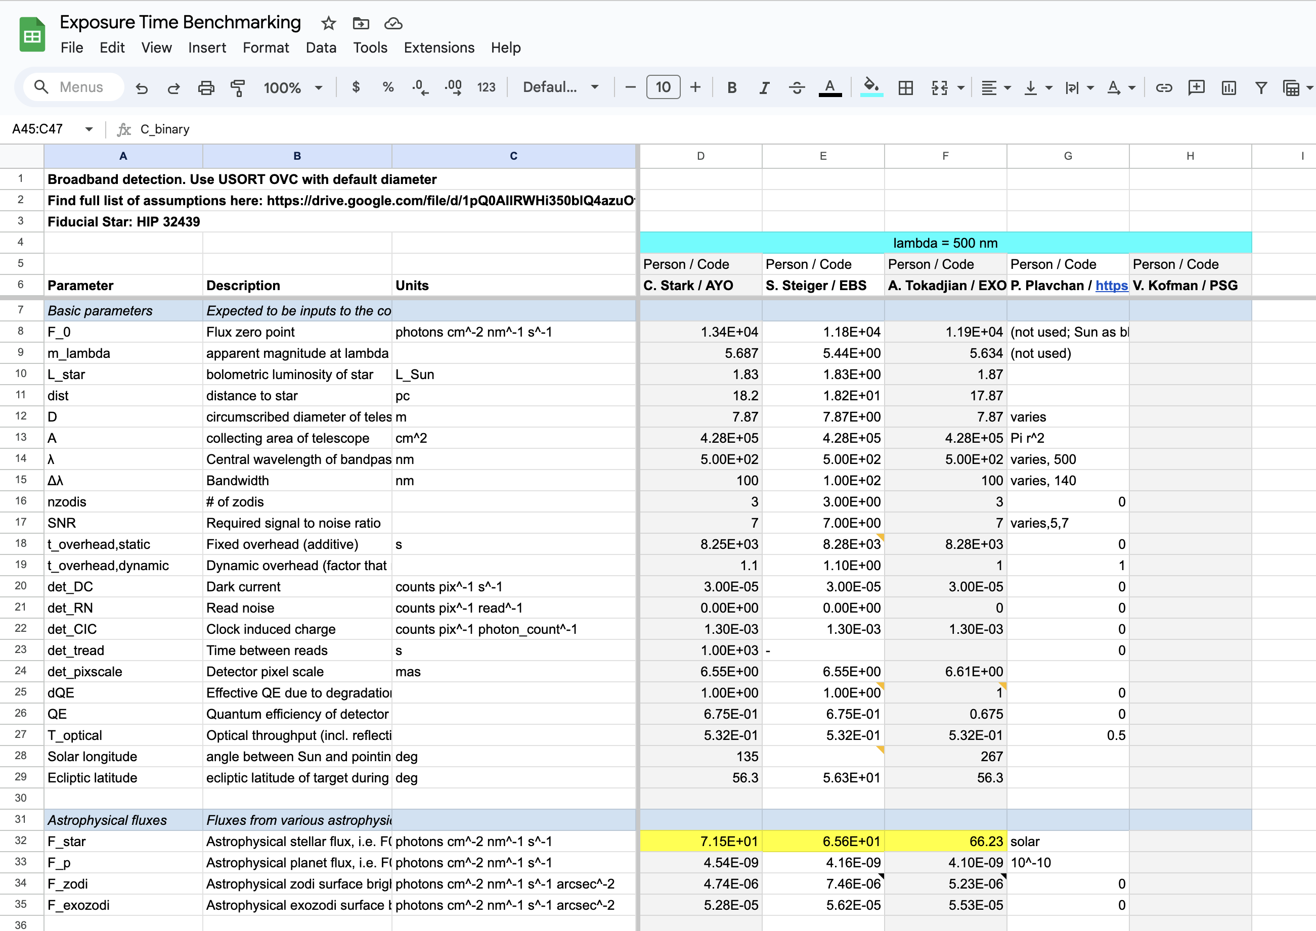
First Task: ETC Benchmarking/Cross-Model Validation
https://drive.google.com/drive/u/1/folders/1iURjzKsqGG6_EXyJRNEAadZU0Rc93ZJa
Identified existing ETCs
Defined common inputs
Comparing inputs, astrophysical fluxes, intermediate parameters, count rates, and exposure times
Working meetings every Monday @ 3:30 PM ET
Big thank you to Sarah Steiger and Armen Tokadjian

Slide 14
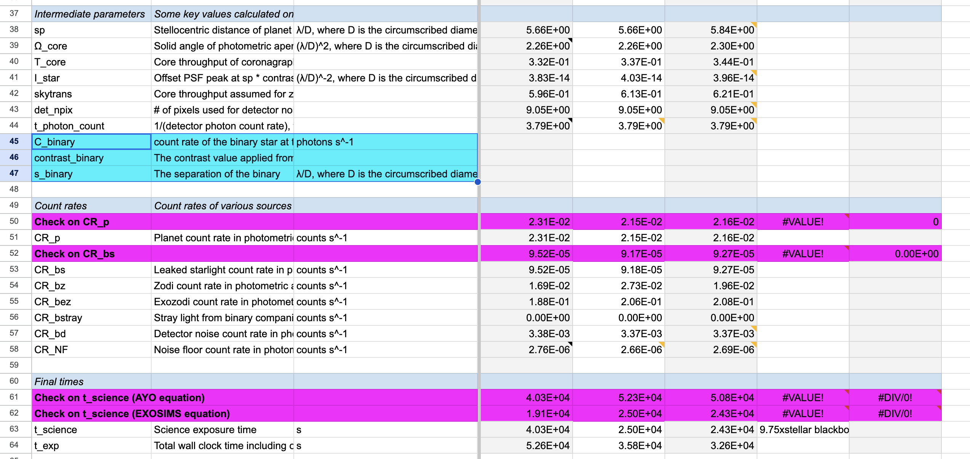
First Task: ETC Benchmarking/Cross-Model Validation
Roughly 75% done
Have agreed on all values for detection calculations for HIP 32439
Currently disagreeing on stray light from binary stars (should wrap up this week)
Will wrap up all detection issues this week
Move on to spectral characterization times
Participation in this is open to anyone interested that has an ETC to benchmark
Participation can occur later as well; benchmarking document will be kept permanently

Slide 15
First Task: ETC Benchmarking/Cross-Model Validation
Lessons learned so far:
Cross-model validation of exposure times is a very valuable but significant effort
Identified several substantial and important issues that were fixed
Provided users with greater insight into how code worked
Coronagraph exposure times calculated at reasonable fidelity is a very detailed process
We have established a method/format for cross-model validation that should greatly reduce this effort in the future
There will always be differences between codes due to slightly different treatments (e.g. stellar fluxes)
Understanding the reason for disagreements is sometimes more important than addressing them
Agreement to the tens of percent level should be considered success
There are some areas where we yield codes could improve and adopt consistent defintions/inputs (e.g., D vs D_{inscribed}, PSF evaluations at large λ/D, target list)
SEI will help with this
Having multiple exposure time calculators is a good way to cross-check results, identify issues, and check for consistency w/ inputs
We should repeat this validation effort infrequently in the future

Slide 16
ESYWG Products & Timeline
Goal: CML3 by ~Jan 2025
Key First Year Products
[02/2024] Establish comms. w/ Sci-Eng Interface WG to define required inputs for bounding architectures
[04/2024] Exposure time benchmarking report (coordinated w/ Data Simulation WG)
[06/2024] Document all assumptions w/ links to publicly available inputs; identify necessary updates
[06/2024] List of observation/survey strategies to investigate
[06/2024] Status update at START/TAG F2F meeting
[08/2024] Assessment of ExoEarth candidate yields and sensitivities for several architecture bounding cases
[10/2024] Preliminary assessment of alternative survey strategies[10/2024] Multi-dimensional grid of yields covering phase space of high-level mission parameters

Slide 17
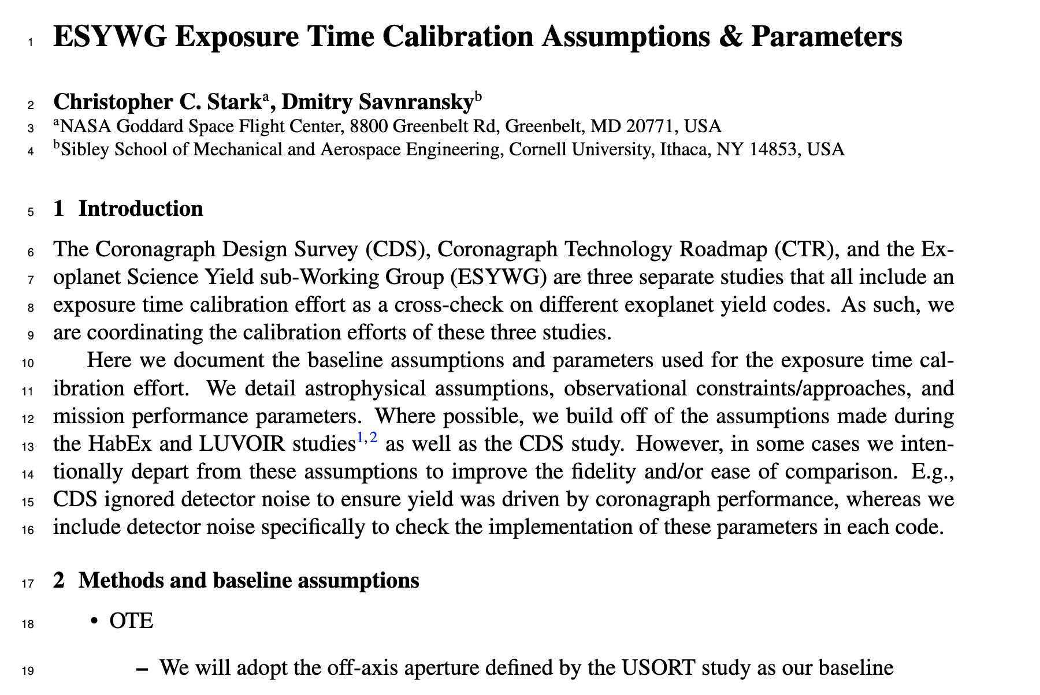
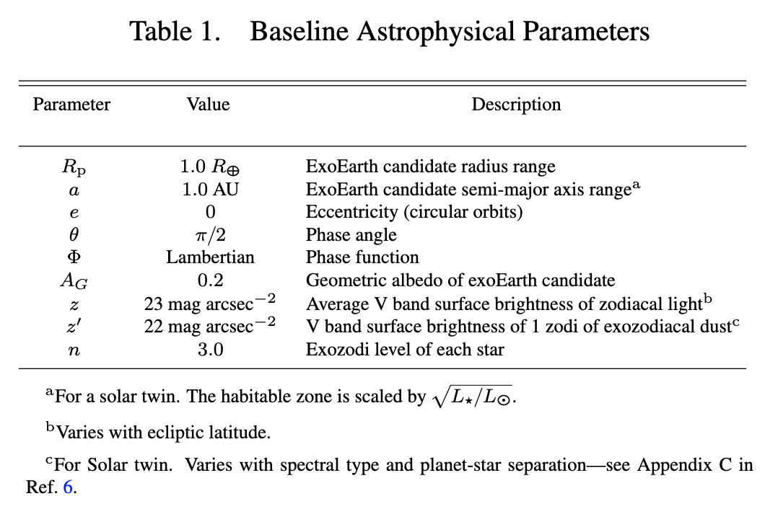
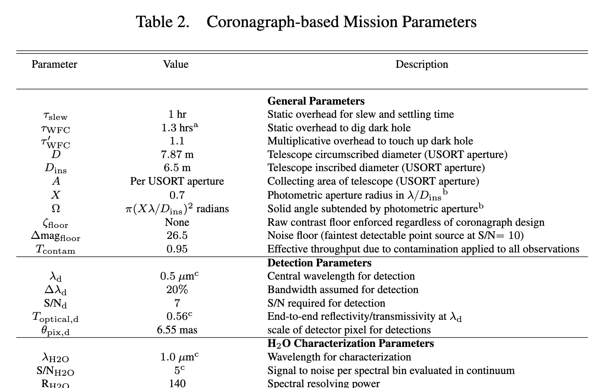
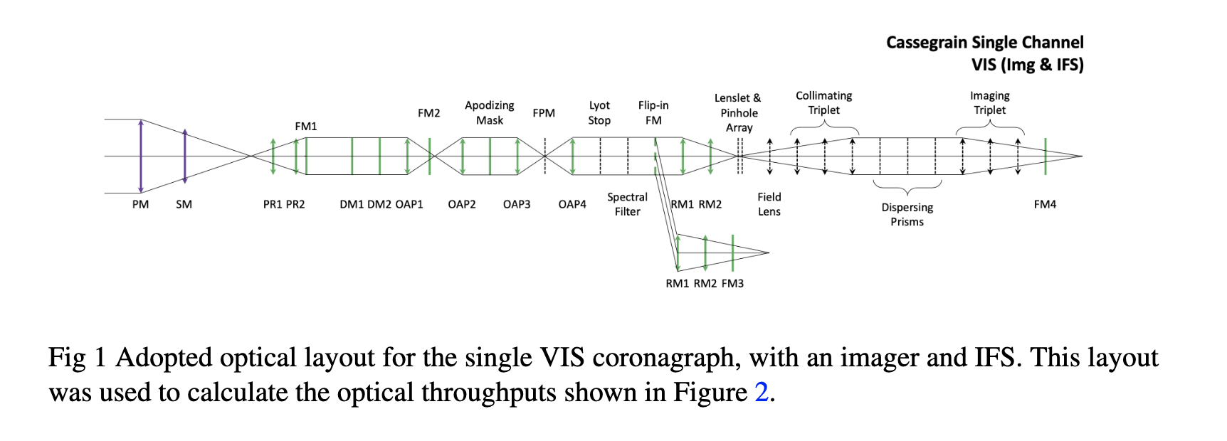
Documenting assumptions
Draft is in the ESYWG folder/Exposure Time Benchmarking

Slide 18
Discussion
What are the goals of the document?
Thoughts on format/how we will deliver it?
What to include? Are we missing something?
What specifically needs updating since LUVOIR/HabEx?

Slide 19
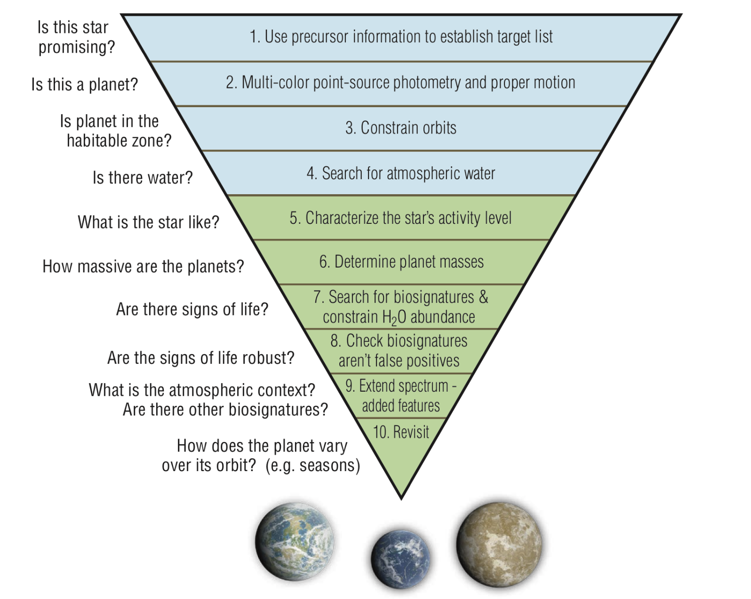
Observation/Survey Strategies
LUVOIR & HabEx assumed multiple photometric detections to measure exoEarth orbits, then spectral characterization to search for water, then harder stuff...
Alternatives? Changes?
E.g., look for H2O + O2 simultenaously
Go straight for spectra
Etc.

Slide 20
Task Groups
Yield Input Parameters Task Group
[04/2024] Establish task group focused on EAC/CEC parameters and mission performance assumptions
Review all astrophysical assumptions starting from HabEx/LUVOIR reports
Review survey strategies adopted in HabEx/LUVOIR reports
Make publicly available inputs accessible
Identify gaps in inputs
[06/2024] Deliver draft document of assumptions
Observation Strategy Task Group
[06/2024] Deliver list of observation/survey strategies to investigate
Visualization Task Group (suggested by Bruce Macintosh)
Create list of possible visualizations desired from yield code and prioritize
Create code to produce visualizations?

Slide 21
Task Groups
Other ideas?
Thoughts on how to solicit participation/choose task leads?

