Slide 1


Recap

Slide 2
→ Research Topics
→ Concepts
→ Implementation

Slide 3
Research Topics
Competitor Analysis → Comparing features with Translue Goals
Different Approaches on AI Text Recognition → Research best fitting methods for Translue‘s use case
How to build an AI – Constructing a pipeline:
→ Gathering useful technologies to build a toolkit for a tech-stack on mobile
→ Cutting-edge research
→ Element Identification
→ Tracking Technology

Slide 4
→ Research Topics
→ Concepts
→ Implementation

Slide 5
Concepts
Contextual Segmentation: → Grouping and arranging detected integral texts in reading order to produce contextual text blocks
Image Scaler: → Resizing or cropping images to have uniform dimensions
Feature Extraction Unit: → Convolutional neutral network to locate image patches with text
Integral Embedding Extractor: → Learning visual and contextual Feature embeddings for each detected integral text unit
Character Classification Unit: → Convolutional neutral network to find characters in obtained image patches

Slide 6
→ Research Topics
→ Concepts
→ Implementation

Slide 7
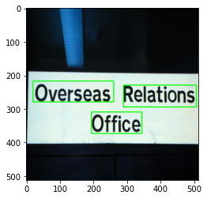
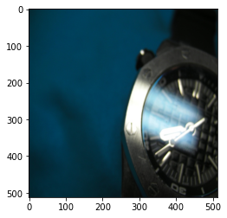
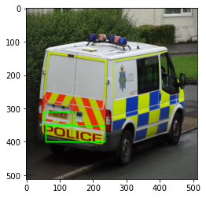
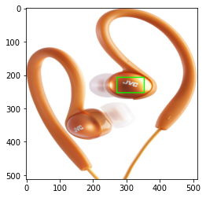
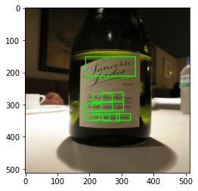
Implementation - First Review

Slide 8

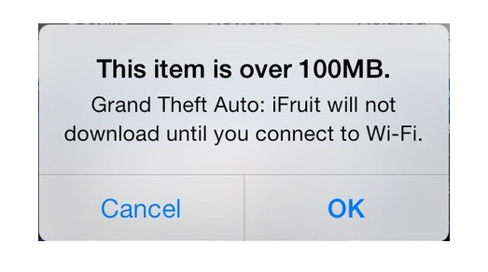
Implementation
Training AI: -> Supervised Learning -> Running through dataset (ICDAR) with reshuffled 461 images
Pruning and Quantization: -> Significantly and effectively reducing the number of parameters -> Lowering memory demands -> Raising Performance all while maintaining accuracy

Slide 9
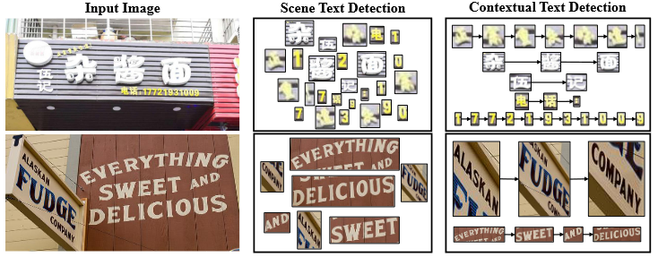
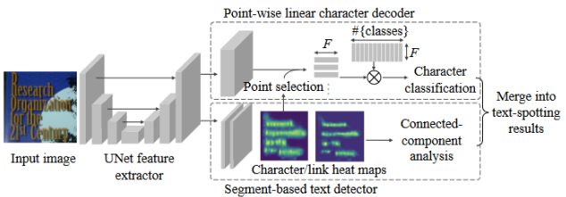
Implementation - Possible improvements
→ ? →

Slide 10
More Papers!
Our decisions were largely driven by recent advances in ML/AI
Model Compression and Hardware Acceleration for Neural Networks: A Comprehensive Survey [Deng et al., IEEE 2020]
You Only Look Once: Unified, Real-Time Object Detection [Redmon et al., IEEE 2015]
Learning Both Weights and Connections for Efficient Neural Network [Han et al., NeurIPS 2015]
And more! All referenced in ClickUp! Also interesting, yet too recent:
RGB no more: Minimally-decoded JPEG Vision Transformers [Park et al., NeurIPS 2022 (November 29th)]

Slide 11
Thank You!

