Slide 1
SOCIAL ENGINEERING
0

Slide 2
Introduction to Social Engineering
1
What is it and why is it important?

Slide 3
The psychology behind an attack
Reciprocity

Slide 4
The psychology behind an attack
Reciprocity
Commitment & Consistency

Slide 5
The psychology behind an attack
Reciprocity
Commitment & Consistency
Social Proof

Slide 6
The psychology behind an attack
Reciprocity
Commitment & Consistency
Social Proof
Authority

Slide 7
The psychology behind an attack
Reciprocity
Commitment & Consistency
Social Proof
Authority
Liking

Slide 8
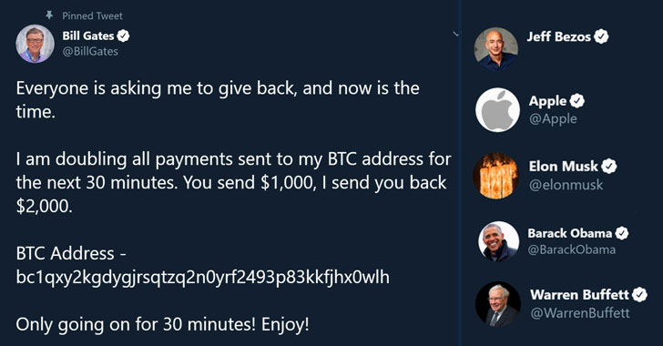
Twitter

Slide 9
Social Engineering vectors
3
There are 4 key social engineering vectors and several other concepts

Slide 10
Key vectors
Phishing

Slide 11
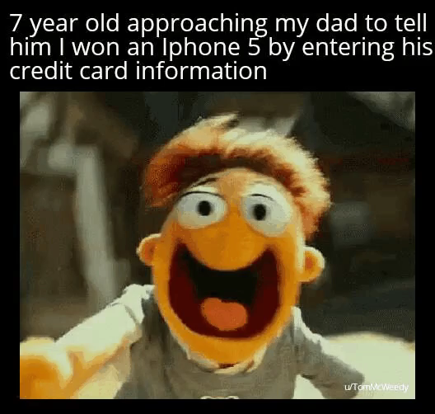

Slide 12
Key vectors
Phishing
Vishing

Slide 13
Key vectors
Phishing
Vishing
Smishing

Slide 14
Key vectors
Phishing
Vishing
Smishing
Impersonation

Slide 15
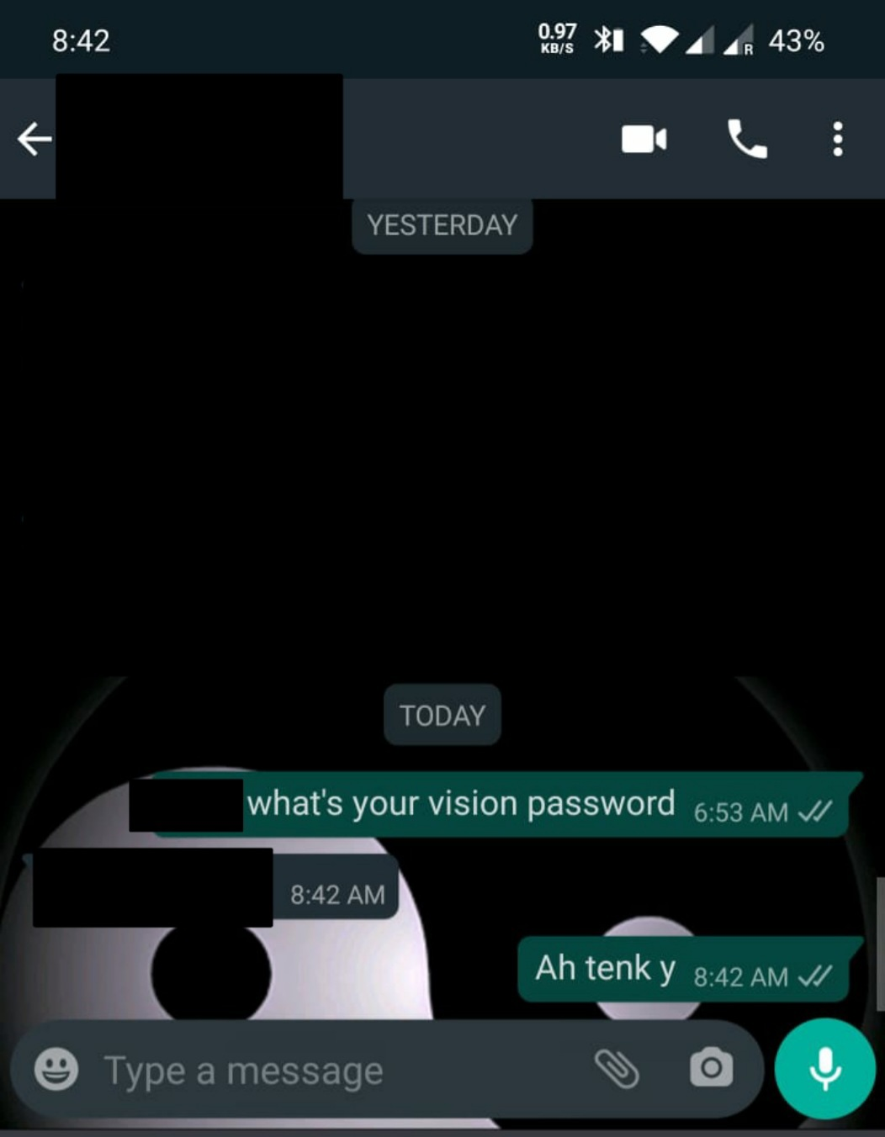
Heriot Watt Tech Club

Slide 16
Other concepts
Pretexting
Water Holing
Scareware
Baiting

Slide 17
297 .
290 (98%) .
135 (45%) .
Drives dropped
Drives picked up
Called home!

Slide 18

Shorebreak Security
No-fail Test

Slide 19
Shorebreak Security
No-fail Test
Domain Test

Slide 20
Other concepts
Quid Pro Quo

Slide 21
Other concepts
Quid Pro Quo
Tailgating

Slide 22
Other concepts
Quid Pro Quo
Tailgating
Dumpster Diving

Slide 23
Other concepts
Quid Pro Quo
Tailgating
Dumpster Diving
Spear Phishing

Slide 24
Effectiveness of Spear Phishing
 | Phishing | Spear Phishing
Opening Email | 3% | 70%
Successful Attack | 5% | 50%

Slide 25

TestArmy CyberForces

Slide 26
Prevention
12
Looking at prevention on a corporate and individual level

Slide 27
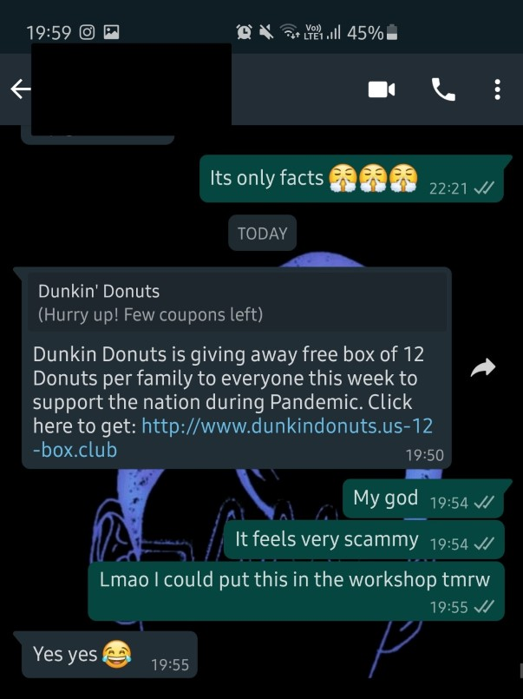

Slide 28
The Corporate Level
Training Employees

Slide 29
The Corporate Level
Training Employees
Establishing Frameworks of Trust

Slide 30
The Corporate Level
Training Employees
Establishing Frameworks of Trust
Scrutinizing Information

Slide 31
The Corporate Level
Training Employees
Establishing Frameworks of Trust
Scrutinizing Information
Testing & Reviewing

Slide 32
The Corporate Level
Training Employees
Establishing Frameworks of Trust
Scrutinizing Information
Testing & Reviewing
Waste Management

Slide 33
The Individual Level
Avoid emails and attachments from suspicious sources

Slide 34
The Individual Level
Avoid emails and attachments from suspicious sources
Use multifactor authentication

Slide 35
The Individual Level
Avoid emails and attachments from suspicious sources
Use multifactor authentication
Be wary of tempting offers

Slide 36
The Individual Level
Avoid emails and attachments from suspicious sources
Use multifactor authentication
Be wary of tempting offers
Keep software updated

Slide 37
The Individual Level
Avoid emails and attachments from suspicious sources
Use multifactor authentication
Be wary of tempting offers
Keep software updated
Don’t trust strangers online

Slide 38
The Individual Level
Avoid emails and attachments from suspicious sources
Use multifactor authentication
Be wary of tempting offers
Keep software updated
Don’t trust strangers online
High spam filters

Slide 39
Conclusion
15

Slide 40
THANKS!
Any questions?
You can find me at:
pc59@hw.ac.uk

Slide 41
Credits
Special thanks to all the people who made and released these awesome resources for free:
Presentation template by SlidesCarnival
Illustrations by Sergei Tikhonov
Photographs by Unsplash

