Slide 1
Forecasting ESG score Based on 10-K Annual Reports
20240419 TEN MFS.key

Slide 2
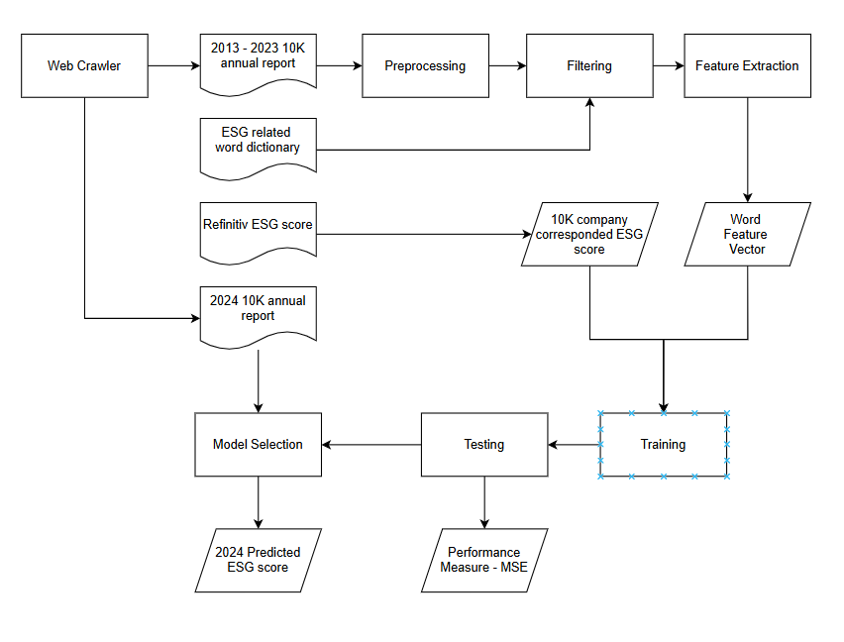
Flow Chart
Reference

Slide 3
Experiment
Extracting items from 10K dataset
Extract specific industry from 10K dataset
Different method for producing word vector

Slide 4
Thanks for listening
Title

