Slide 1
Map, Food, & Smiles
Hampus Fink Gärdström
20240419 TEN MFS.key

Slide 2
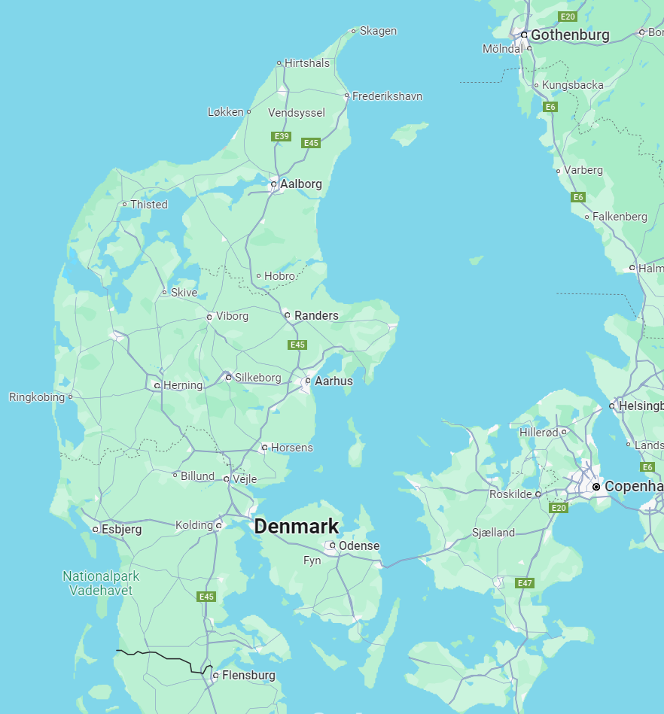
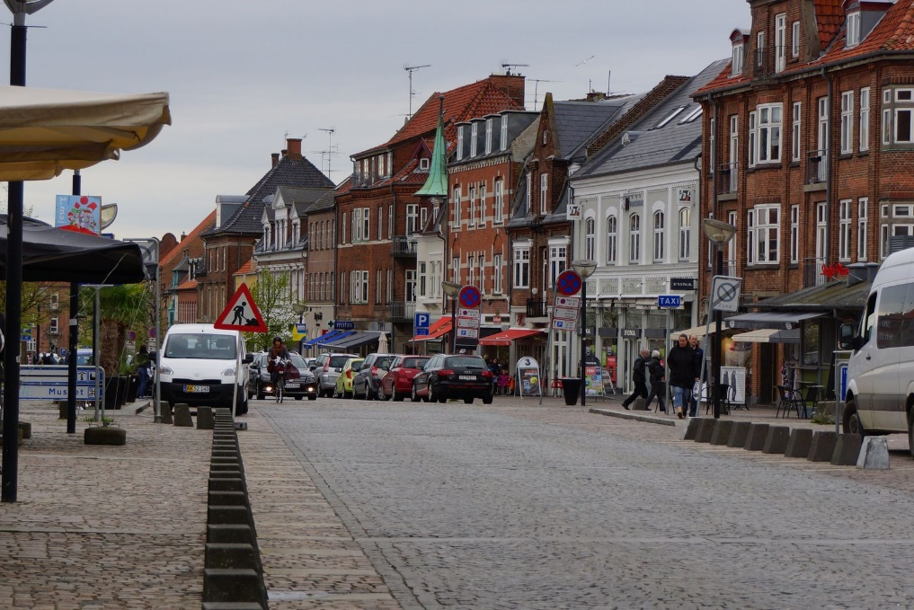
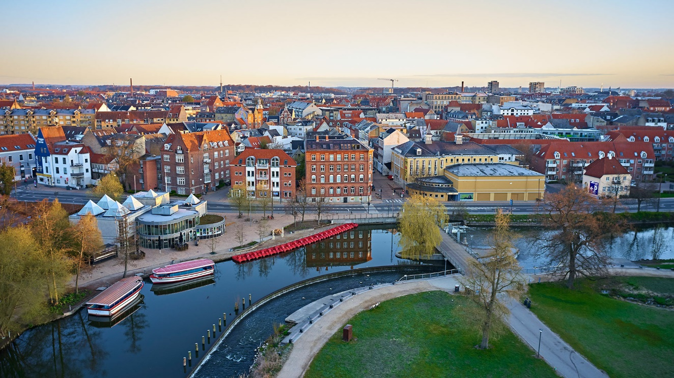


Maps
2001-2020: Holbæk, Denmark
2020-Present: SDU at Odense
Title

Slide 3
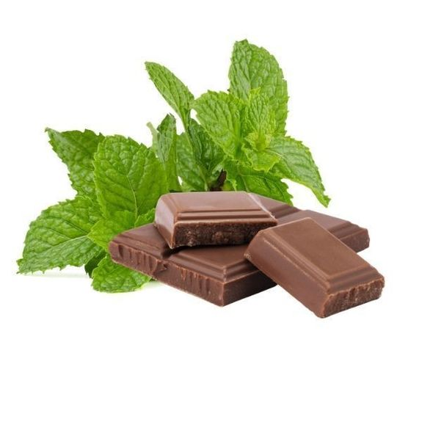
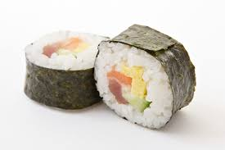
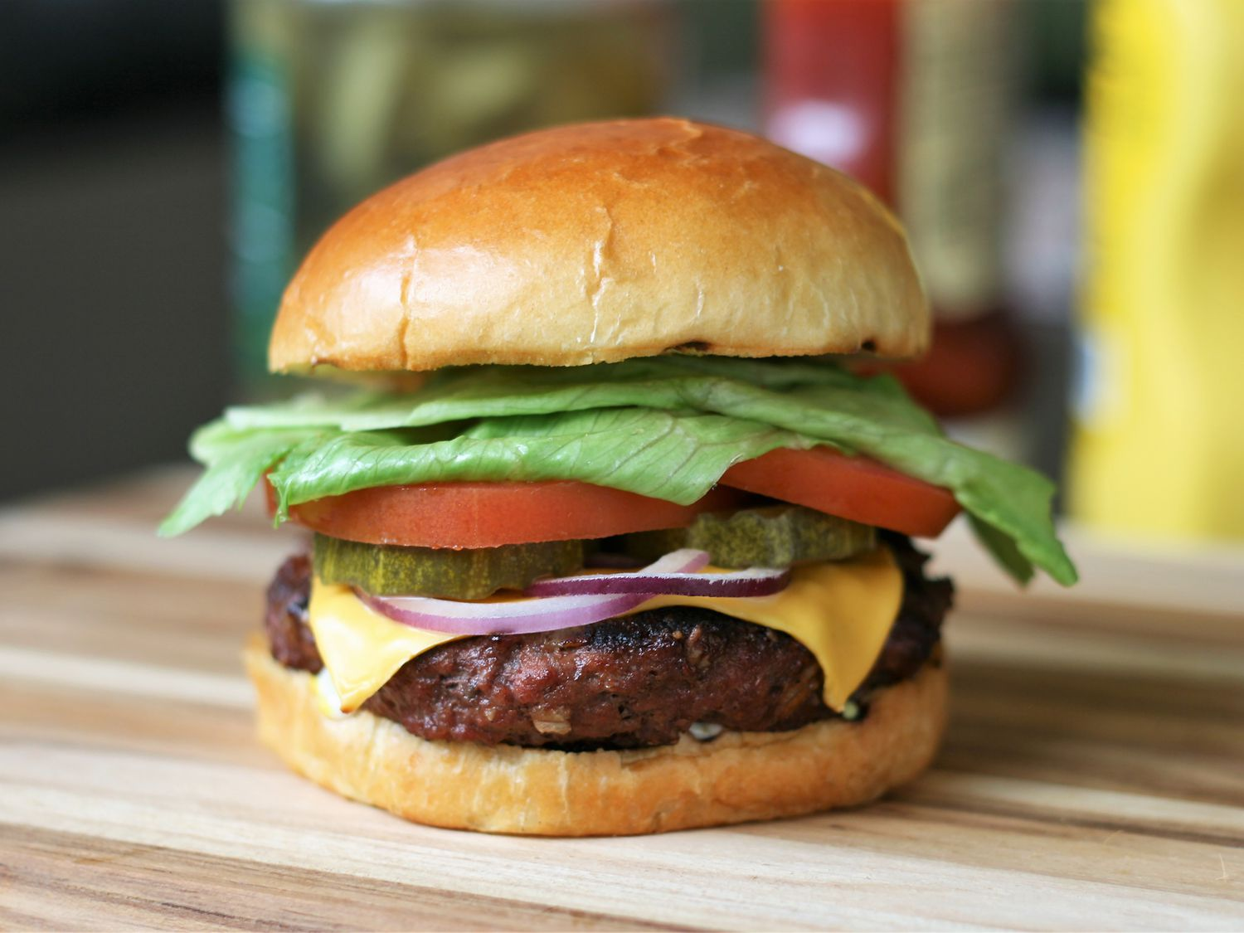
Food
Mint chocolate
Title

Slide 4




Smiles
MFS Hampus

Slide 5
Map, Food, Smiles
Hampus Fink Gärdström
20240419 TEN MFS.key

