Slide 1
Predicting Rental Prices with Machine Learning:Insights and Applications
Hung-Cheng Chang, 張宏正(Jack)
20241209

Slide 2
Motivation
Flow Chart
Data
Method
Result

Slide 3
Motivation
Motivation
In recent years, the housing issue in Taiwan has become a hot topic, which has led to a sharp rise in housing prices.
Rent plays an important role in the housing market, directly reflecting the supply and demand relationship.
It is hoped that the model can serve as a benchmark for both landlords and tenants in deciding rental prices.

Slide 4
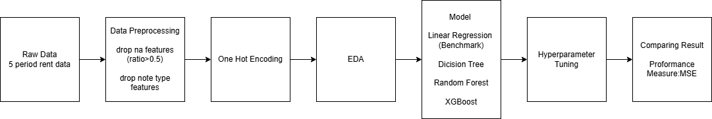
Flow Chart
Flow Chart

Slide 5
Data
Data
Source:不動產成交案件(Dept of Land Administration M. O. I.)
Release Date:240811~240921(Total 5 periods)
Size:n=36498, p=35

Slide 6
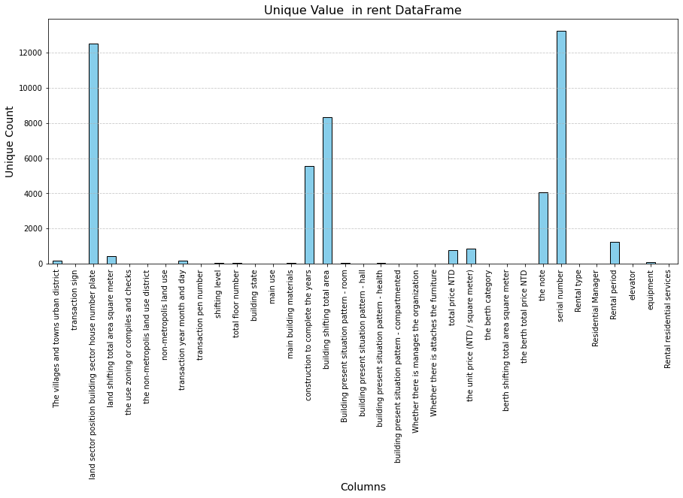
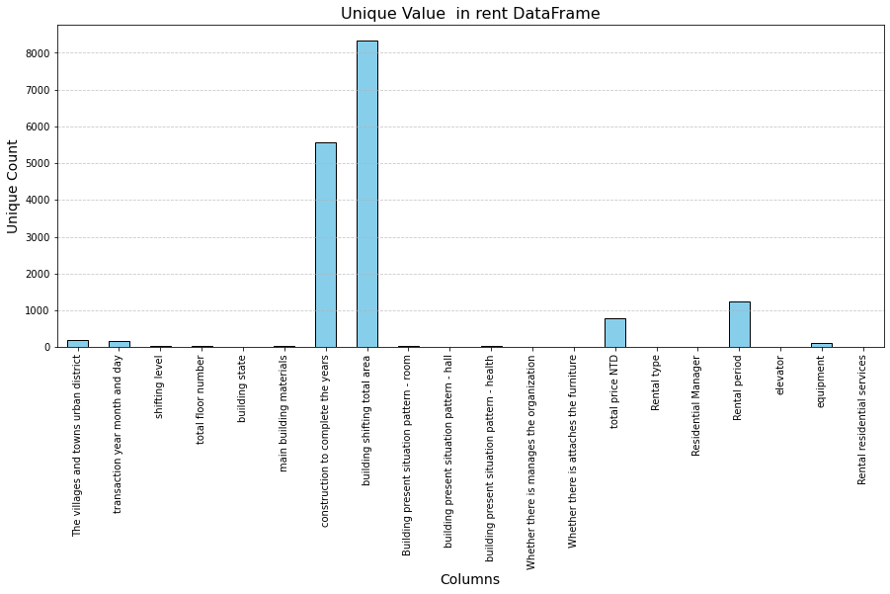
Data Preprocessing
Data
Drop nan ratio>0.5 features
Drop note type features

Slide 7
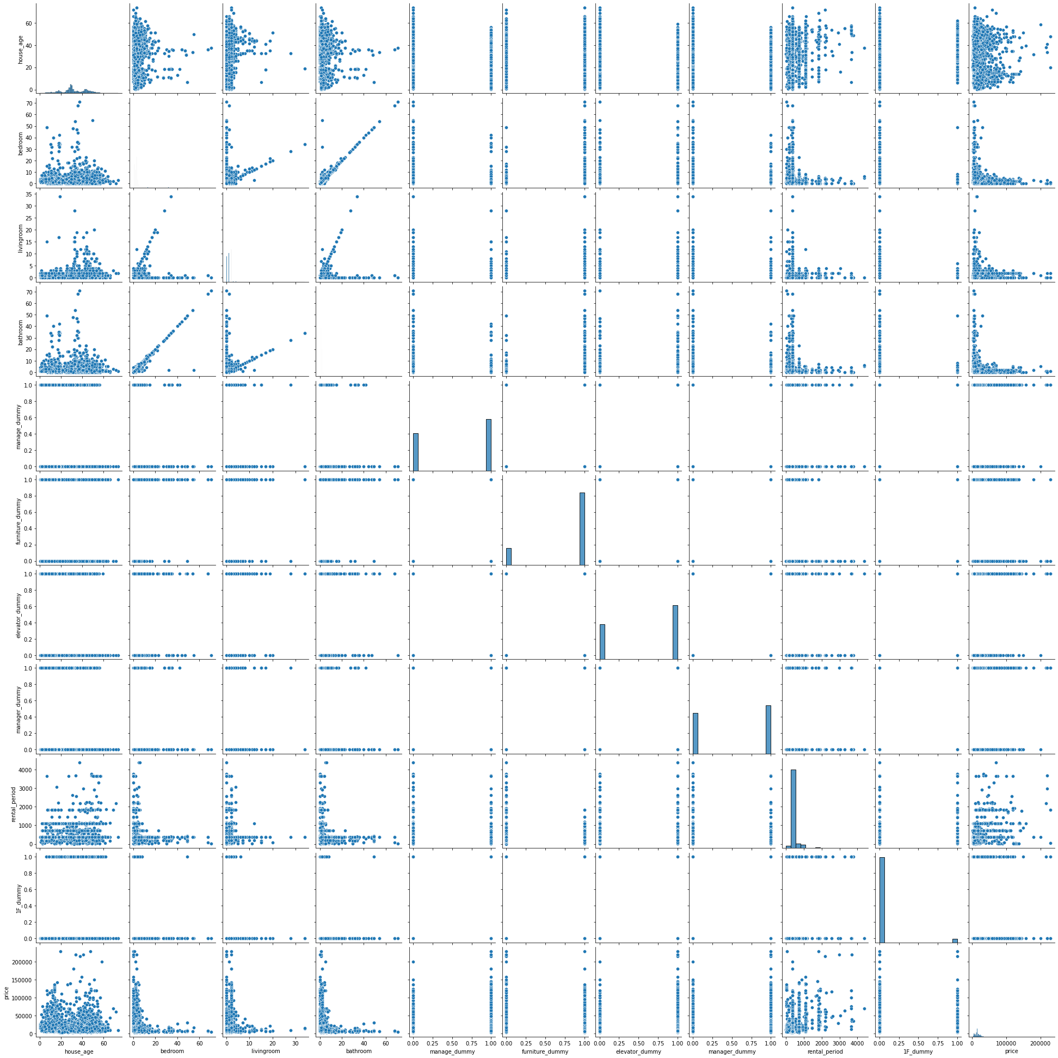
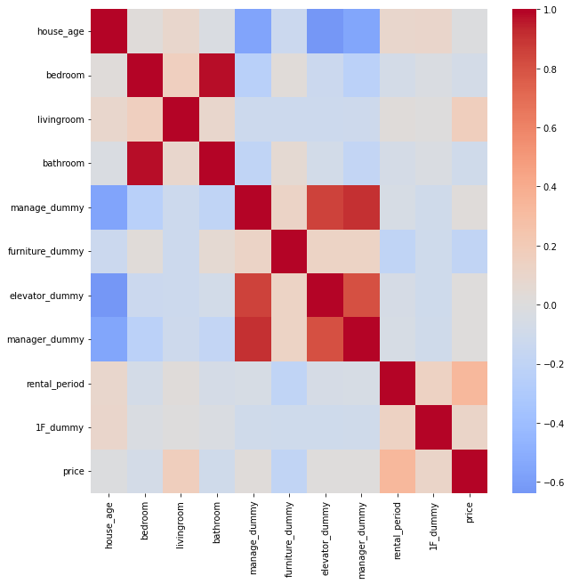
Exploratory data analysis
Data

Slide 8
Method
Method
Linear Regression(benchmark)
Dicision Tree
Random Forest
XGBoost

Slide 9
Hyperparameter
Method
Linear Regression(benchmark)
No hyperparameter
Dicision Tree
Random Forest
XGBoost
Using GridSearchCV
scoring:MSE, CV=5

Slide 10
Result - Hyperparameter
Result
Linear Regression(benchmark)
No hyperparameter
Dicision Tree
Random Forest
XGBoost

Slide 11
Result - Validation & Test
Result

Slide 12
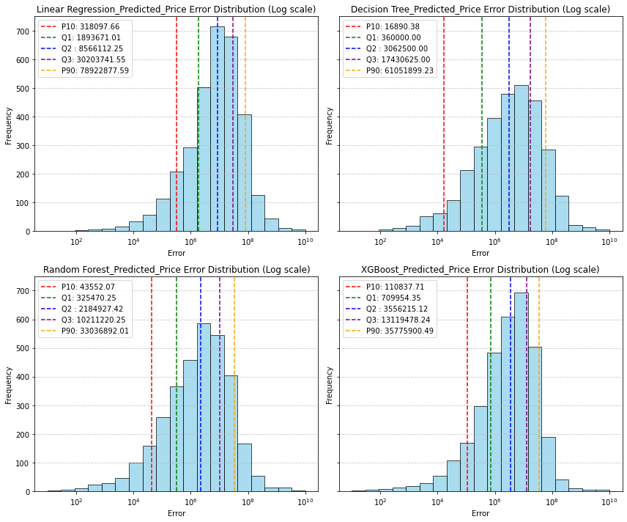
Result - Error
Result

Slide 13
Predicting Rental Prices with Machine Learning:Insights and Applications
Hung-Cheng Chang, 張宏正(Jack)
20241209

