Slide 1
機器學習應用於信用卡詐欺的績效評估
Machine learning applied to the performance evaluation of credit card fraud detection
312707033包坤達、313707048郭奕伶
20240419 TEN MFS.key

Slide 2
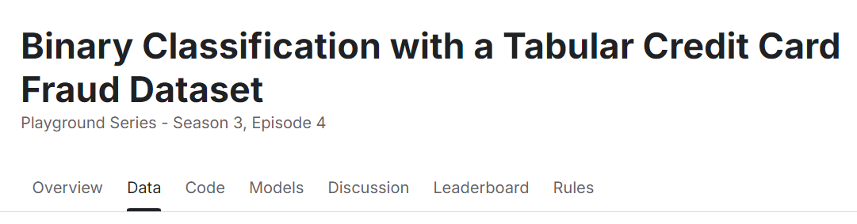
Motivation
Motivation
Credit card fraud detection is a challenging and typical binary classification problem that involves handling highly imbalanced data.
Researching this problem helps demonstrate the potential of machine learning algorithms in the financial sector, particularly in improving model performance and addressing data imbalance issues.
IDA Template

Slide 3
Motivation
How to do
Advantages of Decision Trees in Fraud Detection:
Easy to interpret: Decision trees are based on a tree-like structure that can intuitively display the decision-making process, which is crucial for fraud detection.
Ability to handle imbalanced data: Decision trees can effectively handle missing values in the data and produce reasonable classification results for imbalanced datasets.
IDA Template

Slide 4
Motivation ✓
Styleguide
IDA Template

Slide 5
Section Title
Slide Title
Use
All
w2
w3
Title

Slide 6

Styleguide
Logo and Links to Quantinar Courselets
Use Quantinar icon and name as source
IDA Template

Slide 7

Styleguide
Logo and Links to Quantlet/GitHub
Use Quantlet icon and name as source
Hyperlink both to GitHub repository
Change the presentation logo in the master slide (see View/Edit Master Slide, shortcut: Shift-Command-E)
Styleguide
IDA Template

Slide 8
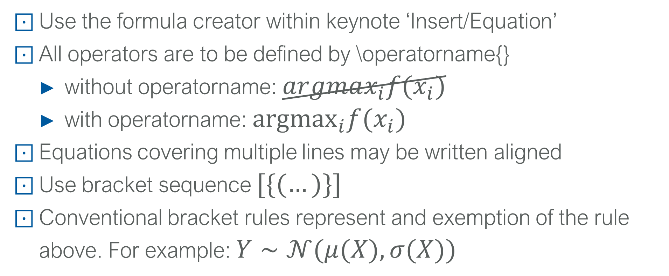
Styleguide
LvB notations 1
Use the formula creator within keynote ‘Insert/Equation’
All operators are to be defined by \operatorname{}
without operatorname: $argmax_{i}f(x_{i})$
with operatorname: ${argmax}_{i}f(x_{i})$
Equations covering multiple lines may be written aligned
Use bracket sequence $[\{(…)\}]$
Conventional bracket rules represent and exemption of the rule above. For example: $Y∼𝒩(μ(X),σ(X))$
IDA Template

Slide 9
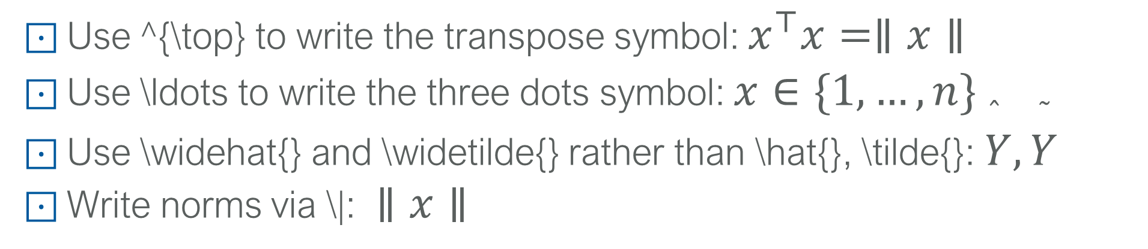
Styleguide
LvB notations 2
Use ^{\top} to write the transpose symbol: $x^{⊤}x=∥x∥$
Use \ldots to write the three dots symbol: $x∈\{1,…,n\}$
Use \widehat{} and \widetilde{} rather than \hat{}, \tilde{}: $\overset{̂}{Y},\overset{˜}{Y}$
Write norms via \|: $∥x∥$
IDA Template

Slide 10
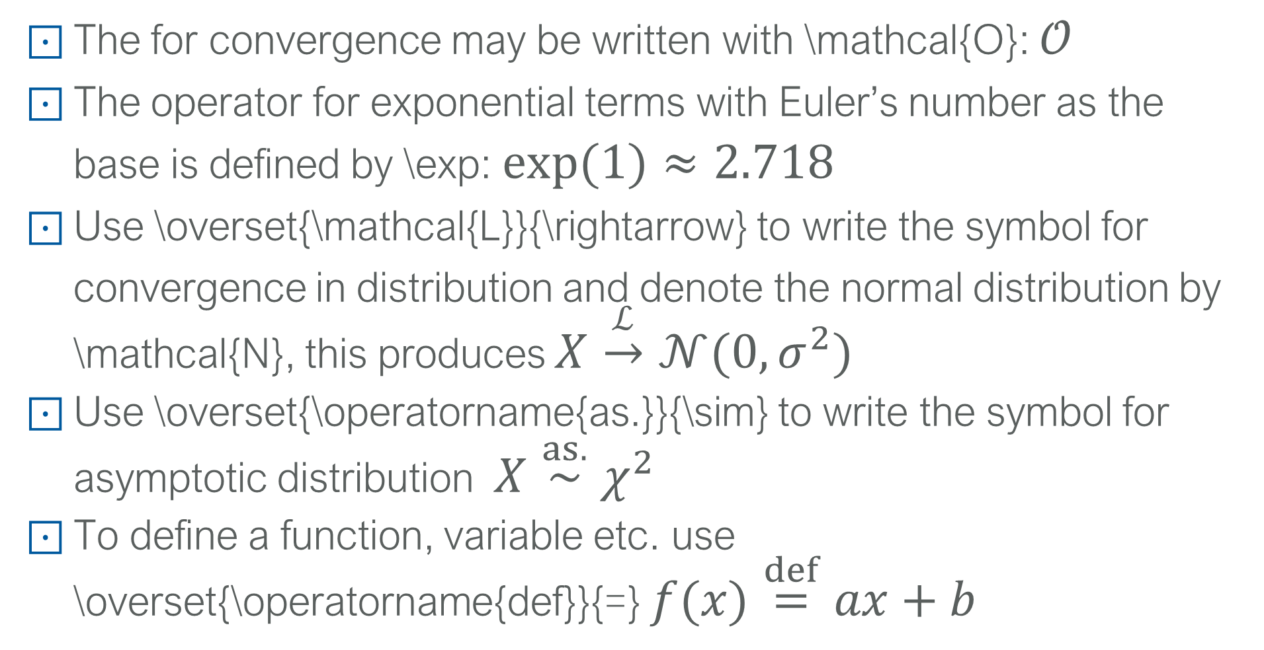
Styleguide
LvB notations 3
The for convergence may be written with \mathcal{O}: $𝒪$
The operator for exponential terms with Euler’s number as the base is defined by \exp: $exp(1)≈2.718$
Use \overset{\mathcal{L}}{\rightarrow} to write the symbol for convergence in distribution and denote the normal distribution by \mathcal{N}, this produces $X\overset{ℒ}{→}𝒩(0,σ^{2})$
Use \overset{\operatorname{as.}}{\sim} to write the symbol for asymptotic distribution $X\overset{as.}{∼}χ^{2}$
To define a function, variable etc. use \overset{\operatorname{def}}{=} $f(x)\overset{def}{=}ax+b$
IDA Template

Slide 11
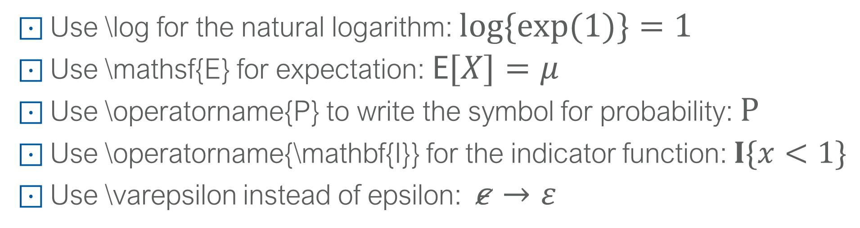
Styleguide
LvB notations 4
Use \log for the natural logarithm: $log\{exp(1)\}=1$
Use \mathsf{E} for expectation: $E[X]=μ$
Use \operatorname{P} to write the symbol for probability: $P$
Use \operatorname{\mathbf{I}} for the indicator function: $I\{x<1\}$
Use \varepsilon instead of epsilon: $ε→ε$
IDA Template

Slide 12
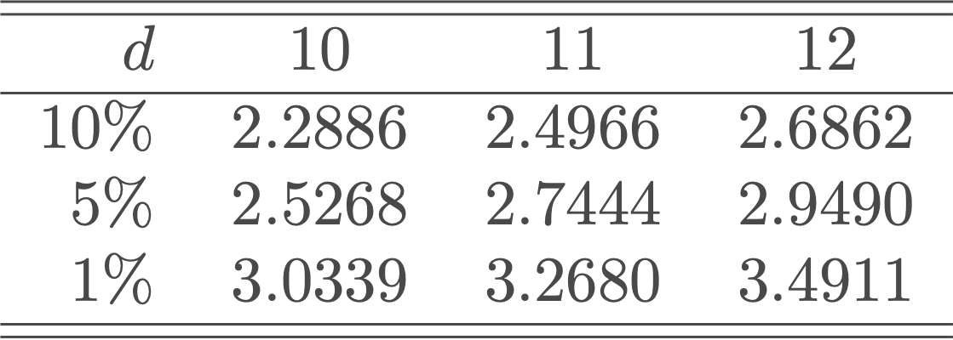
Styleguide
Tables
Follow the Cambridge University Press Style
Round appropriately (as much information as necessary, as little as possible)
Align decimal points
IDA Template

Slide 13
Styleguide
Figures
Give informative axis labels
If x- and y-axis are on the same domain, the plot should be square
Use same color scheme for multiple plots if they show the same content.
IDA Template

Slide 14
TEN Template
Repeat on last slide the lead picture

