Slide 1
TEN Template
always add date of touching a keynote
20240125 IDA Template Keynote.key

Slide 2
機器學習應用於信用卡詐欺的績效評估
Machine learning applied to the performance evaluation of credit card fraud detection
312707033包坤達、313707048郭奕伶
20240419 TEN MFS.key

Slide 3
Motivation
Motivation
Machine learning models can show good performance in credit card fraud detection, but different machine learning algorithms often have different performances in terms of detection accuracy, recall rate, and computational efficiency.
In order to better select the appropriate model and improve the detection effect, it is necessary to comprehensively evaluate and compare the performance of some models.
this is a lead picture
IDA Template

Slide 4
Motivation ✓
Styleguide
IDA Template

Slide 5
Section Title
Slide Title
Use
All
w2
w3
Title

Slide 6

Styleguide
Logo and Links to Quantinar Courselets
Use Quantinar icon and name as source
IDA Template

Slide 7

Styleguide
Logo and Links to Quantlet/GitHub
Use Quantlet icon and name as source
Hyperlink both to GitHub repository
Change the presentation logo in the master slide (see View/Edit Master Slide, shortcut: Shift-Command-E)
Styleguide
IDA Template

Slide 8
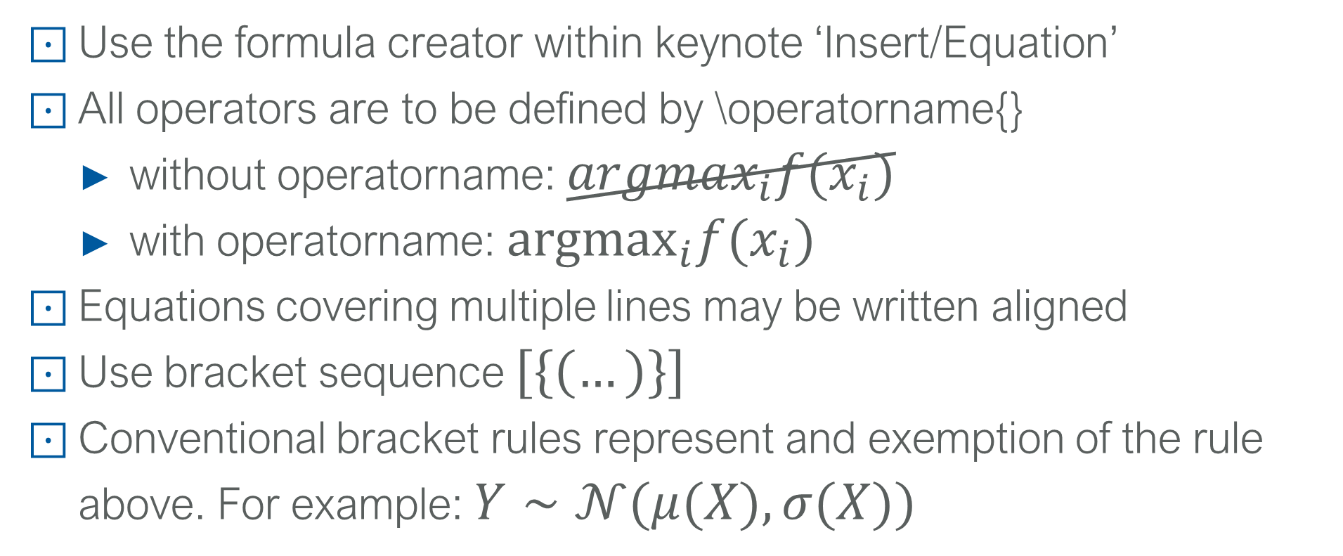
Styleguide
LvB notations 1
Use the formula creator within keynote ‘Insert/Equation’
All operators are to be defined by \operatorname{}
without operatorname: $argmax_{i}f(x_{i})$
with operatorname: ${argmax}_{i}f(x_{i})$
Equations covering multiple lines may be written aligned
Use bracket sequence $[\{(…)\}]$
Conventional bracket rules represent and exemption of the rule above. For example: $Y∼𝒩(μ(X),σ(X))$
IDA Template

Slide 9
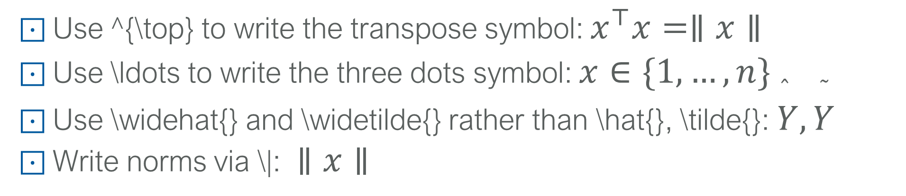
Styleguide
LvB notations 2
Use ^{\top} to write the transpose symbol: $x^{⊤}x=∥x∥$
Use \ldots to write the three dots symbol: $x∈\{1,…,n\}$
Use \widehat{} and \widetilde{} rather than \hat{}, \tilde{}: $\overset{̂}{Y},\overset{˜}{Y}$
Write norms via \|: $∥x∥$
IDA Template

Slide 10
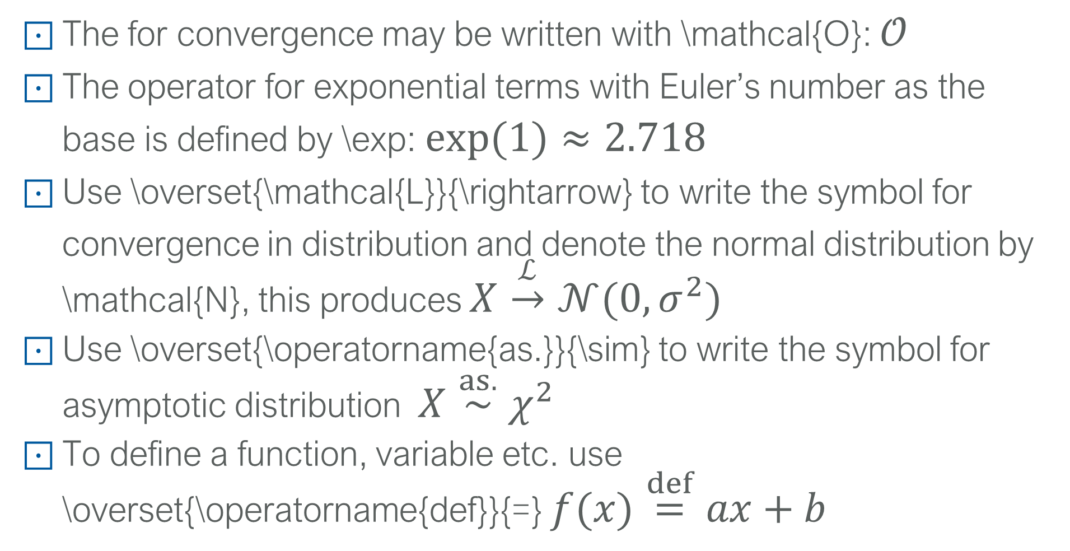
Styleguide
LvB notations 3
The for convergence may be written with \mathcal{O}: $𝒪$
The operator for exponential terms with Euler’s number as the base is defined by \exp: $exp(1)≈2.718$
Use \overset{\mathcal{L}}{\rightarrow} to write the symbol for convergence in distribution and denote the normal distribution by \mathcal{N}, this produces $X\overset{ℒ}{→}𝒩(0,σ^{2})$
Use \overset{\operatorname{as.}}{\sim} to write the symbol for asymptotic distribution $X\overset{as.}{∼}χ^{2}$
To define a function, variable etc. use \overset{\operatorname{def}}{=} $f(x)\overset{def}{=}ax+b$
IDA Template

Slide 11
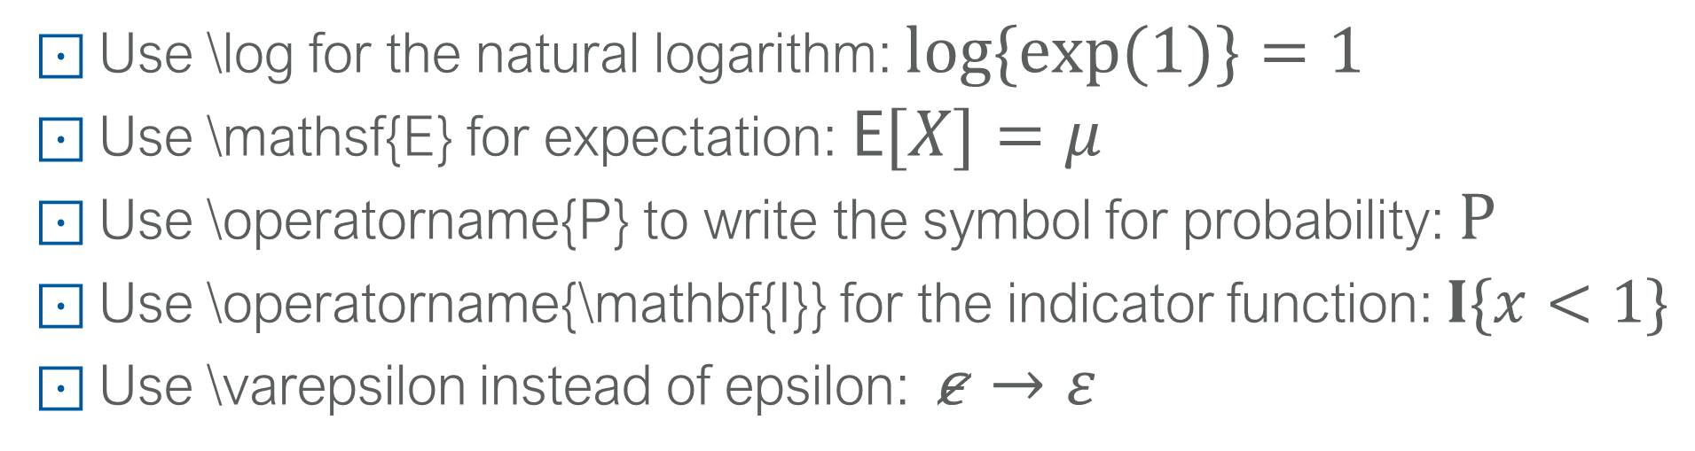
Styleguide
LvB notations 4
Use \log for the natural logarithm: $log\{exp(1)\}=1$
Use \mathsf{E} for expectation: $E[X]=μ$
Use \operatorname{P} to write the symbol for probability: $P$
Use \operatorname{\mathbf{I}} for the indicator function: $I\{x<1\}$
Use \varepsilon instead of epsilon: $ε→ε$
IDA Template

Slide 12
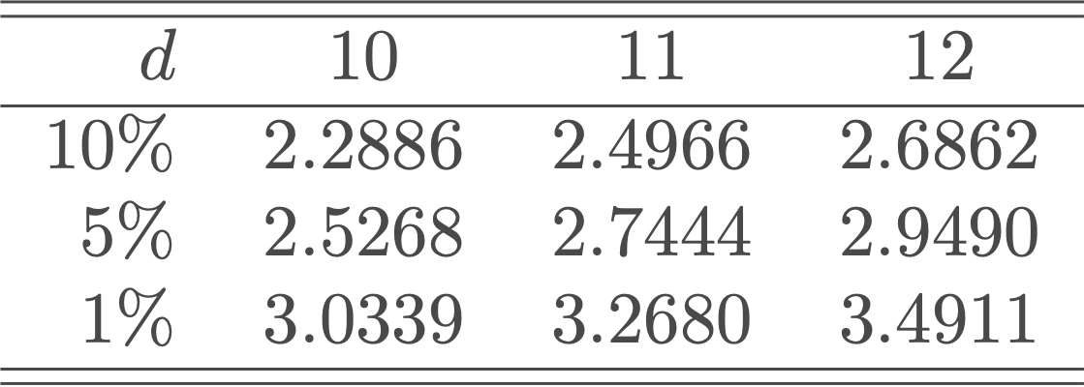
Styleguide
Tables
Follow the Cambridge University Press Style
Round appropriately (as much information as necessary, as little as possible)
Align decimal points
IDA Template

Slide 13
Styleguide
Figures
Give informative axis labels
If x- and y-axis are on the same domain, the plot should be square
Use same color scheme for multiple plots if they show the same content.
IDA Template

Slide 14
TEN Template
Repeat on last slide the lead picture

