Slide 1
Map, Food, & Smiles
Ting-Siou Chen, 陳亭秀
20240909

Slide 2

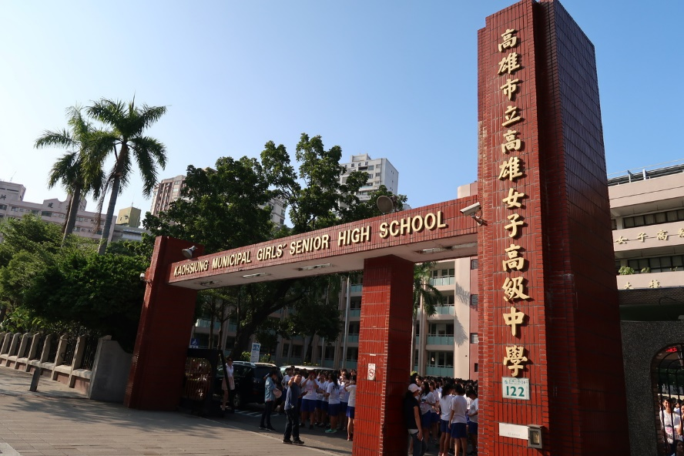
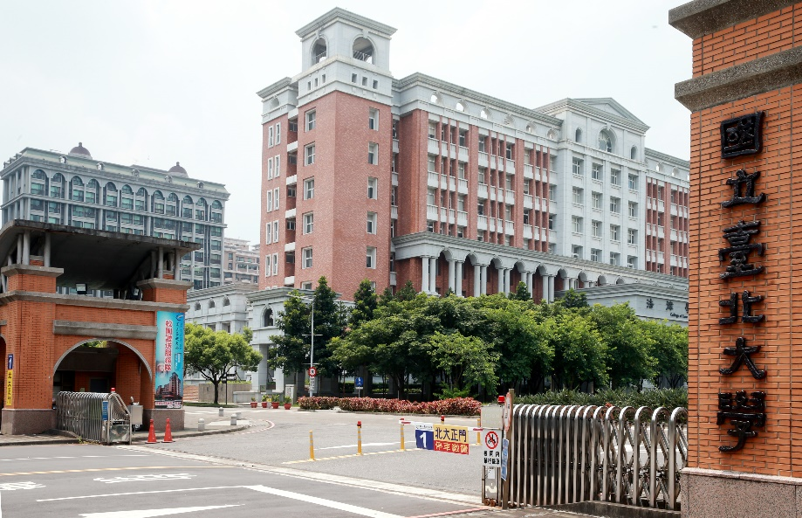
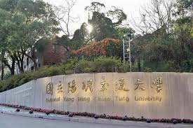
Maps
2002-2020 Kaohsiung
2018-2020 KGHS
2020-2024 NTPU
2024-? NYCU
Title

Slide 3
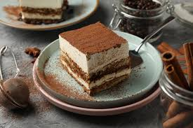
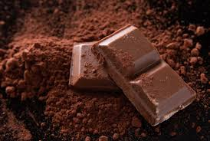
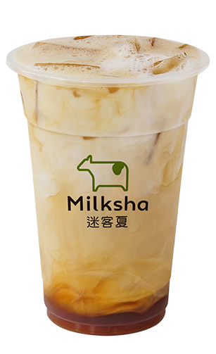
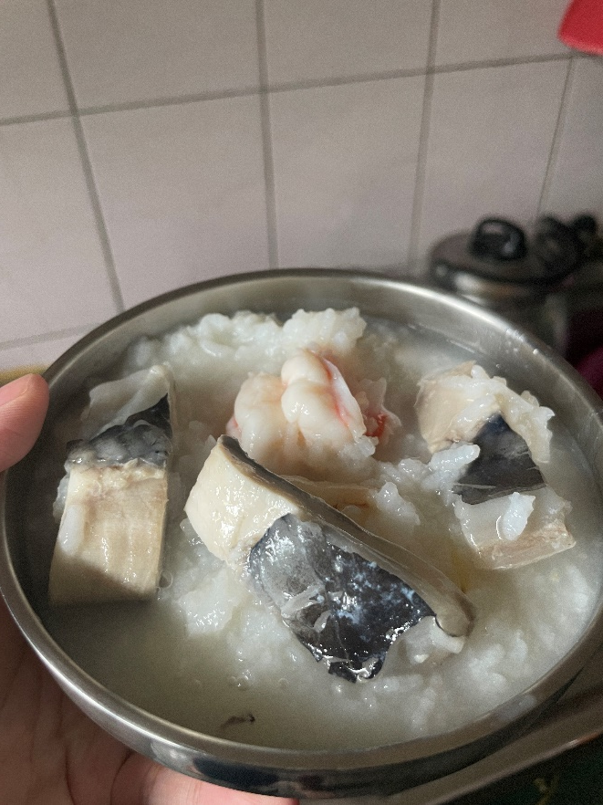
Food
desserts
chocolate
milk tea
Everything my grandma cooks
Title

Slide 4
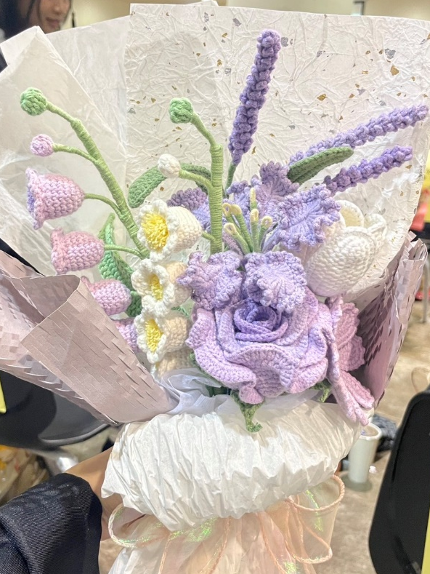
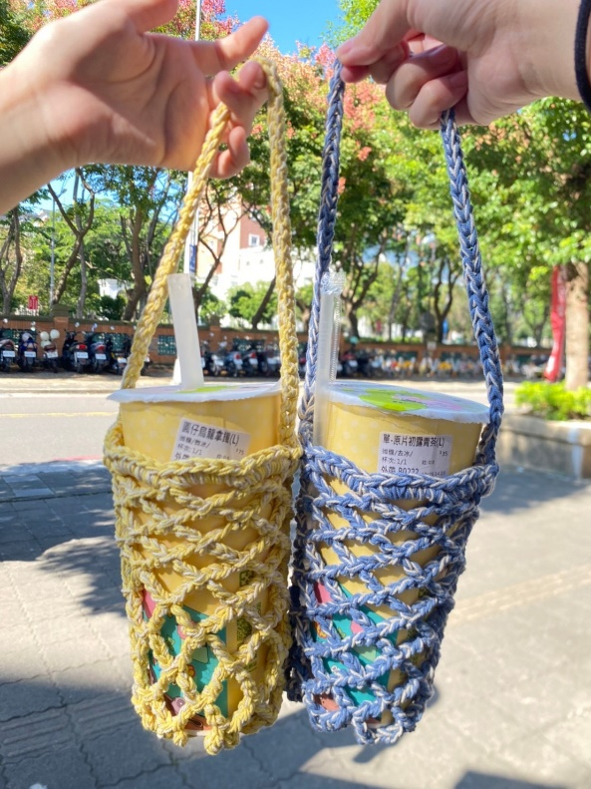
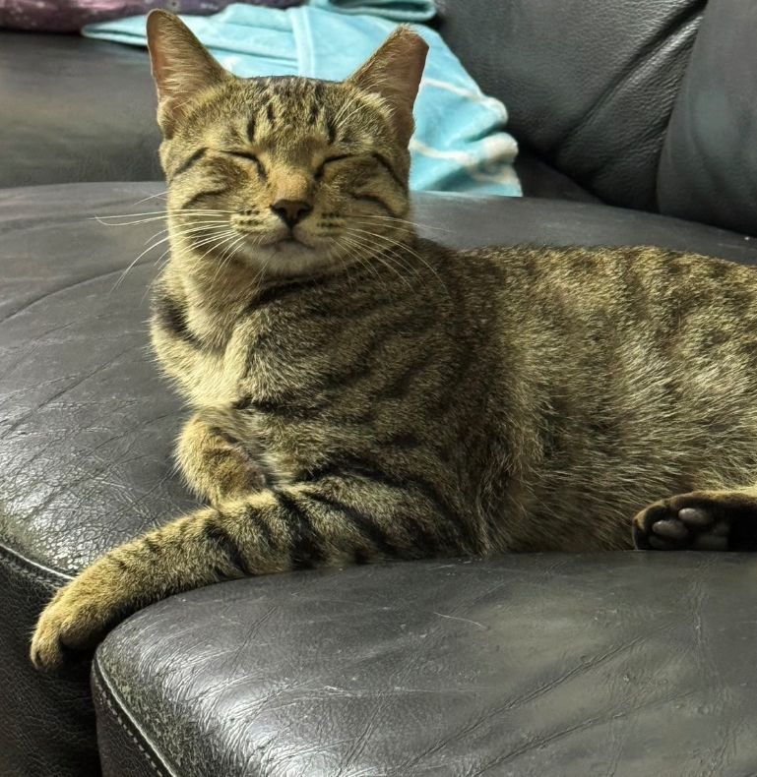
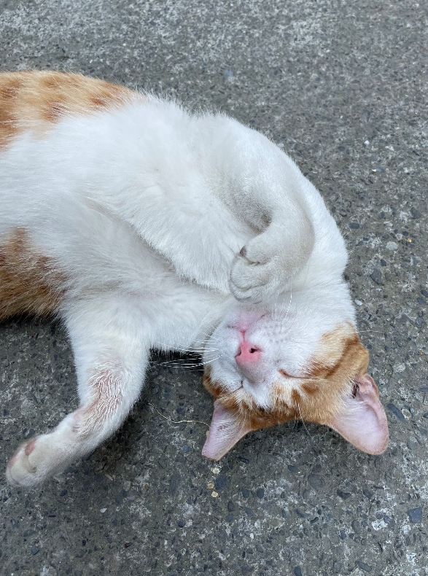
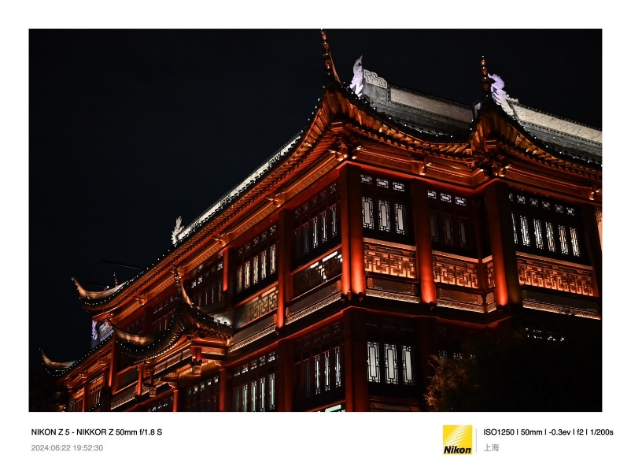
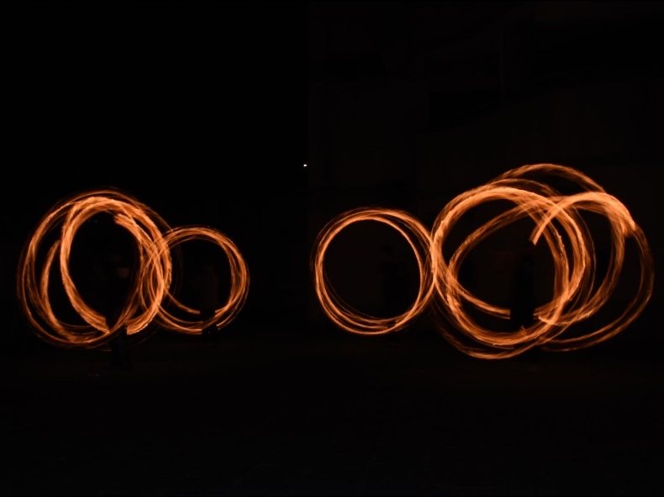
Smiles
Crochet
Cat
Photography
Title

Slide 5
Topic：
Credit card default prediction
Title

Slide 6
Map, Food, Smiles
T2
20240419 TEN MFS.key

