Slide 1
Map, Food, & Smiles
Yi-Ling,Kuo 郭奕伶
20240419 TEN MFS.key

Slide 2
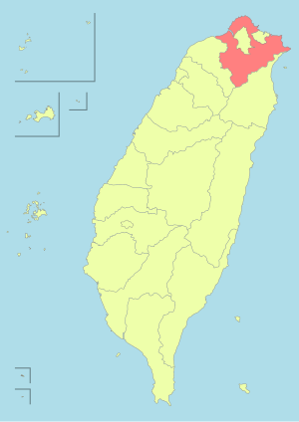
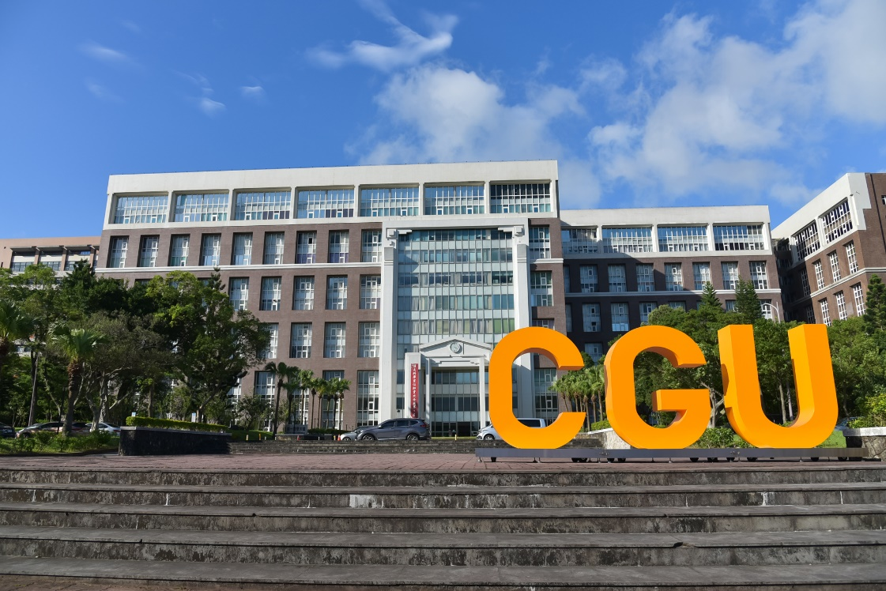
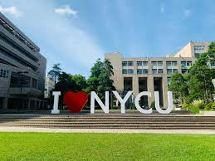
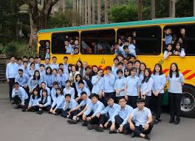
Maps
2002: New Taipei , TW
2020-2024: CGU
2017-2020: DongShan high school
2024-present: NYCU
Title

Slide 3
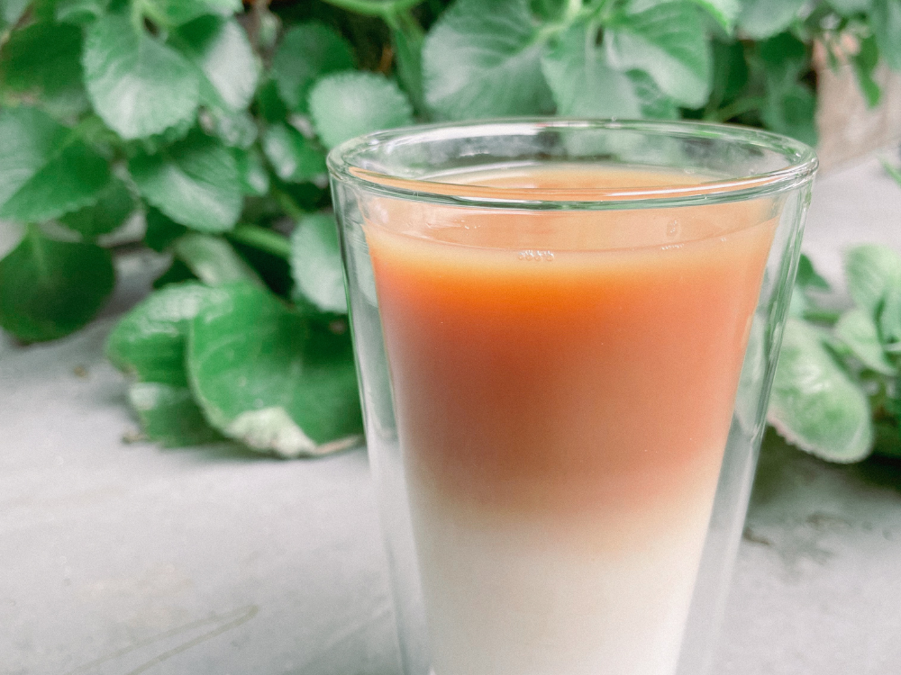
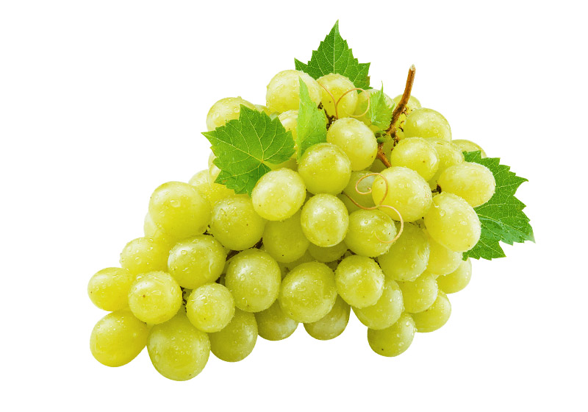
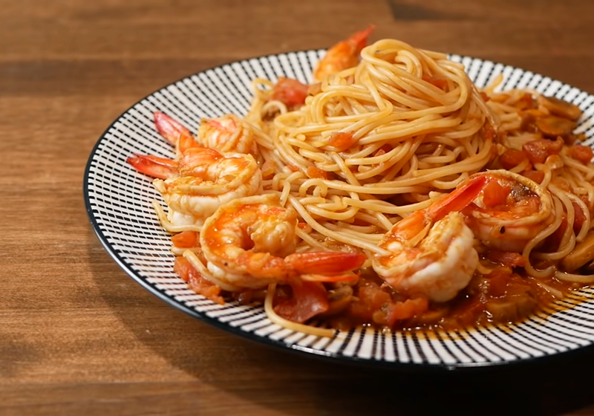
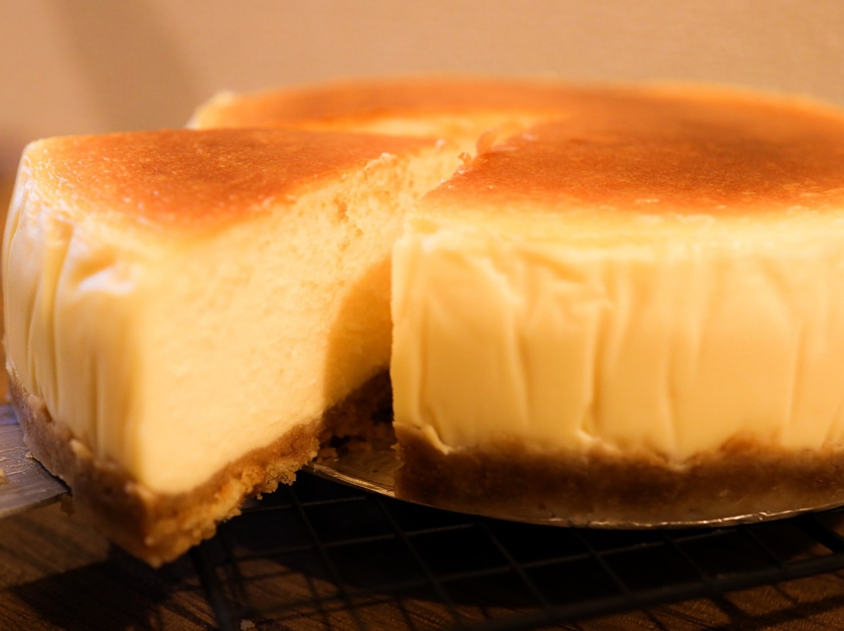
Food
Milk tea
Green grapes
pasta
Cheese cake
Title

Slide 4


Smiles
Dance: Girl style / Kpop
Listen music
Title

Slide 5
Project topic:
Binary classification with a tabular credit card fraud dataset
Work with: 包坤達
20240419 TEN MFS.key

