Slide 1
11 Credit Default Prediction
Hampus Fink Gärdström
313551806
20241125 CDP.key

Slide 2
Motivation
EDA
Preprocessing
Feature engineering
Training
Results
Conclusion
IDA Template

Slide 3
Motivation
Motivation
Credit card fraud detection
High amount of features
Comparing RFE and PCA for dimensionality reduction
Comparing KNN, RF and XGBoost
IDA Template

Slide 4
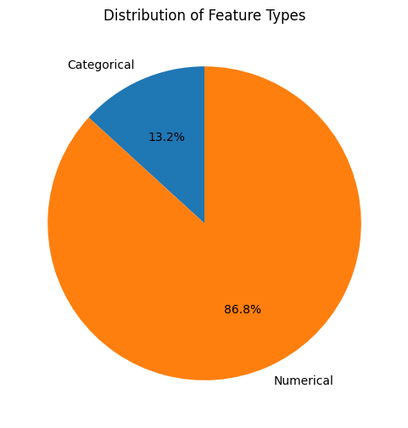
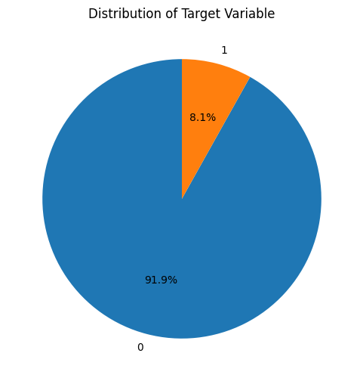
Data
Data
~300.000 entries
~120 features
Large class imbalance
IDA Template

Slide 5
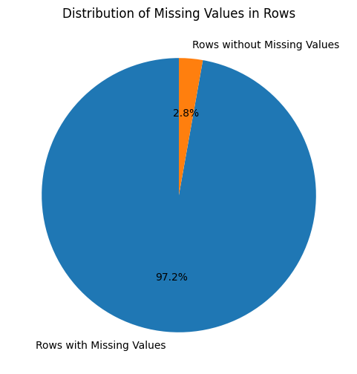
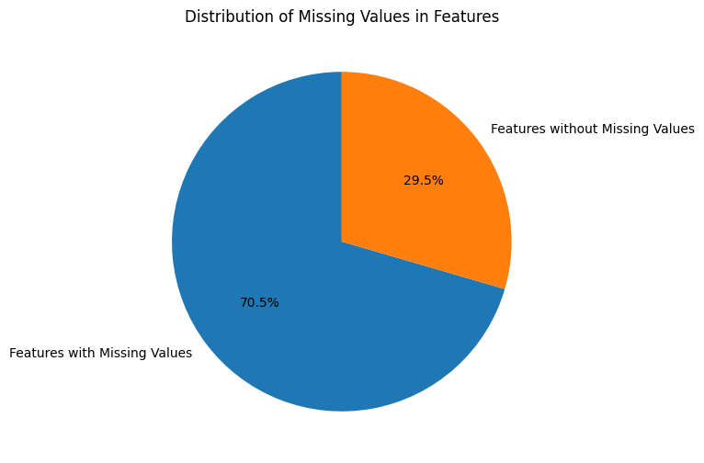
Data
Data
~300.000 entries
~120 features
Large class imbalance
Many missing values
IDA Template

Slide 6
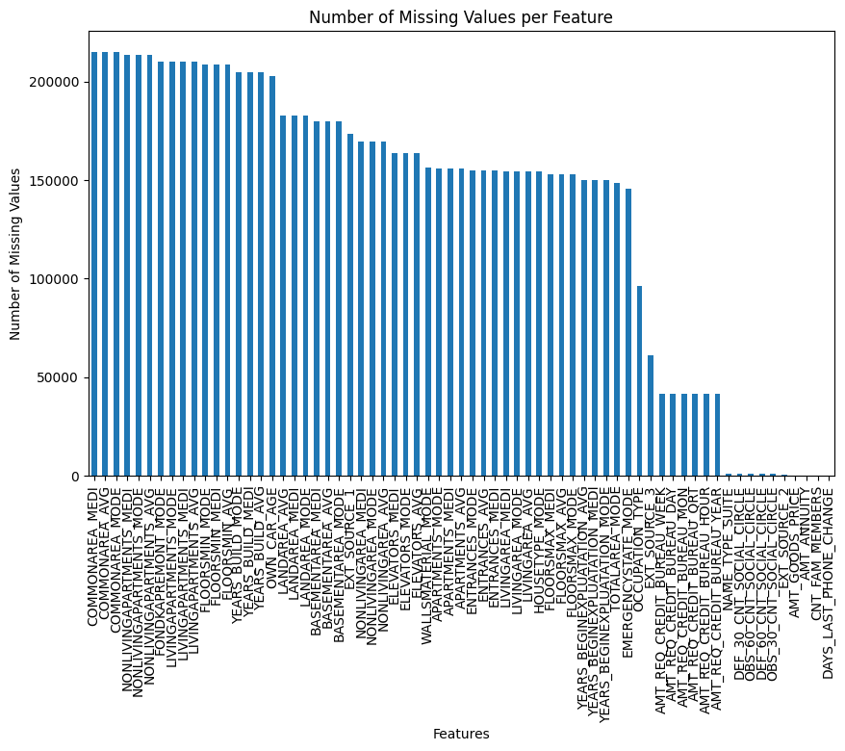
Data
Data
~300.000 entries
~120 features
Large class imbalance
Many missing values
IDA Template

Slide 7
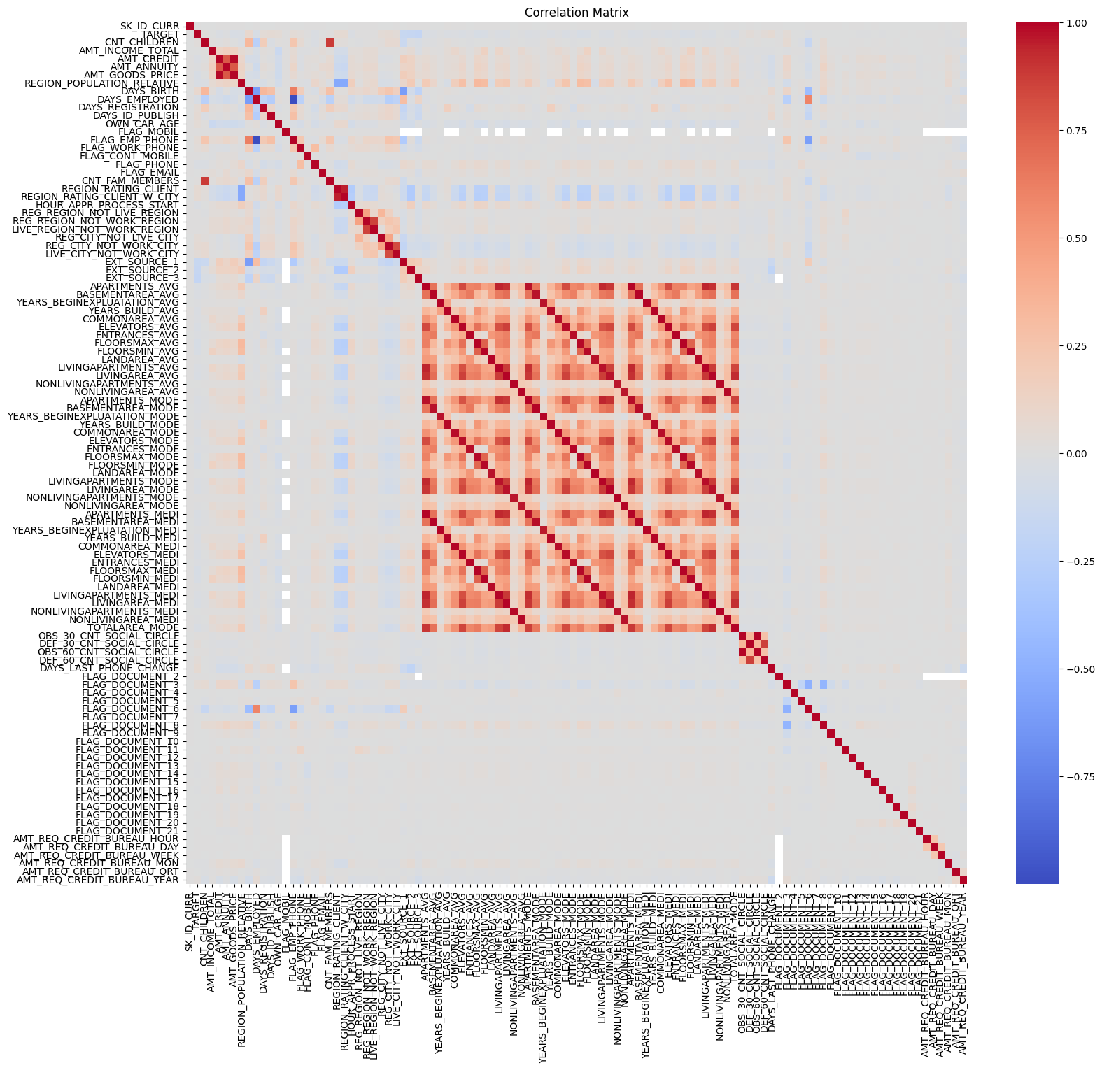
Data
Data
Correlation matrix
Little correlation between most features
Highly correlated features relate to housing
IDA Template

Slide 8
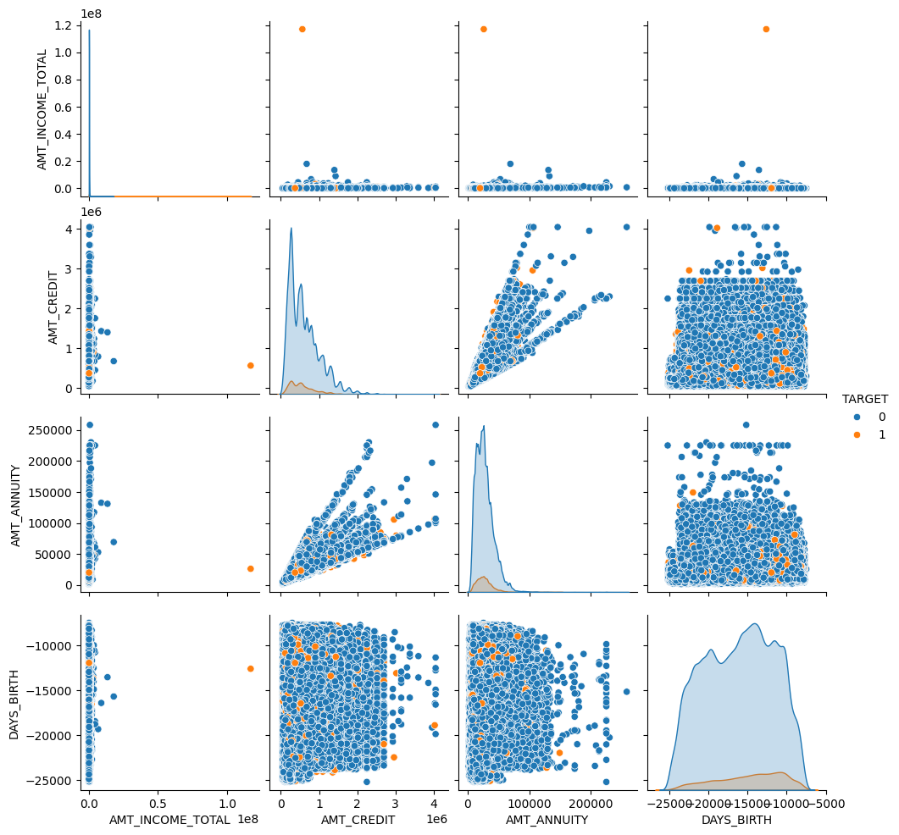
Data
Data
Scatterplot of select features
Suggests that there may be some outliers
IDA Template

Slide 9
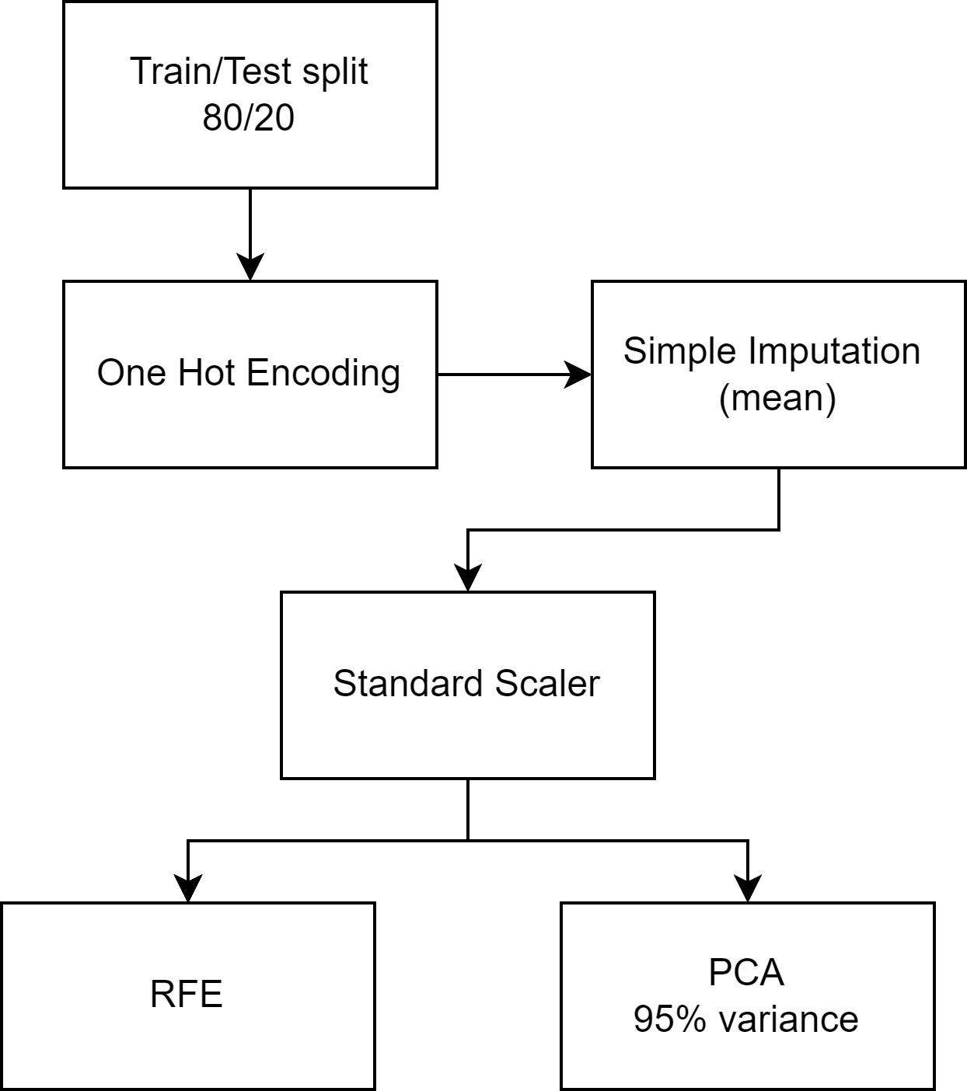
Data
Feature engineering
Train/Test split, 80% & 20%
OHE
Imputation
Scaling
IDA Template

Slide 10
Feature engineering
Feature engineering
Train/Test split, 80% & 20%
OHE
Imputation
Scaling
Feature selection
IDA Template

Slide 11
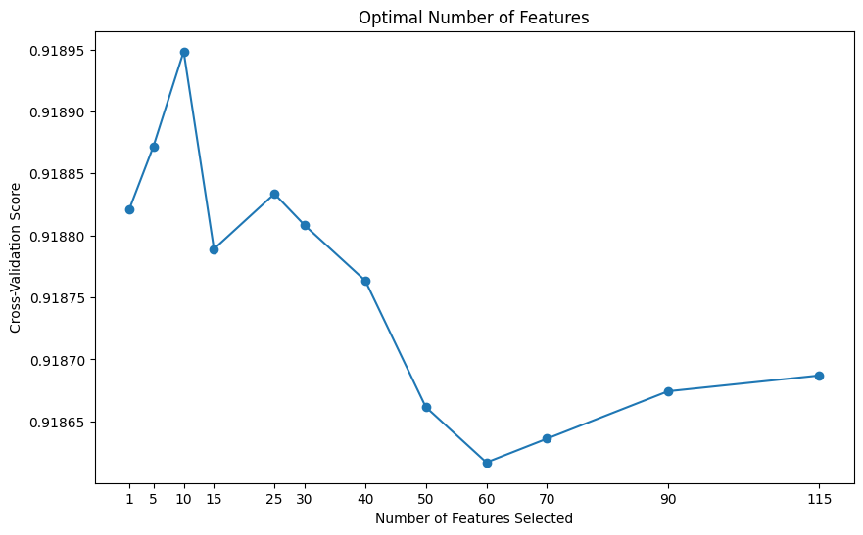
Feature engineering
RFE
Recursive feature elimination
Logistic regression, cross-val CV 5
Suggests 10 features is best for logistic regression
IDA Template

Slide 12
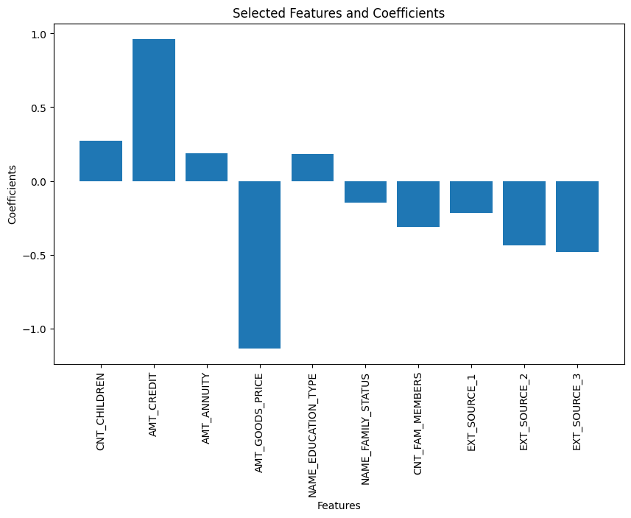
Feature engineering
RFE
Recursive feature elimination
Logistic regression
10 Selected features
IDA Template

Slide 13
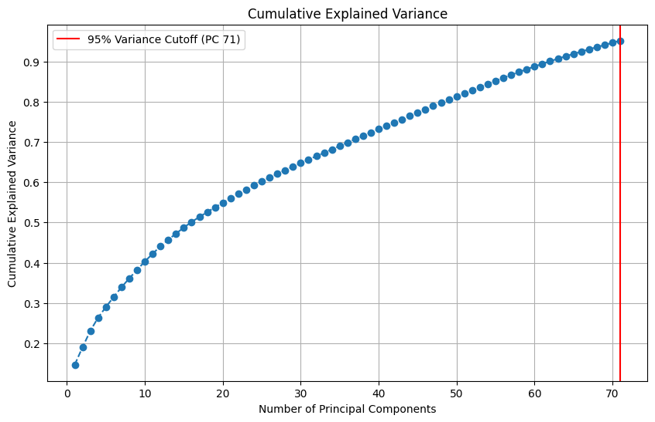
Feature engineering
PCA
95% variance at 71 PCs
IDA Template

Slide 14
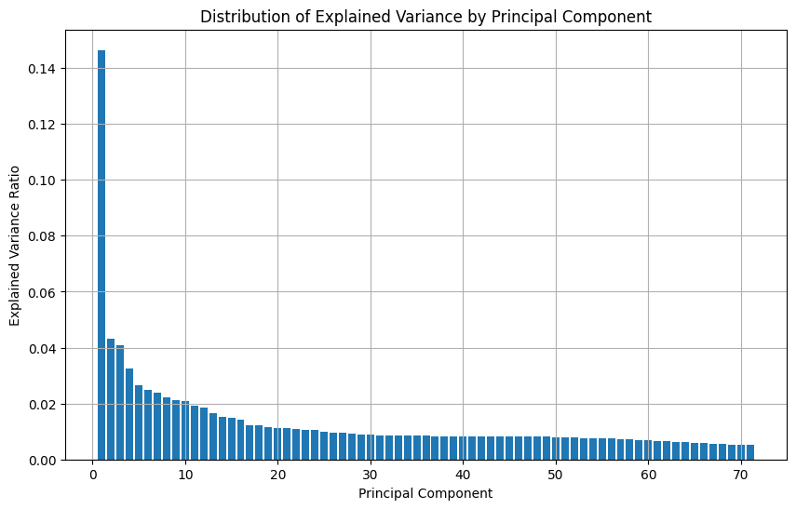
Feature engineering
PCA
Distribution of explained variance
IDA Template

Slide 15
Training
Models
Logistic Regression (benchmark)
Random Forest
KNN
XGBoost
IDA Template

Slide 16
Training
Hyperparameter tuning
RandomizedSearchCV – max 25 iterations, CV5
Model | Parameter | Values
Logistic Regression | C | 0.001, 0.01, 0.1, 1, 10, 100
 | solver | lbfgs, liblinear
Random Forest | n_estimators | 25, 50, 100
 | max_depth | None, 10, 20
 | min_samples_split | 2, 5, 10
 | min_samples_leaf | 1, 2
K-Nearest Neighbors | n_neighbors | 3, 5, 7, 10, 15, 20
 | weights | uniform, distance
 | leaf_size | 20, 30, 40
XGBoost | max_depth | 3, 5, 7, 9
 | learning_rate | 0.01, 0.1, 0.2
 | n_estimators | 25, 50, 100
 | subsample | 0.8, 1.0
 | colsample_bytree | 0.8, 1.0
 | gamma | 0, 0.1, 0.2
IDA Template

Slide 17
Training
RFE Hyperparameter tuning
RFE
RandomizedSearchCV – max 25 iterations, CV5
Model | Parameter | Values
Logistic Regression | C | 0.001, 0.01, 0.1, 1, 10, 100
 | solver | lbfgs, liblinear
Random Forest | n_estimators | 25, 50, 100
 | max_depth | None, 10, 20
 | min_samples_split | 2, 5, 10
 | min_samples_leaf | 1, 2
K-Nearest Neighbors | n_neighbors | 3, 5, 7, 10, 15, 20
 | weights | uniform, distance
 | leaf_size | 20, 30, 40
XGBoost | max_depth | 3, 5, 7, 9
 | learning_rate | 0.01, 0.1, 0.2
 | n_estimators | 25, 50, 100
 | subsample | 0.8, 1.0
 | colsample_bytree | 0.8, 1.0
 | gamma | 0, 0.1, 0.2
IDA Template

Slide 18
Training
PCA Hyperparameter tuning
PCA
RandomizedSearchCV – max 25 iterations, CV5
Model | Parameter | Values
Logistic Regression | C | 0.001, 0.01, 0.1, 1, 10, 100
 | solver | lbfgs, liblinear
Random Forest | n_estimators | 25, 50, 100
 | max_depth | None, 10, 20
 | min_samples_split | 2, 5, 10
 | min_samples_leaf | 1, 2
K-Nearest Neighbors | n_neighbors | 3, 5, 7, 10, 15, 20
 | weights | uniform, distance
 | leaf_size | 20, 30, 40
XGBoost | max_depth | 3, 5, 7, 9
 | learning_rate | 0.01, 0.1, 0.2
 | n_estimators | 25, 50, 100
 | subsample | 0.8, 1.0
 | colsample_bytree | 0.8, 1.0
 | gamma | 0, 0.1, 0.2
IDA Template

Slide 19
Results
Results RFE
RFE
Similar good accuracy for class 0
Poor performance for class 1, no recall
Model | Accuracy | CV Mean Accuracy | Precision (0) | Recall (0) | F1-Score (0) | Precision (1) | Recall (1) | F1-Score (1)
Logistic Regression | 0.9205 | 0.9220 (+/- 0.0003) | 0.92 | 1.00 | 0.96 | 1.00 | 0.00 | 0.01
Random Forest | 0.9188 | 0.9220 (+/- 0.0007) | 0.92 | 1.00 | 0.96 | 0.17 | 0.00 | 0.01
K-Nearest Neighbors | 0.9179 | 0.9221 (+/- 0.0009) | 0.92 | 1.00 | 0.96 | 0.23 | 0.01 | 0.02
XGBoost | 0.9201 | 0.9220 (+/- 0.0002) | 0.92 | 1.00 | 0.96 | 0.00 | 0.00 | 0.00
IDA Template

Slide 20
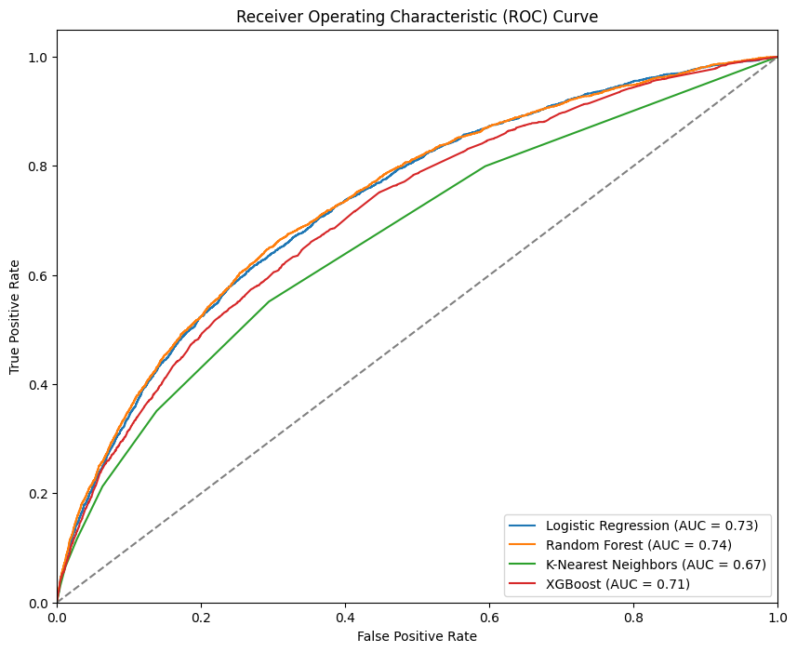
Results
Results RFE
RFE ROC AUC
RF is best but comparable to LR
KNN worst
IDA Template

Slide 21
Results
Results PCA
PCA
Similar results to using RFE
Model | Accuracy | CV Mean Accuracy | Precision (0) | Recall (0) | F1-Score (0) | Precision (1) | Recall (1) | F1-Score (1)
Logistic Regression | 0.9201 | 0.9219 (+/- 0.0003) | 0.92 | 1.00 | 0.96 | 0.00 | 0.00 | 0.00
Random Forest | 0.9201 | 0.9219 (+/- 0.0002) | 0.92 | 1.00 | 0.96 | 0.00 | 0.00 | 0.00
K-Nearest Neighbors | 0.9195 | 0.9220 (+/- 0.0004) | 0.92 | 1.00 | 0.96 | 0.00 | 0.00 | 0.00
XGBoost | 0.9198 | 0.9222 (+/- 0.0005) | 0.92 | 1.00 | 0.96 | 0.33 | 0.00 | 0.01
IDA Template

Slide 22
Motivation
Conclusion
Models show little difference
Models heavily favor class 0
- Likely because of class imbalance
PCA vs RFE
- Negligible accuracy difference, but less features with RFE
IDA Template

Slide 23
11 Credit Default Prediction
Hampus Fink Gärdström
313551806
20240419 TEN MFS.key

