Slide 1
基於ESG語氣用字的投資策略報酬預測
Sabrina
20240419 TEN MFS.key

Slide 2
Motivation
Method
KPI

Slide 3
Motivation
Interested in sentiment analysis
ESG trend
Title

Slide 4
Method
Crawl data from 10-K
Data cleaning
EDA
ESG Sentiment word dictionary
Train classifier
Input newest 10-k data and decide investment strategy
Title

Slide 5
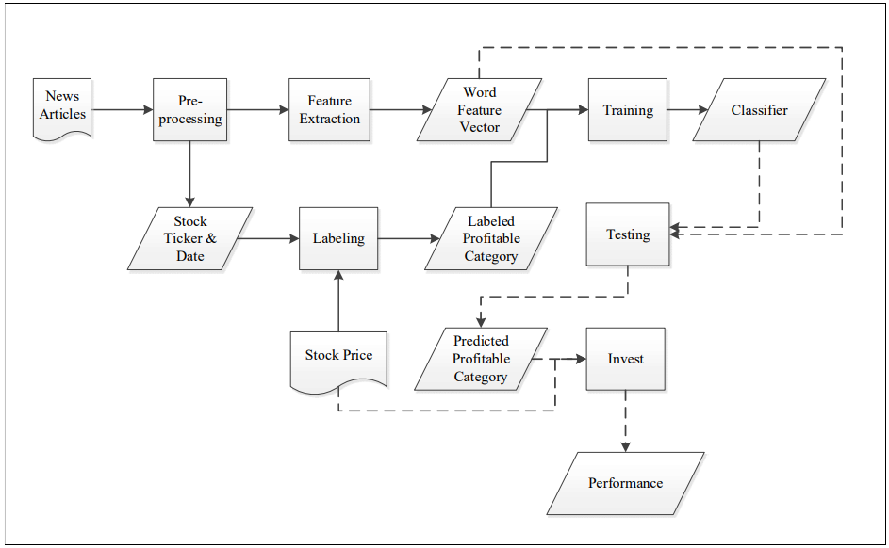
Flow Chart
Reference

Slide 6
KPI
Randomly pick one or two company and input their newest 10-K article and predict its best investment strategy
Title

Slide 7
Thanks for listening
Title

