Slide 1
Transportation Research Part A: Policy and Practice
Volume 181, March 2024, 103995
Predicting passenger satisfaction in public transportation using machine learning models
第3組
111701069張貽堯⁺ (第3章)
111701071馮偉宸⁺ (第2、7章)
314703019劉宇軒⁺ (第1章)
410701004陳信元⁺(第4 、8章)
414701003陳怡慧⁺ (第5、6、8章)
Notes:
20分鐘簡報+5分種QA

Slide 2








Contents
Introduction
Analysis
Machine learning predictive models
Discussion
Methodology and data
Conclusions
Results and evaluation of models
Our comments

Slide 3
Introduction

Slide 4
Introduction
Public transportation must excel in availability, frequency, trip time, and schedule to outcompete private cars usage.
These elements influence a consumer's satisfaction regarding quality of public transportation.
Introduction
01

Slide 5
Machine learning predictive models

Slide 6
Machine Learning Predictive Models
Predictive models can be subdivided into regression models and classification models.
Regression models: predict continuous outputs
Classification models: assign observations to particular labels (or discrete classes)
Machine Learning Predictive Models
02

Slide 7
Machine Learning Predictive Models
Classification models can be further subdivided into supervised & unsupervised learning.
Unsupervused(descriptive): search for structures that are able to explain any phenomena over the data.
Supervised: there is a single variable called label (𝑌) that has to be explained using the rest of the variables (𝐗). To predict the outcome 𝑌 from certain data input 𝐗.
One of the purposes of this research is to predict different discrete values with the rating score of the quality of the bus transit service the problem corresponds to a supervised classification problem.
Machine Learning Predictive Models
03

Slide 8
Machine Learning Predictive Models
Supervised classification models is a classification model is an algorithm capable of predicting a result based on a series of inputs. The algorithm receives as input a new data point with valued variables and returns the probability of belonging to a class. In some models, instead of calculating a probability, the model assigns the data point directly to a class, this is equivalent to assigning a probability 1.0 to one of the classes.
Most supervised models consider two stages: training and application.
In the training stage, part of the data set, called the training set, is used to develop the structure and parameters of the model, which are later tested over the test set.
The second stage consists of predicting the class of an input data 𝐗. Here, the trained model is applied on 𝐗 and the output corresponds to the probability of belonging to a class.
Machine Learning Predictive Models
04

Slide 9
Machine Learning Predictive Models
There are several classification models in the literature, four of the most common:
decision tree
random forest
support vector machines (SVM)
neural networks
Machine Learning Predictive Models
05

Slide 10

Machine Learning Predictive Models
Decision Tree:
A tree of decision nodes and leaves; each node tests a feature and routes the sample down a path to a leaf.
Leaves output class probabilities or labels.
Trained by recursively choosing the split with the largest information gain (entropy reduction).
Pros: simple, interpretable, fast inference, supports incremental growth.
Cons: prone to overfitting if used alone.
Machine Learning Predictive Models
06

Slide 11
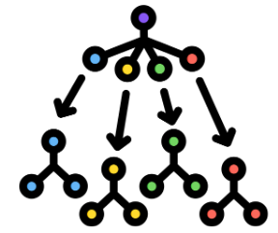
Machine Learning Predictive Models
Random Forest:
An ensemble of many decision trees trained with bootstrap samples (bagging).
At each split, consider only a random subset of features; final prediction by majority vote.
Pros: reduces overfitting, robust to noise/outliers, typically higher accuracy than a single tree.
Cons: slower to train/infer than a single tree; less transparent than one tree.
Machine Learning Predictive Models
07

Slide 12
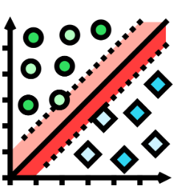
Machine Learning Predictive Models
Support Vector Machines (SVM):
Finds a hyperplane that maximizes the margin between classes in (possibly very) high-dimensional space.
Uses kernels for nonlinear separability; soft margins improve generalization.
Pros: strong regularization, works well with high-dimension/low-sample data.
Cons: computationally heavy at scale; kernel/parameter tuning can be difficult.
Machine Learning Predictive Models
08

Slide 13

Machine Learning Predictive Models
Neural Networks:
Feedforward layers (input–hidden–output) with weighted connections and nonlinear activations.
Trained by backpropagation and gradient-based optimization to minimize loss.
Pros: captures highly complex, nonlinear relationships.
Cons: data- and compute-hungry; architecture and hyperparameter design are challenging.
Machine Learning Predictive Models
09

Slide 14
Methodology and data

Slide 15
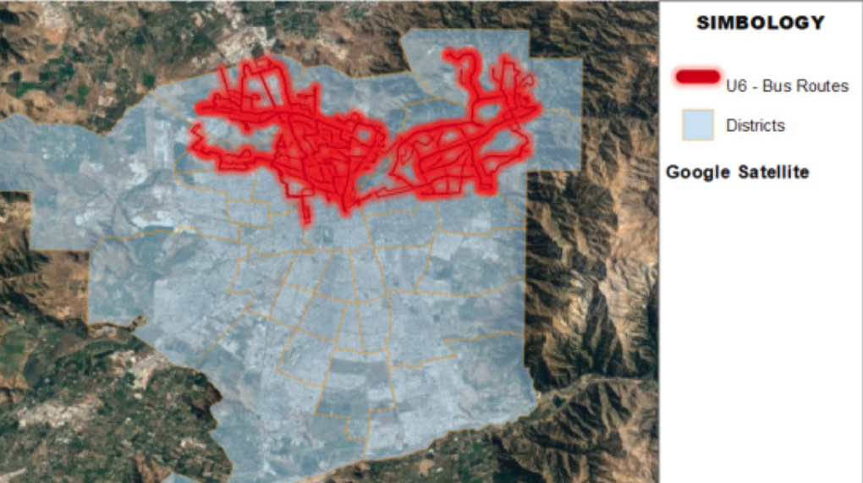
Study Area (Context)
Case: Transantiago (Santiago, Chile)
Focus: Operator U6 (NE area)
102 routes | 1,478 stops | ~160k weekday trips
Data: Mar–Jun 2018, 4,850 records
Coverage: 90% stops | 97% routes
Methodology and data
10

Slide 16
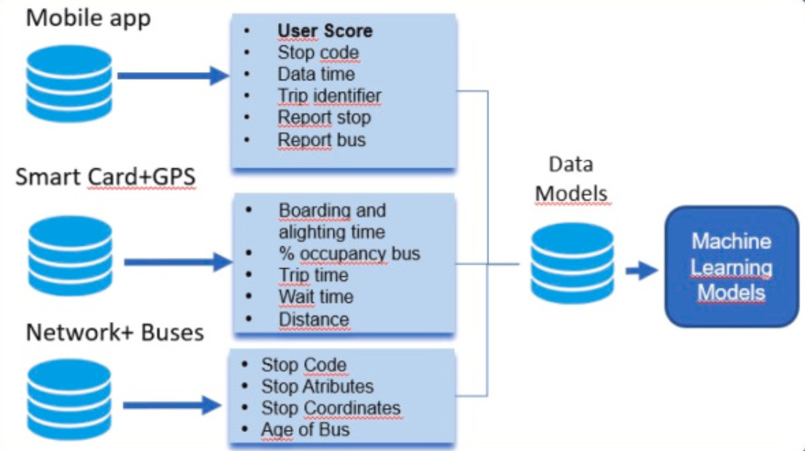
Data Pipeline
Mobile App: Score (1–7), stop/bus eval, timestamp
Network + Buses: stop attributes, vehicle age/cond.
Smartcard + GPS: wait/trip time, occupancy, distance
Matching procedure: smartcard–GPS (Munizaga & Palma, 2012)
Final dataset: 4,090 trips × 17 variables
Methodology and data
11

Slide 17
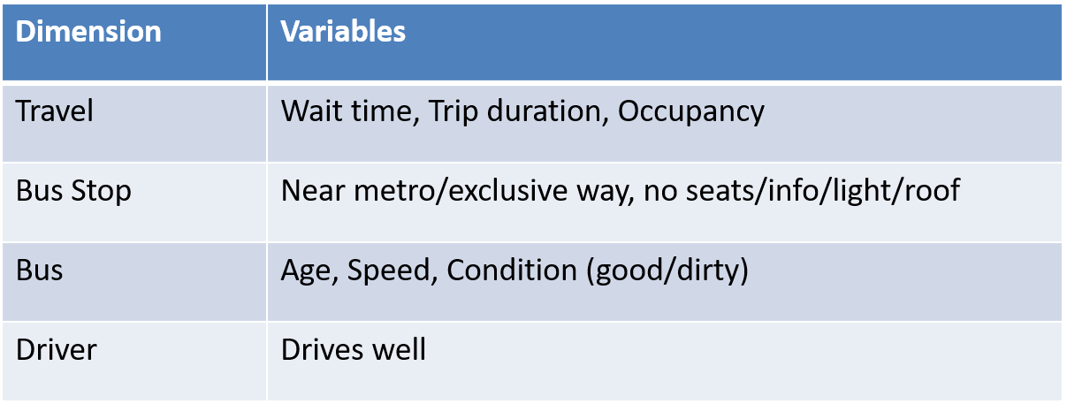
Variables (4 Dimensions)
Methodology and data
12

Slide 18
Target Classes (Score Aggregation)
Methodology and data
13

Slide 19
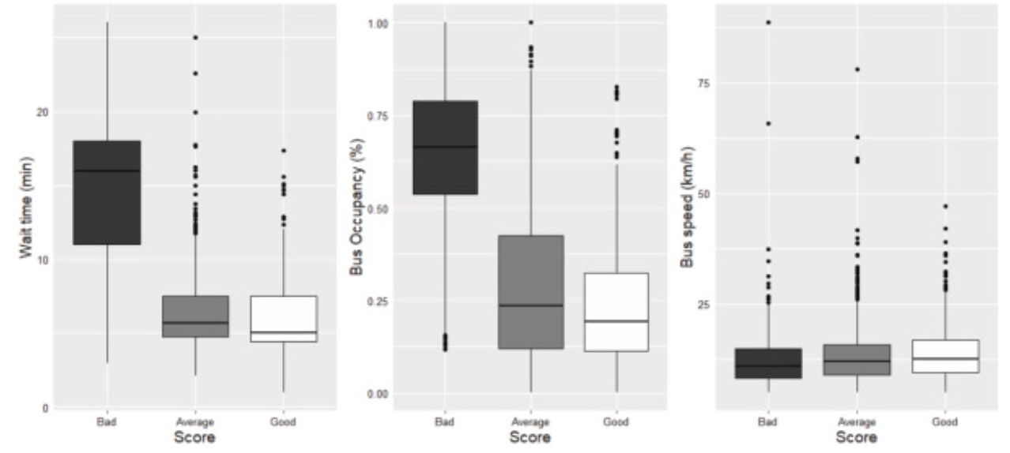
EDA: continuous vars vs Score
Wait ↑ → Score ↓ Occupancy ↑ → Score ↓
Speed difference small
Methodology and data
14

Slide 20
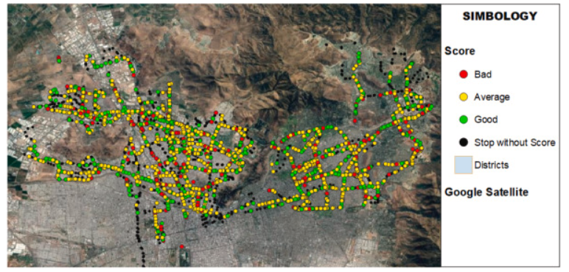
Spatial Distribution of Scores
Bad clusters: congested corridors Good clusters: near metro / better stops
Methodology and data
15

Slide 21
Results and evaluation of models

Slide 22
Evaluation of Models
Purpose: Compare Statistical models & ML models for predicting passenger satisfaction
Data Split
Statistical Models | ML Models
Ordinal Logit | Decision Tree
Multinomial Logit model | Random Forest
 | Support Vector Machines (SVM)
 | Neural Networks
70%/ 2,862 | Estimated for training use
30%/ 1,227 | reserved for prediction testing
Results & Evaluation of Models
16

Slide 23
Statistical models
The same significant variables were found for both the Ordinal and Multinomial Logit models.
Non-Significant Variables:
Trip duration in either model.
Travel | Bus Stop | Bus
Bus occupation Average waiting time Whether the bus had a full bus stop | Presence of seats at the bus stop Presence of lighting at the bus stop | The condition of the bus (good or bad) Whether the bus was clean or not
Results & Evaluation of Models
17

Slide 24
Comparison of Model Performance
ML models provide better predictive performance.
Random Forest is top, followed by SVM and Neural Networks.
Indicator | Ordinal Logit | Multinomial Logit | Random Forest | Decision Tree | SVM | Neural Networks
Accuracy | 0.66 | 0.66 | 0.74 | 0.67 | 0.71 | 0.72
AUC | 0.75 | 0.76 | 0.83 | 0.78 | 0.79 | 0.77
Recall | 0.66 | 0.67 | 0.68 | 0.67 | 0.71 | 0.69
Sensitivity | 0.66 | 0.67 | 0.71 | 0.67 | 0.71 | 0.67
Specificity | 0.70 | 0.71 | 0.78 | 0.73 | 0.76 | 0.74
F1 Score | 0.66 | 0.67 | 0.68 | 0.68 | 0.71 | 0.71
Results & Evaluation of Models
18

Slide 25
Analysis of the Confusion Matrices
Random Forest model performed slightly better than the others.
Use the Random Forest model for the subsequent analysis.
 | Ordinal Logit |  |  | Multinomial Logit |  |  | Random Forest
 | Bad | Avg | Good | Bad | Avg | Good | Bad | Avg | Good
Bad | 79 | 6 | 1 | 86 | 8 | 3 | 81 | 6 | 1
Avg | 29 | 446 | 192 | 18 | 450 | 192 | 27 | 496 | 162
Good | 1 | 189 | 284 | 5 | 183 | 282 | 1 | 119 | 334
 | Decision Trees |  |  | SVM |  |  | Neural Networks
 | Bad | Avg | Good | Bad | Avg | Good | Bad | Avg | Good
Bad | 90 | 12 | 0 | 86 | 8 | 1 | 89 | 9 | 1
Avg | 13 | 436 | 171 | 18 | 446 | 136 | 27 | 439 | 210
Good | 6 | 193 | 306 | 5 | 187 | 340 | 5 | 147 | 300
Results & Evaluation of Models
19

Slide 26
Analysis

Slide 27
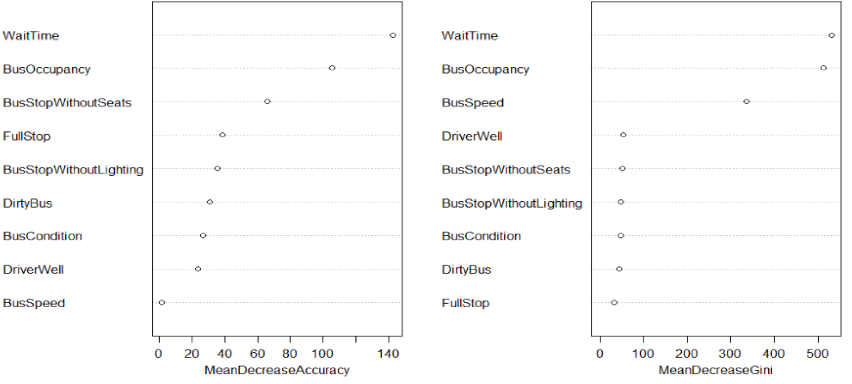

Analysis
Using the best-performing ML model, Random Forest, to identify the key variables that influence passenger service quality evaluations and how they influence them.
Chien, 2005、Garrido et al., 2014、Saleem et al., 2023、Weng et al., 2023.
Analysis
20
Notes:
First, find the order of variable importance through Mean decrease accuracy and Mean decrease Gini.

Slide 28

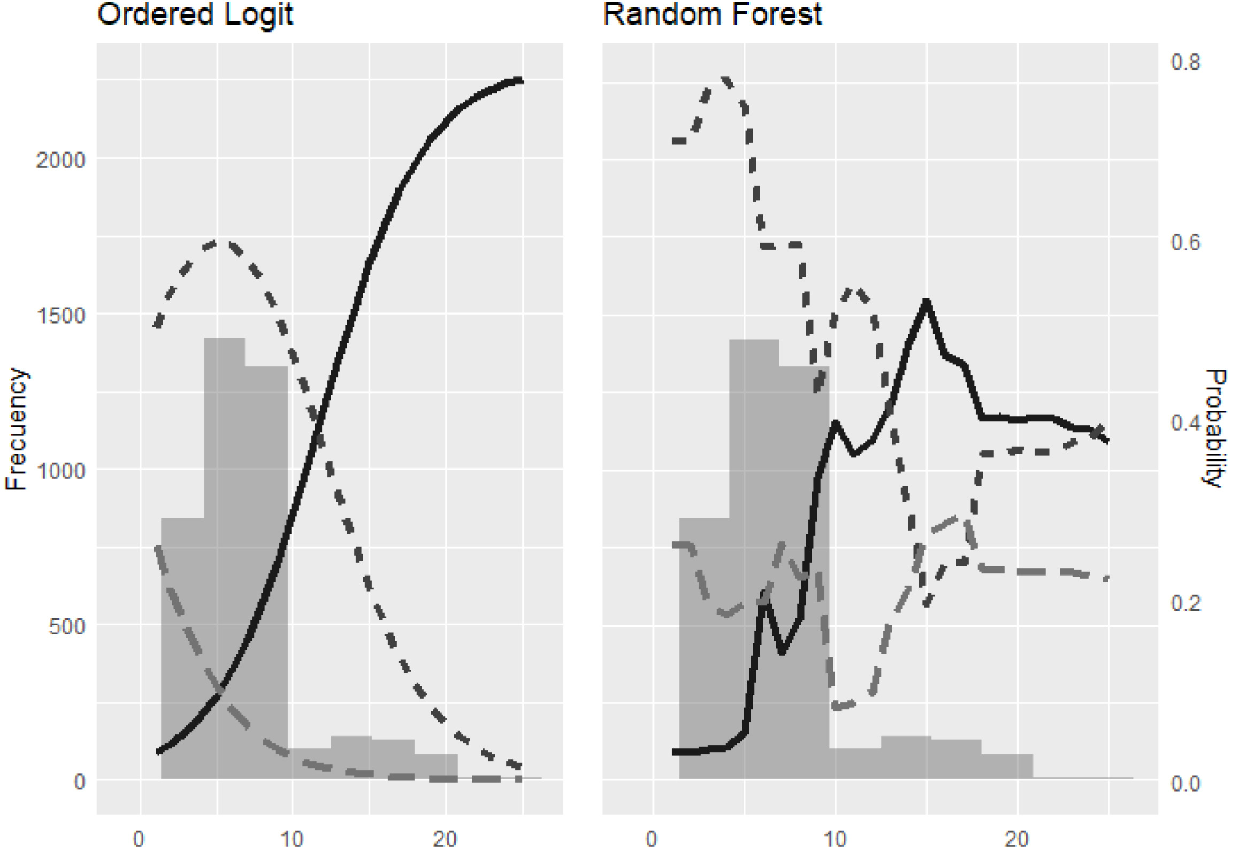
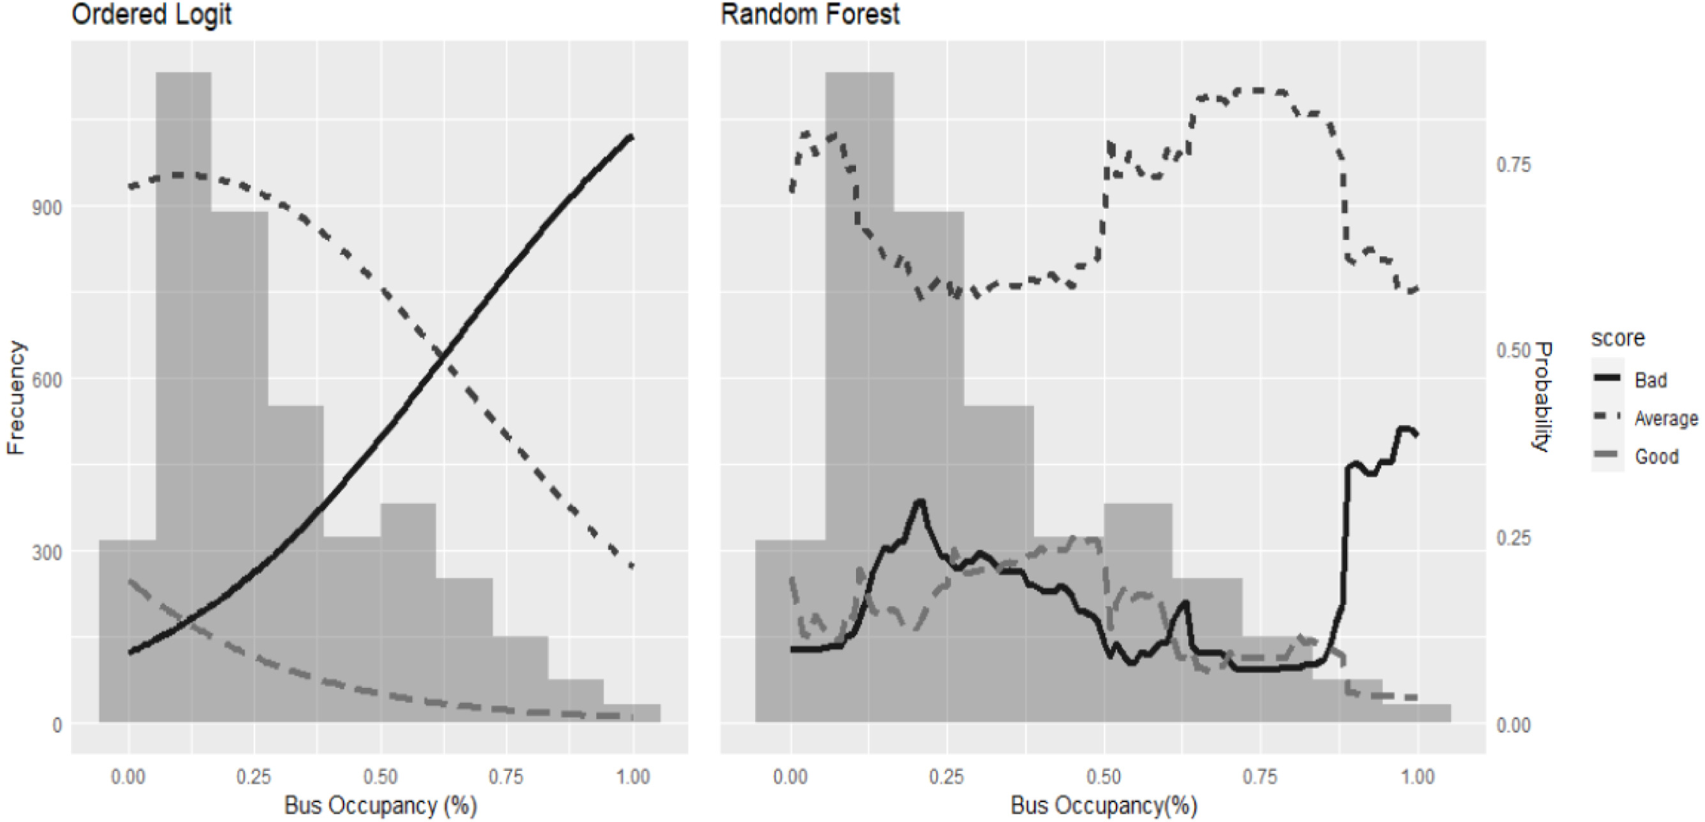
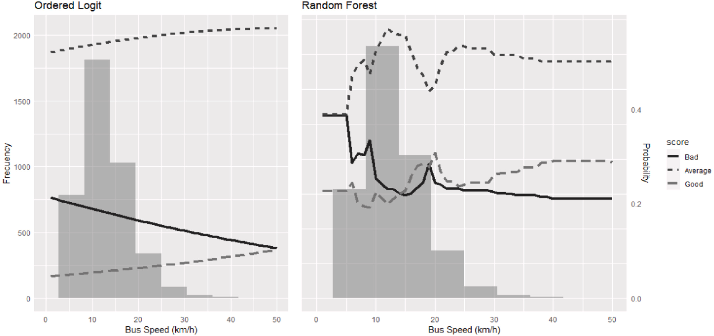

Analysis
Joint changes in the predictor variables are no clear interaction effects with the quality score.
Use Ordered Logit model and Random Forest to explore each variable separately.
10~15 km/h
5 mins
25 %
55 %
10 mins
75 %
85 %
Waiting time(min)
Bus occupancy(%)
Bus speed(km/h)
Analysis
21
Notes:
等待時間十分鐘後又往上?(狀況可能比乘客預期的好所以往上) 圖8的good超過15 公里/小時之後比bad多?(既希望公車行快速抵達，又不希望犧牲安全感)

Slide 29
Discussion

Slide 30
Discussion
Optimize service schedules, reduce waiting intervals, and enhance operational efficiency.
Real-time monitoring and adaptive scheduling enable operations managers to stay updated on system status at all times.
Invest in amenities at transportation stops can enhances the waiting experience.
Waiting time
Use identified critical occupancy levels (e.g., 80%–85%) as benchmarks for acceptable service quality.
Install sensors or vision-based systems on vehicles to monitor occupancy in real time.
Bus occupancy
Address safety concerns linked to high bus speeds through driver training, behavior monitoring systems, and public awareness campaigns.
Bus speed
Discussion
22

Slide 31
Conclusions

Slide 32



Conclusions
3 distinct sources of dataset
3 levels of evaluation socres from the tranportation mobile app
4 kinds of ML model
Conclusion
23

Slide 33


Conclusions
All ML models outperform Ordinal and Multinomial Logit baselines
Random Forests deliver the best predictive performance by flexibly capturing nonlinearities.
Ordinal Logit & Multinomial Logit
4 kinds of ML model
Conclusion
24

Slide 34


Conclusions
RF identifies actionable thresholds:
(i) waiting-time breakpoints around 5 and 10 minutes
(ii) tolerance to bus occupancy up to ~80–85% (with “good” ratings declining from ~55%)
(iii) rising negative ratings beyond a speed threshold (~15 km/h)
Conclusion
25

Slide 35

Conclusions
Future work targets temporal dynamics, cross-context validation, and dynamically updated, interactive tools to monitor and improve low-quality routes/stops.
Conclusion
26

Slide 36
Our comments

Slide 37
Our Comments
Check for Feature Importance
Data integration & preprocessing complexity
Sample size & sampling bias
Supplement the existing Gini-based feature importance with a ranking based on Mean Decrease in Entropy.
Comparing both results can help assess the consistency and robustness of the model's interpretability.
Matching mobile application, bus and stops networks, smartcard and bus GPS data requires complex preprocess; errors in cross-matching or missing value handling may propagate into the model
Depending on APP usage for passenger satisfaction, certain passenger demographics might be overrepresented, may not fully represent all passenger segments or routes, especially for larger transit systems.
Our Comments
27

Slide 38
謝謝大家
Q & A
Notes:
20分鐘簡報+5分種QA

