Slide 1


B V RAJU INSTITUTE OF TECHNOLOGY
(UGC Autonomous)
Vishnupur , Narsapur , Medak District
Department of Artificial Intelligence & Data Science
Major Project – Review
Real-Time Hate Speech Detection with Robust DistilBERT-SVM
By:
G.Yashasree 21211A7221
M. Harshavardhan Reddy 21211A7239
R. Abhishek 22215A7201
Guided By:
Mr. S Pavan Kumar Reddy
Assistant Professor
Department of AI&DS

Slide 2
Outline
Problem Statement and Introduction
Objectives
Related Work
Methodology
Work Flow Diagram
Setup
Results
Deployment and Real-Time Inference
Conclusion and Future Work

Slide 3

Problem Statement and Introduction
Problem Statement : The rise of hate and offensive speech on social media platforms has created an urgent need for automated detection systems. However, the complexity of language and the demand for efficient, real-time solutions present significant challenges.
Social media platforms have become breeding grounds for harmful content, with hate speech fueling online toxicity and division.
Language complexity, as hate speech often varies by cultural, contextual, and linguistic factors, making it difficult to identify universally.
Rapid spread of content, requiring systems to process vast amounts of data quickly and accurately.
Evolving nature of hate speech, as new forms and expressions emerge, challenging existing detection methods.
Addressing hate speech is essential to protect user well-being, reduce societal polarization, and promote safer digital spaces.

Slide 4




Objectives
Develop a hybrid Distil BERT-SVM model to improve hate speech detection accuracy.
Address class imbalance using preprocessing and augmentation for better model fairness
Ensure high accuracy and computational efficiency for real-time hate speech detection
Deploy the model in a Flask-based system for real-time tweet classification.

Slide 5
Related Works
Traditional and Deep Learning: SVM, Logistic Regression, CNNs, and RNNs were used, but struggled with semantics and efficiency (Davidson et al., 2017; Zhang et al., 2018). Paul (2023) achieved 0.94 accuracy with ANN and SMOTE.
Transformers: BERT offered high accuracy but is computationally intensive (Mozafari et al., 2020). DistilBERT reduced overhead (Sanh et al., 2019).
Hybrid Models: BERT-SVM and HateBERT combined transformers with classifiers for better efficiency (Aluru et al., 2020; Caselli et al., 2020).
Real-Time Systems: Flask-based systems enabled real-time inference, but scalability and usability remain gaps (Ribeiro et al., 2021).
Traditional Method (Davidson et.al)
Transformer and Hybrid Models ( Sang et.al ,Mozafari et.al ,Aluru et.al
2018
2021-2023
2017
2019 – 2020
Deep Learning Models (Zhang et.al)
Real-Time Systems and Advanced Models (Ribeiro et.al, paul)

Slide 6
Methodology
Dataset
Davidson et.al dataset(24,783 tweets ,labelled as Hate ,Offensive ,Neutral
Pre-Processing
Lower Case Conversion, Removal of Special Characters, Stop Words, Lemmatization
Augmentation
Increased Representation of Hate and Neither classes by 20%
Model Training
Hybrid DistillBERT – SVM(DistillBert for embedding, SVM with RF Kernel for Classification
Deployment
Flask based Real-Time Inference System

Slide 7
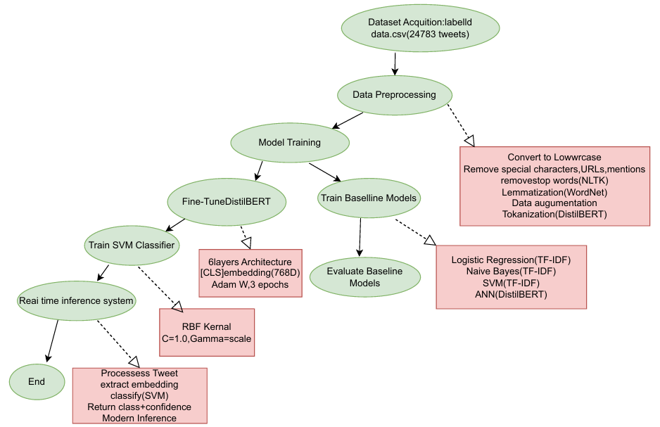
Work flow Diagram

Slide 8
Setup
Data Set Split : 80% training and 20% testing
Training | 80% (19826 tweets)
Testing | 20% (4957 tweets)
Models Evaluated :
Evaluation Metrics
Logistic
Regression
Naïve Bayes
ANN
SVM
DistillBERT-SVM
Accuracy
Precision
F1-Score
Recall

Slide 9
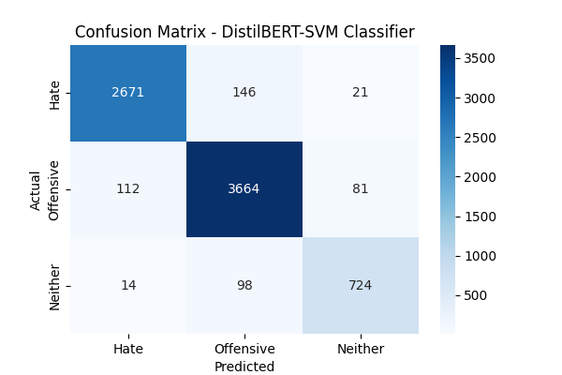
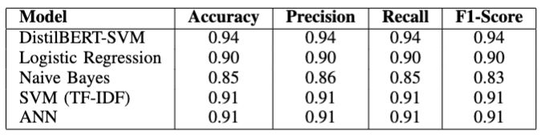
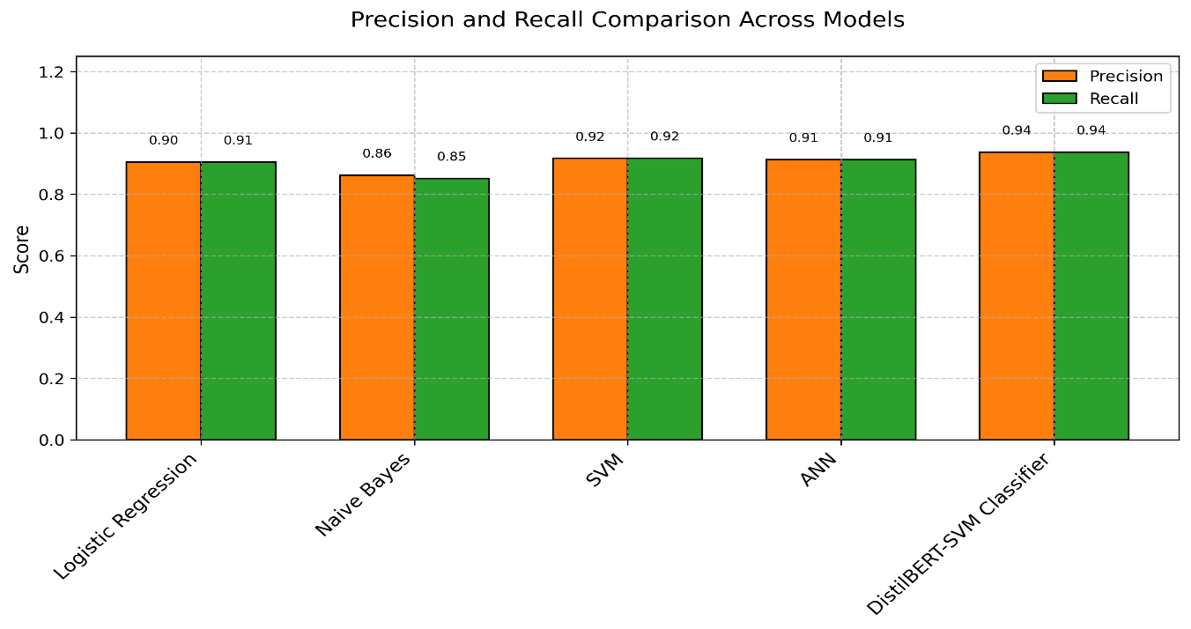
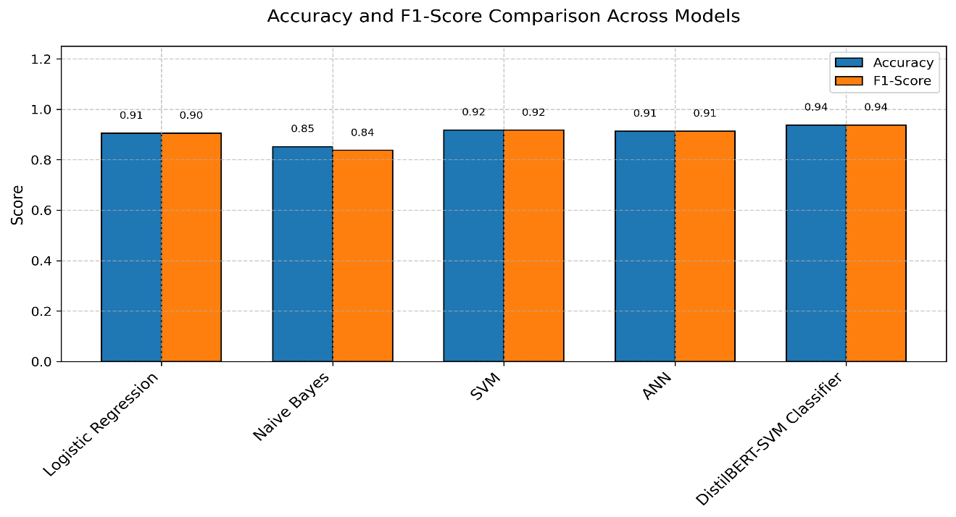
Results

Slide 10
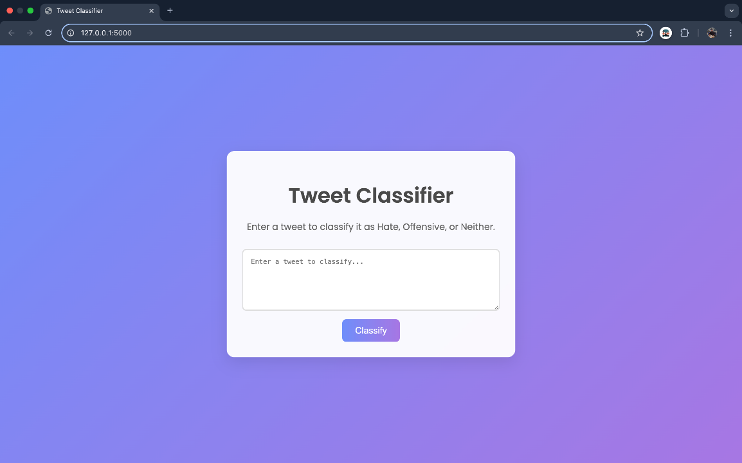

Deployment and Real-Time Inference
Flask-Based System : Deployed the Distil BERT-SVM model for real-time tweet classification on a Flask web server.
Deployment Environment: Hosted on a local server (Intel i5, 16GB RAM, Ubuntu 20.04).
Inference Time: Average of 1.5 seconds per request, enabling real-time moderation.
Features :
User-friendly web interface for moderators to input tweets and receive instant classifications.
Confidence scores with each prediction to prioritize flagged content.
Scalable architecture using asynchronous processing to handle concurrent requests efficiently.

Slide 11
Conclusion
Developed a hybrid Distil BERT-SVM model, achieving a high accuracy of 0.937, outperforming baseline
models like Logistic Regression (0.90).
Addressed class imbalance through preprocessing and augmentation, improving F1-score on the minority
Hate class
Deployed a scalable Flask-based system for real-time inference, processing tweets in 1.5 seconds per
request, suitable for live moderation.
Contributes to ethical AI by enabling safer social media environments through accurate
hate speech detection.
Future Work:
Extend the model to support multilingual hate speech detection for broader applicability.
Integrate advanced contextual analysis to better handle sarcasm and cultural nuances.

Slide 12
Thank You
© BVRIT
AI-DS

