Slide 1
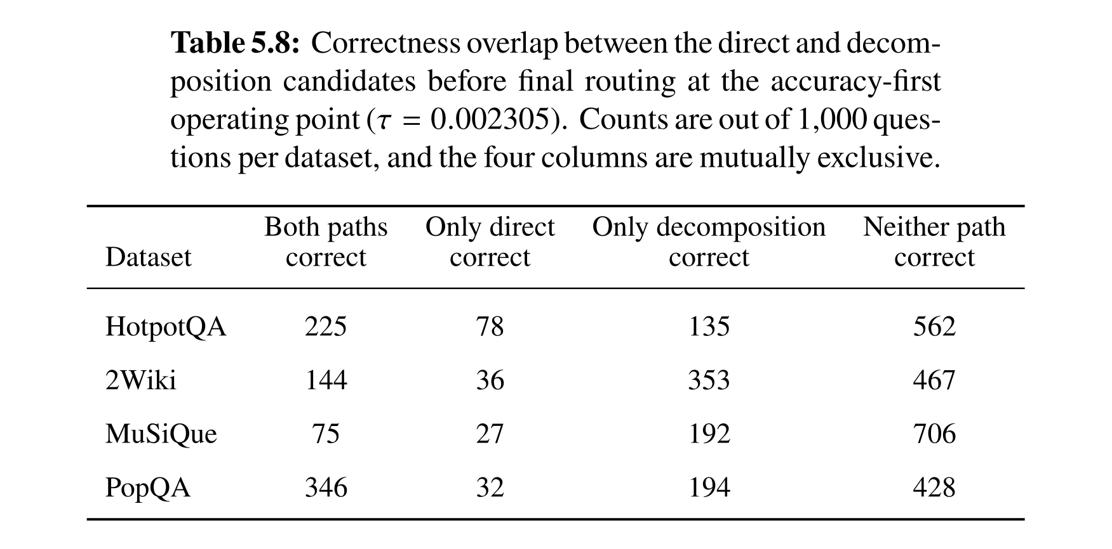
Analysis
Correct Answer Distribution Across Two Paths
Thesis-formatted result · accuracy-first tail-leakage gate τ = 0.002305
Thesis Table 5.8
Decomposition-only wins exceed direct-only wins on every dataset.
50

Slide 2
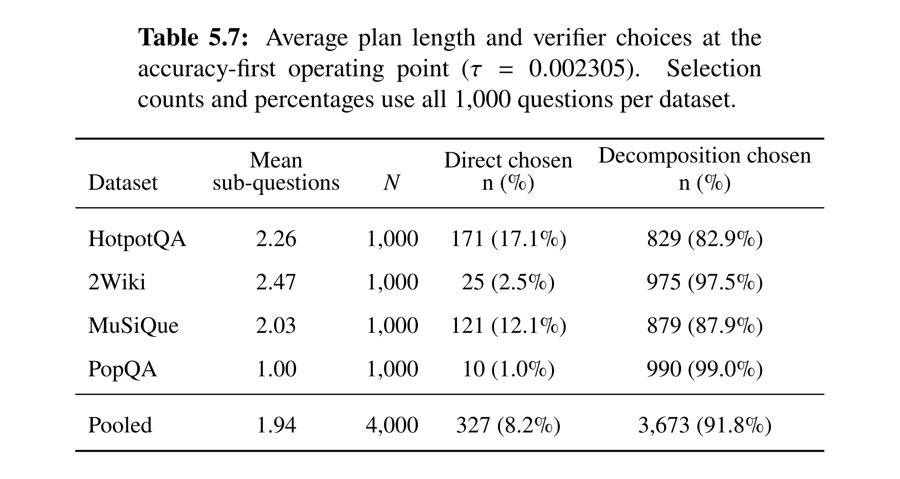
Analysis
Verifier Path Selection
Thesis-formatted result · accuracy-first tail-leakage gate τ = 0.002305
Thesis Table 5.7
The verifier chooses decomposition 91.8% of the time while retaining a direct fallback.
51

Slide 3
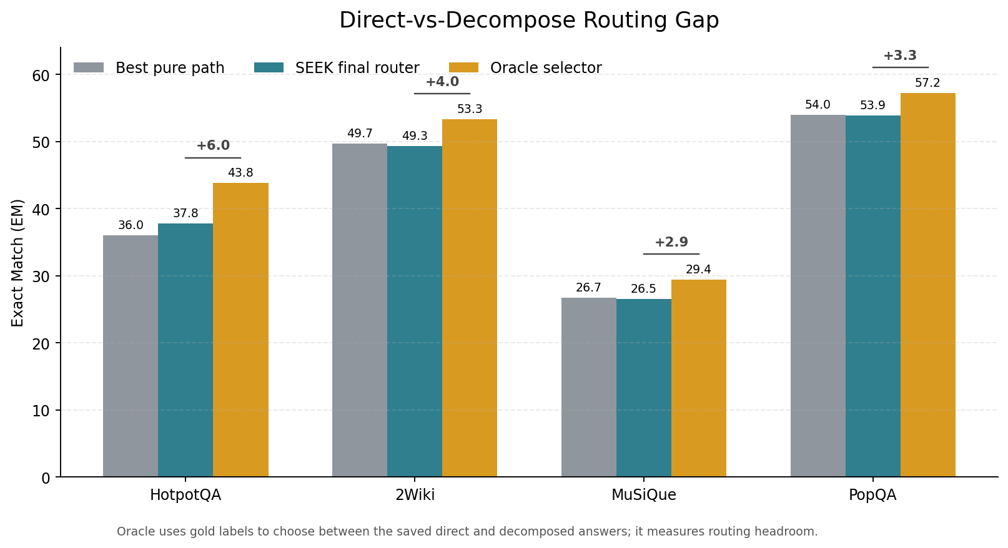
Analysis
Direct-vs-Decompose Oracle Gap
Thesis-formatted result · accuracy-first tail-leakage gate τ = 0.002305
Thesis Figure 5.5
A perfect path selector still offers +4.05 EM on average; HotpotQA has the largest gap (+6.0).
52

