Slide 1
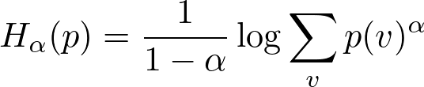

Methodology
Lower α Reveals Tail Uncertainty
Formula relationship → weighting mechanism → empirical error detection
1
DEFINE
2
REWEIGHT
3
DETECT
Connect Rényi to Shannon
See what α changes
Measure the empirical effect
Rényi entropy family
Same probabilities, different emphasis
2Wiki error-detection AUROC ↑
Effective weight ∝ p(v)^α
+0.065
α = 2
α → 1
α = 0.5
0.716
α → 1
HEAD-SENSITIVE
SHANNON
TAIL-SENSITIVE
0.671
0.651
α → 1 recovers Shannon entropy.
head
tail
head
tail
head
tail
0.50
α = 2
α → 1
α = 0.5
One parameter controls which probabilities matter.
Lower α → stronger tail influence
Tail-sensitive α = 0.5 performs best.
As α decreases, tail influence and error-detection AUROC both increase.

