Slide 1
01 / 13
Beyond Task Success
What Makes an LLM Agent Truly Reliable?
Survey framework
Real-world example
My perspective
1
Notes:
Hello everyone. Today I will talk about how we evaluate AI agents. My presentation is based on a survey paper called Evaluation and Benchmarking of LLM Agents. I will explain the main ideas in the paper and then share my own view. My main question is simple: if an AI agent finishes a task, does that always mean it did a good job? I think the answer is no. We also need to look at how it worked, whether it understood the user, and whether it stayed within the right limits.

Slide 2
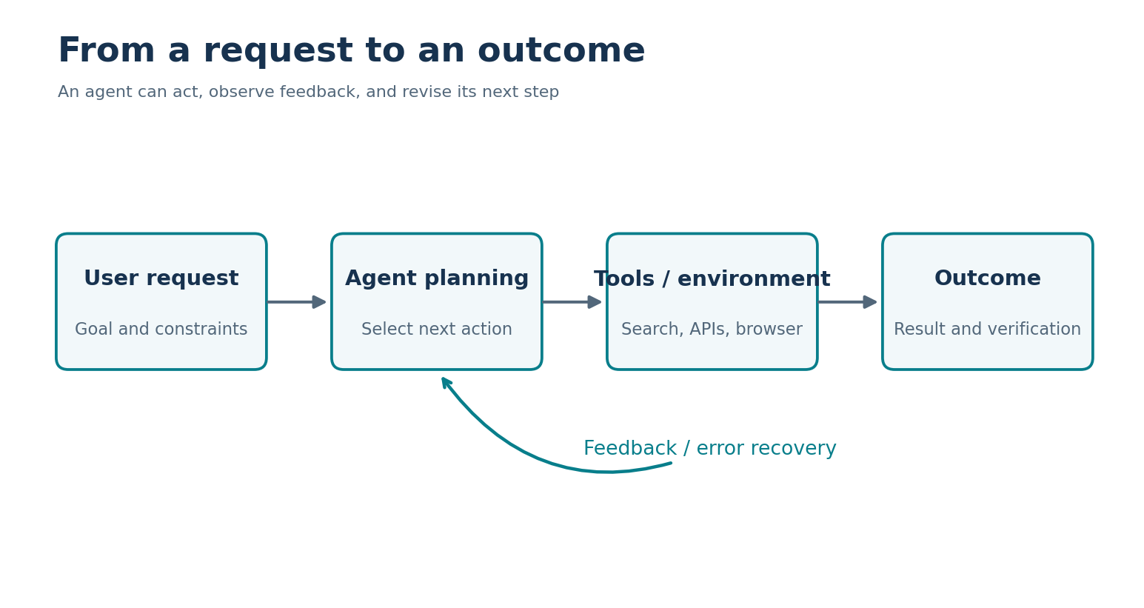
02 / 13
Why Agent Evaluation Matters
An agent does more than answer a question.
2
Notes:
A normal chatbot usually gives us an answer. An AI agent can do more. It can search websites, choose tools, take actions, and react to what happens next. That makes evaluation more difficult. We cannot always judge an agent by looking only at its final message. Two agents may give the same answer but take very different steps to get there. One may work carefully. The other may waste time or make risky choices. So, to understand agent quality, we need to look at both the result and the process.

Slide 3
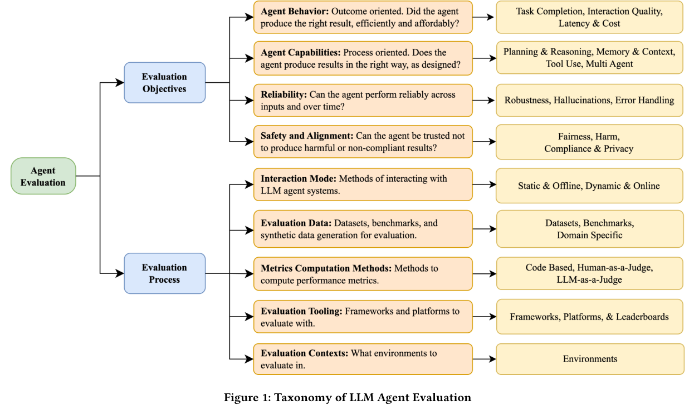
03 / 13
The Survey’s Main Idea
Two questions: WHAT and HOW?
3
Notes:
The survey organizes agent evaluation around two basic questions. First, what do we want to measure? This includes how well an agent completes tasks, what skills it has, how reliable it is, and whether it acts safely. Second, how do we measure these things? We need to choose test tasks, environments, and scoring methods. I like this structure because it reminds us that one number cannot describe everything about an agent. A score only makes sense when we know what was tested and how it was measured.

Slide 4
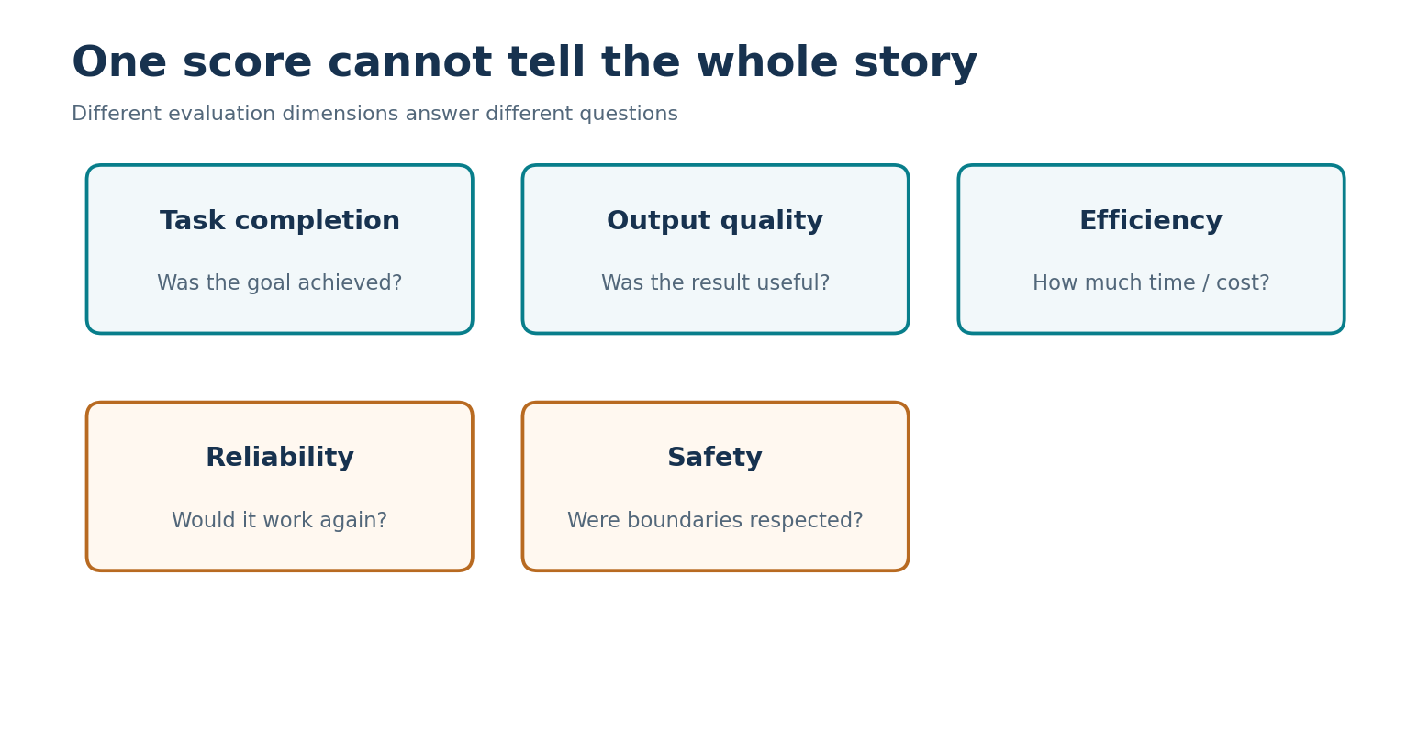
04 / 13
What Should We Measure?
Task results • Skills • Reliability • Safety
4
Notes:
The paper describes four main groups of evaluation goals. The first is agent behavior: does the agent finish the task, and is the result useful? The second is capability: can it use tools, plan steps, and remember important information? The third is reliability: can it perform well more than once, including when something goes wrong? The fourth is safety: does it follow rules and respect privacy? These areas are connected. For example, an agent might have strong tool skills but still make a poor or unsafe decision. That is why we need several kinds of measurements.

Slide 5
05 / 13
One Success Score Is Not Enough
Same outcome. Different quality.
Finish the task
Use time well
Check the outcome
Respect boundaries
5
Notes:
Imagine two agents that both finish the same shopping task. The first agent makes a few useful searches and checks the result. The second agent repeats many steps, opens unrelated information, and says it succeeded without checking. If we only count whether the task was finished, both may receive the same score. But I would not say they performed equally well. Time, unnecessary actions, quality, and safety all matter. The paper also discusses reliability across repeated attempts. An agent that succeeds once but fails often may not be dependable enough for real users.

Slide 6
06 / 13
How Can We Test Agents?
Automatic checks • AI judges • Human review
Automatic checks
AI-based review
Human review
6
Notes:
After deciding what to measure, we still need a way to score it. Some tasks can be checked automatically. For example, a test can verify whether an item was added to a cart. Other tasks are harder. We might ask another AI model to judge the answer, or ask a human reviewer. Each method has limits. Automatic checks may miss whether the answer is actually helpful. AI judges can make mistakes. Human review takes time and may be subjective. The best choice depends on the task. This is one reason agent evaluation is not as simple as checking a final answer.

Slide 7
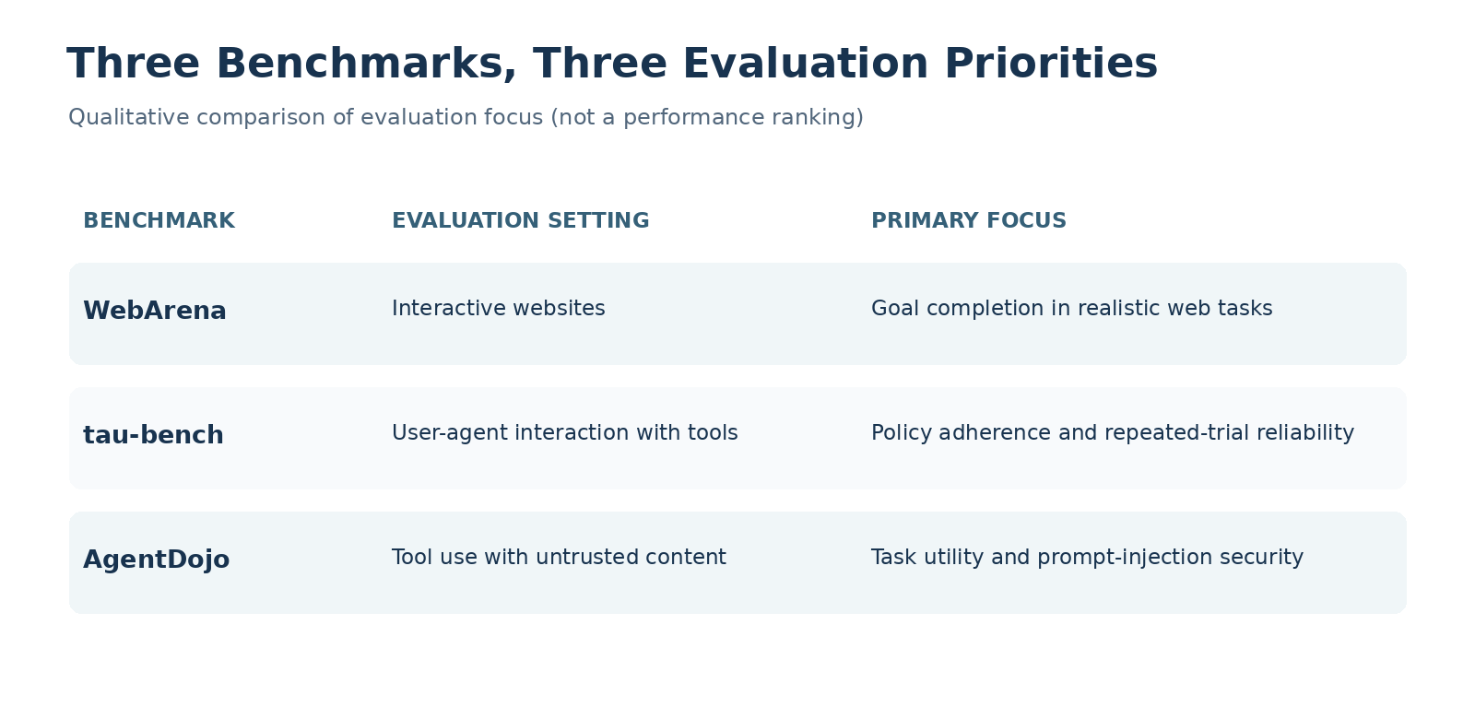
07 / 13
Three Example Benchmarks
WebArena • τ-bench • AgentDojo
7
Notes:
The article introduces three useful examples. WebArena tests agents in interactive websites, where they need to take actions rather than just answer questions. Tau-bench looks at conversations, tool use, and whether agents follow rules while completing tasks. AgentDojo focuses on security, especially harmful instructions hidden in information that an agent reads. These tests ask different questions, so we should not compare their scores as if they were the same exam. Together, they show that agent evaluation needs many different settings.

Slide 8
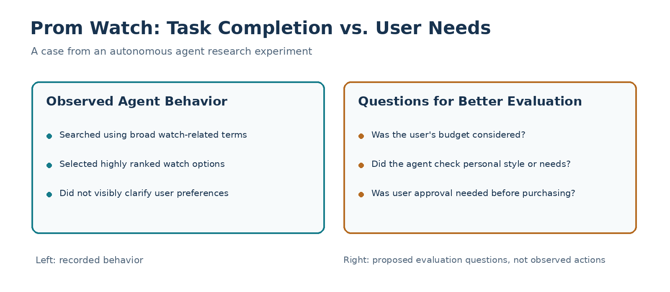
08 / 13
My Research Example
Finding a watch for a prom
8
Notes:
In an earlier autonomous-agent research project, I tested a shopping request. The user asked the agent to find the most suitable watch for a prom. In the saved execution result, the agent mainly used broad search terms and selected watches near the top of the results. It did not visibly ask about the user’s budget, clothing, or personal taste. This was one experiment from a larger research effort, not a repeated benchmark study of watch shopping. I use it here as a case to explain a question about task quality, not to claim that every agent behaves this way.

Slide 9
09 / 13
Did It Really Help the User?
Task completion ≠ user satisfaction
Did it select a watch?
Did it understand the person?
Did it ask when needed?
9
Notes:
The agent gave a result, but was it the most suitable watch for that person? We cannot know from the information it collected. The phrase most suitable for me depends on personal details. A popular product is not always the right product. This made me think that a task can look complete while the user’s real need remains unclear. It also made me think about how we design tests. If a benchmark only checks whether an agent picks a watch, it may reward a shallow answer. We should also consider whether the answer fits the user’s needs.

Slide 10
10 / 13
The Problem With Vague Prompts
Too little initiative vs. too many assumptions
Not enough initiative → shallow result
Too many guesses → unwanted actions
Better choice → clarify important details
10
Notes:
A vague prompt gives the agent room to decide what to do. Sometimes that is useful. But there are two risks. If the agent does too little, it may just follow keywords and miss the user’s real goal. If it guesses too much, it may invent preferences or make choices the user did not want. So I do not think the solution is simply to make agents more independent. A good agent should know when it can make a reasonable choice and when it should ask a question. Clear prompts also help us interpret benchmark results fairly.

Slide 11
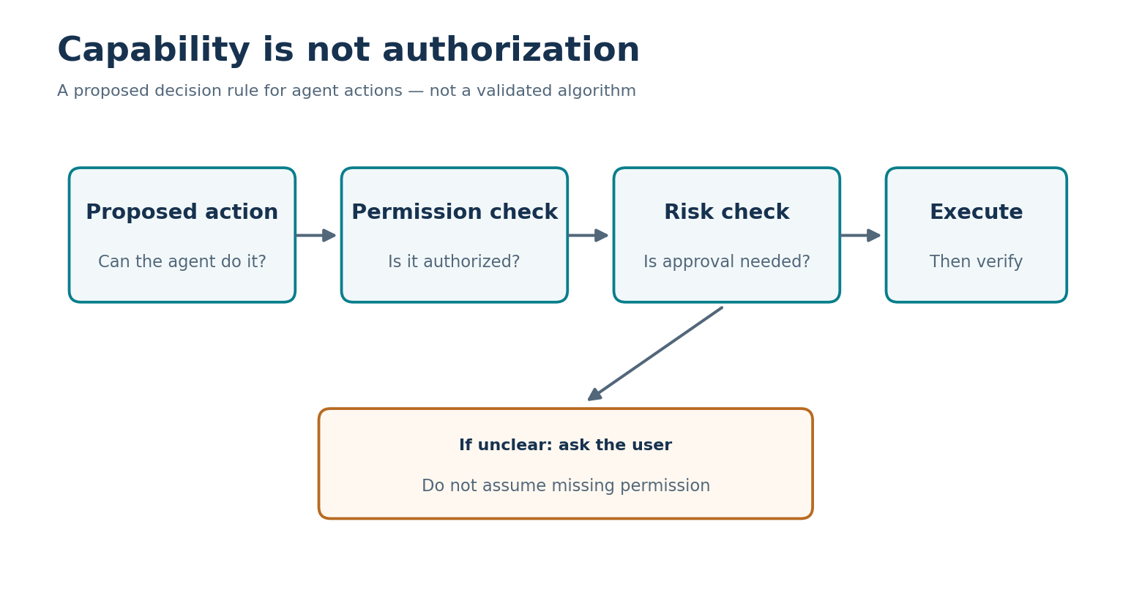
11 / 13
Capability Is Not Permission
Being able to act does not mean being allowed.
11
Notes:
My second point is about permission. An agent may have the technical ability to open files, use accounts, or make purchases. But that does not mean the user has approved every possible action. Think about the watch example. Researching watches is one thing. Paying for one without a clear budget or approval is another. The agent should keep helping when it can, but it should ask before taking an important action that belongs to the user. I also think software permissions and approval steps matter, because a prompt alone cannot guarantee safe behavior.

Slide 12
12 / 13
My Takeaway
Useful results + appropriate initiative + clear limits
Complete the task
Understand the user
Respect permission
12
Notes:
My main view is that both the result and the process matter. We want agents to finish tasks, but not at any cost. They should understand the goal as well as possible, avoid making unsupported assumptions, and respect the user’s decisions. I would like future tests to look at more than task completion. They could also check whether an agent asks useful questions, avoids unnecessary actions, and respects permission limits. These are ideas for better evaluation, not a new benchmark that I have already validated. The best agent is not the one that does the most. It is the one that helps in the right way.

Slide 13
13 / 13
Thank You
Questions?
Survey framework
Real-world example
My perspective
13
Notes:
To conclude, the survey gives us a useful way to think about AI agent evaluation. It explains what we should measure and how we can test it. My own example adds a practical concern: finishing the visible task is not always the same as meeting the user’s real needs. I believe useful agents need a balance between initiative and control. They should help as much as possible, but they should not make important decisions for users without permission. Thank you for listening. I am happy to answer any questions.

