Slide 1

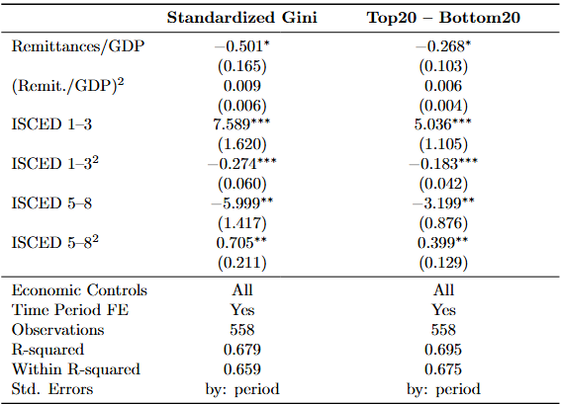
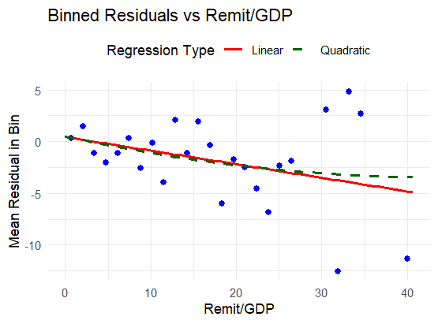
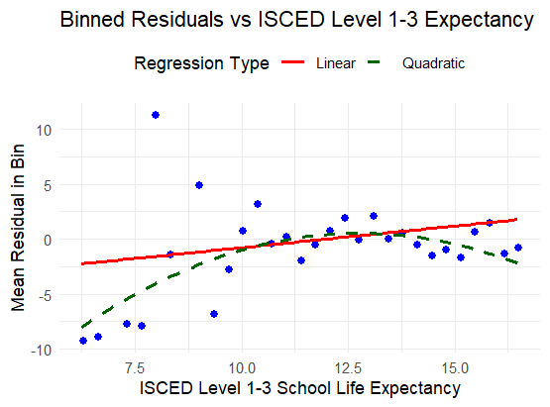
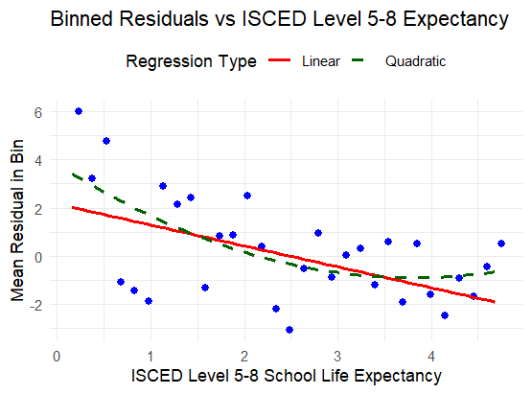
The Relationship Between Remittance Dependence and Income Inequality Across Countries Heyang Liu, Advised by Kyle Coombs Department of Economics, Bates College
Introduction
According to World Bank data, personal remittances have increased more than tenfold over the past three to four decades. However, not all countries are equally involved in this trend. Some economies are highly dependent on remittances, with inflows accounting for over 30% of their GDP. Yet, other countries with similar economic conditions show minimal reliance on remittances. This raises an important question: how does such variation in remittance dependency affect countries with similar economic conditions? One possible hypothesis is that it may influence income inequality.
Research Question: How does a country’s dependence on international remittances affect its income inequality?
Method
The Primary regression includes both the linear and quadratic terms of the remittance-to-GDP ratio and two education control variables.
Country-specific macroeconomic indicators (included in linear form only) are added to control the economic conditions of each country. These variables serve two purposes:
To account for macro-level influences on inequality, and
To substitute for country/region fixed effects using economic contexts.
Time fixed effects are introduced through the construction of 13 time periods, rather than yearly dummies. This strategy:
Ensures sufficient observations within each period, especially during earlier years, and
Avoids splitting across major historical/economic milestones (e.g., the 1991 dissolution of the Soviet Union, and the 2008 financial crisis).
Results Summary & Discussions
Income inequality is negatively and linearly associated with remittances as a share of GDP. This finding contrasts with previous literature that often reports an inverted U-shaped relationship.
Basic education (ISCED 1–3) shows an inverted U-shaped relationship with income inequality, while higher education (ISCED 5–8) exhibits a U-shaped pattern.
Role of Economic Controls:
Without them, remittances show an inverted U-shaped relationship with inequality—but this disappears once controls are added.
These controls also make education variables significant and reveal the U-shaped effect of higher education, which becomes statistically robust with time fixed effects.
This suggests that economic structure may play a more important role in shaping inequality than education alone.
The core findings hold consistently across two different measures of inequality (the Gini index and the income share difference) and remain robust even when using reduced sets of macroeconomic controls.
The data used are more complete in the modern era and for more developed countries. This may introduce selection bias.
Given possible endogeneity concerns, particularly reverse causality between inequality and remittance inflows, future studies may consider employing instrumental variable techniques to strengthen causal inference.
Previous Literature
The effect of remittances on income inequality follows an inverted U-shaped pattern( Koechlin & León, 2006)
The impact of remittances on inequality varies by region—they increase inequality in South Asia, reduce it in Eastern Europe, Latin America, and Sub-Saharan Africa, and show no significant effect in the MENA region (Anwar, Mang, & Plaza, 2024).
The skill composition of migrants influences inequality outcomes—low-skilled migrants tend to remit more and reduce inequality, while high-skilled migrants remit less. Education significantly affects poverty, but its role in inequality is more nuanced (Kratou & Khlass, 2022; Murodova, 2018).
Data
The ratio of remittance to GDP is obtained from the World Bank.
Two inequality measures are used: the standardized Gini coefficient and the income share difference between the top 20% and bottom 20%, both from the WIID Companion dataset (United Nations, 2024).
School life expectancy is drawn from ISCED levels 1–3 (primary to high school) and ISCED levels 5–8 (tertiary to doctoral), reflecting basic and higher education respectively (United Nations, 2016). (School life expectancy = sum of enrollment rates by age)
Macroeconomic indicators are taken from the World Economic Outlook database (IMF, 2024), using only data in index, percentage, or international dollar formats to ensure comparability across countries and time.
Due to data limitations, the final dataset is constructed as the intersection of the sources above and converted into a panel data format. The resulting panel includes 72 units from 1980 to 2015, with a total of 558 observations.
Acknowledgements:
I would like to thank Professor Kyle Coombs for helping me refine my research methodology and for suggesting the visualization approach. I am also grateful to all the professors who have taught me and to my classmates for their valuable feedback and support along the way.

