Slide 1
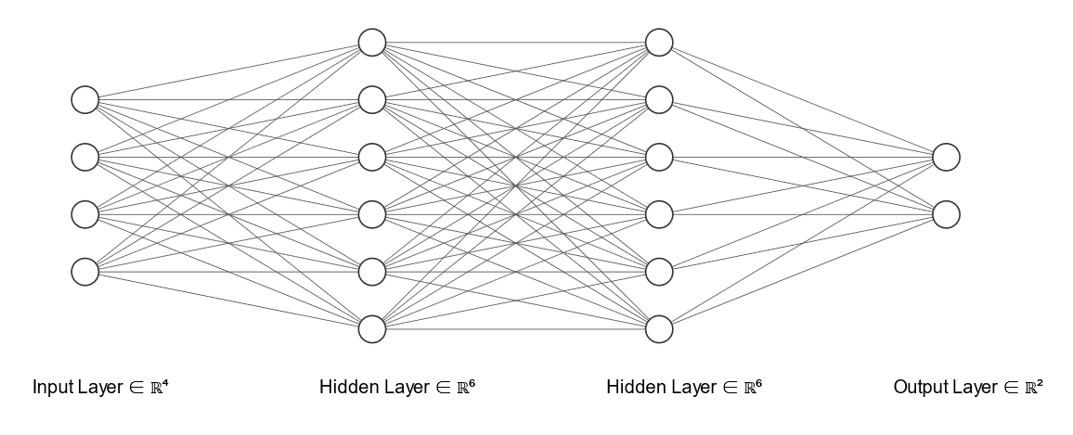
Backpropagation
ReLU
ReLU
ReLU
Y1
Y2
Y3
Ratio

