Slide 1

TITLE OF PRESENTATION
임인혁 임경호 현병훈

Slide 2
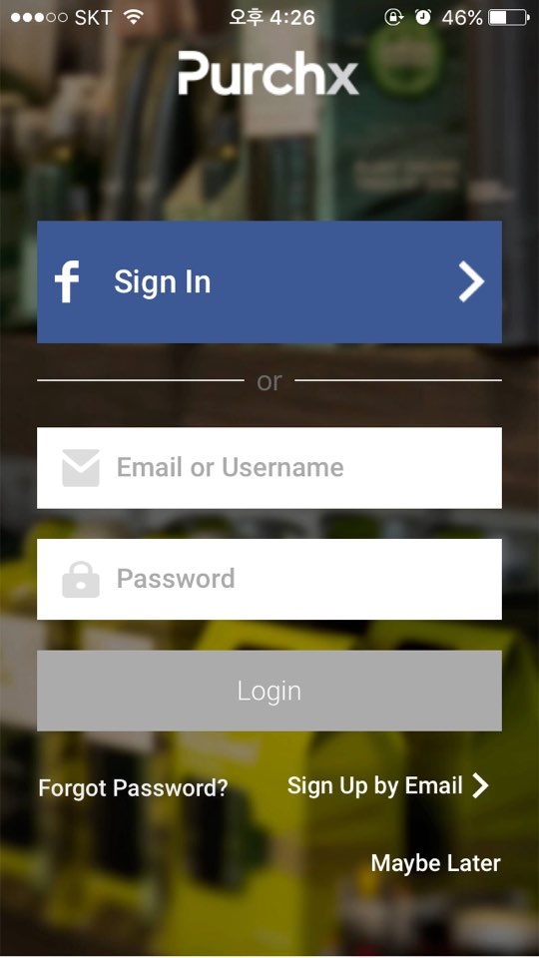

User Interface
Login Screen
E-mail
Password
Login button
Facebook login

Slide 3
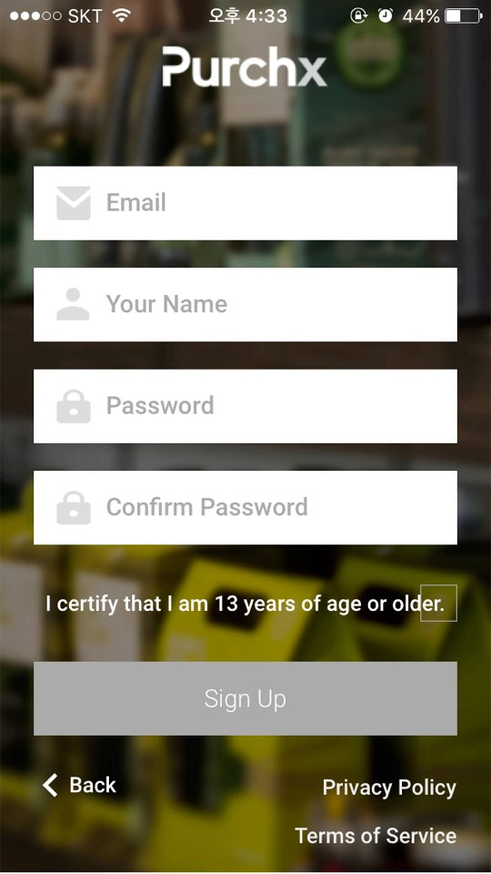

User Interface
Sign Up Screen
E-mail
Your Name
Password
Confirm Password
Sign up button

Slide 4
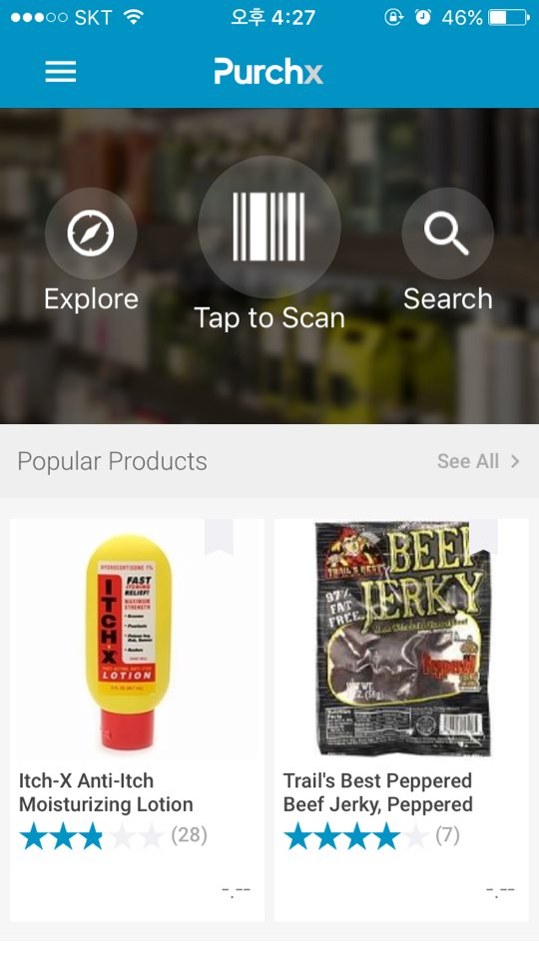
User Interface
Main Screen
Explore category
Barcode to Scan
Search
Review list
Menu bar

Slide 5
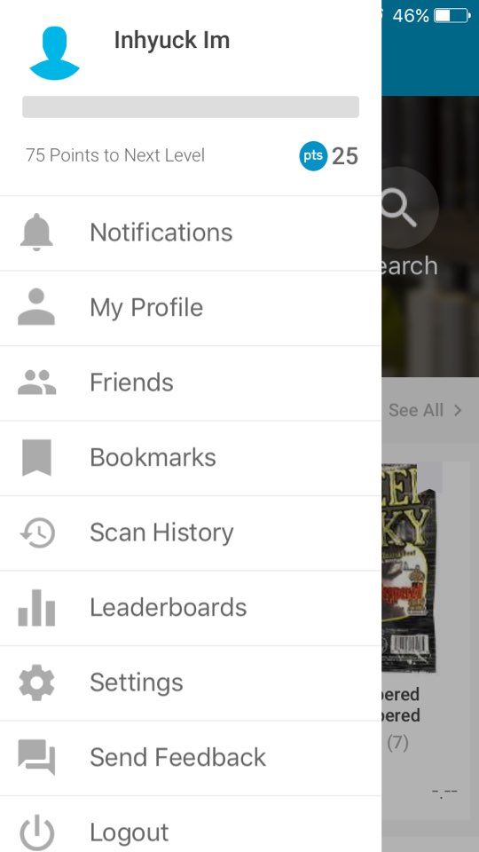
User Interface
My menu Screen
Notifications
My Profile
Bookmarks
Alarming On / Off
Accumulated Point
Logout

Slide 6
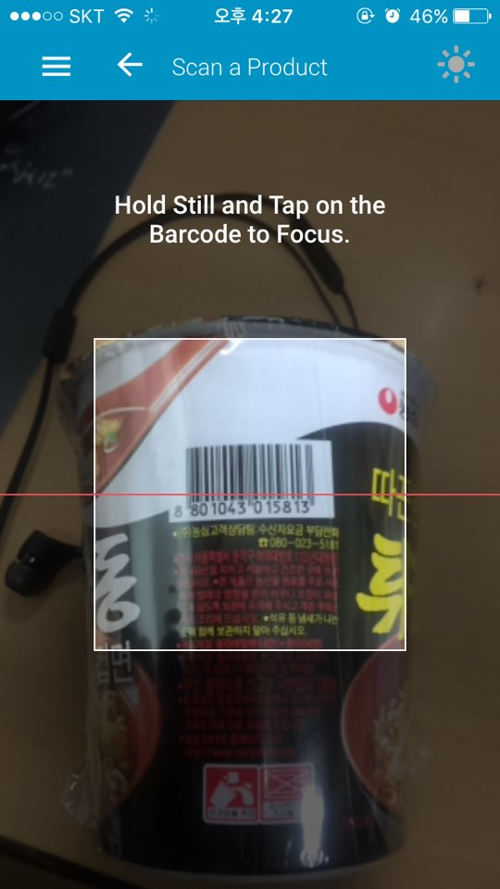
User Interface
Barcode Screen
Focus on
Barcode line

Slide 7

User Interface
Review Screen
Product image
Explanation of product
Explanation of product
Rating of product

Slide 8
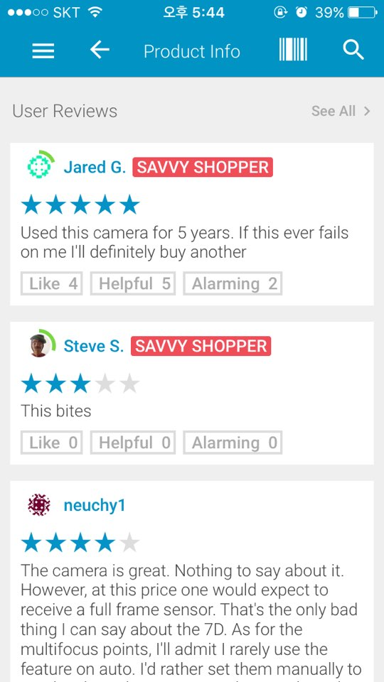
User Interface
Review Screen
Different consumer
Review content
Like button

Slide 9
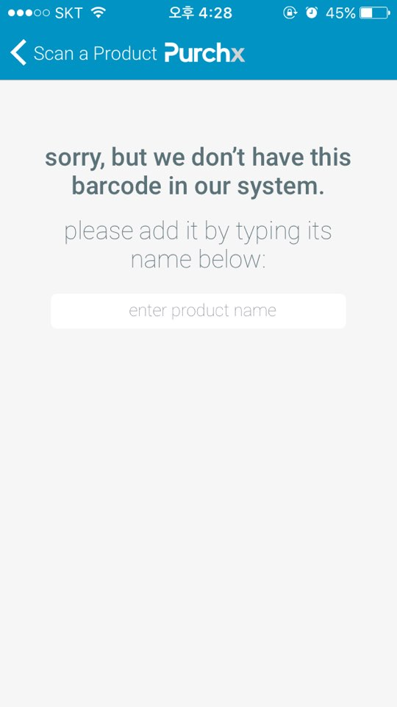
User Interface
No exist Screen
Apology statement
The first review registration

Slide 10
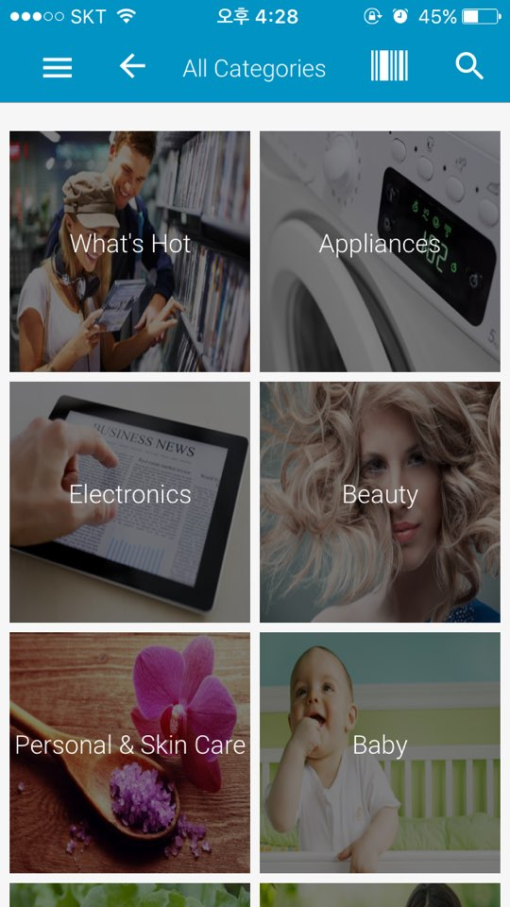
User Interface
Category Screen
Products image
Products list

Slide 11
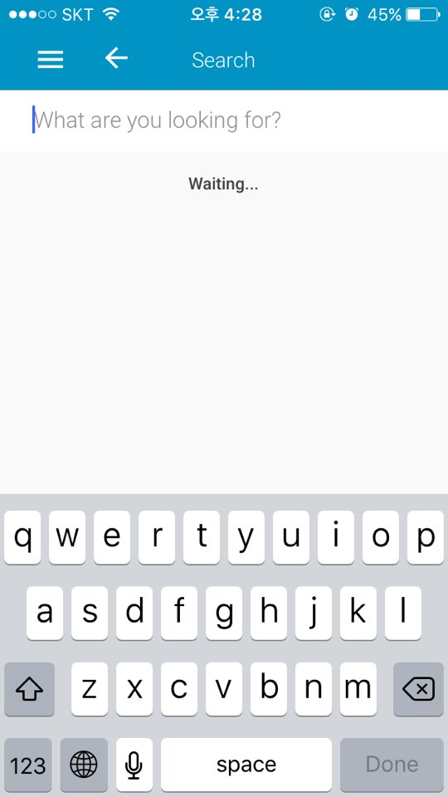
User Interface
Search Screen
Search Box
Keyboard Pop Up

Slide 12
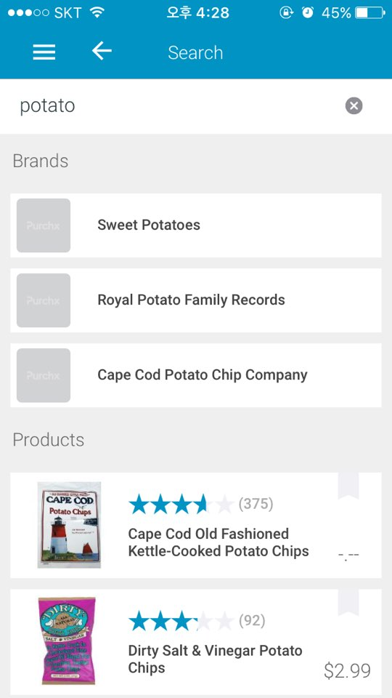
User Interface
Search Screen
Search Box
Keyboard Pop Up
Search Results
Results Image

Slide 13
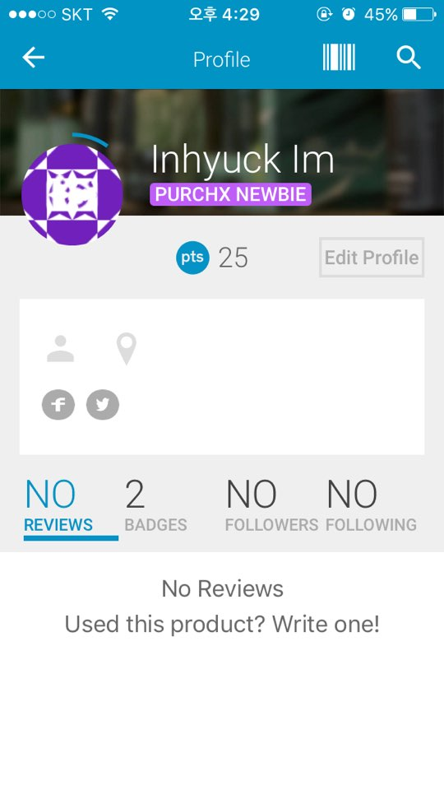
User Interface
Profile Screen
Name
Accumulated Point
Accumulated Reviews

Slide 14
TITLE OF PRESENTATION
THANK YOU.

