Slide 1

Phishing Website Classification
Viveak k
717824Z160 26/10/2025

Slide 2
Project Overview
Classify websites as Legitimate or Phishing.
Multi-algorithm machine learning pipeline.
Evaluation using Accuracy, AUC, Confusion Matrices.
Visualizations include ROC curves, Pie charts, Feature Importance.

Slide 3
Dataset
Dataset: Training Dataset.arff
Number of Observations: 11,055
Number of Features: 31
Features include: URL_Length, SSLfinal_State, DNSRecord, etc.
Target: Result (-1 = Legitimate, 1 = Phishing)

Slide 4
Data Pre-processing
Convert factors to numeric where necessary.
Train-Test split: 80% train, 20% test.
Numeric encoding for Logistic Regression, SVM, and ROC computation.
Handle multi-level features (e.g., 3-level features mapped to numeric).

Slide 5
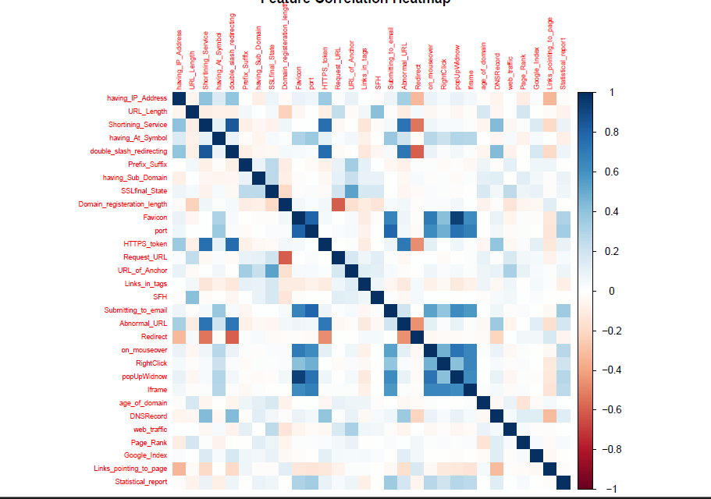
Exploratory Data Analysis
Original Class Distribution (Pie Chart)
Correlation Heatmap of numeric features.
Insights: Identify highly correlated features.

Slide 6
Machine Learning Models
Random Forest
Decision Tree
Logistic Regression
k-Nearest Neighbors (kNN, k=5)
Support Vector Machine (SVM)

Slide 7
Model Evaluation Metrics
Accuracy
Confusion Matrix
ROC Curve & AUC
Feature Importance (Random Forest)
Decision Tree Plot

Slide 8
ROC Curves
Display ROC curves of all models in one graph.
AUC scores for comparison:
Random Forest: 0.98
Decision Tree: 0.92
Logistic Regression: 0.90
kNN: 0.88
SVM: 0.95

Slide 9
Confusion Matrices
Visualize confusion matrices for all models.
Helps identify False Positives and False Negatives.

Slide 10
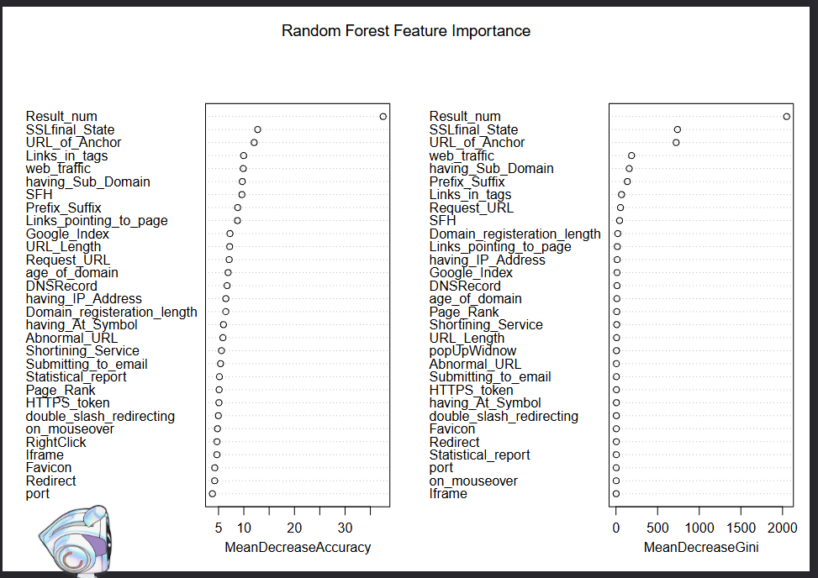
Feature Importance & Decision Tree
Random Forest Feature Importance (bar chart).
Decision Tree structure plot.
Insight: Top contributing features to phishing classification.

Slide 11
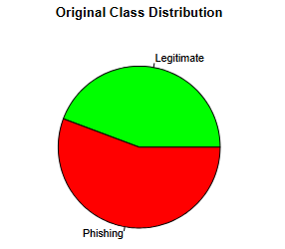
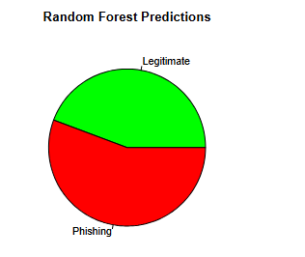
Predicted Class Distribution
Pie charts for predicted outputs of each model.
Compare predicted vs original class distribution.

Slide 12
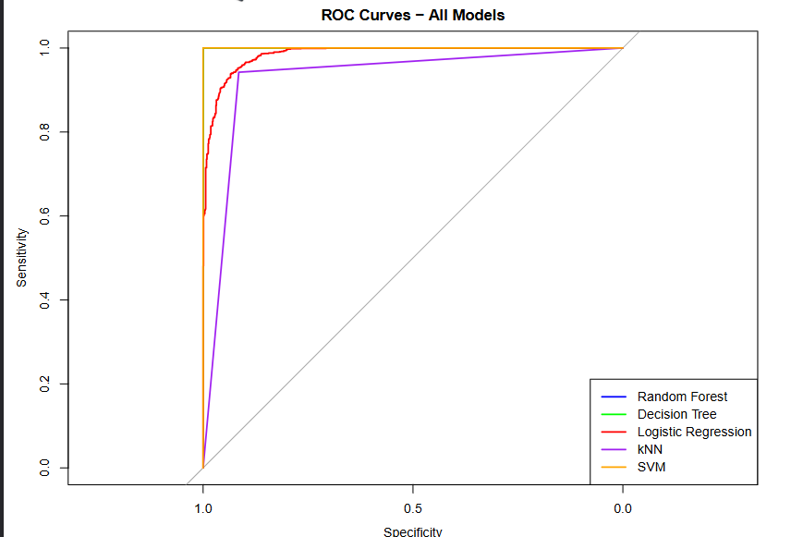
Model Comparison
Accuracy and AUC comparison (bar chart).
Best performing model: Random Forest.

Slide 13
Conclusion
Multi-algorithm comparison ensures robust evaluation.
Random Forest provides highest accuracy & feature interpretability.
Model can be deployed for real-time phishing detection.
GitHub ropository- link https://github.com/HYPER-VIVEAK/R-mini_project.git

Slide 14
References
R packages: caret, randomForest, rpart, pROC, ggplot2
Dataset: Phishing Websites Dataset (ARFF)
GenAI: Chatgpt for syntax refrences

Slide 15

Thank You
viveakviveak26988@gmail.com

