Slide 1
User
用户
Liftable surface
可升降平面

Slide 2
User
用户
Liftable movable surface
可升降可移动平面
When the player moves, the surrounding space will be automatically filled with the player as the center.
当玩家移动后，以玩家为中心将周围的空间自动填补上
This is the 3D space scheduling algorithm
这就是空间调度算法

Slide 3
Liftable movable surface
可升降可移动平面

Slide 4
Liftable movable surface
可升降可移动平面

Slide 5
Liftable movable surface
可升降可移动平面

Slide 6
Liftable movable surface
可升降可移动平面

Slide 7
Liftable movable surface
可升降可移动平面

Slide 8
空间调度算法控制升降平台的移动，要做到两个平台之间严丝合缝
The space scheduling algorithm controls the movement of the lifting platform to ensure that the two platforms fit together perfectly.

Slide 9
User
用户
Liftable surface
可升降平面
Drones
无人机
When the player moves, the surrounding game object will be automatically filled with the player as the center.
当玩家移动后，以玩家为中心将周围的游戏物体自动填补上
This is the 3D drones scheduling algorithm
这就是无人机调度算法

Slide 10
User
用户
Liftable surface
可升降平面
Drones
无人机
When the player moves, the surrounding game object will be automatically filled with the player as the center.
当玩家移动后，以玩家为中心将周围的游戏物体自动填补上
This is the 3D drones scheduling algorithm
这就是无人机调度算法

Slide 11
User
用户
Liftable surface
可升降平面
Drones
无人机
When the player moves, the surrounding game object will be automatically filled with the player as the center.
当玩家移动后，以玩家为中心将周围的游戏物体自动填补上
This is the 3D drones scheduling algorithm
这就是无人机调度算法

Slide 12
无人机能够提供各种物件的实时摆放，比如说装备、食物、武器，机器人的摆放等等
Drones can provide real-time placement of various objects, such as equipment, food, weapons, robots, etc.

Slide 13
The food and toilets that players see in VR glasses are real, and they can eat, drink, defecate and urinate in an immersive way.
玩家在VR眼镜里看到的食物和厕所都是真实存在的，可以沉浸式吃喝拉撒

Slide 14
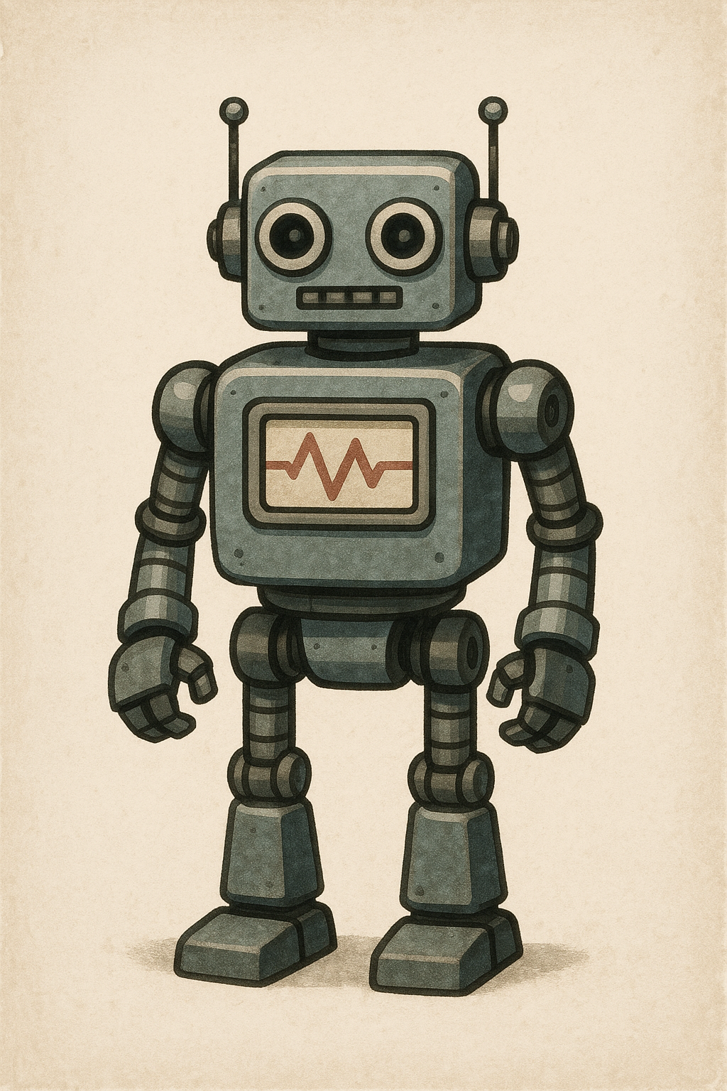
各种机器人能够和玩家交互、战斗，战斗机器人通过WiFi7或6G网络来控制，CPU和GPU可以不安装在机器人身体上，被玩家砍报废了也值不了多少钱，能够有效带动机器人的销量，玩家在游戏中享有真实触感和击打感受
Various robots can interact and fight with players. Combat robots are controlled through WiFi7 or 6G networks. The CPU and GPU do not need to be installed on the robot body. Even if they are destroyed by players, they are not worth much. This can effectively boost the sales of robots. Players can enjoy real touch and hitting feelings in the game.

Slide 15

游戏过程中有救生员时刻观察运行的情况，按下紧急制动按钮可以立刻将所有设备停止运行，救援无人机出动救人
During the game, there are lifeguards who are always watching the operation. Pressing the emergency brake button can immediately stop all equipment and the rescue drone will be dispatched to save people.

Slide 16
玩家使用定制的蓝牙耳塞耳机进行降噪，据说效果很不错
为什么要降噪：因为周围都是升降移动平台和无人机调度的声音
Players use customized Bluetooth earbuds for noise cancellation, which is herd to be very effective.
Why noise reduction: Because there are sounds of lifting and moving platforms and drone movement all around

Slide 17
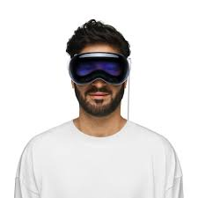
使用Apple vision pro来提供接近现实的画面，双8K显示屏幕
两块轻量级电池背在玩家的后背上面
Apple Vision Pro is used to provide a vision close to reality, dual 8K display screens and two lightweight batteries are carried on the player's back.
This is battery

Slide 18
使用优质的绳索绑在玩家身上防止意外跌落，部分游戏可以让玩家飞起来玩耍
Use high-quality ropes to tie the players to prevent accidental falls. Some games allow players to fly and play.

Slide 19
Basic element
Food unit
Climbable item unit
Helicopter unit
Drones unit
Toilet unit
Grabable unit（something you can grab）
Cell phone unit
iWatch unit

Slide 20
Basic robots
Combat robots
Sex rebots
Rescue robots
Common robots
Clean robots

Slide 21
The first batch of supported games
第一批支持的游戏
逃出疯人院
古墓丽影
刺客信条
镜之边缘
堡垒之夜
Escape from a Lunatic Asylum
Tomb Raider
Assassin's Creed
Mirror's Edge
Fortnite

