Slide 1
2018년도 2학기 시스템 프로그래밍
류은경 교수님
System Programming
TEAM PROJECT
Presentatation by Rainy Team
Member
2013105107 홍혁진
2015114934 김경래
2016113204 송영욱
2017111680 김현유

Slide 2
INDEX
Page1
System Programming Team Project by Rainy Team
INDEX
What Program
HOW Implement
DEMO Play
FINISH
1. What program
프로그램 선정 계기 및 이유
2. How implement
구현 방식 및 실행 순서 설명
3. Demo play
동영상을 통한 프로그램 시연

Slide 3

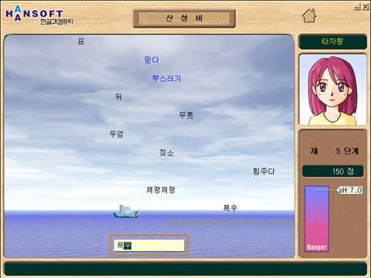
What Program
Page2
System Programming Team Project by Rainy Team
INDEX
What Program
HOW Implement
DEMO Play
FINISH

Slide 4
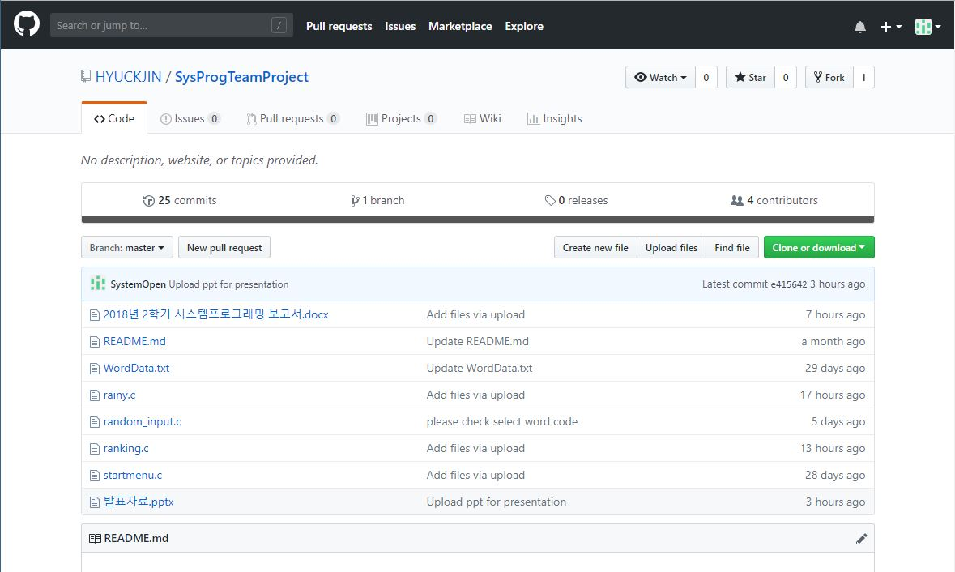
How Implement
Page3
System Programming Team Project by Rainy Team
https://github.com/HYUCKJIN/SysProgTeamProject
INDEX
What Program
HOW Implement
DEMO Play
FINISH

Slide 5
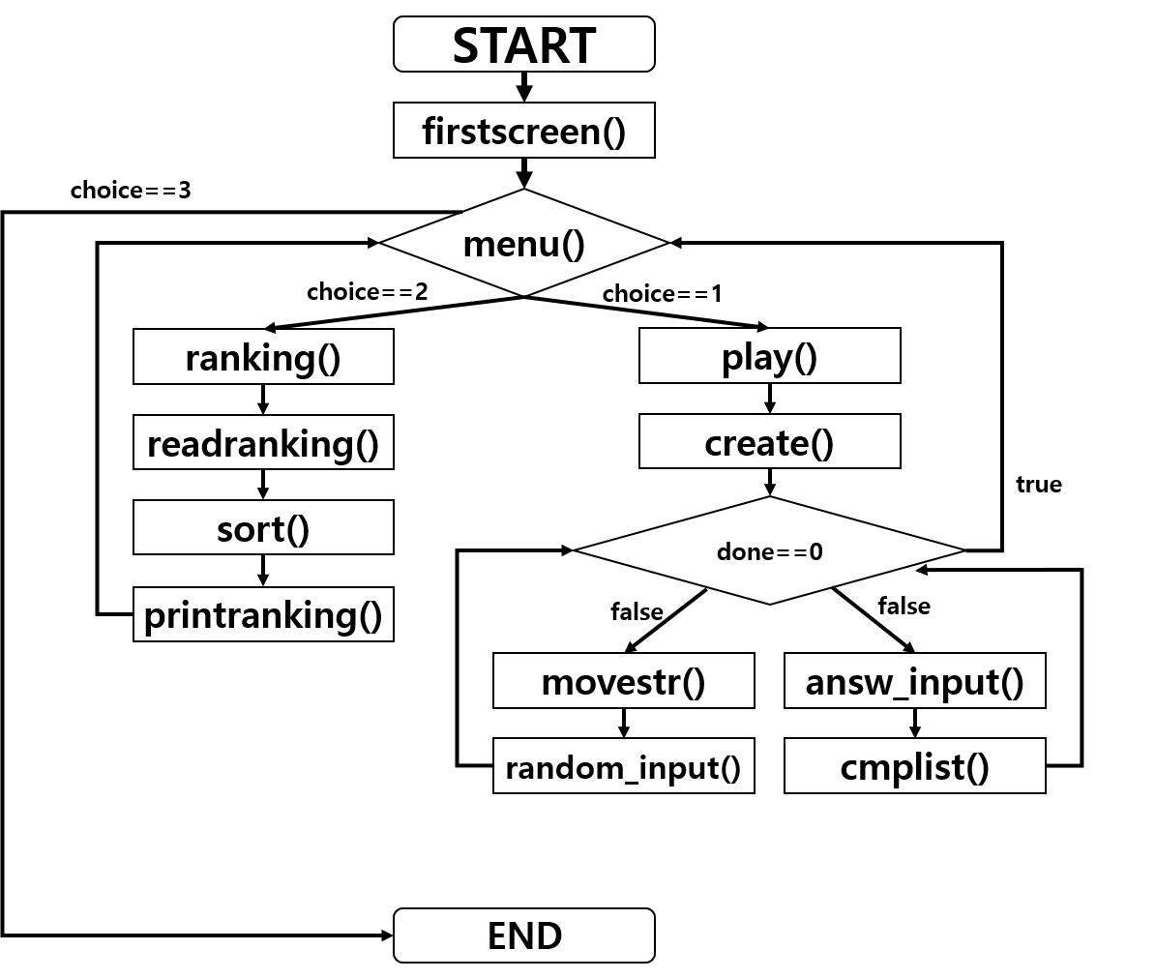
How Implement
Page3
System Programming Team Project by Rainy Team
void create
wordptr random_input
void play
void movestr
void *asnw_input
void cmplist
INDEX
What Program
HOW Implement
DEMO Play
FINISH
Game play
DB
WordData
ranking
void ranking
int readranking
void sort
void printrank
Ranking

Slide 6
DEMO Play
Page4
System Programming Team Project by Rainy Team
INDEX
What Program
HOW Implement
DEMO Play
FINISH

Slide 7
FINISH
Page5
System Programming Team Project by Rainy Team
감사합니다!
QnA
INDEX
What Program
HOW Implement
DEMO Play
FINISH

