Slide 1
C++ Program Design -- How to design your program
Shengfa Wang
sfwang@dlut.edu.cn
Notes:
Now that you’ve learned some basics about programs, let’s look more closely athow to design a program.
When you sit down to write a program, generally you have some sort of problem that you’d like to solve,
or situation that you’d like to simulate.
New programmers often have trouble figuring out how to convert that idea into actual code. But it turns out, you have many of the problem solving skills you need already, acquired from everyday life.

Slide 2

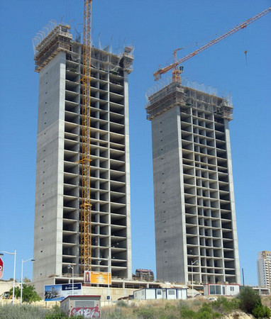
design your program
design before coding
programming is like architecture
Spend lots of time fixing problems that could been avoided with a little thinking ahead
Notes:
西班牙貝尼多爾姆市(Benidorm)為了向全世界展現他們逃過金融危機，在城市裡建起一棟號稱全歐洲最高的住宅大樓「InTempo」，作為精神與希望的象徵。然而悲劇發生了，現在摩天樓眼看要蓋完，建商才赫然發現……忘了設計可用的電梯！
InTempo摩天樓本來是西班牙建築業繁榮的代表，高聳的200公尺雙塔總計47層，共有269個房間。不過，它其實已經蓋了10年，中途出資者一度轉手，由Caixa Galicia銀行換為另一家專門處理不良資產的Sareb銀行。
事實上，InTempo大樓最初只準備要蓋20層，也有設計電梯。但在Sareb接手後，他們貪婪地更改設計圖，把建築物提高到47層，並且盡可能地增加房間數。結果所有人都把電梯這個問題給忘了，因為47層大樓所需的電梯空間與電機設備是20層大樓完全不能相提並論的，建商沒有保留額外的空間裝設負載量更大的電梯，可能出現電梯不夠住戶使用的情形。
消息在網上熱傳的當天，即有網友提出質疑，認為從設計到施工無人發現電梯問題，『顯然不合理。
大樓忘裝電梯的說法只是個玩笑，並推測是該大樓專案的促銷手段

Slide 3
Step 1: Define the problem
what problem your program is attempting to solve
state this in a sentence or two
I want to write a phone book application to help me keep track of my friend’s phone numbers.
I want to write a program that will read information about stocks from the internet and predict which ones I should buy.
The worst thing you can do is write a program that doesn’t actually do what you (or your boss) wanted!
Notes:
建栋大楼，挖口井

Slide 4
Step 2: Define your tools, targets, and backup plan
When you are an experienced programmer:
Understanding who your target users are and what they want.
Defining what target architecture and/or OS your program will run on.
Determining what set of tools you will be using.
Determining whether you will write your program alone or as part of a team.
Collecting requirements (a documented list of what the program needs to do).
Defining your testing/feedback/release strategy.
Determining how you will back up your code - version control (e.g. github).
Notes:
However, as a new programmer, the answers to these questions are typically simple: You are writing a program for your own use, alone, on your own system, using an IDE you purchased or downloaded, and your code is probably not used by anybody but you. This makes things easy.
It’s not enough to just zip or copy the directory to another location on your machine (though this is better than nothing).
use a version control system residing on another machine or in the cloud (e.g. github). Version control systems have the added advantage of not only being able to restore your files, but also to roll them back to a previous version.

Slide 5
Step 3: Break hard problems down into easy problems
continuously splitting complex tasks into simpler ones until each of them is manageable
Top down
Write report on carrots
Do research on carrots
Write outline
Fill in outline with detailed information about carrots
Add table of contents
Write report on carrots
Notes:
If those subtasks are still too difficult to solve, they can be broken down further.
By continuously splitting complex tasks into simpler ones, you can eventually get to a point where each individual task is manageable, if not trivial.

Slide 6
Bottom up
Pick out clothes
Get dressed
Eat breakfast
Drive to work
Brush your teeth
Get out of bed
Prepare breakfast
Get in your car
Take a shower
Get from bed to work
Bedroom things
Get out of bed
Pick out clothes
Bathroom things
Take a shower
Brush your teeth
Breakfast things
Prepare breakfast
Eat breakfast
Transportation things
Get in your car
Drive to work

Slide 7
task hierarchy
The top level task => main()
“Write a report on carrots”
“Get from bed to work”
The subitems => functions
Notes:
As it turns out, these task hierarchies are extremely useful in programming, because once you have a task hierarchy, you have essentially defined the structure of your overall program.
The top level task (in this case, “Write a report on carrots” or “Get from bed to work”) becomes main() (because it is the main problem you are trying to solve). The subitems become functions in the program.
If it turns out that one of the items (functions) is too difficult to implement, simply split that item into multiple sub-items/sub-functions. Eventually you should reach a point where each function in your program is trivial to implement.

Slide 8
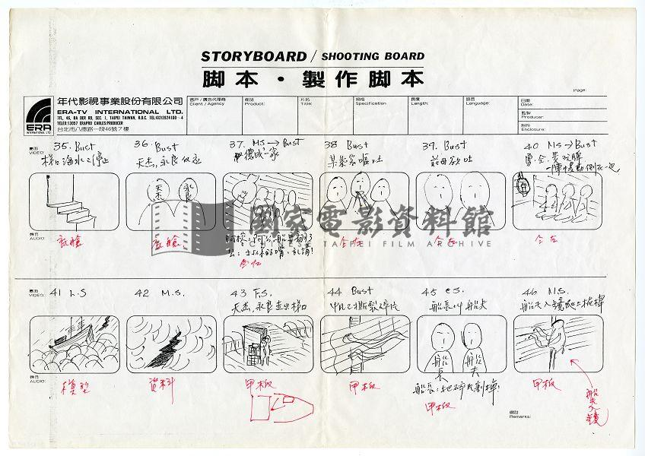
Step 4: Figure out the sequence of events
Notes:
Now that your program has a structure, it’s time to determine how to link all the tasks together.
The first step is to determine the sequence of events that will be performed.

Slide 9
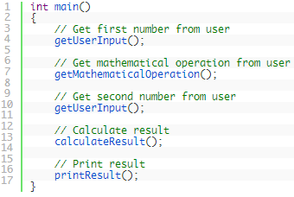
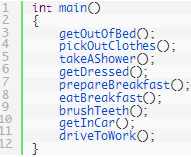
Step 4: Figure out the sequence of events
comment each of these out until you actually write them
work on them one at a time, testing each as you go.
Notes:
For example, when you get up in the morning, what order do you do the above tasks? It might look like this:
Note that if you’re going to use this “outline” method for constructing your programs, it’s a good idea to comment each of these out until you actually write them,
and then work on them one at a time, testing each as you go.
That way the compiler won’t complain about them not being defined.

Slide 10
Step 5: Figure out the data inputs and outputs for each task
a hierarchy and a sequence of events
input data => parameters.
output => a return value or parameters
function prototype
Notes:
Once you have a hierarchy and a sequence of events, the next thing to do is figure out what input data each task needs to operate, and what data it produces as a result (if any). If you already have the input data from a previous step, that input data will become a parameter. If you are calculating output for use by some other function, that output will generally become a return value.

Slide 11
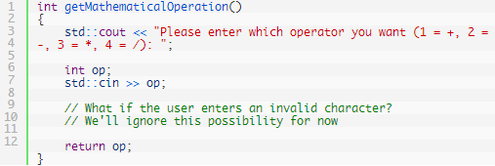
Step 6: Write the task details
write implementation.
simple & straightforward or
be broken down into subtasks.
Notes:
In this step, for each task, you will write its actual implementation.
If you have broken the tasks down into small enough pieces, each task should be fairly simple and straightforward.
If a given task still seems overly-complex, perhaps it needs to be broken down into subtasks that can be more easily implemented.

Slide 12

Step 7: Connect the data inputs and outputs

Slide 13
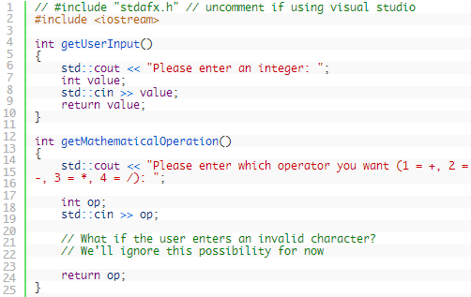
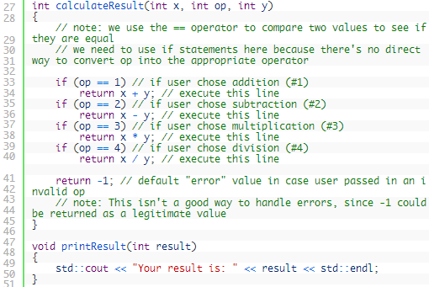
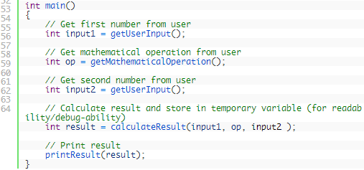

Slide 14
Words of advice when writing programs
Keep your programs simple to start.
Grand vision
“I want to write a role-playing game with graphics and sound and random monsters and dungeons, with a town you can visit to sell the items that you find in the dungeon”
overwhelmed and discouraged at your lack of progress
Add features over time.
have your simple program working and working well
then you can add features to it
Notes:
Keep your programs simple to start. Often new programmers have a grand vision for all the things they want their program to do. “I want to write a role-playing game with graphics and sound and random monsters and dungeons, with a town you can visit to sell the items that you find in the dungeon” If you try to write something too complex to start, you will become overwhelmed and discouraged at your lack of progress. Instead, make your first goal as simple as possible, something that is definitely within your reach. For example, “I want to be able to display a 2d field on the screen”.
Add featu
Once you have your simple program working and working well, then you can add features to it. For example, once you can display your 2d field, add a character who can walk around. Once you can walk around, add walls that can impede your progress. Once you have walls, build a simple town out of them. Once you have a town, add merchants. By adding each feature incrementally your program will get progressively more complex without overwhelming you in the process.res over time.

Slide 15
Words of advice when writing programs
Focus on one area at a time
Test each piece of code as you go
Not write the entire program in one pass
the compiler reports hundreds of errors
not only be intimidating, if your code doesn’t work, it may be hard to figure out why
write a piece of code, and then compile and test it immediately.
If it doesn’t work, you’ll know exactly where the problem is, and it will be easy to fix.
Once you are sure that the code works, move to the next piece and repeat
Notes:
Focus on one area at a time. Don’t try to code everything at once, and don’t divide your attention across multiple tasks. Focus on one task at a time, and see it through to completion as much as is possible. It is much better to have one fully working task and five that haven’t been started yet than six partially-working tasks. If you split your attention, you are more likely to make mistakes and forget important details.
Test each piece of code as you go. New programmers will often write the entire program in one pass. Then when they compile it for the first time, the compiler reports hundreds of errors. This can not only be intimidating, if your code doesn’t work, it may be hard to figure out why. Instead, write a piece of code, and then compile and test it immediately. If it doesn’t work, you’ll know exactly where the problem is, and it will be easy to fix. Once you are sure that the code works, move to the next piece and repeat. It may take longer to finish writing your code, but when you are done the whole thing should work, and you won’t have to spend twice as long trying to figure out why it doesn’t.

Slide 16
Too many steps & suggestions?
following these steps will definitely save you a lot of time in the long run.
A little planning up front saves a lot of debugging at the end.
Good news:
they will start coming naturally to you without even thinking about it.
Eventually you will get to the point where you can write entire functions without any pre-planning at all.
Notes:
Most new programmers will shortcut many of these steps and suggestions (because it seems like a lot of work and/or it’s not as much fun as writing the code). However, for any non-trivial project, following these steps will definitely save you a lot of time in the long run. A little planning up front saves a lot of debugging at the end.
The good news is that once you become comfortable with all of these concepts, they will start coming naturally to you without even thinking about it. Eventually you will get to the point where you can write entire functions without any pre-planning at all.

Slide 17
Debugging your program

Slide 18
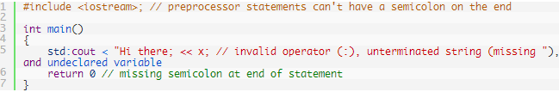
Syntax and semantic errors
Errors: syntax errors, & semantic errors (logic errors).
A syntax error not valid according to the grammar of the C++
missing semicolons
undeclared variables
mismatched parentheses or braces
unterminated strings
compiler will generally catch syntax errors and generate warnings or errors
Notes:
Syntax句法，semantic语义
Programming can be difficult, and there are a lot of ways to make mistakes. Errors generally fall into one of two categories: syntax errors, and semantic errors (logic errors).
A syntax error occurs when you write a statement that is not valid according to the grammar of the C++ language. This includes errors such as missing semicolons, undeclared variables, mismatched parentheses or braces, and unterminated strings. For example, the following program contains quite a few syntax errors:

Slide 19
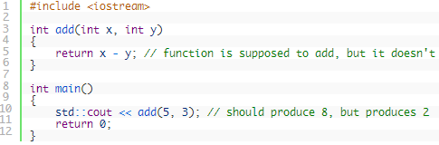
Syntax and semantic errors
Errors: syntax errors, & semantic errors (logic errors).
A semantic error occurs when a statement is syntactically valid, but does not do what the programmer intended.
compiler will not be able to catch these types of problems => Debugger
Notes:
Once your program is compiling correctly, getting it to actually produce the result(s) you want can be tricky. A semantic error occurs when a statement is syntactically valid, but does not do what the programmer intended.

Slide 20


The debugger
A debugger is a computer program that allows the programmer to control how a program executes and watch what happens as it runs.
Before proceeding: Make sure your program is set to use the debug build configuration.
Notes:
调试器

Slide 21
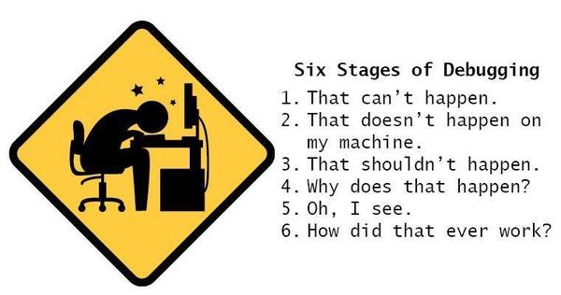

Slide 22
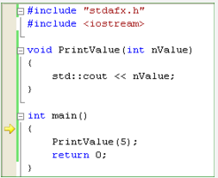
Stepping
execute (step through) your code line by line
3 different stepping commands: step into, step over, and step out
step into
executes the next line of code
If this line is a function call, step into enters the function and returns control at the top of the function.
go to the debug menu and choose “Step Into”, or press F11.
arrow indicates:
the line being pointed to will be executed next
Notes:
When you do this, two things should happen.
First, because our application is a console program, a console output window should open.
It will be empty because we haven’t output anything yet. Second, you should see some kind of marker appear to the left of the opening brace of main.
This arrow marker indicates that the line being pointed to will be executed next. In this case, the debugger is telling us that the next line that will be executed is the opening brace of main(). Choose “Step into” again to execute the opening brace, and the arrow will move to the next line.

Slide 23
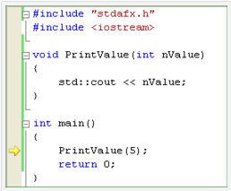
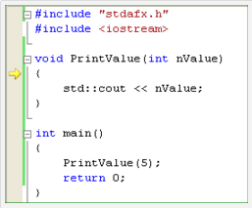
step into

Slide 24
step into
choose “Stop Debugging” from the debug menu. This will terminate your debugging session.
Notes:
You will note that the arrow is again pointing to printValue()!
While you might think that the debugger intends to call printValue() again,
in actuality the debugger is just letting you know that it is returning from the function call.

Slide 25
step into, step over, and step out
Step over
command executes the next line of code.
If this line is a function call, “Step over” executes all the code in the function
and returns control to you after the function has been executed.
Step out
executes all remaining code in the function you are currently in, and returns control to you when the function has finished executing.

Slide 26
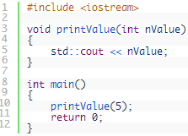
Run to cursor, Run
Run to cursor: executes the program like normal until it gets to the line of code selected by your cursor.
Simply put your cursor on the std::cout << nValue; line inside of printValue(), then right click and choose “Run to cursor”.
Run: it may be called “Go” or “Continue”
Notes:
While stepping is useful for examining each individual line of your code in isolation, in a large program, it can take a long time to step through your code just to get to the point where you want to examine in more detail.
Fortunately, modern debuggers provide a few more tools to help us efficiently debug our programs.

Slide 27
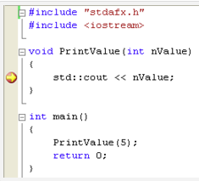
Breakpoints
tells the debugger to stop execution of the program at the breakpoint when running in debug mode.
“Toggle Breakpoint” (right click, choose Breakpoint -> Insert Breakpoint).

Slide 28
Debugging your program (watching variables and the call stack)

Slide 29
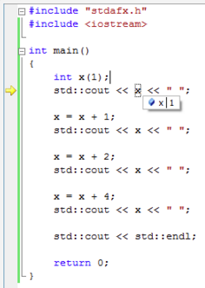
watching variables and the call stack
stepping through a program
examine the value of variables
Watching variables
inspecting the value of a variable while the program is executing in debug mode
Notes:
stepping through a program is only half of what makes the debugger useful. The debugger also lets you examine the value of variables as you step through your code.

Slide 30
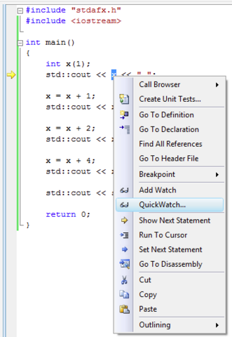
AddWatch
Highlight the variable name x with your mouse,
choose “AddWatch” from the right-click menu.
Notes:
I prefer addWatch than quickWatch.

Slide 31
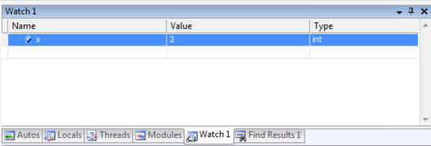
The watch window
where you can add variables you would like to continually inspect
and these variables will be updated as you step through your program.
Debug Menu->Windows->Watch->Watch 1
note: you have to be in debug mode, so step into your program first
Notes:
Using watches is the best way to watch the value of a variable change over time as you step through your program

Slide 32
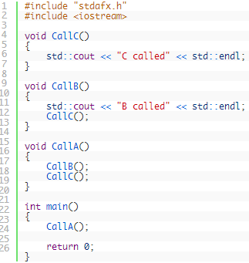
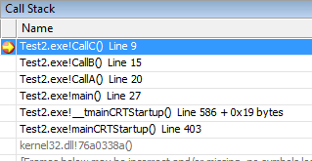
The call stack window
a list of all the active functions that have been called to get to the current point of execution.
Debug Menu->Windows->Call Stack
double-click on the various lines
Notes:
When your program calls a function, you already know that it bookmarks the current location, makes the function call, and then returns. How does it know where to return to? The answer is that it keeps track in the call stack.
Whenever a new function is called, that function is added to the top of the call stack. When the current function returns to the caller, it is removed from the top of the call stack, and control returns to the function just below it.
The program started by calling main(). main() called CallA(), which called CallB(), which called CallC(). You can double-click on the various lines in the Call Stack window to see more information about the calling functions.

Slide 33
Conclusion
Design, test, coding
Purpose
Divide and conquer => Functions
Sequence/hierarchy of events
Function prototype
Debug
Stepping
Breakpoints
Watches
Call stack window
Takes practice, trial & error
Definitely worth your time investment!

