Slide 1
Common map & Sequential map
Siqi Wang
2018.05.03

Slide 2
Total counts of NC_1 miRNA
 | A1 | A2 | A3 | B1 | B2 | B3 | N1 | N2 | N3
sequential | 1150915 | 1150915 | 1321719 | 1321719 | 3201116 | 1823033 | 1518287 | 1518287 | 1529372
commen | 748068 | 748068 | 748068 | 748068 | 748068 | 1214626 | 1214626 | 1214626 | 1019939

Slide 3
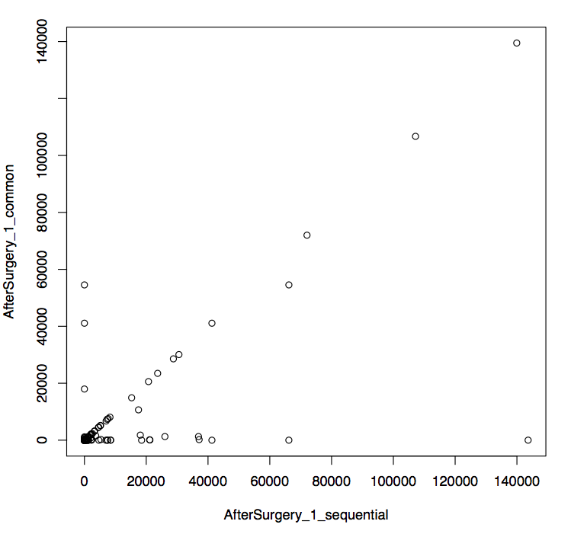
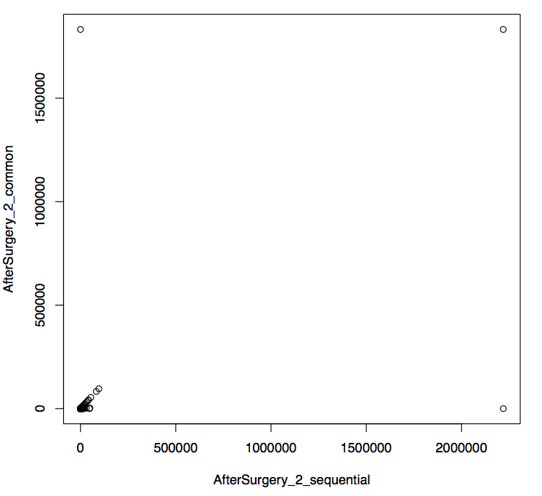
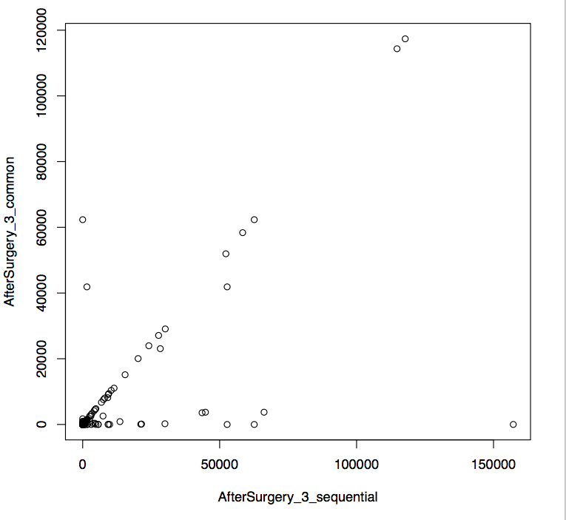
Correlation
r = 0.69 r = 0.76 r = 0.74

Slide 4
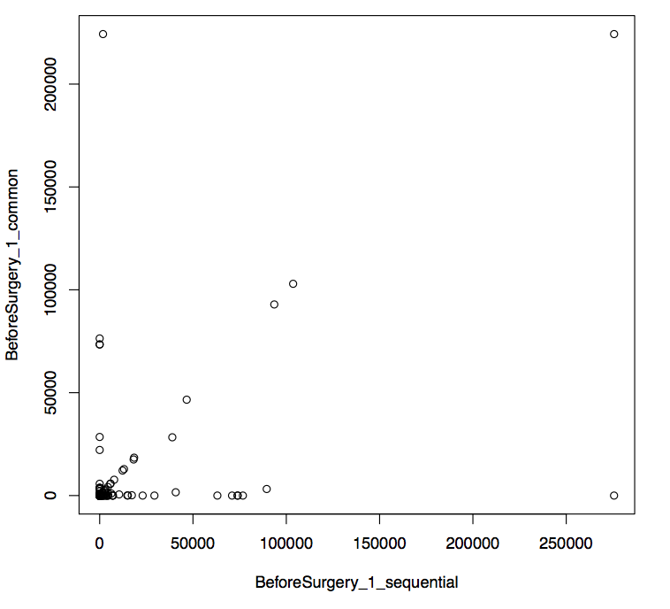
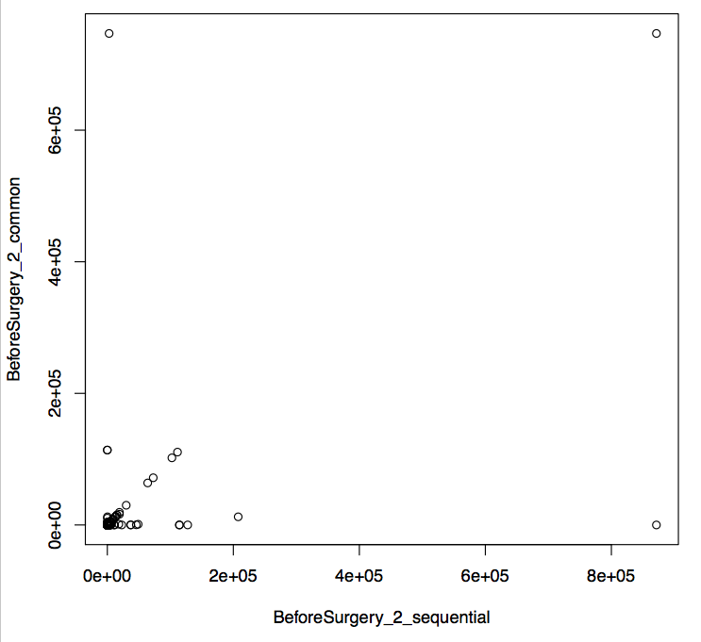
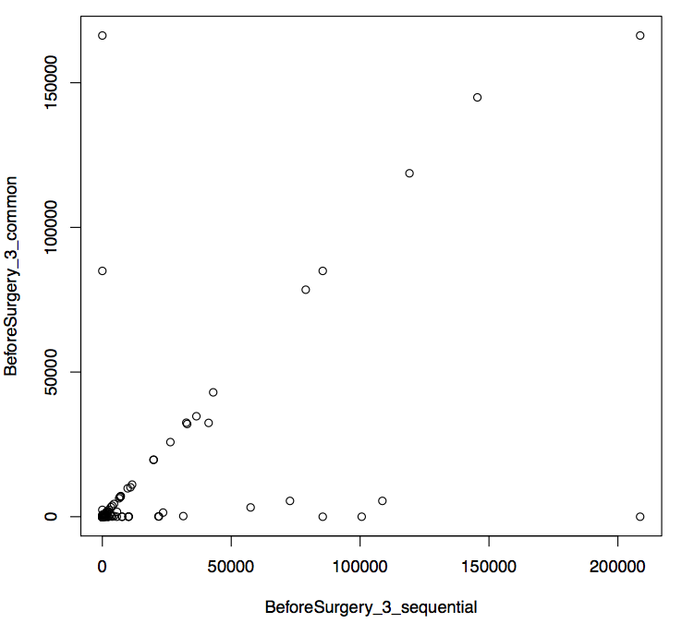
Correlation
r = 049 r = 0.57 r = 0.77

Slide 5
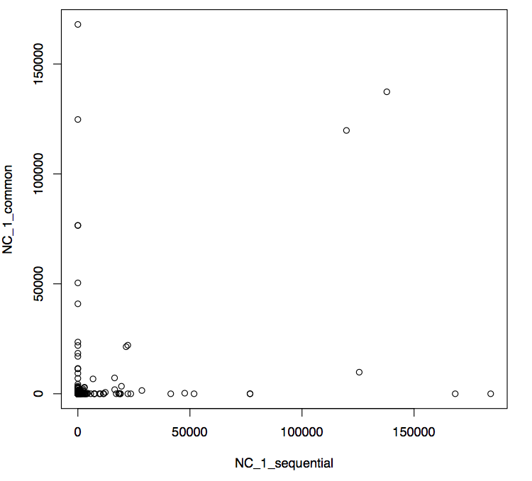
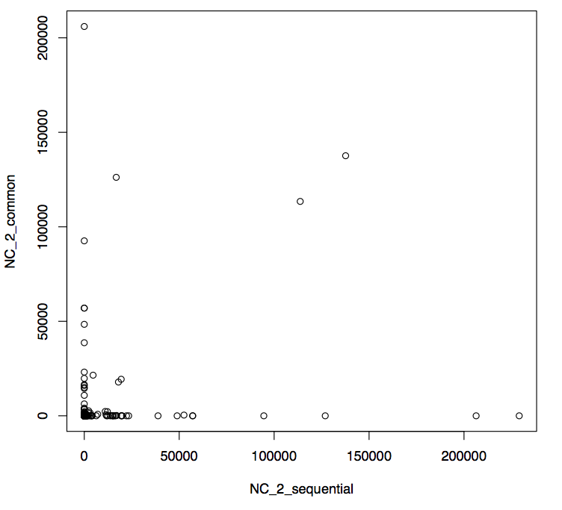
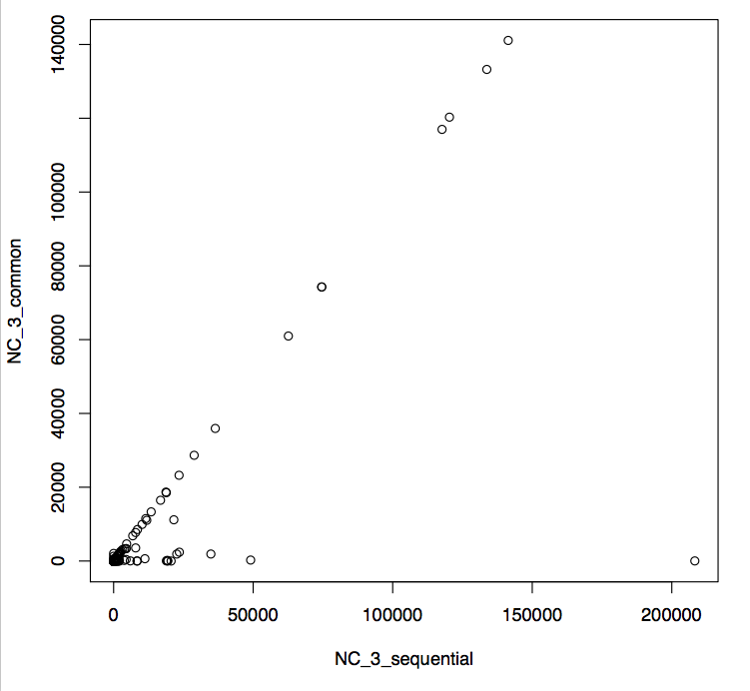
Correlation
r = 0.38 r = 0.21 r = 0.80

Slide 6
Explaination
When multiple alignment occurred, bowtie2 would randomly choose a location.
When mapping to whole genome, short reads would be multiple aligned. “bowtie2 -L 20”, only allowed <20 location, so many reads would be discarded.

