Slide 1

Iteration 2 – Exploring different machine learning models
Group Members:
Hady Yousef - X00219585
OSAMA ALOBAID - X00230146
ALMUJTABA MOHAMED - X00230145

Slide 2

Dataset Overview
Dataset: Household Power Consumption
Source: UCI / Kaggle
Description: Each row represents electricity usage at a specific time
Time Resolution: Minute-level data
Key Features: Global_active_power (target) , Global_reactive_power , Voltage , Global_intensity,
Sub_metering_2 , Sub_metering_3
Target Variable: Global_active_power

Slide 3
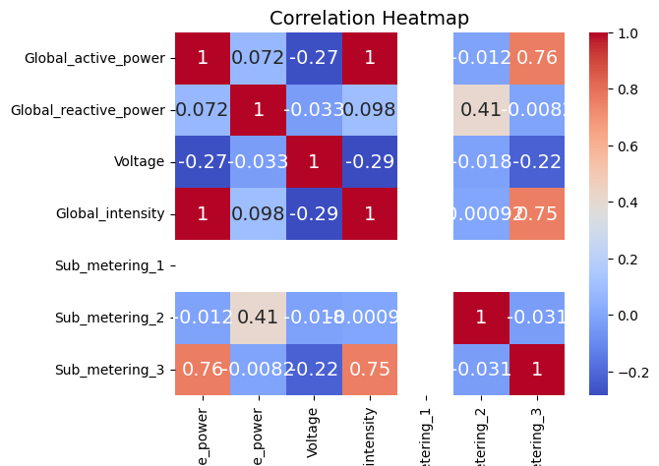
Data Preparation
Converted Date and Time into a single DateTime feature
Performed correlation
analysis to understand relationships between variables
Selected relevant features for modelling
Removed non-informative features (e.g., Sub_metering_1)

Slide 4
Feature Selection
Target variable: Global_active_power
Removed Sub_metering_1
Selected features based on correlation
Final features: Global_reactive_power, Voltage, Global_intensity, Sub_metering_2, Sub_metering_3

Slide 5
Feature Scaling
Applied StandardScaler
Ensures features are on the same scale
Used for Linear Regression and KNN
Not required for Random Forest

Slide 6
Data Preparation - Modelling
Separated features (X) and target variable (Global_active_power)
Split data into training, validation, and test sets
Applied feature scaling where required
Trained and evaluated multiple machine learning models

Slide 7
Models
Linear Regression
KNN Regressor
Random Forest Regressor
All models achieved high performance (~0.9 R²)
Linear Regression captured general trends
KNN showed weaker generalisation
Random Forest performed most consistently

Slide 8
Global_Intensity Impact
Highly correlated with target variable
Improves prediction accuracy
Introduces redundancy
May inflate model performance

Slide 9
Best Model: Random Forest Regressor
Highest R² score
Captures complex patterns
More robust and stable
Selected as final model

