Slide 1




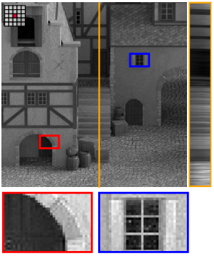
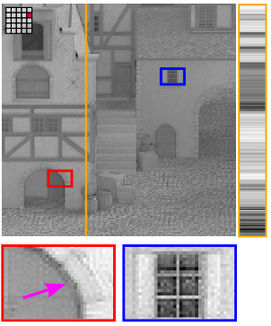
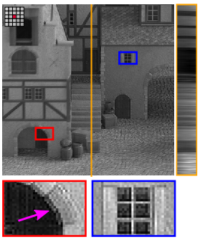
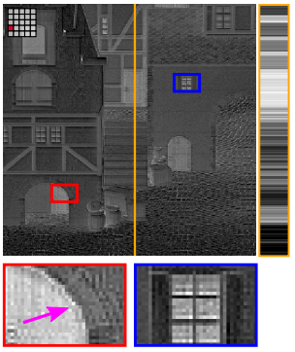
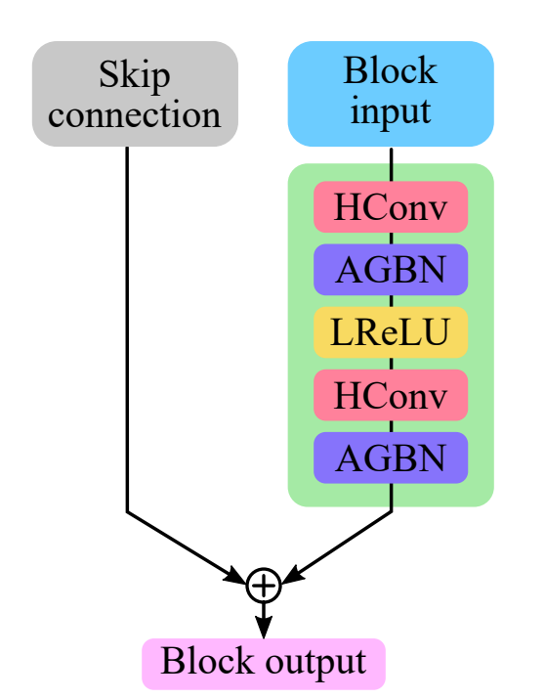
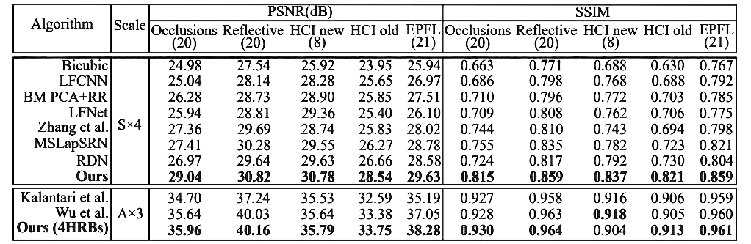
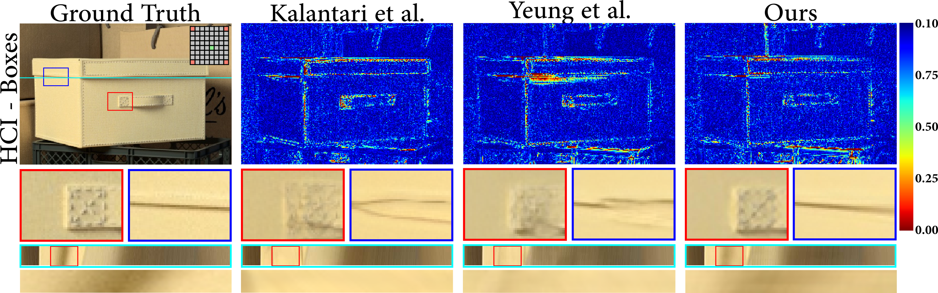
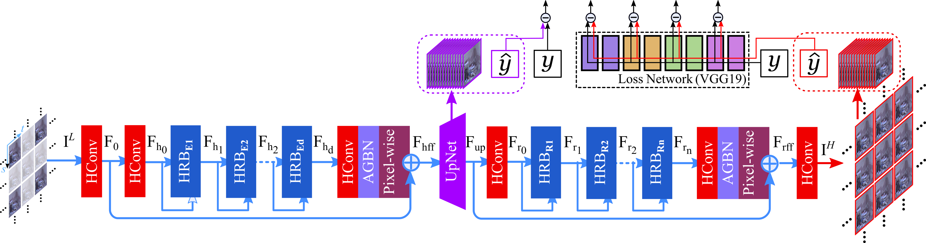
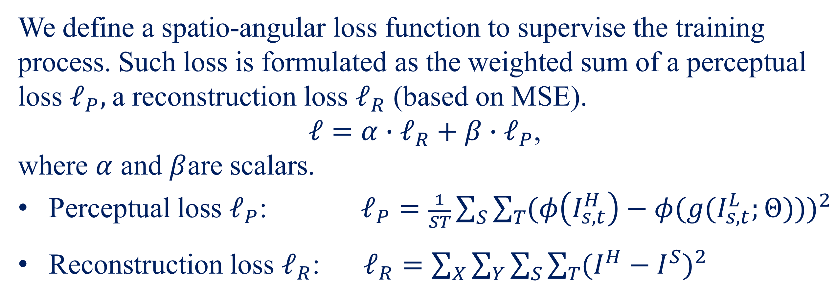
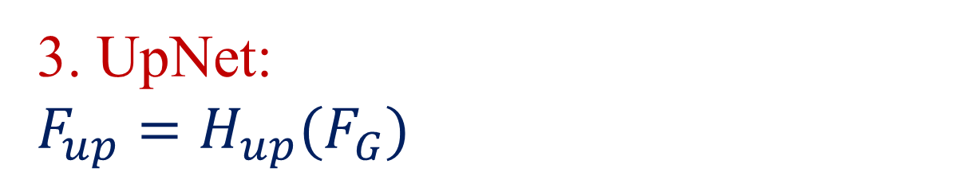

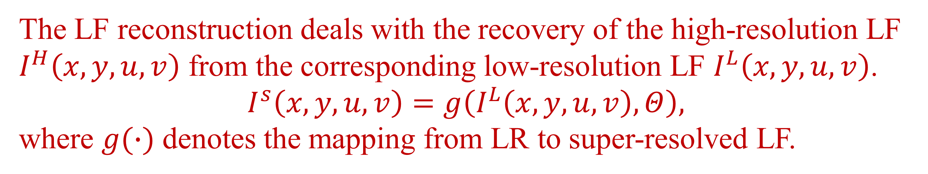
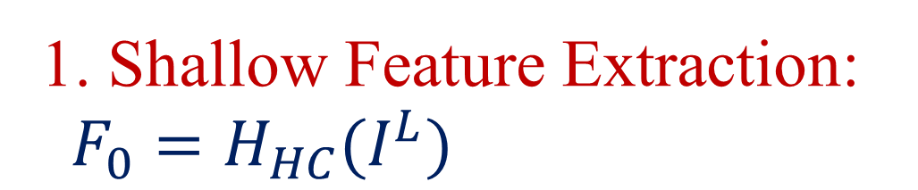
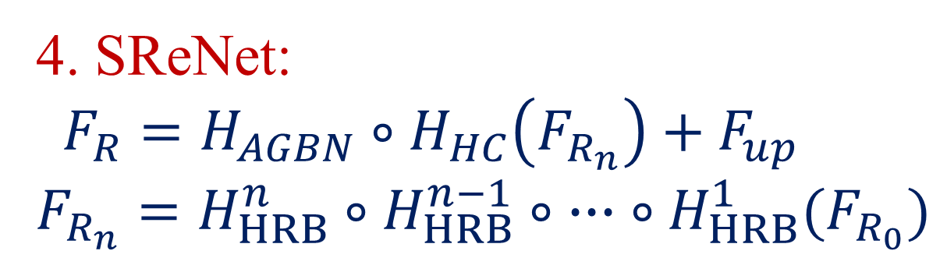
High-Order Residual Network for Light Field Super-Resolution
¹Nan Meng, ²Xiaofei Wu, ²Jianzhuang Liu, ¹Edmund Y. Lam
¹Depart of Electrical and Electronic Engineering, University of Hong Kong
²Huawei Noah’s Ark Lab, China
Introduction
We propose to establish a framework tailored to the light field (LF) structural information.
We propose a novel high-order structure, named high-order residual block (HRB) to learn the features by fully considering the information from all sub-aperture images of a LF. Such features extracted from HRB preserve high angular coherence.
By stacking a set of the HRBs, the proposed network is able to extract diverse spatial features endowed with scene geometry information.
Experimental results demonstrate that our model not only outperforms the state-of-the-art reconstruction methods on quantitative measurements and visual quality.
Reconstruction
Feature (HRB 8)
Feature (HRB 5)
Feature (HRB 3)
Fig.3 Geometric features extracted from different HRBs.
Loss function
We define a spatio-angular loss function to supervise the training process. Such loss is formulated as the weighted sum of a perceptual loss $ℓ_{P},$a reconstruction loss $ℓ_{R}$ (based on MSE).
$ℓ=α∙ℓ_{R}+β∙ℓ_{P}$,
where $α$ and $β$are scalars.
Perceptual loss $ℓ_{P}$: $ℓ_{P}=\frac{1}{ST}\sum_{S}{\sum_{T}{{(φ\left(I_{s,t}^{H}\right)−φ(g(I_{s,t}^{L};Θ)))}^{2}}}$
Reconstruction loss $ℓ_{R}$: $ℓ_{R}=\sum_{X}{\sum_{Y}{\sum_{S}{\sum_{T}{{(I^{H}−I^{S})}^{2}}}}}$
Problem formulation
The LF reconstruction deals with the recovery of the high-resolution LF $I^{H}\left(x,y,u,v\right)$ from the corresponding low-resolution LF $I^{L}\left(x,y,u,v\right)$.
$I^{s}\left(x,y,u,v\right)=g\left(I^{L}\left(x,y,u,v\right),Θ\right),$
where $g(∙)$ denotes the mapping from LR to super-resolved LF.
Results
HRB module
Table 1. Quantitative evaluation on PSNR and SSIM on both synthetic LF and real-world LF for Spatial $4×$ and Angular $3×$.
1. Each HRB contains two HConv layers with the 3×3 angular receptive field, allowing it to fully utilize the information from all SAIs of input features.
2. We propose the aperture group batch normali-zation (AGBN) to avoid that the whitening decorrelates the coherence among feature SAIs.
Fig.1 Structure of HRB.
Network
Fig.2 The architecture of our hierarchical high-order network
Fig 4. Visual comparisons on a real-world scene (HCI - Boxes) for angular $2×2⟶8×8$ SR.
Network Modules
1. Shallow Feature Extraction:
$F_{0}=H_{HC}(I^{L})$
1. We compare the quantitative results with both SISR methods and LFSR methods on 5 public LF datasets.
2. The proposed model outperforms existing SOTA methods on both real-world and synthetic scenes.
3. The visual results show that our model is able to generate the spatial details with better image fidelity compared with SOTA methods.
2. GRLNet:
$$F_{G_{d}}=H_{HRB}^{d} \left(F_{G_{d−1}}\right)$$
$=H_{HRB}^{d} \left(H_{HRB}^{d−1}(F_{G_{d−2}})\right)$
$=H_{HRB}^{d}∘H_{HRB}^{d−1}∘ ∙∙∙ ∘H_{HRB}^{1}(F_{G_{0}})$
$F_{G}=H_{AGBN}∘H_{HC}\left(F_{G_{d}}\right)+F_{0}$
3. UpNet:
$$F_{up}=H_{up}(F_{G})$$
4. SReNet:
$F_{R}=H_{AGBN}∘H_{HC}\left(F_{R_{n}}\right)+F_{up}$
$$F_{R_{n}}=H_{HRB}^{n}∘H_{HRB}^{n−1}∘ ∙∙∙ ∘H_{HRB}^{1}(F_{R_{0}})$$
Related Work
The proposed approach can learn the completely spatial-angular structure and redundancy, which can be useful for HD visual signal reconstruction in computational imaging.
[1] N. Meng, H. K.-H. So, X. Sun, and E. Y. Lam, “High-dimensional dense residual convolutional neural network for light field reconstruction,” IEEE Trans on Pattern Analysis Machine Intelligence.

