Slide 1
CS 4701 Final Presentation
Generalized MCTS Game Engine

Slide 2
Outline
MCTS Overview
Connect 4 MCTS AI Implementation
MCTS vs Mini-Max Connect4
MCTS Generalized Engine
Tic-Tac-N Implementation
Data Insights on MCTS
Questions/Demo

Slide 3
MCTS
A reinforcement learning algorithm that utilizes self ran simulations to understand a large search space without full exploration (as opposed to Mini-Max)
3 phases:
Selection
Simulation
Back Propagation

Slide 4
Choosing MCTS over Mini-Max
Pros
Cons
Don’t necessarily need a game-specific heuristic
Don’t need to fully explore game space to arbitrary depth
Can run for any pre-selected time or simulation count
Can miss things because of randomness

Slide 5
Connect 4 MCTS
We first implemented a Connect4 MCTS based AI to test the effectiveness of the algorithm on a popular and well understood game.
Was our first attempt at a generalized engine. Made some assumptions/bad decisions that we abstracted away in the next implementation.
Game is not necessarily 2 players (more players/teams)
User should have ability to implement game specific heuristics
For large game spaces the neighbors should be generated lazily
The user should only need to implement one abstract class to enable more freedom in their design

Slide 6
Connect4 MCTS vs Mini-Max
We pulled Mini-Max Connect4 implementations from the Internet and manually tested our MCTS implementation against it
Our MCTS (thinking time = 5 seconds) won in every test we ran, even against a depth 8 Mini-Max that required significantly more time
Example Game (see repo)

Slide 7
Generalized MCTS Game Engine
Satisfied with the performance of MCTS as an adequate game playing agent we moved on to our next improved implementation.
User must implement only one abstract class called GameState
User has the freedom to specify some game specific knowledge if desired

Slide 8
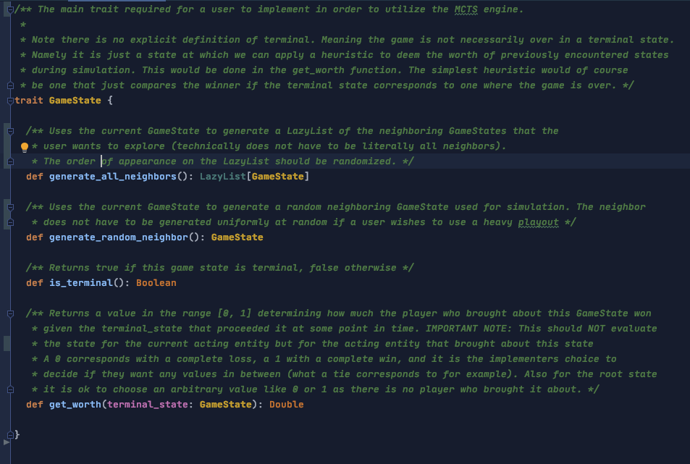

Slide 9
Tic-Tac-N
At this point our focus had turned to understanding the MCTS simulations under the hood.
We implemented a generalized Tic-Tac-N game which is just Tic-Tac-Toe parameterized by a board size and the number of pieces you need in a row to win.
The various parameters allows us to explore the effectiveness of MCTS in different settings
Quick Demo

Slide 10
Experiment 1
Ran simulations on dimensions 4-8 in which the longer running agent ran for twice as much time than the shorter running agent, for longer running times of 2⁰ to 2⁴ for a total of 500 games worth of data (connect 4 in a row)
Plotted the win rate of the longer running agent vs time magnitude (0 to 4) on different dimensions

Slide 11
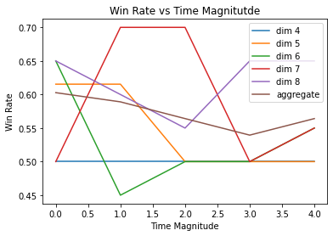

Slide 12
Experiment 2
Ran games for equal running time agents (2, 4, 6, 8) on different dimensions (5-12) for total 160 games worth of data. (connect 5 in a row)
Plotted Number of Simulations vs Move Progression
Plotted Number of Simulations vs Dimension
Plotted Best Move Score vs Move Progression for all Dimensions
Plotted Distribution of Move Score for different Time/Dim Combinations

Slide 13
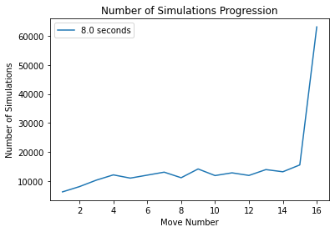

Slide 14
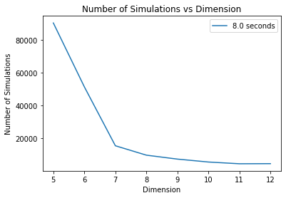

Slide 15
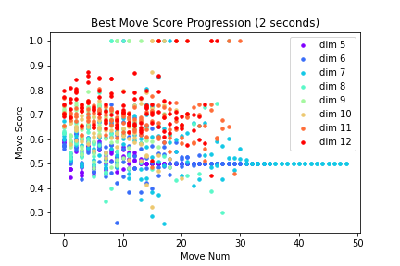
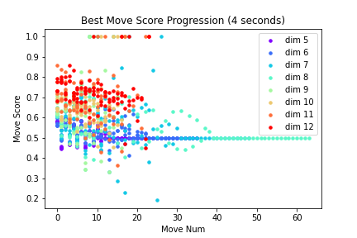
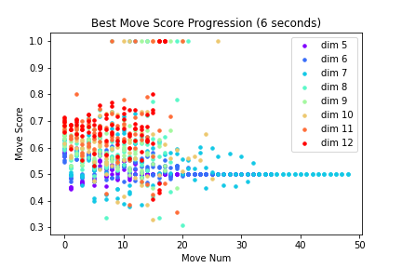
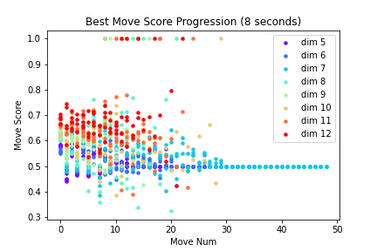

Slide 16
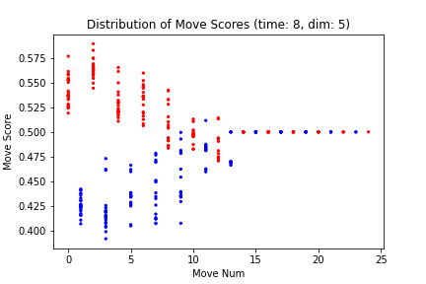
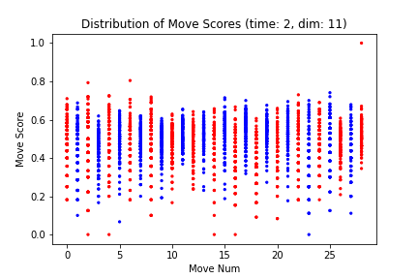
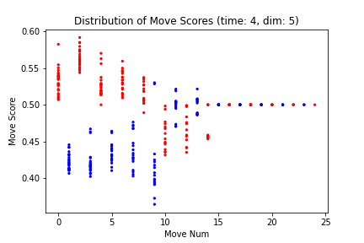
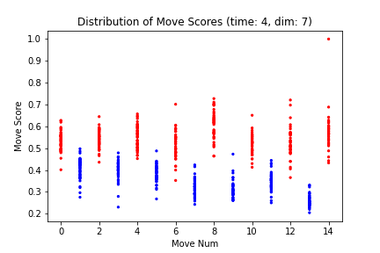

Slide 17
Practical Challenges in Simulation and Data Gathering
For experiment 1, 500 games were simulated. The average amount of time for agent 1 to make a move and then for agent 2 to make a responding move is roughly 9.3 seconds assuming each game on average is 10 moves back and forth, and we have 500 games this simulation would take approximately 13 hours.
To expedite this process we leveraged parallelism to simulate these 500 games in only 2.5 hours!
We also needed a serialized data format to move data from Scala simulations to Python for plotting. We chose JSON due to the highly nested nature of our game data

Slide 18
AI/ML Concepts Utilized
Reinforcement learning (Monte Carlo Tree Search)
Data gathering and analysis
Optimizing expensive computation with parallelism
Common tools: Scala, Python, matplotlib, JupyterLab

Slide 19
Sources
https://en.wikipedia.org/wiki/Monte_Carlo_tree_search
https://www.geeksforgeeks.org/ml-monte-carlo-tree-search-mcts/
https://jonathan-hui.medium.com/monte-carlo-tree-search-mcts-in-alphago-zero-8a403588276a
https://web.engr.oregonstate.edu/~afern/classes/cs533/notes/uct.pdf

