Slide 1
LLM – DATA – TOOL – MCP
How AI Connects to Data and Tools
LLM
DATA
TOOL
MCP
→
→
→

Slide 2
OVERVIEW
2
LLM
Data
Tool
MCP
Demo
→
→
→
→

Slide 3
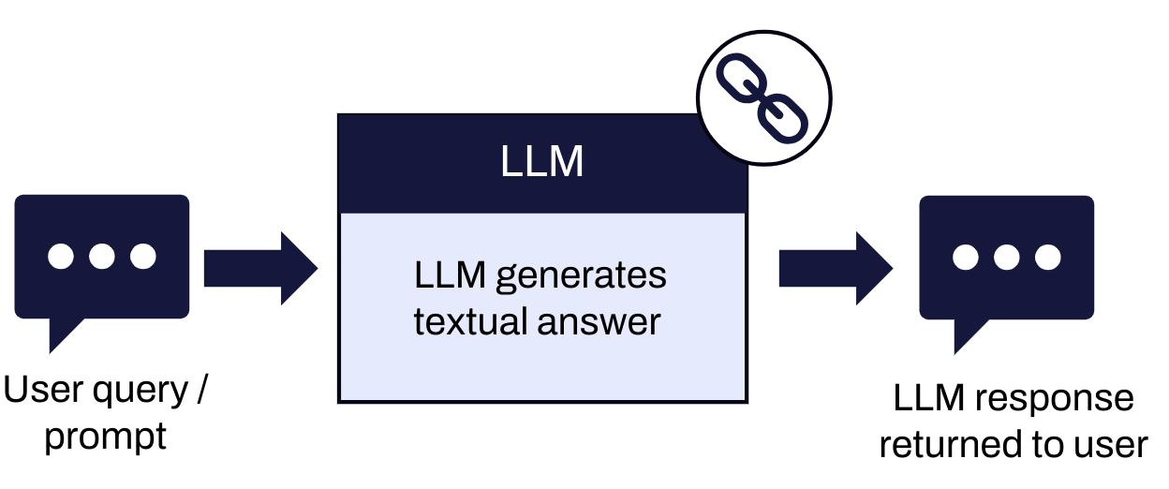
WHAT IS AN LLM?
3
Large Language Model
• Understand text
• Generate text
• Learn from data
• Answer questions

Slide 4
WHAT CAN LLM DO?
4
• Answer questions
• Write text
• Summarize
• Translate
• Write code
• Chat

Slide 5
HOW DOES LLM WORK?
5
Input
Tokens
LLM
Next Token
Output
→
→
→
→
Tokens
LLM
Next Token
Output

Slide 6
TOKEN
6
Small units of text
Used by the model
Help process text

Slide 7
TRANSFORMER & ATTENTION
7
Transformer = Main model architecture
Attention = Find important parts
Understand context

Slide 8
LLM IN AI AGENT
8
• LLM = THE BRAIN
• Understand
• Think
• Plan
• Choose
• Respond

Slide 9
LIMITS OF LLM
9
• No private data
• No live data
• Cannot do every action
• Needs external information
Solution: DATA + TOOLS

Slide 10
WHAT IS DATA?
10
DATA = INFORMATION
Files
Databases
Websites
APIs
Documents
→
→
→
→

Slide 11
DATA SOURCES
11
• Database
• Files
• Websites
• APIs
• GitHub
• Google Drive
• Company Systems

Slide 12
WHY DOES LLM NEED DATA?
12
“What are our sales this month?”
LLM → No company data → Cannot answer
LLM → Database → Answer

Slide 13
DATA GIVES CONTEXT
13
• DATA
• CONTEXT
• LLM
• ANSWER
• Data helps AI give better answers.

Slide 14
WHAT IS A TOOL?
14
• Search
• Calculate
• Get data
• Call APIs
• Use databases
• Create images
TOOL = ACTION

Slide 15
TYPES OF TOOLS
15
• Search — Find information
• Calculator — Calculate
• Database — Get data
• API — Connect systems
• Weather — Get weather
• Code — Run code

Slide 16
HOW DOES LLM USE A TOOL?
16
User
LLM
Choose Tool
Use Tool
Get Result
LLM
Answer
→
→
→
→
→
→
LM
Choose Tool
Use Tool
Get Result
LLM
Answer

Slide 17
EXAMPLE: WEATHER TOOL
17
“What is the weather in HCMC?”
User → LLM → Weather Tool
Weather Tool → Weather API
Weather Data → LLM → Answer
→
→
→
User → LLM → Weather Tool
Weather Tool → Weather API
Weather Data → LLM → Answer

Slide 18
LLM + DATA + TOOL
18
LLM = THINK
DATA = KNOW
TOOL = ACT

Slide 19
THE PROBLEM
19
• Database
• API
• GitHub
• Files
• Many connections = Hard to manage

Slide 20
WHAT IS MCP?
20
MODEL CONTEXT PROTOCOL
DATA
TOOLS
SERVICES
One common way to connect AI

Slide 21
BEFORE MCP
21
Database Connector
GitHub Connector
AI
API Connector
File Connector
Many different connections

Slide 22
WITH MCP
22
Database
API
MCP
GitHub
Files
One common protocol

Slide 23
MCP ARCHITECTURE
23
AI Application
MCP Client
MCP Server
Data / Tools
Client = Connect
Server = Provide
→
→
→
→
→
MCP Client
MCP Server
Data / Tools
Client = Connect
Server = Provide

Slide 24
MCP: 3 MAIN PARTS
24
PROMPTS — Instructions
RESOURCES — Data / Context
TOOLS — Actions

Slide 25
25
DEMO

Slide 26
LLM = THINK
LLM = THINK
DATA = KNOW
TOOL = ACT
MCP = CONNECT
DATA = KNOW

