Slide 1
Kinect Connector
USER GUIDE

Slide 2

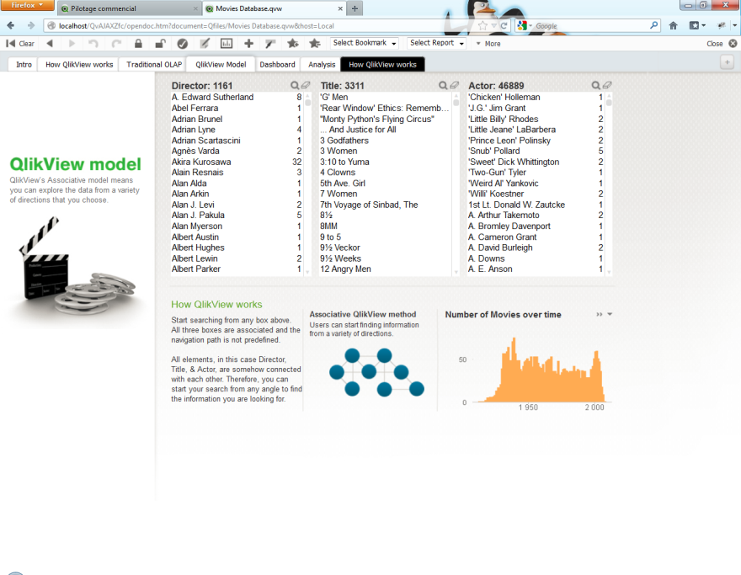
Virtual box corresponding to the screen
70cm
60cm
Moving your hand in the box will make the mouse move in the screen

Slide 3
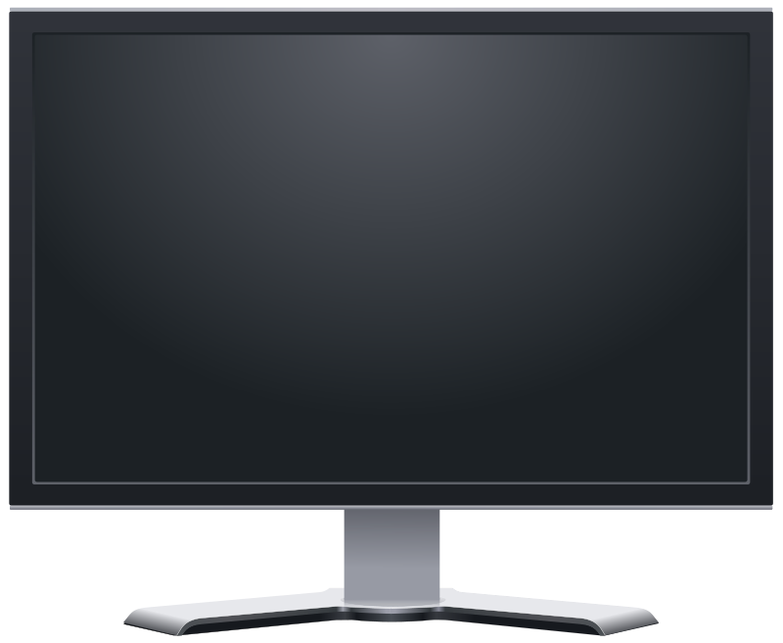


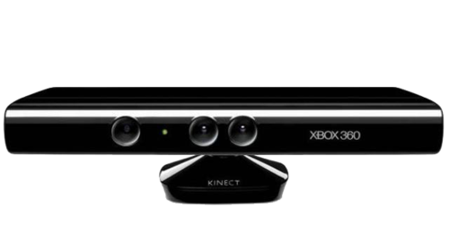
Always target the Kinect when you point to click

Slide 4
1
2
Perform a click
To maintain the click stay in position 1

Slide 5
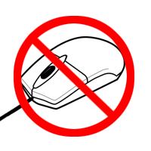
Set the mouse to paused

Slide 6
Take the control when someone else got it

Slide 7
NEXT TAB
2
+
+
=
1
1
2
1

Slide 8
CLEAR
EXIT
MENU
1
2
x2

Slide 9
SCROLL UP
SCROLL DOWN
PREVIOUS TAB
1
2
1
2
2
1

Slide 10
LOOPING NEXT TAB
LOOPING PREVIOUS TAB
+
+
1
1

Slide 11
INFINITE SCROLL UP
LOOPING PREVIOUS TAB
1
+
+
1

Slide 12

CLOSE THE WINDOW
Words you can say :
CLEAR
EXIT
MAX
MIN
MULTIPLE
NEXT
OPEN
PREVIOUS
1

Slide 13
INTERFACE

Slide 14
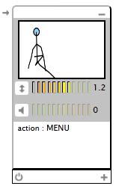
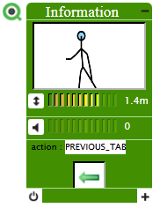
Deploy/Undeploy icon
s
Minimize
SkeletonViewer
Distance Viewer
Volume Viewer
ActionViewer
Visual Feedback
Kinect State Viewer
Maximize

Slide 15
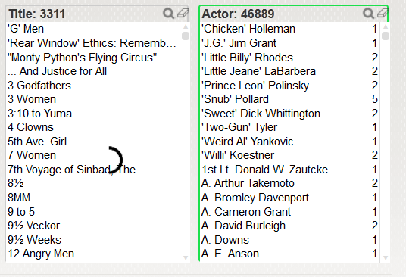
Current selected QvFrame
Selection Cursor
(when the circle is filled, the element passes to selected)

Slide 16
THAT’S IT !

