Slide 1
Project_NUI Natural User Interface
Realization of a motion tracking system to control navigation and selection in a QlikView application deployed on a Browser

Slide 2
QLIKVIEW
KINECT
POSSIBLE ACTIONS IN QLIKVIEW
SOFTWARE ARCHITECTURE
OVERVIEW
DETAILED VIEW
TECHNICAL ARCHITECTURE
BEHAVIOR OF AN ACTION / A GESTURE : CHAIN OF REPONSIBILITY
FINGER DETECTION
WEB CLIENT
ARCHITECTURE
UI
INSTALLATION AND USE
ISSUES & FEATURES
ANNEXES

Slide 3



Slide 4
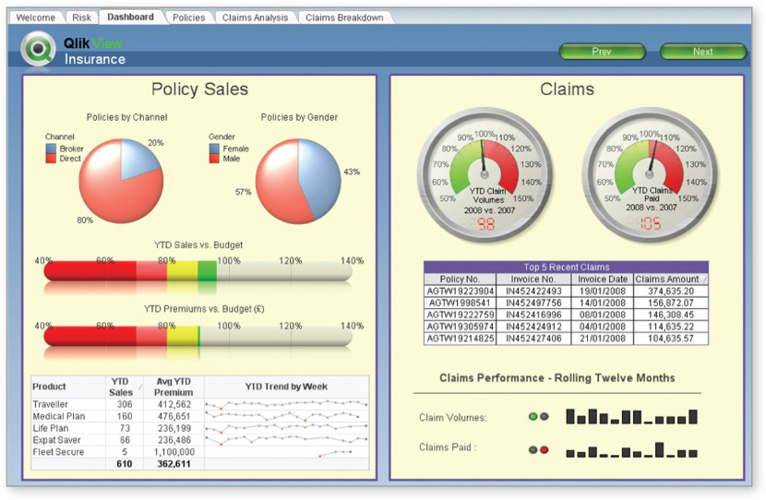

Slide 5
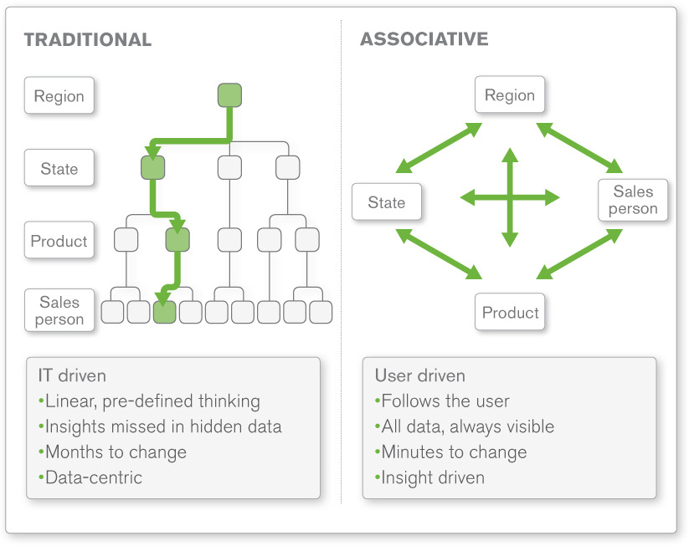

Slide 6
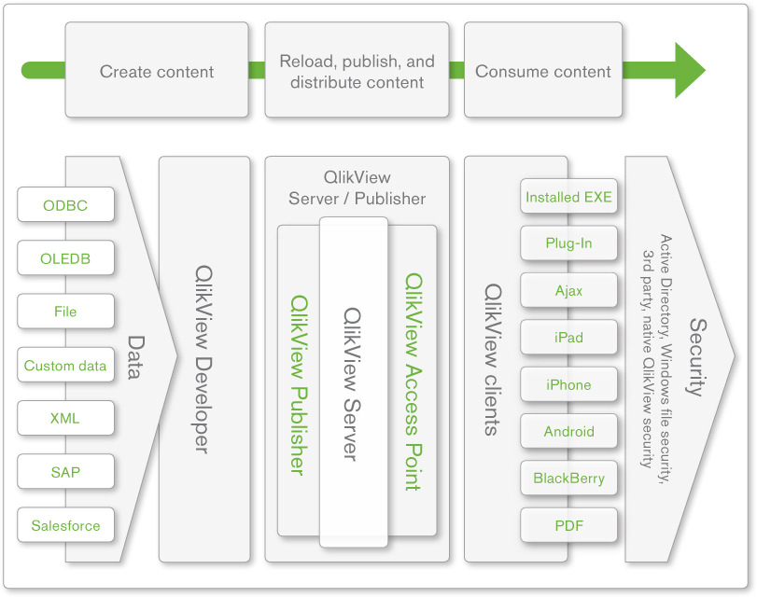

Slide 7
TECHNICAL SOLUTIONS ?

Slide 8
PROBLEMATIC | Making a motion detection system to control navigation and selection in a QlikView application through a Browser
CRITERIA\CHOICES | KINECT | WEBCAM | LEAP ?
PRICE | 250$ | 30€ | 70$
DEV DURATION | Body: 2w, Fingers: 3w, Voice: 2w, | Body: 4w , Fingers: 4w, Voice: ? | ?
COVER REQUIREMENTS | Full | No Voice | No Voice
EXECUTION TIME | ++ | + | ?
SUSTAINABILITY | + | ++ | ?
NEEDED | Kinect SDK + OpenCV | OpenCV | ?
PROS | Native detection of the skeleton + micros | Present everywhere | innovation
CONS | High cost ? | Hard to implement the detection | Not available before decembre 2012

Slide 9
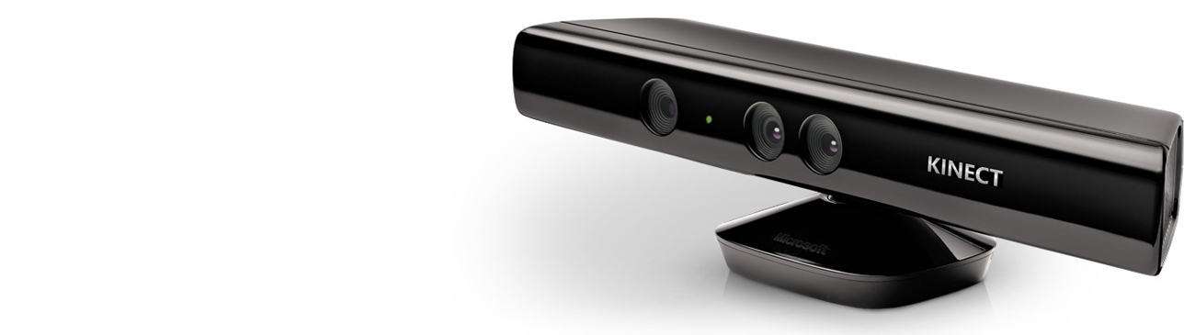


Slide 10
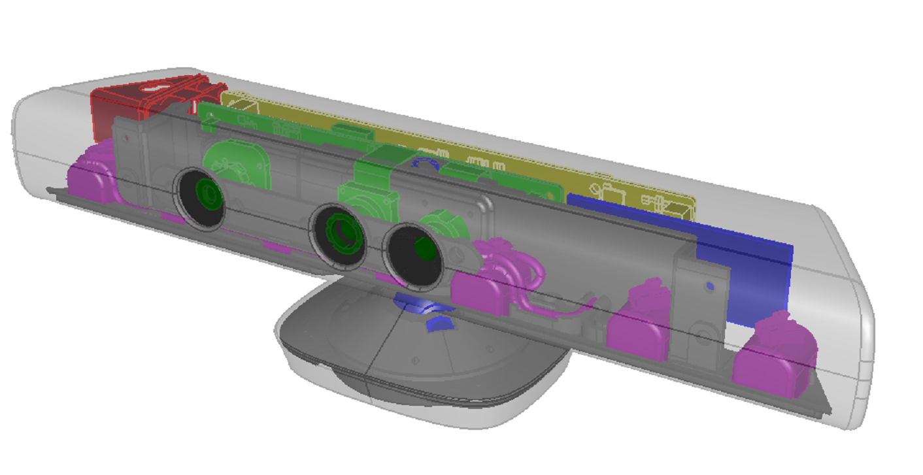
KINECT SENSORS
IR Emitter
Color Sensor
IR Depth Sensor
Tilt Motor
Microphone Array

Slide 11
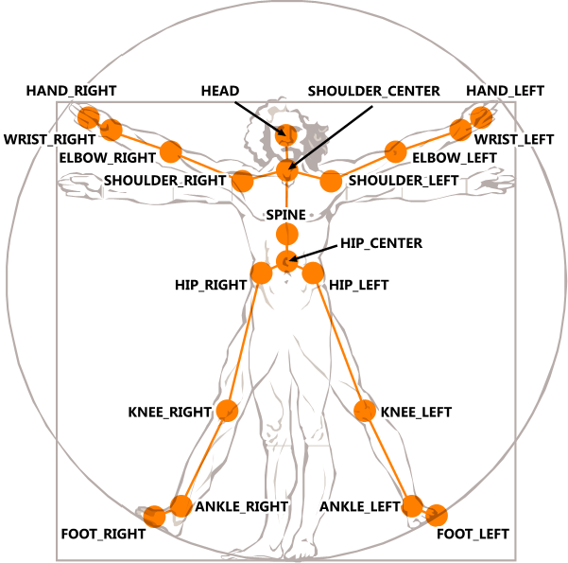
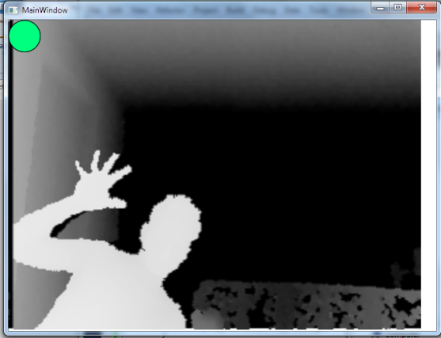
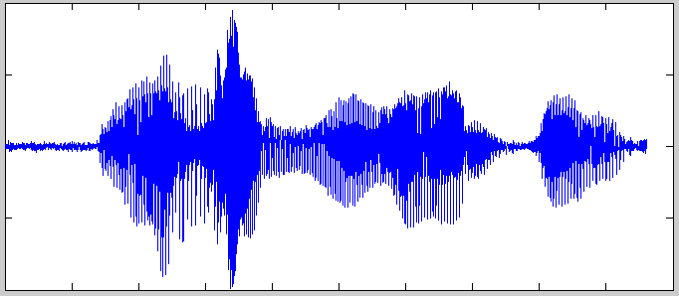
KINECT DATAS
Skeleton datas
Sound datas
Depth datas

Slide 12
POSSIBLE ACTIONS IN QLIKVIEW

Slide 13
Action | PC controller | Body controller | Visual FeedBack
Unique selection | Mouse left click | Hand Forward / Fingers down | Circle
Multiple Selection | Click maintained Ctrl + click | Left Fist + Unique selection / Voice + Unique Selection | Circle
Menu | Right Click
Elevator | Mouse Wheel | Fingers / Vertical Waves
Clear | Btn | ‘Clear’ | Eraser
Next/Previous | Btn | ‘Next’/’Previous’ | Arrow
Change Tab | Btn | Horizontal Wave | /
Add a bookmark | Btn | Voice | Star +
Delete a bookmark | Btn | Voice | Star -
Select a bookmark | Btn | Voice | Star
Create a note | Btn | Voice | /
Close/Home | Btn | ‘Close’ | /
Search | Btn | Voice
Zoom/UnZoom | Ctrl+ Mouse Wheel | ‘Max’/’Min’ - Hands in diagonal | /
Navigation (Object+Sheet) | Mouse | 1 hand steady + 1 hand moving | Cursor [+ skeleton]

Slide 14
SOFTWARE ARCHITECTURE
OVERVIEW

Slide 15
instantiates
stream
event
Kinect
Manager
others
Gesture and Voice Detection
Web Connector
API javascript
Hardware Connector
Mouse + KeyBoard
Web Client

Slide 16
SOFTWARE ARCHITECTURE
DETAILED VIEW

Slide 17
instantiates
stream
event
Kinect
others
QlikMoveManager
KinectHelper
GestureHelper
VoiceHelper
ActionHelper
SkeletonReady()
DepthReady()
AudioStream
InitKinect()
EventRecognised()
EventRecognised()
ActionRecognised()
SocketServer
OurAPI
QvAjax
Send()
Receive()
Dispatch()
Method()
MouseSimulator
Cursor
SetPosition()
Input()
X
y
Web Client

Slide 18
BEHAVIOUR OF AN ACTION/ A GESTURE
CHAIN OF RESPONSABILITY

Slide 19
Event (Body/Hand/Voice)
ActionPart++
ACTION
ActionPart1
2
1
1
CheckPart()
Queue<Event> Events
ActionPart2
List<Actions> Actions
CheckPart()
Actions.UpdateAll(Events)
ACTION PART :
2
1
0
ACTION VALIDATED
ActionHelper
Action
* nbActions

Slide 20
TECHNICAL ARCHITECTURE

Slide 21
Microsoft.Kinect.dll
Emgu.dll
Body_Gesture_Recognition.cs
Microsoft.Recognition + System.Speech.Recognition
Hand_Gesture_
Recognition.cs
+
Fleck.dll
user32.dll
(mouse controler)
Web-Socket.js
OurAPI.js
WEB CLIENT
QvAjax.js

Slide 22
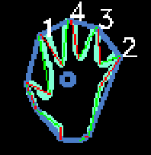
FINGER DETECTION

Slide 23
skeletonFrame
depthFrame
List of templates
Class Name
handtype
Contour
description
handType
Template classes
HAND DETECTOR
FoundTemplateDesc*2
all_Frames_Ready
Emgu.CV
NIVEAU A0

Slide 24
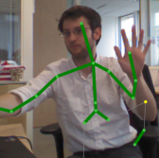
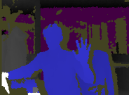
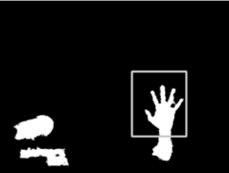
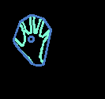
Skeleton
Frame
Template Classes
Depth
Frame
HandType
GetEverything
Between(min,max)
CheckZHand()
CheckOrientation()
R
E
S
U
L
T
S
All
Frames
Ready
CheckMovement()
ExtractContourAndHull()
GetNearestClass()
Hand Detector
Emgu.CV
LEVEL A-0

Slide 25
WEB CLIENT
ARCHITECTURE

Slide 26
json
Server
Socket server
Send()
context
onMessage()
message
Kinect
Action
Skeleton
Audio
MsgManager
context
message
context
QvAjaxInterface
UIManager
CallQvAjax()
datas
Currently we are mixing the QvAjax and Jquery triggers on buttons
UI1
UI2
UI3
datas
datas
datas

Slide 27

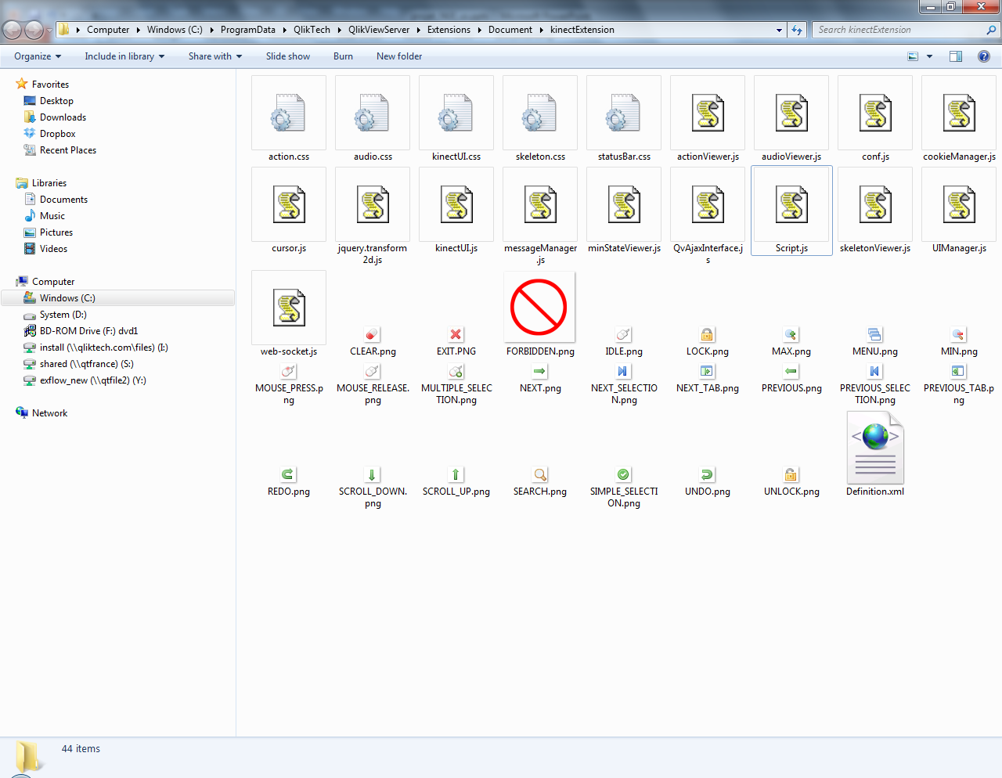
At the moment the scripts are deployed as an extension
Including all the scripts and styles

Slide 28

WEB CLIENT
UI

Slide 29
ELEMENTS | DETAILS
Kinect state | Light
Skeleton state | Distance Viewer
Joints | Canvas sticks
Voice state | Graduate Volume
Finger Tracking | /
Hand Position | Cursor
Shape of the Hand | Cursor
Performed action | Text + picture

Slide 30
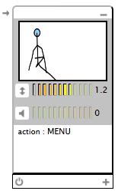
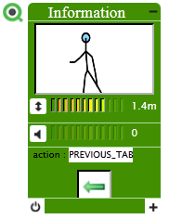
Deploy/Undeploy icon
s
Minimize
SkeletonViewer
Distance Viewer
Volume Viewer
ActionViewer
Visual Feedback
Kinect State Viewer
Maximize

Slide 31
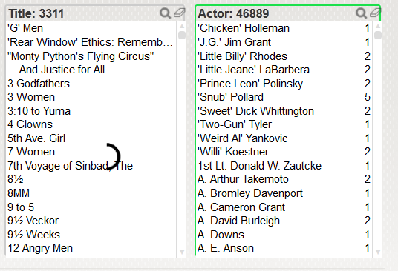
Current selected QvFrame
Selection Cursor
(when the circle is filled, the element passes to selected)
This allow specified action related to the element : scroll, clear, etc..

Slide 32
INSTALLATION & USE

Slide 33
Install the Kinect runtime 1.6
Double click on the extension and copy paste in the server
Install the QlikView.Move
Launch/ refresh the client
Use
Libs | Link
Kinect Runtime v1.6 (containing the drivers ) | http://www.microsoft.com/en-us/kinectforwindows/develop/developer-downloads.aspx
emgucv-windows-x86 2.3.0.1416 | http://www.emgu.com/wiki/index.php/Download_And_Installation
Fleck.dll | https://github.com/statianzo/Fleck/
opencv_core231.dll
opencv_imgproc231.dll
The software will change the z-angle automatically – during this phase you won’t be recognised
When you will be recognised, the web UI will show up if you are viewing a web QlikView app – when you leave it will undeploy
Another user can come and take control by raising his hands in the air

Slide 34
A log file is created in the application folder.
log info : 14:41:44
16/08/2012 14:41:44 [INFO] | QlikMove ==> Init QlikMove
16/08/2012 14:41:44 [INFO] | BodyGestureControler ==> BodyGestures defined
16/08/2012 14:41:44 [INFO] | HandGestureControler ==> HandGestures defined
16/08/2012 14:41:44 [INFO] | VoiceHelper ==> Grammars loaded
16/08/2012 14:41:44 [INFO] | ActionHelper ==> Actions defined
16/08/2012 14:41:44 [INFO] | ServerHelper ==> Server initialized
16/08/2012 14:41:44 [INFO] | KinectHelper ==> Kinect Status : Connected
16/08/2012 14:41:48 [INFO] | VoiceHelper ==> audio stream started
16/08/2012 14:41:49 [INFO] | KinectHelper ==> skeleton is now tracked
16/08/2012 14:41:49 [INFO] | KinectHelper ==> tracking has lost the skeleton
16/08/2012 14:41:50 [INFO] | KinectHelper ==> Kinect sensor is moving
16/08/2012 14:41:51 [INFO] | KinectHelper ==> skeleton is now tracked
16/08/2012 14:42:20 [INFO] | ActionHelper ==> action Recognised :
Action type : PREVIOUS_TAB
timeStamp : 16 August 2012
List of the events :
Event type : BODY
timeStamp : 16/08/2012 14:42:20
16/08/2012 14:42:20 [INFO] | ActionHelper ==> current window file:///C:/Users/pce/Documents/Visual Studio 11/Projects/QlikMove/QlikMove/bin/Debug/QlikMove.EXE
16/08/2012 14:42:21 [INFO] | ActionHelper ==> action Recognised :
Action type : PREVIOUS_TAB
timeStamp : 16 August 2012
List of the events :
Event type : BODY
timeStamp : 16/08/2012 14:42:21

Slide 35
ISSUES & POSSIBILITIES

Slide 36
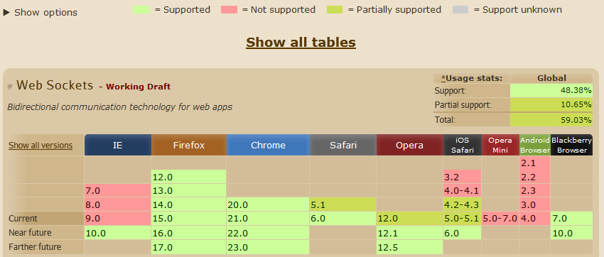
The finger detection is not accurate. We should limitate it to open/close detection or implement a learning machine if we want more (predator TLD)
WebSockets are not already supported by all browsers
A visual software could be implemented so that the user could create his own movements and link them with actions based on a database + see his actual movements
The current software should be transformed to a service if we do not want any configuration from the user.
Create an installer

Slide 37
ANNEXES

Slide 38
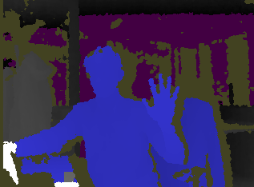

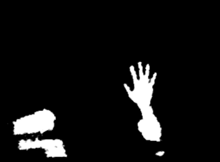
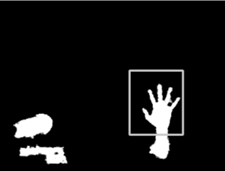
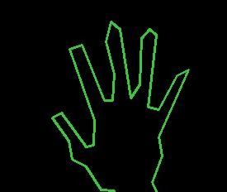
Got a problem

Slide 39
PROBLEMATIC | Conduct a dialogue interface between a server. NET and a web client interchanging text data
CRITERIA\CHOICES | NUGGET.dll | FLECK.dll | SUPERSOCKET.dll | .NET
EASY TO HANDLE | + | + + | - | - -
SUSTAINABILITY | + | + | + + | + +
COVER REQUIREMENTS | + | + | + | +
DEV DURATION | + | + + | - | - -

