Slide 1



Streaming MySQL To ElasticSearch with Kafka

Slide 2

Kafka?
Apache Kafka is a high-throughput distributed messaging system developed by the Apache Software Foundation written in Scala and Java.
Features
High-Throughput
low-latency
Fault-tolerance
Real-time processing

Slide 3

What problem does Apache Kafka solve?

Slide 4
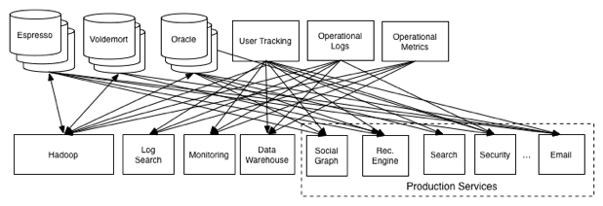
Linkedin Data Platform Around 2011

Slide 5

Re-think our data system

Slide 6
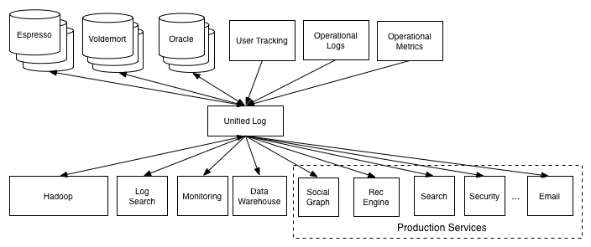
New Data Platform

Slide 7
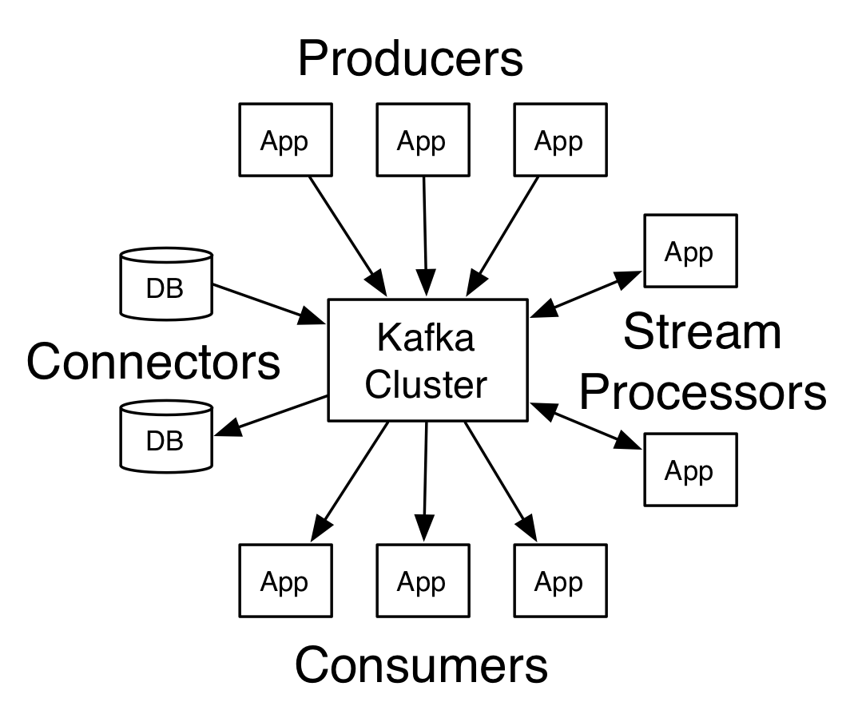
Kafka core concepts

Slide 8
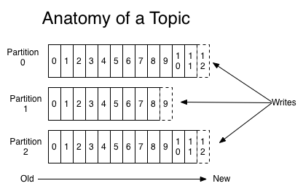
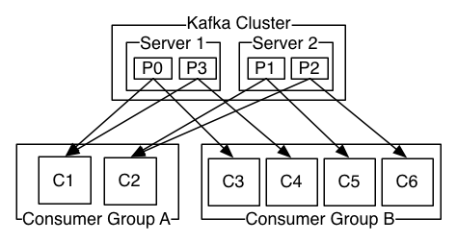
Topics

Slide 9
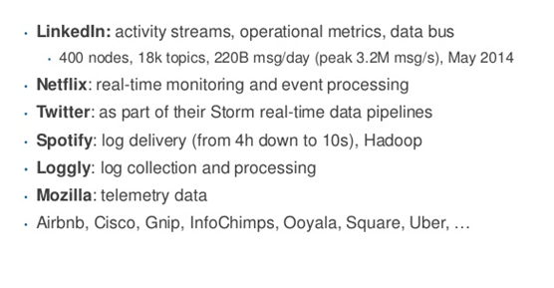
Kafka use cases

