Slide 1
Telecom Churn Strategic Analysis
Recruiter-Ready Business Intelligence Presentation

Slide 2
1. Executive Summary
Overall customer churn rate: 20.3%
Estimated monthly revenue at risk: $5350.6
Family Plan and Postpaid Basic customers show the highest churn risk
Auto-debit users exhibit the highest payment-method churn behavior
High support call frequency strongly correlates with churn

Slide 3
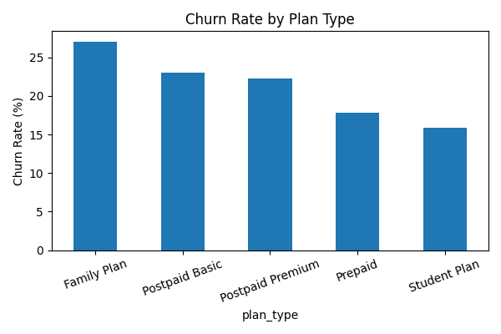
2. Key Research Findings – Plan Segments
Key Insights
• Family Plan churn exceeds 27%
• Postpaid Basic customers also show elevated churn
• Student Plan customers demonstrate stronger retention
• Indicates pricing-value mismatch in higher-risk segments

Slide 4
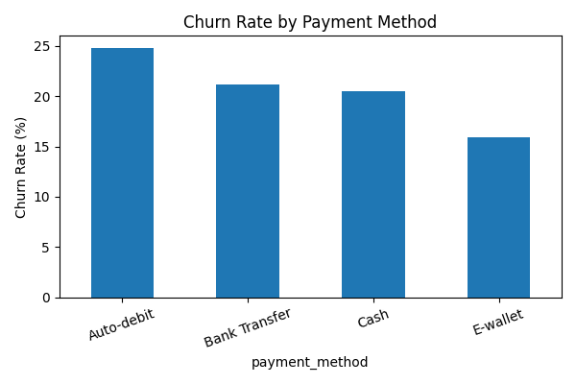
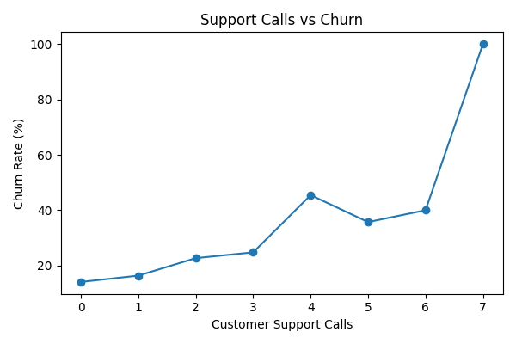
2. Key Research Findings – Customer Behavior
Auto-debit users show the highest churn rate (~24.8%), while churn sharply increases after 4+ customer support calls, reaching near-certain churn at extreme cases.

Slide 5
3. Strategic Recommendations (Recruiter-Ready)
Redesign Family Plan pricing and bundled benefits
Launch proactive retention campaigns for high-risk Postpaid users
Improve onboarding and billing transparency for Auto-debit customers
Deploy AI-assisted customer support escalation before 4+ complaints
Use churn prediction models for early customer intervention

Slide 6
4. Conclusion
The analysis identifies churn as a measurable financial risk driven by plan dissatisfaction, support friction, and payment behavior.
By targeting high-risk customer segments and improving service quality, telecom providers can significantly improve retention and revenue stability.
This project demonstrates practical data analytics, business storytelling, and strategic decision-making skills suitable for data analyst and business analyst roles.

